Slide 1
Harnessing the Power of Team-Based Care to Improve Maternity Outcomes: Medicine and Midwifery as Partners in Care
Facilitator: Holly Smith, MPH, CNM, FACNM
Panelists: Ana Delgado, MS, CNM | Annette Fineberg, MD | Malini Nijagal, MD, MPH | Ana Rapoport, MS, CNM, WHNP
Notes:
1

Slide 2
Housekeeping
All attendees are muted upon entry
Questions will be answered at the end of the webinar and as time allows
The webinar is recorded and will be available from the CMQCC website within 3-7 business days
The slides will also be available for free download from the CMQCC website, www.cmqcc.org

Slide 3
Instructions
You are welcome to use any of the slides provided for educational purposes
If you modify or add a slide, please substitute your institutional logo and do not use the CMQCC logos
We welcome your feedback and recommendations for improving the slide set

Slide 4
This slide set is considered an educational resource but does not define the standard of care in California or elsewhere. Readers are advised to adapt the guidelines and resources based on their local facility’s level of care and patient populations served and are also advised to not rely solely on the guidelines presented here.

Slide 5
Continuing Education Notice
In order to receive contact hours (RN) for this webinar, please complete the evaluation via the link, which will be sent to you 24 hours after this webinar. You must be in attendance on the webinar for a minimum of 50 minutes for a contact hour to be awarded.

Slide 6
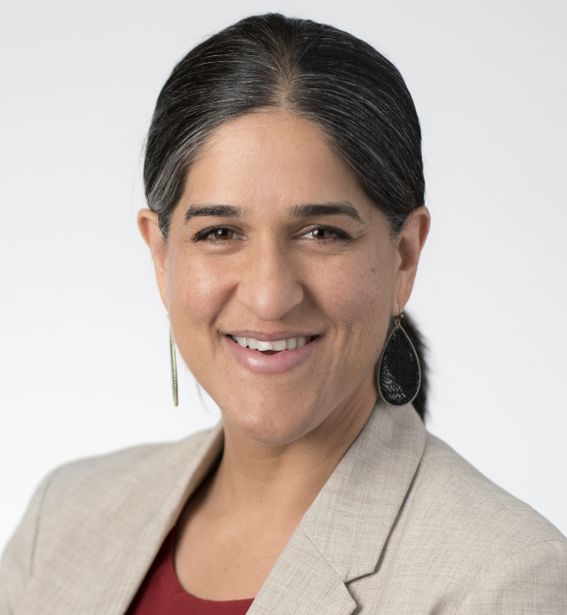
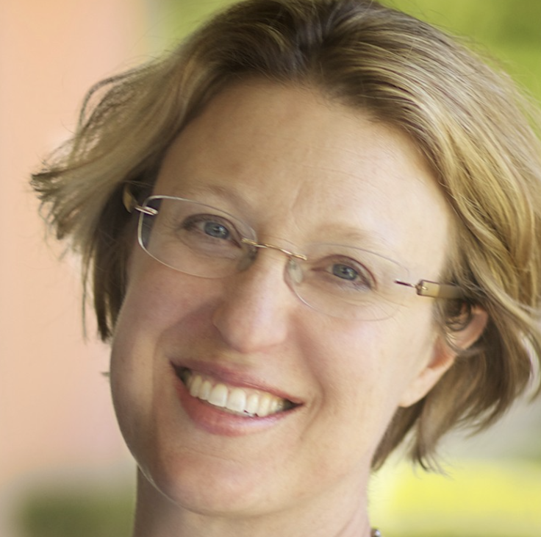
Today’s Panelists
Ana Delgado, MS, CNM
Malini Nijagal, MD, MPH
Annette Fineberg, MD
Ana Rapoport, MS, CNM, WHNP

Slide 7
Objectives
Describe team-based care between midwives, nurses, and physicians and its potential for improving patient experience and birth outcomes
Appreciate the roles of the care team in providing high-value, high-quality maternity care
Identify challenges and opportunities for improvement in team-based care at your facility

Slide 8
Today’s Webinar is Webinar #2 in a Five-Part Series
The Next Step in California's Quality Improvement Journey: Integrating Midwives, Doulas, & Community-Based Birth Care (Nov 30, 2022; recording available at cmqcc.org)
2. Harnessing the Power of Team-Based Care to Improve Maternity
Outcomes (Feb 3, 2023)
3. Midwifery Integration – What it Means and Why it's Important for Birthing
People in California (May 9, 2023)
4. Partnering with Doulas (Aug 30, 2023)
5. Community Birth - Improving Transfer of Care (Oct 25, 2023)

Slide 9
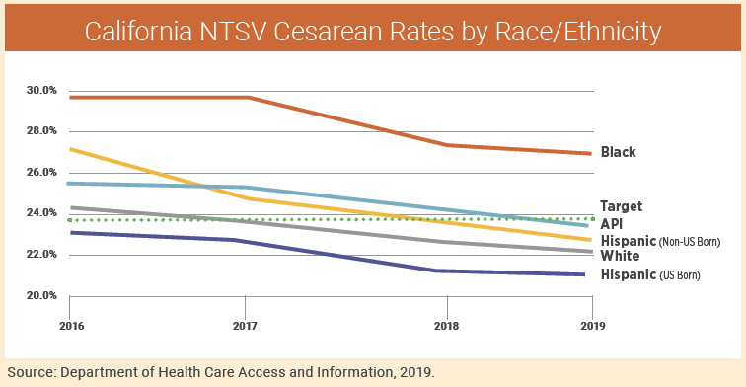
Cesarean Disparities by Race and Ethnicity
Image source: CMQCC Toolkit to Support Vaginal Birth and Reduce Primary Cesareans

Slide 10
Birth Equity
“The assurance of the conditions of optimal births for all people with a willingness to address racial and social inequalities in a sustained effort.”
– Joia Crear Perry, MD, FACOG
Founder, National Birth Equity
Collaborative

Slide 11
Achieving Birth Equity Means
Utilizing strategies that consider the root causes of disparities
Considering community needs/wants in our approaches to quality improvement (patient and community-centeredness)
Humility to accept that what we are doing right now isn’t working for everyone
Bringing all quality improvement pressure points to bear; using all the tools in the toolbox

Slide 12
Quality Improvement Ecosystem
Health Care
Education
Substance Use
Mental Health
Structural Racism
Built Environment
Intimate Partner Violence
Immigration Status
Housing Insecurity
Food Insecurity
Incarceration

Slide 13
Clinical Strategies that Consider Root Causes of Disparities
Team-Based Care
Midwifery Integration
Improving Partnerships with Community Birth Providers and Improving Community Birth Transfer
Partnering with Doulas

Slide 14
The Elephant in the Zoom
A values “check-in” around midwives and team-based care
Patient-Centered Care: “Providing care that is respectful of and responsive to individual patient preferences, needs, and values and ensuring that patient values guide all clinical decisions.” – Institute of Medicine | Institute for Health Care Improvement
There is no singular intervention that will reduce CS rates or eliminate birth disparities – we must utilize all the tools in the toolbox.
Midwives of all credential types (CNM, CPM, CM) meet or exceed ICM training standards. All licensure types provide unique expertise and are needed to improve maternity outcomes and fill gaps in care.
Community birth is safe:
provided by trained, skilled providers,
risk assessment is ongoing,
within an integrated system of care where higher levels of care and medical consultation are easily accessible
Respectful maternity care
IS A CHOICE

Slide 15
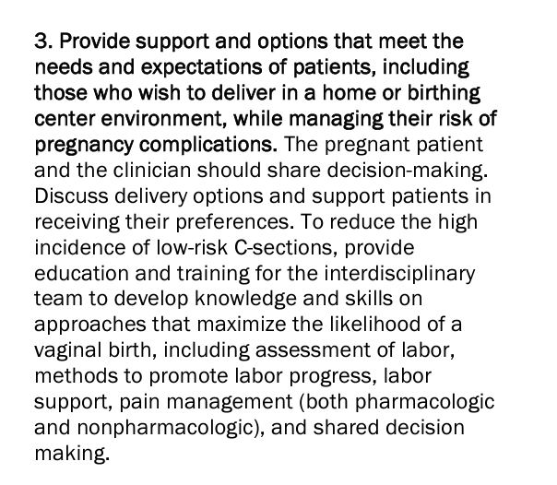

Slide 16
Midwifery Care
The midwifery model of care is standard in all countries that have better birth outcomes
Patient empowerment is a central theme of midwifery care
“Whole-person” care that considers all the patient’s needs (physical, emotional, SDOH, personal values, cultural needs)
Midwifery is defined as “skilled, knowledgeable and compassionate care for childbearing women, newborn infants and families across the continuum from prepregnancy, pregnancy, birth, postpartum and the early weeks of life.”
– World Health Organization

Slide 17
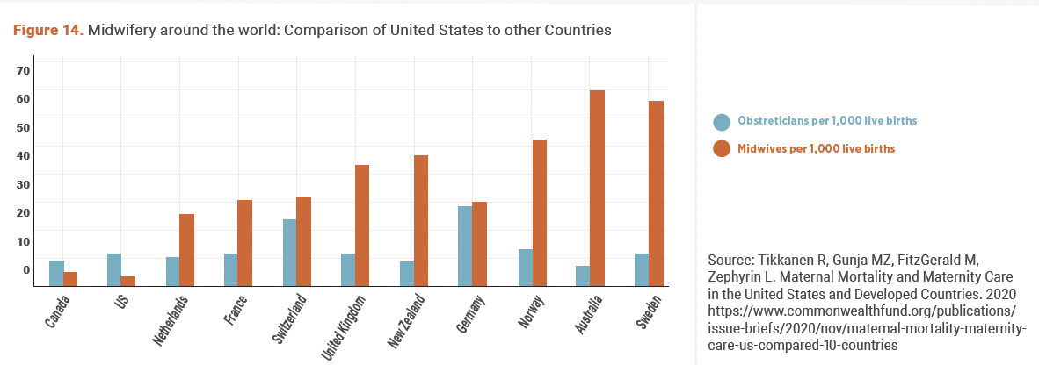
Midwifery Care Around the World

Slide 18
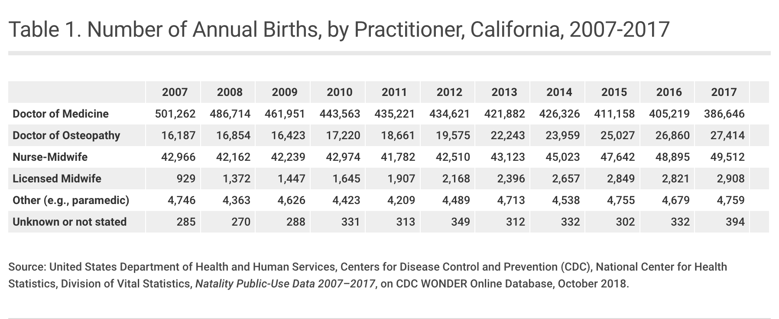
Midwifery in California
*Slide source: CHCF California’s Midwives: How Scope of Practice Laws Impact Care. 2019.

Slide 19
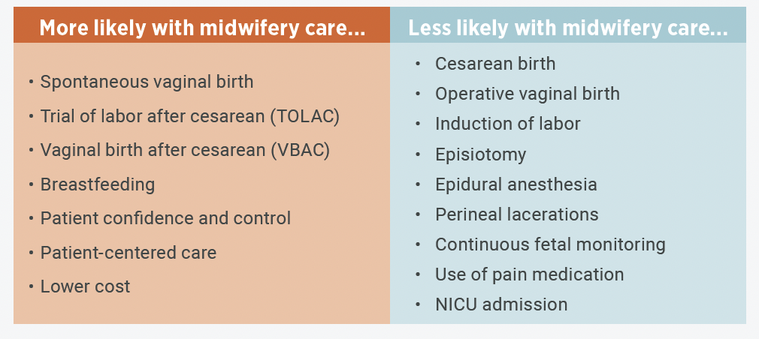
Benefits of Midwifery Care
Image Source: CMQCC Toolkit to Support Vaginal Birth and Reduce Primary Cesareans

Slide 20
Midwifery Care
Midwifery philosophy has long preserved three immutable elements:
Patient-centeredness
“The therapeutic use of the human presence”
Nonintervention unless necessary for the health and well-being of the pregnant person and/or fetus
Source: Akileswaran CP, Hutchison MS. Making Room at the Table for Obstetrics, Midwifery, and a Culture of Normalcy Within Maternity Care. Obstet Gynecol. Jul 2016;128(1):176-80. doi:10.1097/aog.0000000000001493

Slide 21
Team-Based Care

Slide 22
What is Team-Based Care?
“A team-based model of care is one that strives to meet patient needs and preferences by actively engaging patients as full participants in their care while encouraging all health care providers to function to the full extent of their education, certification, and experience….
Relationships are governed by negotiated shared norms and visions…
Each team member has knowledge and skills that contribute to the work, service, and problem solving that are the purpose of the team."
ACOG, Collaboration in Practice – Implementing Team-Based Care

Slide 23
Terms Used Interchangeably (but inaccurately)
Team-Based Care
Collaboration
“Right Care at the Right Time”
Co-Management

Slide 24
ACNM’s Definition
“Collaboration is the process whereby health care professionals jointly manage care. The goal of collaboration is to share authority while providing quality care within each individual's professional scope of practice. Successful collaboration is a way of thinking and relating that requires knowledge, open communication, mutual respect, a commitment to providing quality care, trust, and the ability to share responsibility.”
Notes:
Acog prefers team-based care instead of collaboration because
In some practices, collaboration erroneously refers to a supervisory relationship (e.g. an ob-gyn supervising a CNM)
Team-based care is preferred because it is the more comprehensive definition of patient-centered, high-quality, high-value care
A way of thinking – aspirational and philosophical; paradigm shift

Slide 25
Team-Based Care
Focus today is on the principles of team-based care and collaboration between physicians and midwives
These principles can inform team-based care between many provider types and other team-members
Physicians and community birth midwives
CNMs and LMs
Nurses, doctors, and midwives
Family practice and Ob/Gyn; Family practice and midwives

Slide 26
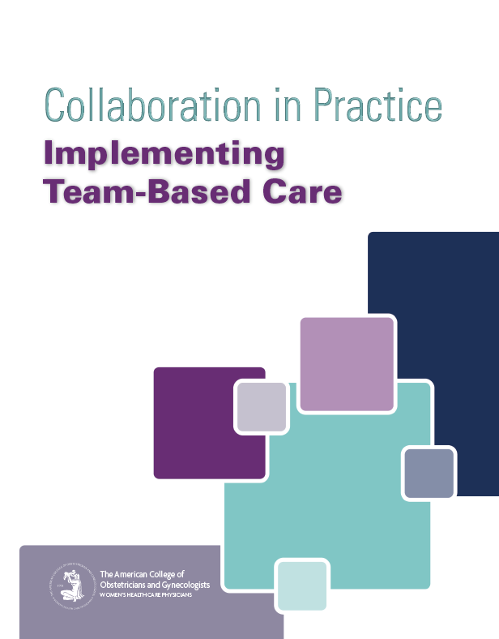
Key Principles of Team-Based Care
The PATIENT is the INTEGRAL CORE of the team
The team must have a SHARED VISION
ROLE CLARITY is essential to optimal team functioning
All team members are ACCOUNTABLE for their own practice and to the team
Effective COMMUNICATION is key
Team LEADERSHIP is SITUATIONAL and DYNAMIC

Slide 27
Patients and families are actively engaged as members of the team
The team must have common commitment to patient-centered care
“nothing about me without me”
locus of control is with the patient
the patient has choice in all matters, without exception (Shared Decision Making)
Has created a “disruptive shift in control and power” in health care delivery

Slide 28
The Team Has a Shared Vision
Must identify shared goals
Collaboratively create a roadmap to guide expectations of “how” things will be done
Unity: teams are an “integrated body of knowledge and skills working together toward a common goal” (not individuals practicing in parallel)
Notes:
Nothing works in team, whether youre in tech, or building widgets, or on the Olympic curling team, it just won’t work unless the team establishes a shared vision
One of the team of panelists we have on the call are from San Francisco General. And one the authors of this paper, Ana Delgado, is here as well.
And this practice very clearly puts forth in that paper that their shared vision is key and creates the foundation of everything that comes after that. And that is

Slide 29
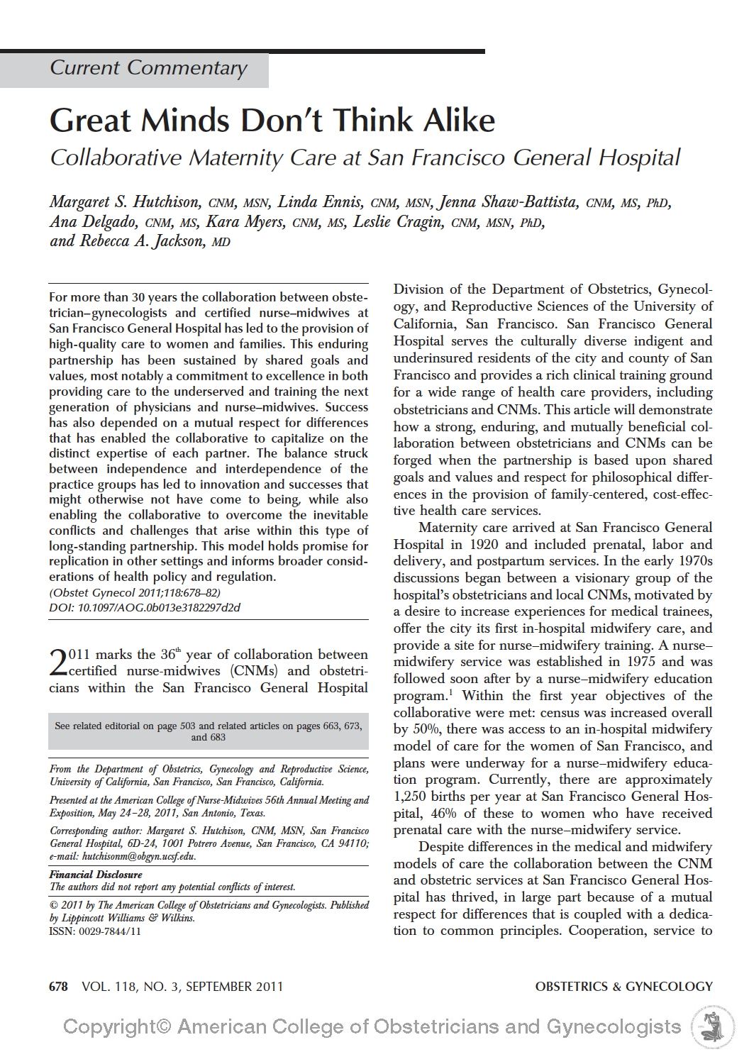
Shared Vision: Zuckerberg San Francisco General Hospital
“a mutual respect for differences that is coupled by a dedication to common principles. Cooperation, service to the community, and collaboration in the education of the next generation of practitioners are shared core values, but respect for distinct approaches to maternity care – great minds don’t think alike – has been an equally important determinant of the success of this collaboration.”

Slide 30
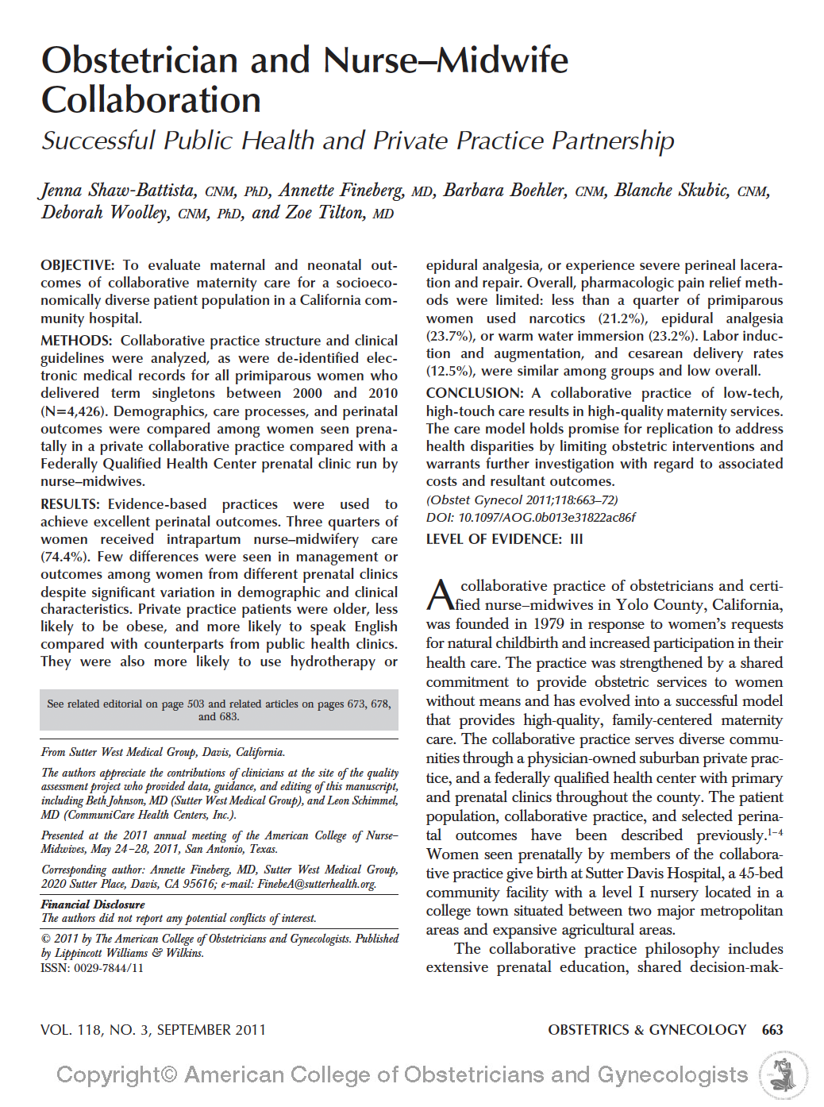
Shared Vision: Sutter West Medical Group + Communicare (FQHC)
“The collaborative practice philosophy includes extensive prenatal education, shared decision making, and judicious use of obstetric intervention in accordance with evidence-based clinical guidelines that are developed collaboratively.”

Slide 31
Role Clarity is Essential to Team Functioning
Respect for each member’s expertise
Understanding of each team member’s scope and role
“Great minds do NOT always think alike”* – the team values the unique contributions of each member and their differing approaches to maternity care
Maximizes the expertise of each team member (each team member functions to the full extent of their education and training)
Clinical guidelines facilitate expectations and communication for consultation/co-management/transfer of care
*Hutchison MS, Ennis L, Shaw-Battista J, et al. Great minds don't think alike: collaborative maternity care at San Francisco General Hospital.
Obstet Gynecol. Sep 2011;118(3):678-682. doi:10.1097/AOG.0b013e3182297d2d

Slide 32
All team members are accountable for their own practice and to the team
Everyone is committed to consistently practicing within their scope of practice and appropriate to their training/experience; professional competence
Committed to continuous learning outside of the clinical situation, and situational learning within each encounter
Hold each other accountable (“situational monitoring”)
Mutually agreed-upon clinical guidelines

Slide 33
All team members are accountable for their own practice and to the team
Requires:
honesty, discipline, reliability, and humility

Slide 34
Effective Communication is Key
Skilled communication with the patient (Shared Decision Making)
Adopt standard frameworks for how patient status is communicated
”Trust, honesty, transparency, and timeliness”
Check your assumptions! When in a team, assume the best about each person’s motives and goals
Active listening
Can share concerns, without retribution

Slide 35
Team Leadership is Situational and Dynamic
High-functioning collaborative practices have developed beyond a hierarchical structure
The clinician who “can best address the priority needs of the patient assumes the lead health care provider role for the patient.”– ACOG
“Shared power
Requires flexibility and fluidity
No provider type is superior to the other

Slide 36
Team Leadership is Situational and Dynamic
Requires “experiential learning, building respectful relationships, and time.”

Slide 37
ACOG/ACNM Joint Statement of Practice Relations
Lower
Risk
Patients
Moderate
Risk
Patients
Higher
Risk
Patients
Midwife-Led
Care
Jointly-Led
Care
Physician-Led
Care
“Ob-gyns and CNMs/CMs are experts in their respective fields of practice and are educated, trained, and licensed, independent providers who may collaborate with each other based on the needs of their patients. Quality of care is enhanced by collegial relationships characterized by mutual respect and trust, as well as professional responsibility and accountability.”
Slide source: ACNM Maternity Care Workforce Presentation 11/18/15

Slide 38
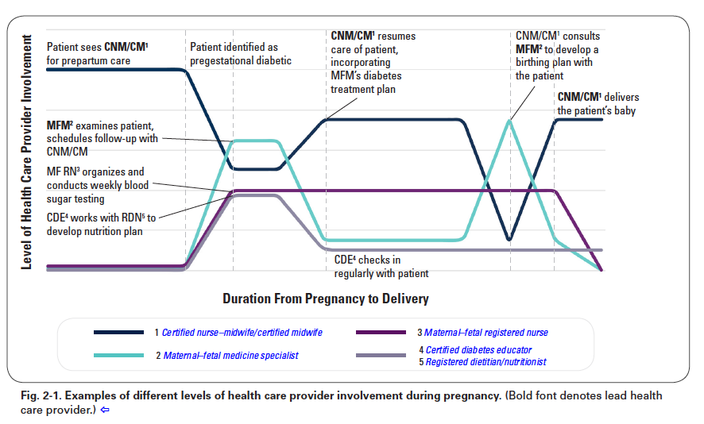
Example of situational and dynamic leadership
Image Source: Collaboration in Practice: Implementing Team Based Care (ACOG)

Slide 39
Panelists
Ana Delgado, MS, CNM
Malini Nijagal, MD, MPH
Annette Fineberg, MD
Ana Rapoport, MS, CNM, WHNP

Slide 40
CMQCC clinical leads and data center
Data questions
datacenter@cmqcc.org
Clinical improvement questions or questions about toolkit
csakowski@cmqcc.org
Questions about midwifery and team-based care in California
holly@midwiferyrising.org

