Slide 1
Elliott K. Main, MD
Clinical Professor, Department of Ob/Gyn
Stanford University School of Medicine
Maternal Sepsis background,
Diagnosis and Screening
Melissa E Bauer, D.O.
Associate Professor
Duke University
Turning lessons learned from patients and community into clinical tools
Kendra L. Smith, PhD, MPH
How Community Co-Leadership Works
Christa Sakowski, MSN, RN, C-ONQS, C-EFM, CLE
Clinical Lead, CMQCC
PRIHSM collaborative model
Notes:
1

Slide 2
Maternal Sepsis: Background, Diagnosis, and Screening
Elliott K. Main, MD
Founding Medical Director, CMQCC
National Implementation Director, ACOG/AIM
Clinical Professor, Department of Ob/Gyn
Stanford University School of Medicine
emain@Stanford.edu
Notes:
2

Slide 3
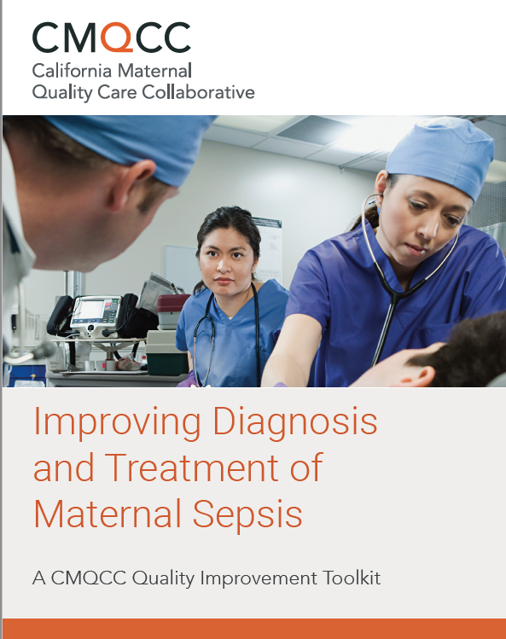
Maternal Sepsis Background Efforts
Large-scale Implementation of Community Co-led Maternal Sepsis Care Practices to Reduce Morbidity and Mortality
NICHD Funding: 2022-2023
Identify clinician and patient based barriers to care
Improve screening and diagnosis criteria
Translate above findings into improved care plan for sepsis
Sepsis in Obstetric Care
2020
February 2023
Lead Editors:
Melissa Bauer, DO
Ron Gibbs, MD
Elliott Main, MD
Lead Editors:
Melissa Bauer, DO
Ron Gibbs, MD
Co-PIs/Leads:
Melissa Bauer, DO
Elliott Main, MD
Kendra Smith, PhD
Notes:
SMFM has also come out with new treatment guidance

Slide 4
Burden of Infection on Maternal Mortality and Morbidity
2nd leading cause of maternal mortality
3rd leading cause of Severe Maternal Morbidity (SMM) at delivery but it is 1st leading cause in antepartum and postpartum periods
Significant racial inequities:
Trost et al, CDC DHHS, 2022
Creanga AA et al. Obstet Gynecol 2017
Petersen EE et al, MMWR Morb Mortal Wkly Rep 2019
Kendel et al. AJOG 2019
Notes:
Maternal sepsis if the 2nd leading cause of maternal mortality
Despite overall improvements in mortality rates in the general population, there has been no noticeable change in the proportion of maternal deaths due to sepsis.
It is the 3rd leading cause of severe maternal morbidity at delivery, but it is the 1st leading cause in the antepartum and postpartum periods
There are significantdisparities in rates of sepsis by race
.

Slide 5
(1) Why are we doing poorly with Maternal Sepsis? after all, we know how to treat sepsis…
Relatively rare (but deadly when it happens)
Definition of Maternal Sepsis is not standardized
Diagnostic approach is not established
Treatment often delayed and piecemeal
Special Challenge of Chorioamnionitis

Slide 6
Many Maternal Infections Can Lead to Sepsis
Antepartum | Intrapartum/ Immed. Postpartum | Post-discharge
Pyelonephritis | Chorioamnionitis/ intraamniotic infection | Endometritis
Septic abortion | Endometritis | Pyelonephritis
Chorioamnionitis/ intraamniotic infection | Pyelonephritis | Wound Infection/ Necrotizing Fasciitis
Pneumonia/ influenza | Pneumonia/influenza | Pneumonia/influenza
Appendicitis | Wound Infection/ Necrotizing Fasciitis | Cholecystitis, Mastitis, Other GI

Slide 7
Diagnostic Criteria for Sepsis: United States
Sepsis-2 (2001): Infection + 2 or more SIRS criteria
Sepsis-3 (2016): life-threatening organ dysfunction caused by a dysregulated host response to infection
CMS still defines sepsis as Infection + SIRS and Severe Sepsis as Sepsis with Organ Injury (SEP-1 metric)
Notes:
It is unclear whether coding favors CMS definition or the current accepted definition of sepsis

Slide 8
Maternal Sepsis: World Health Organization (WHO) 2017
Maternal sepsis is “a life-threatening condition defined as organ dysfunction resulting from infection during pregnancy, childbirth, postabortion, or postpartum period.” This definition has been endorsed by FIGO and is generally followed worldwide.
WHO also emphasizes that the criteria of systemic inflammatory response syndrome (SIRS) are not appropriate for diagnosing maternal sepsis and should not be used.
http://apps.who.int/iris/bitstream/10665/254608/1/WHORHR-17.02-eng.pdf

Slide 9
Current studies should help provide direction
How well do Sepsis Screening tools work in pregnancy?
What are the sensitivity and false positive rates?
How do physiologic changes of pregnancy affect the tests?
How do the screening tests perform if defining sepsis as having end-organ injury?
What about early pregnancy and postpartum patients?
What about patients with chorioamnionitis?
Testing for end-organ injury
Should the criteria for end-organ injury change in pregnancy?
Main E et al and Bauer M et al in press, Obstet Gynecol

Slide 10
Evaluation of Screening Criteria for Maternal Sepsis: Electronic Health Record Analyses
Hospital Admissions from 59 hospitals in 12 states during the years 2016-2021 (estimated N >580,000 births)
Electronic Health Record data collected on EPIC, available using Clarity
2,900 Cases of Maternal Sepsis were identified
COHORT 1: Delivery Admissions: Excluding Chorioamnionitis and Endometritis
COHORT 2: Delivery Admissions: Chorioamnionitis and Endometritis (N=14,591)
COHORT 3: Antepartum Admissions
COHORT 4: Postpartum Admissions:

Slide 11
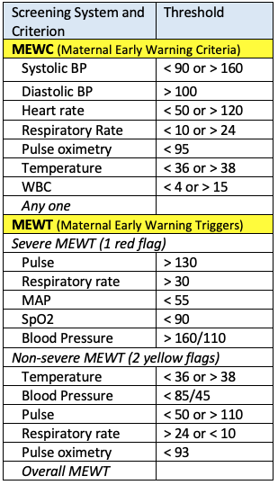
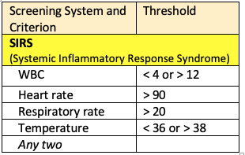
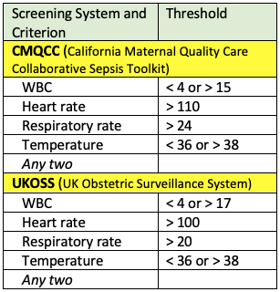
Sepsis Screening
Systems Evaluated
Pregnancy Screens for Severe Morbidity
Standard Non-Pregnant Sepsis Screen
Pregnancy-Adjusted Screens for Sepsis
Goal: Find the balance between Sensitivity and the Screen Positive Rate

Slide 12
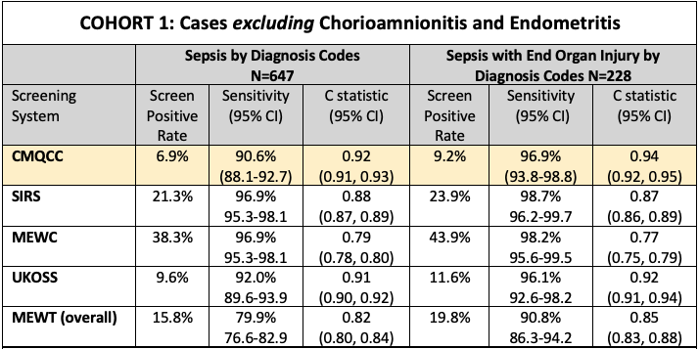
Performance of Screening Tools for Intrapartum Sepsis and Sepsis with Organ Injury

Slide 13
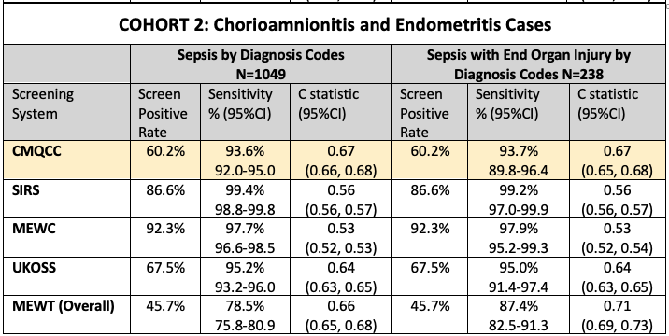
Performance of Screening Tools for Intrapartum Sepsis and Sepsis with Organ Injury

Slide 14
Maternal Sepsis Evaluation Flow Chart
CMQCC Sepsis QI Toolkit
Suspected Infection
Routine Vital Signs Screening
Step 1: Initial Severe Infection Screen
Oral temp <36C (98.6F) or ≥38C (100.4F)
Heart rate >110 bpm
Respiratory rate >24 breaths per min
WBCs >15,000/mm³ or <4,000/mm³ or >10% bands
Positive if any 2 criteria met
Key step:
Need formal direction for RNs, Hospitalists
Action
If infection suspected:
Start source-directed antibiotics and IV fluid bolus
Increase monitoring and surveillance.
Patient-Centered BEDSIDE
EVALUATION
Step 2: Confirmation of Sepsis with End Organ Injury
Laboratory: Chem, Coags, Lactate
Mental Status evaluation
Persistent MAP <65 with infection
Only one criterion needed
Sepsis Treatment
Sepsis appropriate antibiotics and fluids
Attention to Source
Escalation of Care
www.CMQCC.org/toolkits

Slide 15
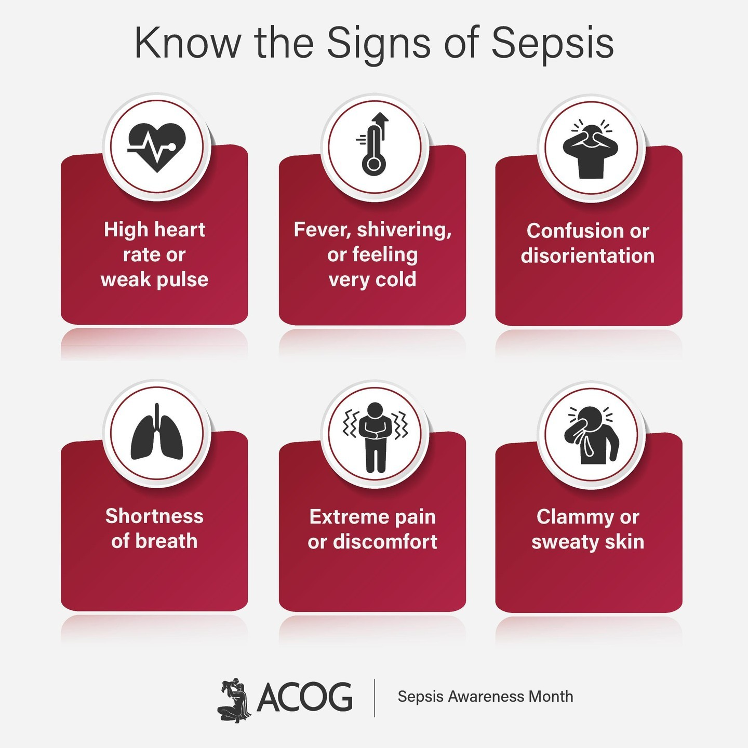
Bedside Evaluation
Red Flag levels of VS
P, RR, dBP (MAP), T are most promising
Study underway
Clinical evaluation
Pt appears toxic, ill
Sepsis symptoms ➔
Evaluate for bleeding
Listen to patient’s concerns!

Slide 16
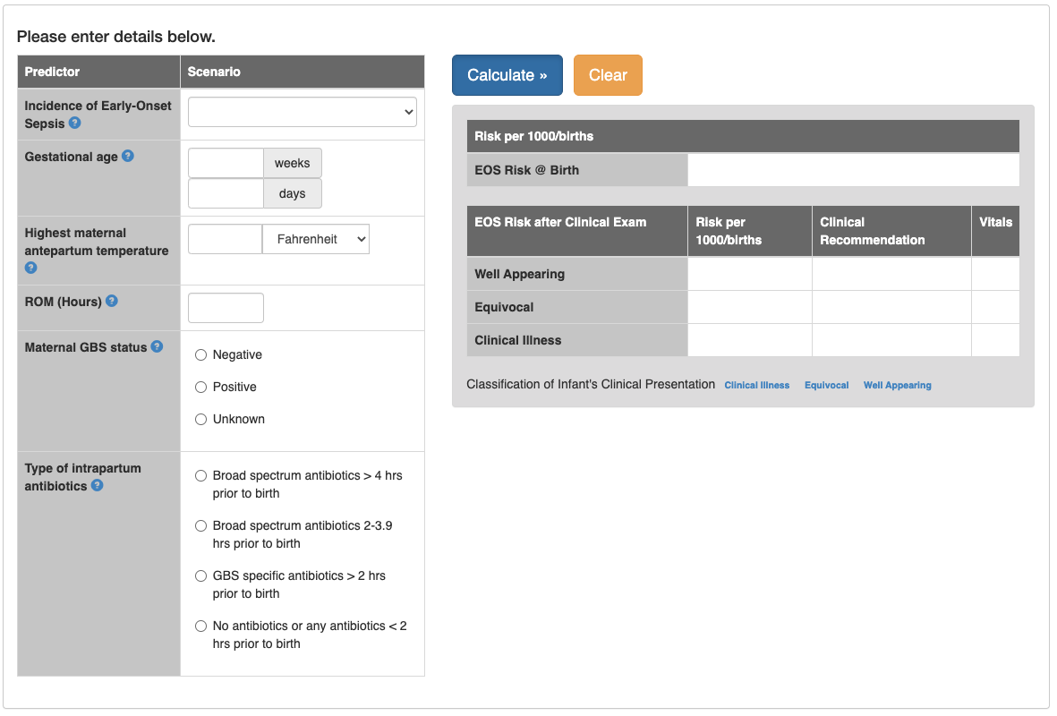
Neonatal Early-Onset Sepsis Calculator (Kaiser 2023)
Most Important Parts of Calculator
Standardized Clinical Evaluation
Enhanced Observation
Bill Benitz 2019, 2020

Slide 17
Evaluation for Organ Injury
Lactate (can be elevated at the end of a long labor)
Chemistry Panel (kidney and liver functions)
CBC (WBC and Plts)
Coagulation Panel (PTT, PT, INR)
Study underway to identify pregnancy appropriate cut-offs
Need for O2, pressors?
CNS symptoms

Slide 18
Key Steps to Reduction of Deaths and Severe Complications from Sepsis in Pregnancy
Diagnostic criteria are not standardized: Use a two–step approach (as per CMQCC and WHO)
Think Sepsis: Ask / Listen Carefully / Screen vital signs / Draw labs
Treatment must be Timely: Give early antibiotics and early fluid support (<1 Hour!)
Special Challenge of Chorioamnionitis: Evaluate carefully, reevaluate, Think Sepsis!

Slide 19
(2) Why are we doing poorly with Maternal Sepsis? after all, we know how to treat sepsis…
Patients and family members do not know the signs and symptoms of sepsis
Sepsis not on patient’s or doctor’s mind: symptoms are dismissed
Patients do not know how to best advocate for themselves

Slide 20
Maternal Sepsis Community Leadership Board
Kendra L. Smith, PhD, MPH

Slide 21
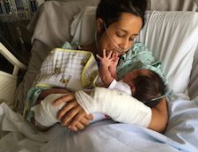
Maile’s Story
In 2015, Maile gave birth to her second child.
Soon after arriving home, she felt unwell and began calling her doctor’s office over the course of the week
She went into severe septic shock
This video tells her story

Slide 22
https://m.youtube.com/watch?v=w0tag0R9EBk

Slide 23
Maternal Sepsis Community Leadership Board
The purpose of the Maternal Sepsis Community Leadership Board (MSCLB) is to engage in research activities designed to understand and reduce maternal morbidity and mortality from maternal sepsis while leveraging community experiences and voices.
Membership:
Maternal Sepsis Survivors
Health Equity Advocates
Public Health Experts
Community members (rural, urban, tribal communities)

Slide 24
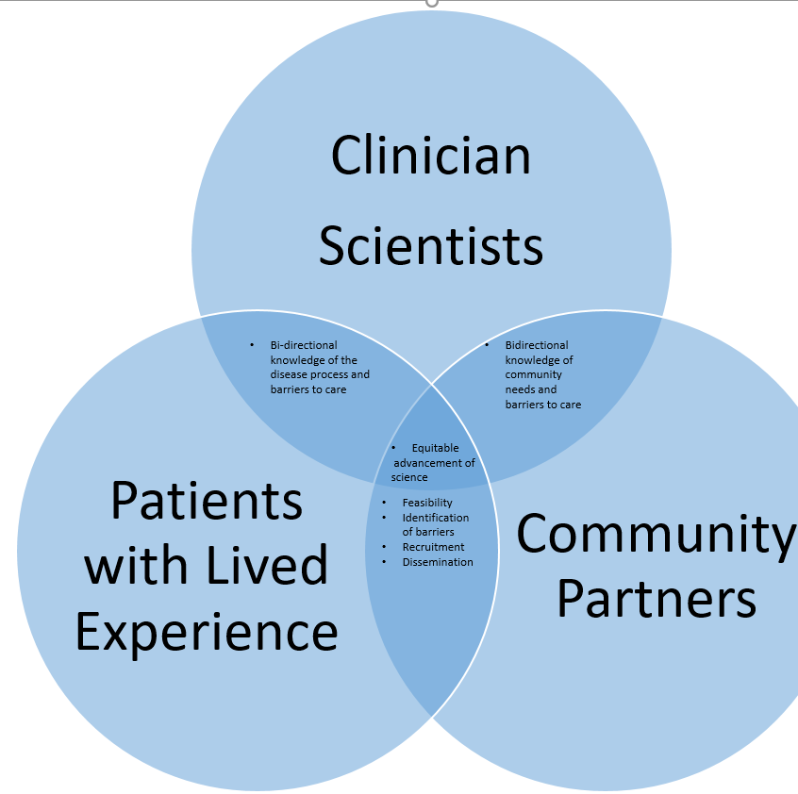
Maternal Sepsis Project Structure
Planning Phase- Maternal Sepsis Community Leadership Board
Patients with lived experience
Patient advocates
Birth equity Advocates
Community leaders engaged in reducing disparities
Diverse membership geographically & ethnically

Slide 25
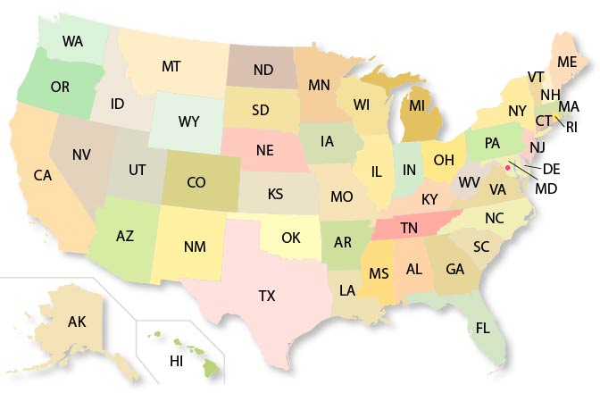
Leverage Experience in California & Michigan
SEMPQIC, Intertribal Council of Michigan, Rural Michigan
California Maternal Quality Care Collaborative

Slide 26
Reducing Power Differentials
Community Liaison, Kendra Smith PhD, empowered community members by level-setting activities
Integrated Community and Patient Co-Leadership with Researchers
Create an equitable compensation structure

Slide 27
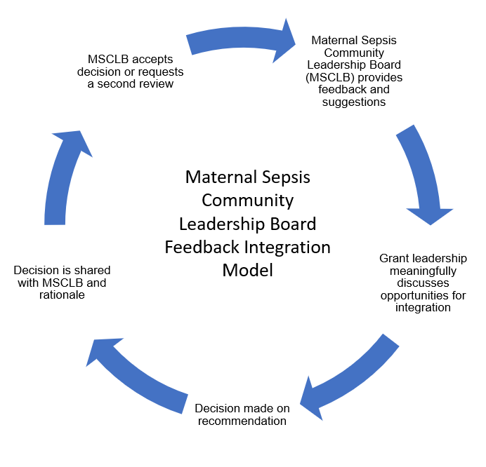
Maternal Sepsis Community Leadership Board Feedback Integration Model

Slide 28
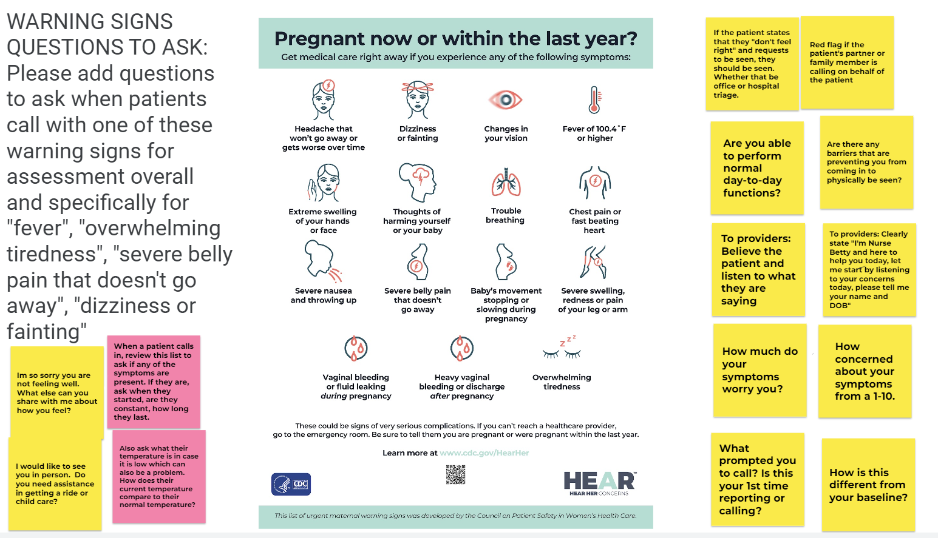
Warning Signs: Questions to Ask

Slide 29
Advocacy Language

Slide 30
Turning Lessons Learned from Community and Patients into Clinical Tools
Melissa E Bauer, D.O.
Associate Professor
Duke University

Slide 31
Preventability
California | North Carolina | Michigan
39% Preventable | 43% Preventable | 73% Preventable
Bauer et al. Obstet Gynecol (2015)
Berg CJ et al. Obstet Gynecol (2005)
Main EK et al. Obstet Gynecol (2015)
Notes:
It is important to note that these deaths are largely preventable. These studies are state maternal mortality reviews in NC and Michigan and also the CA. They evaluated the cases and made determinations whether with different care there may have been a different outcome. 40-70% of the time the cases were preventable

Slide 32
Three Deadly Delays
Recognition
Treatment
Esclation of Care
Seacrist et al. JOGNN 2019
Bauer et al. Obstet Gynecol 2015

Slide 33
Recognition
Notes:
Let’s start with recognition. Which patients are at risk and what screening tools should we use?

Slide 34
In-hospital Recognition Pearls
Most patients do not have any risk factors
No fever (or hypothermia) ≠ No sepsis
Be curious
What is not in the chart can be most important

Slide 35
Outside of the Hospital
Over 50% of cases occur during postpartum readmission
How can we also help the patient identify when to seek care?
How can we help the patient be listened to and feel heard?
Hensley et al. JAMA 2019
Notes:
It’s challenging to be able to remember all of the risk factors. Ranges of ages, Medicaid insurance, cesarean delivery, The common associations across all studies were CD, Medicaid, multiple gestation, PPH, preterm delivery. However many of these database studies do not have the temporality of sepsis with delivery- the entire admission period is one entry. So we are unable to determine which came first (CD, pph and preterm delivery). Those could be implicated by reverse causality. As you can see from these studies, most patients will have risk factors for sepsis.

Slide 36
Survivor Interviews
20 total interviews
19 survivors with 8 support persons
1 support person of a non-survivor

Slide 37
Patient Barriers to Care
Goals:
Identify barriers to care
Listen to patient’s stories and lessons learned
Solutions to address barriers

Slide 38
Patients did not remember education about about warning signs
“If I had known that was a sign to look for, I would have known it when I saw it.”
“I think if when they discharged me, if they had said be on the lookout for these symptoms, if you have any of them, call and check in. If they had taken five minutes to do that, I think it would’ve made a huge difference.”

Slide 39
Urgent Maternal Warning Signs
AIM Cornerstone resource, originally developed by the Council for Patient Safety in Women’s Health Care
Translated into 14 languages
Standardized patient education
www.saferbirth.org/aim-resources/aim-cornerstones/urgent-maternal-warning-signs/

Slide 40
Phone Discharge Education

Slide 41
Patients wanted a way to advocate
“It would have been helpful to have this list to give me the language. I had these symptoms and knew something was wrong. My husband and I thought we should be advocating for ourselves but didn’t know what we were supposed to be advocating for.”
“Patients and their support person should be taught to watch for warning signs and know what they could potentially mean and what to say when entering an emergency room”

Slide 42
Co-Created with Community and Patients with Lived Experience
Advocacy Language
Advocacy Actions

Slide 43
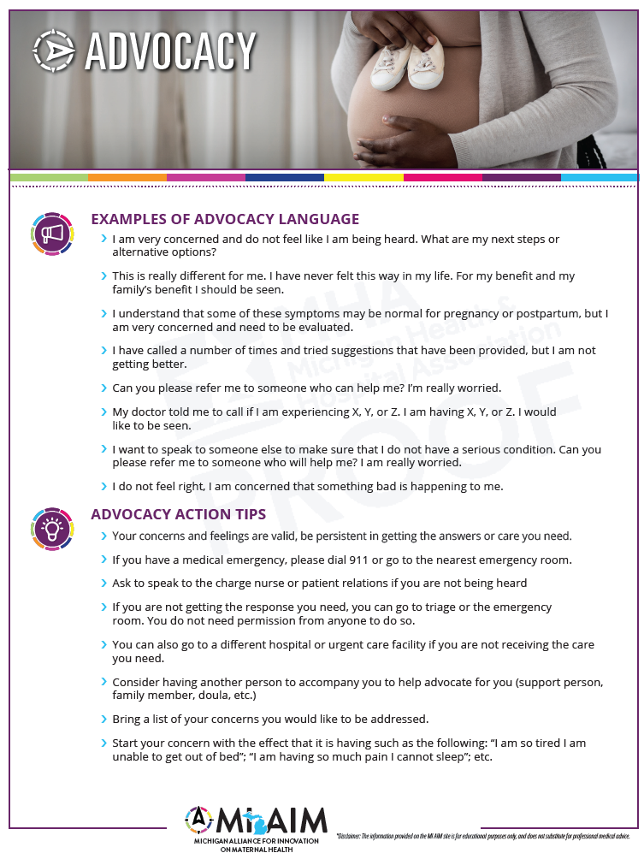

Slide 44
Patient Concerns dismissed as normal
“I was telling all my symptoms, but I was basically just getting like, "Oh, that's normal. That's normal." So, I was very brushed off and I didn't know any better.”

Slide 45
But if they had asked further…
“I had no strength; I couldn’t even go to the kitchen to get a glass of water”
“I was so weak; I couldn’t stand up”
“I was short of breath after brushing my teeth and had to lie down on the bed”

Slide 46
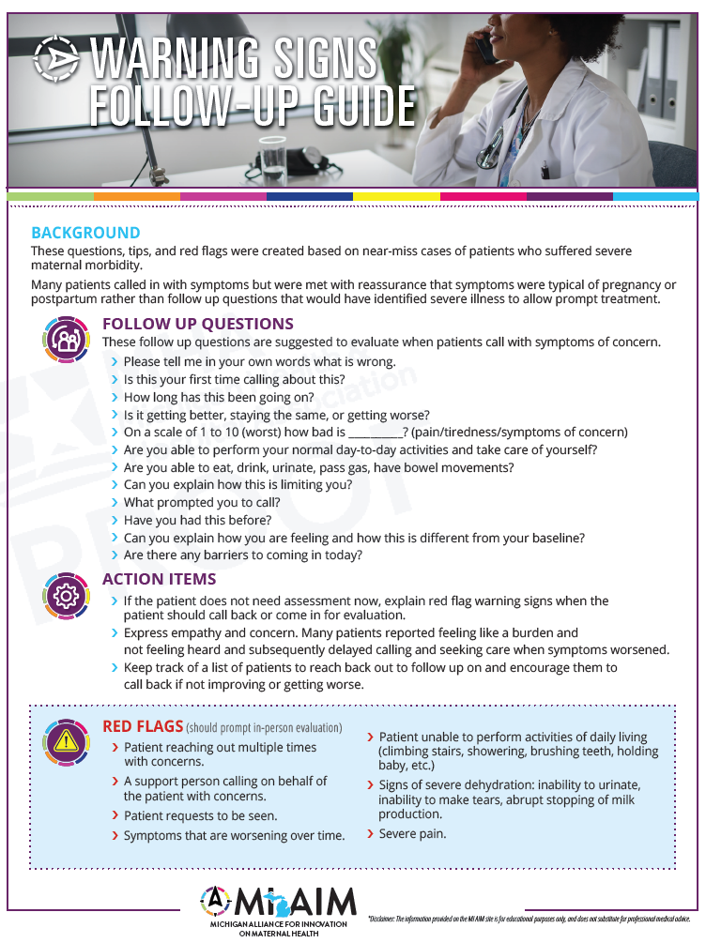

Slide 47
Treatment

Slide 48
Importance of prompt antibiotic therapy
In Pregnant Patients
Antibiotics within one hour
8% mortality
Antibiotics after one hour
20% mortality
Bauer ME et al. Anesth Analg (2018)

Slide 49
CMQCC Toolkit
Courtesy of CMQCC
Notes:
In patients with septic shock, you may want to consider combination therapy, this is defined as two antibiotics of different classes aimed at the most likely pathogen. A good example of this is adding Clindamycin to already broad gram positive coverage. There are some studies showing with clinda and beta lactams in group A strep infections there may be a survival benefit. There is some animal evidence that clinda may decrease toxin production. There is enough GAS in this population to warrant its use in septic shock.

Slide 50
Systems-based solutions
Automated dispensing system availability
IV access
Pharmacy
Waiting for transport
Notes:
In patients with septic shock, you may want to consider combination therapy, this is defined as two antibiotics of different classes aimed at the most likely pathogen. A good example of this is adding Clindamycin to already broad gram positive coverage. There are some studies showing with clinda and beta lactams in group A strep infections there may be a survival benefit. There is some animal evidence that clinda may decrease toxin production. There is enough GAS in this population to warrant its use in septic shock.

Slide 51
Escalation of Care

Slide 52
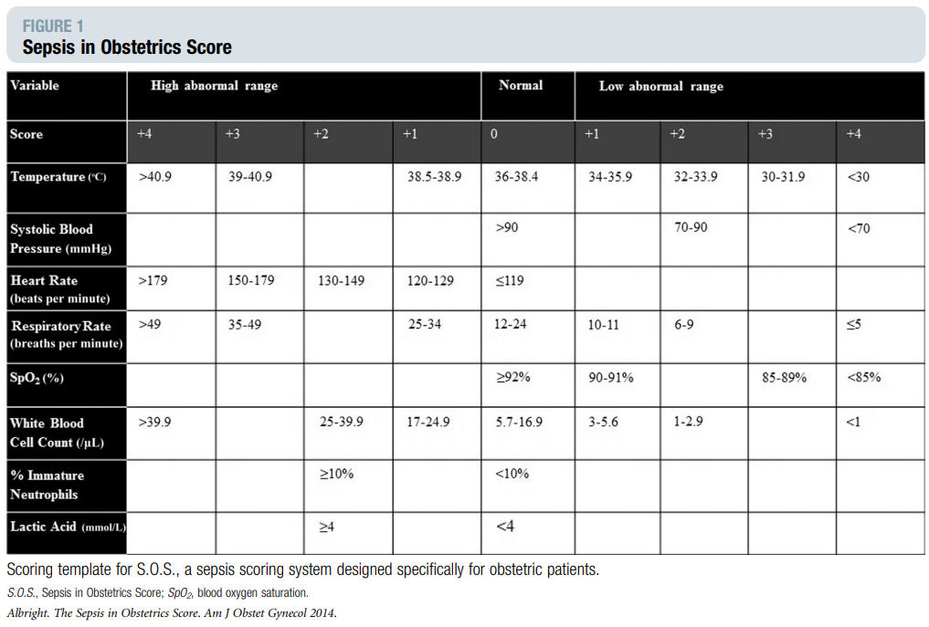
Sepsis in Obstetrics Score
Albright et al. AJOG (2014)
Notes:
A more specific scoring system to determine ICU admission in pregnant women with sepsis is the Sepsis in Obstetrics score. The SOS score is based on measurements of T, SBP, HR, RR, Sp02, WBC, %bands, lactic acid. A score of 6 or greater predicted ICU admission in both retrospective and prospective validation.

Slide 53
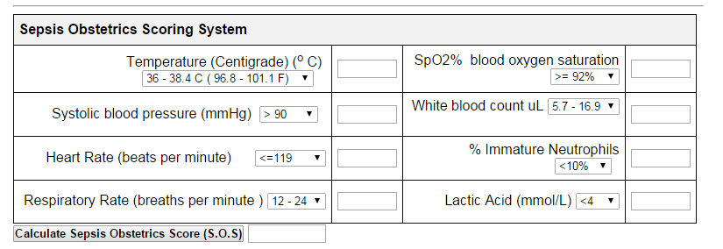
Sepsis Calculator
http://perinatology.com/calculators/Sepsis%20Calculator.htm
Notes:
In the middle of the night, it may be a challenge to remember this citation to find this article. So, A simple calculator for this scoring system can be found on perinatology.com. You can choose drop down values and it will calculate the score for you. Consider transferring to the ICU with a score of 6 or worsening clinical status.

Slide 54
Elliott K. Main, MD
The Q&A box is now open for questions!
Please specify who your question is for.
Thank you!
Kendra L. Smith, PhD, MPH
Melissa E Bauer, D.O.
Notes:
54

Slide 55
Introduction to the Improving Diagnosis and Treatment of Obstetric Sepsis Collaborative
Christa Sakowski, MSN, RN,
C-ONQS, C-EFM, CLE
Clinical Lead - CMQCC csakowski@Stanford.edu

Slide 56
CMQCC Collaborative History and Structure

Slide 57
CMQCC Collaboratives
Improving Health Care Response to Preeclampsia - Complete
Improving Health Care Response to Obstetric Hemorrhage - Complete
Support Vaginal Birth and Reduce Primary Cesareans - Complete
Mother & Baby Substance Exposure - Complete
Birth Equity
Pilot Collaborative - Ongoing
Learning Initiative for Supporting Vaginal Birth with an Equity Lens - Current
Low Dose Aspirin to Prevent Preeclampsia - Current
Community Birth Partnership Initiative (Pilot) - Current
Maternal Sepsis – Current
Notes:
Many of the CMQCC toolkits have been supported with active working collaboratives where best practice standards and implementation ideas are shared amount facilities in a “group think” environment. The mentor model has been utilized to scale up this effort and provide additional touch points with CMQCC.
Over the past three years, CMQCC has been hosting an equity pilot collaborative with 5 hospitals to learn about the best ways to advance equity as a part of quality improvement initiatives. Participant hospitals have deployed a patient-reported experience metric (PREM), implemented implicit bias and birth equity trainings, and tested how to change unit attitudes and culture to support birth equity. Based on the insights and best practices identified in the pilot collaborative, CMQCC established a 22-member Birth Equity Task Force to lead the formal development and identification of action tools to address racism and promote equity. We anticipate releasing resources to interested California membership hospitals later this year

Slide 58
Mentor Model
CMQCC
Clinical Lead
Mentor Physician
Mentor Nurse
Mentor Patient
Hospital Implementation Teams
Notes:
Christa

Slide 59
Build the Team before you Build the Plan
Set the expectation that bedside staff is integral
Expand QI knowledge
Timely Communication
Who
How
When
Prepare for scheduled meetings

Slide 60
Standard Team Members
Physician Leaders – OB, MFM
Midwifery Leaders
Nurse Leaders – Director, Manager, CNS, Educator
Informal Leaders
Data Colleagues
Quality Staff
Patient Safety/Risk Management
Health Information Management Staff
Analyst
Notes:
Christa

Slide 61
Supportive Team Members
Patient Representatives
Community Representatives
Administrative Leaders
Board of Directors
Community Leaders
Marketing
State Collaborative

Slide 62
Why a Collaborative?

Slide 63
The Problem
Obstetric sepsis is the #2 cause of maternal mortality
Obstetric sepsis is the #3 cause of severe maternal morbidity
The Joint Commission (TJC) / Centers for Medicare & Medicaid Services (CMS) are introducing a severe maternal morbidity (SMM) quality measure this year
Implementation of the Sepsis bundle is one of 3 safety bundles (HEM and HTN are the others) that CMS is requiring for designation as Birthing-Friendly

Slide 64
Introduction to the Collaborative
Multi-stakeholder, multi-hospital effort to improve the prevention, diagnosis, and treatment of sepsis in California and Michigan.
Activities will assist hospitals across the states of California and Michigan in improving obstetric sepsis outcomes through
The implementation of the patient safety bundle developed by the Alliance for Innovation on Maternal Health (AIM)
The use of the Improving Diagnosis and Treatment of Obstetric Sepsis Toolkit, developed by CMQCC and a task force of experts from across California.

Slide 65
Why now?
Received a National Institutes of Health (NIH) grant to further our work on obstetric sepsis.
Also in the last few months, ACOG/AIM released a new national safety bundle “Sepsis in Obstetric Care” that includes great resources.
The Collaborative will start in November 2023 and run through November 2024.

Slide 66
Collaborative Structure
All virtual sessions
Kick-off webinar November 2023
Mentor Training November 2023
Quarterly educational webinars that include clinical protocols and lived experience presentations
Twice quarterly small group (6-8 hospitals) sharing with peers led by a physician, nurse, and patient mentor
1st meeting of the quarter – Clinical Protocols
2nd meeting of the quarter – Patient Considerations
Other experts in patient safety, implementation, quality improvement, and data analytics will help hospital teams during small group meetings
Closing webinar November 2024

Slide 67
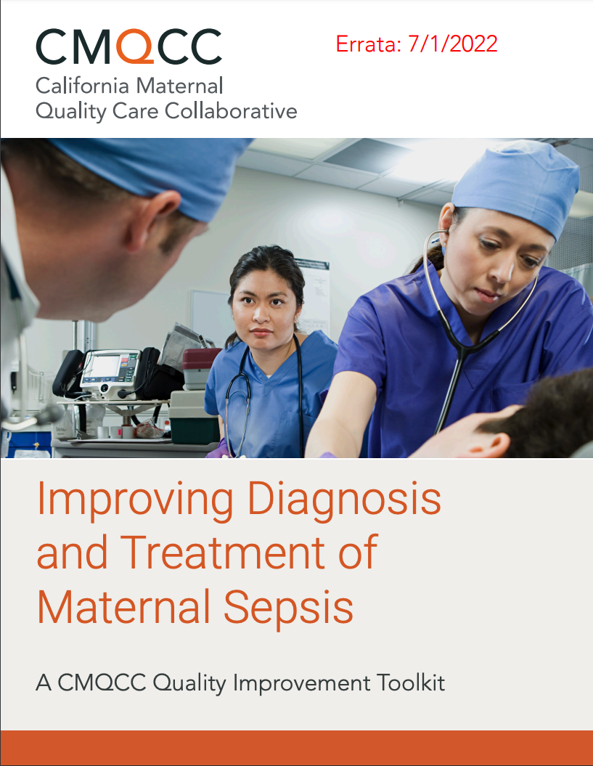
KEY RESOURCES:

Slide 68
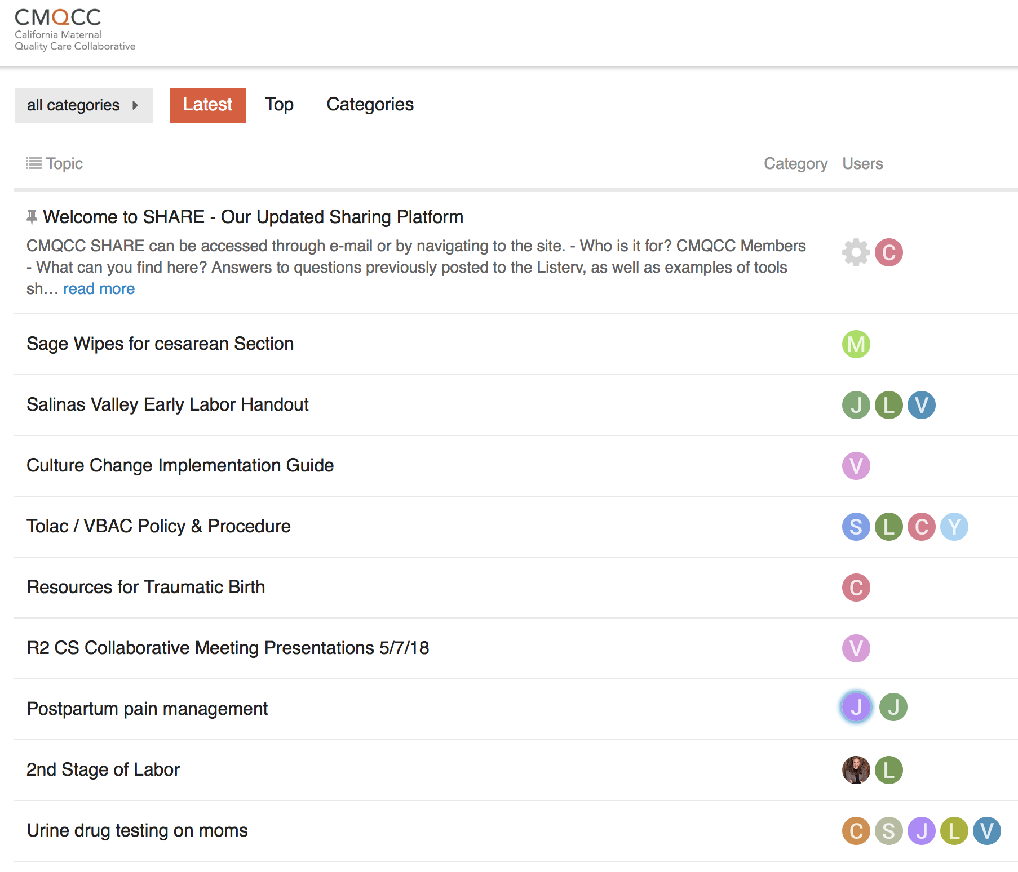
SHARE

Slide 69
Benefits of Hospital Participation
Participating hospital teams will experience a significant extension of your hospital’s quality improvement capacity through
Training materials
Educational webinars
Development and implementation of consistent and standardized approaches to care
Mentor support for the implementation of bundle elements
Assistance from quality improvement experts
Networking opportunities with hospital teams across the state that are also participating in this project

Slide 70
MDC Tools

Slide 71
Sepsis Structure Measures Checklist
10 Structure Measures total
Used to track implementation progress

Slide 72
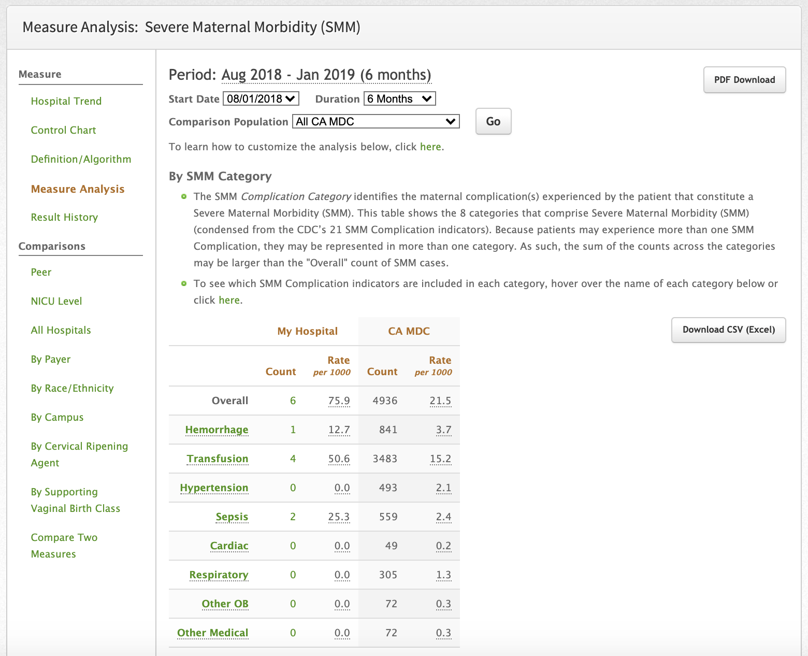
SMM Measure Analysis: Updates
Condense 21 SMM Indicators into 8 Complication categories
Hover over the category to see which Indicators are included
Click into each category to see a trend screen for each category

Slide 73
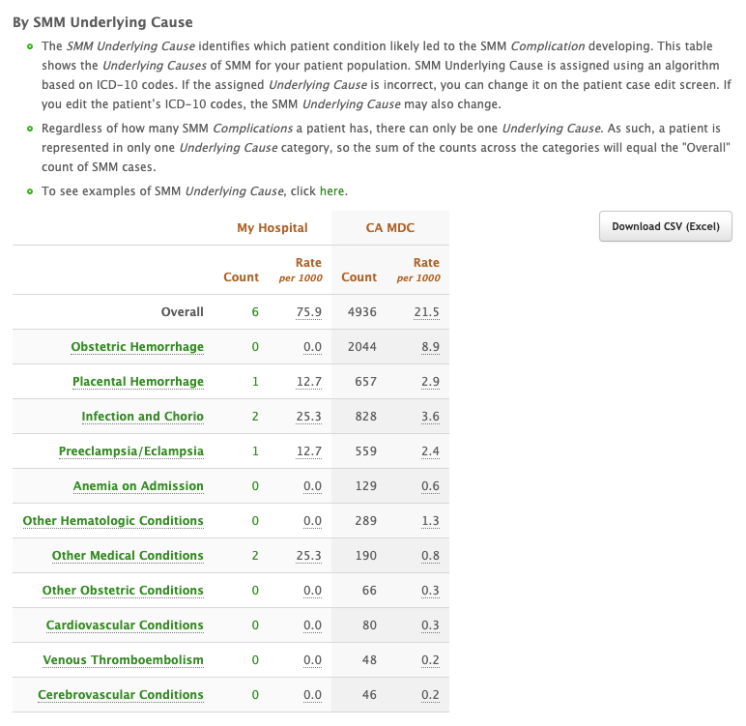
SMM Measure Analysis:
NEW: By SMM Underlying Cause
Hover over the Underlying Cause to see examples of what would be included
Click into each Underlying Cause to see a trend screen for each
Help focus your QI efforts by seeing what drives your SMM rate

Slide 74
Quality Improvement Pearls

Slide 75
All Improvement is Multidisciplinary
QI teams must cast a wide net to get the right people to the table…including patients and community partners
Informal leaders can produce favorable results
Engagement of hospital-level QI personnel has improved effectiveness

Slide 76
Lessons from the Field
Yes
Robust teams most effective
Easy wins matter
Goals and timelines are very useful
It takes time and persistence to get the systems running smoothly
Must have champions
Disciplines & Departments | Needed?
Obstetrics
Nursing
Anesthesia
IT/EMR
Laboratory
Emergency Department
Support personnel
QI
Outpatient Clinics
Patients
Others unique to your setting?

Slide 77
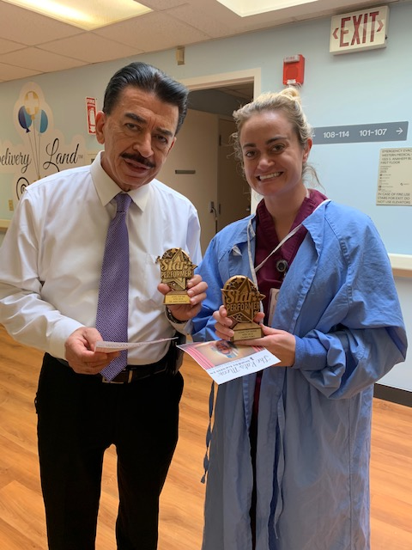
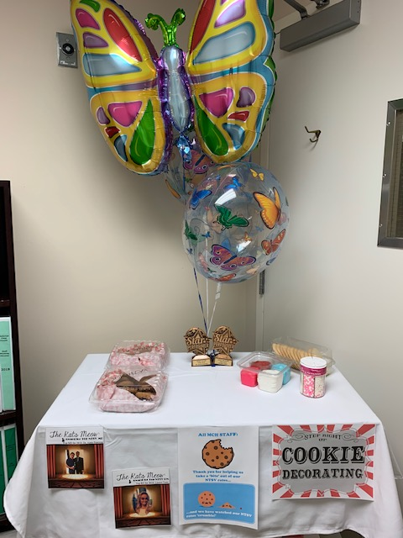
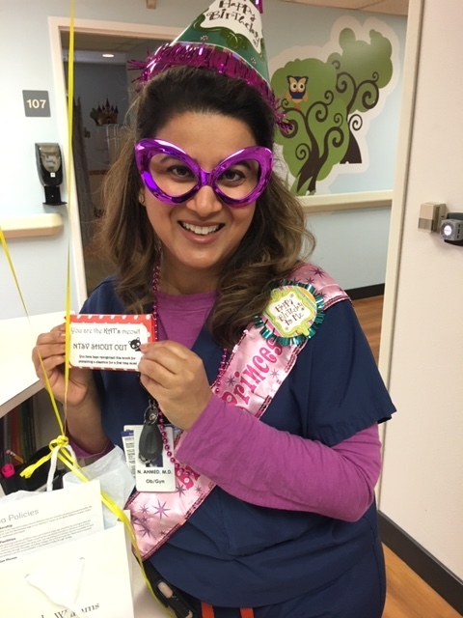
Celebrate!!!
Notes:
I hope that you all sent in your QI team photos for the contest. This work is incredibly hard and you deserve recognition. Promoting vaginal birth requires a change in culture and the slope of that hill is going vary widely from site to site and challenges like staff turnover can definitely impact the gains. Give yourself grace while keeping your eye on the prize. Don’t be afraid to change something that isn’t working. Like I said in the beginning, you’ve got this!

Slide 78
Questions

Slide 80
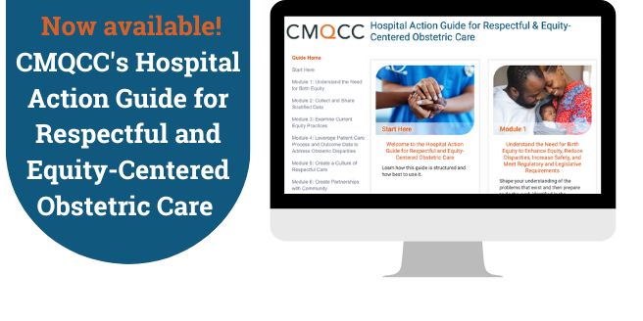
Attention: Physicians, nurses, quality improvement leaders, and obstetric champions. A new tool is now available to support moving beyond implicit bias training to improve outcomes for all California moms and birthing people in California.
If you need assistance, please follow this QR code for more on how to create a CMQCC Accounts Profile tutorial.
How to access the Hospital Action Guide
The Hospital Action Guide is available now through the CMQCC Accounts portal available at CMQCC.org, exclusively for California member hospitals.

Slide 81
Thank you for joining us!
Notes:
81

