Slide 1

Communication Tips to Promote Low-Dose Aspirin Uptake and Adherence
Myths, Misunderstandings, and Meaningful Conversations
1/27/2026
Ky-Shana Jenkins
Patient Advocate
Faculty Advisory Member
Lindsay du Plessis DrPH, MPH
Perinatal Community Engagement Manager, CMQCC
Sarah Vaillancourt DNP, WHNP-BC, RN
Outpatient Clinical Lead, CMQCC
Notes:
Patient Story Outline – Opening Narrative
Purpose:
To ground the presentation in lived experience and illustrate how risk communication impacts trust, decision-making, and outcomes.
1. Context: Who I Am as a Patient
Black woman, age 34
High-risk pregnancy (2023)
Fifth pregnancy:
2 prior live births
1 miscarriage
1 molar pregnancy
All prior deliveries via C-section
2. Initial Prenatal Visit Experience
Expectations set for ultrasound, fetal heartbeat, and monitoring
Appointment felt rushed and non-personal
Recommendation for low-dose aspirin given
Justification centered on race rather than individualized risk
No discussion of labs, family history, or explanation of purpose
3. Impact on Trust and Decision-Making
Confusion and discomfort with recommendation
Refusal to take low-dose aspirin due to lack of explanation
Formal complaint filed
Limited provider options despite complaint
4. Second Appointment Experience
Presence of a student without prior reassurance
Provider communication directed to screen/student rather than patient
Lack of shared decision-making
Comments about weight and physical appearance
Patient refusal of services due to discomfort
5. Transition to Respectful Care
Assignment to a new nurse practitioner
Transparent communication style
Shared review of medical chart
Validation of patient questions and concerns
Recognition that aspirin initiation window had passed
6. Outcome and Reflection
Development of postpartum preeclampsia
Acute symptoms and delayed bonding with newborn
Ongoing monitoring and medication after discharge
Reflection on how respectful, timely communication could have altered experience
7. Transition to Educational Content
Story sets the foundation for discussing low-dose aspirin
Emphasis on respectful risk communication and patient partnership

Slide 2
Objectives
Consider patient and community perspectives related to LDA recommendations and preeclampsia information
Review and apply communication techniques to support patient uptake and adherence to Low-Dose Aspirin
Discuss strategies to address barriers to LDA use

Slide 3


California Maternal Quality Care Collaborative (CMQCC)
Mission:
To end preventable morbidity, mortality and racial disparities in maternity care.
Celebrating 19 years!
Multi-stakeholder collaborative since 2006
Launched with funding from California Department of Public Health to address rise in maternal mortality
Committed to evidence-based and data driven quality improvement
Effector arm of the March of Dimes Prematurity Research Center – funding current LDA work
Notes:
I am sure most of you have heard of CMQCC. It stands for the California Maternal Quality Care Collaborative.
The mission of cmqcc is to end preventable morbidity, mortality and racial disparities in California maternity care.
We have been around for a while.. celebrating 19 years.
CMQCC is committed to evidence-based and data driven quality improvement.
CMQCC has a formula that combines outreach and STAKEHOLDER WISDOM with research and data into quality improvement toolkits to address pressing threats to maternal health

Slide 4
Welcome Ky-Shana Jenkins!

Slide 5


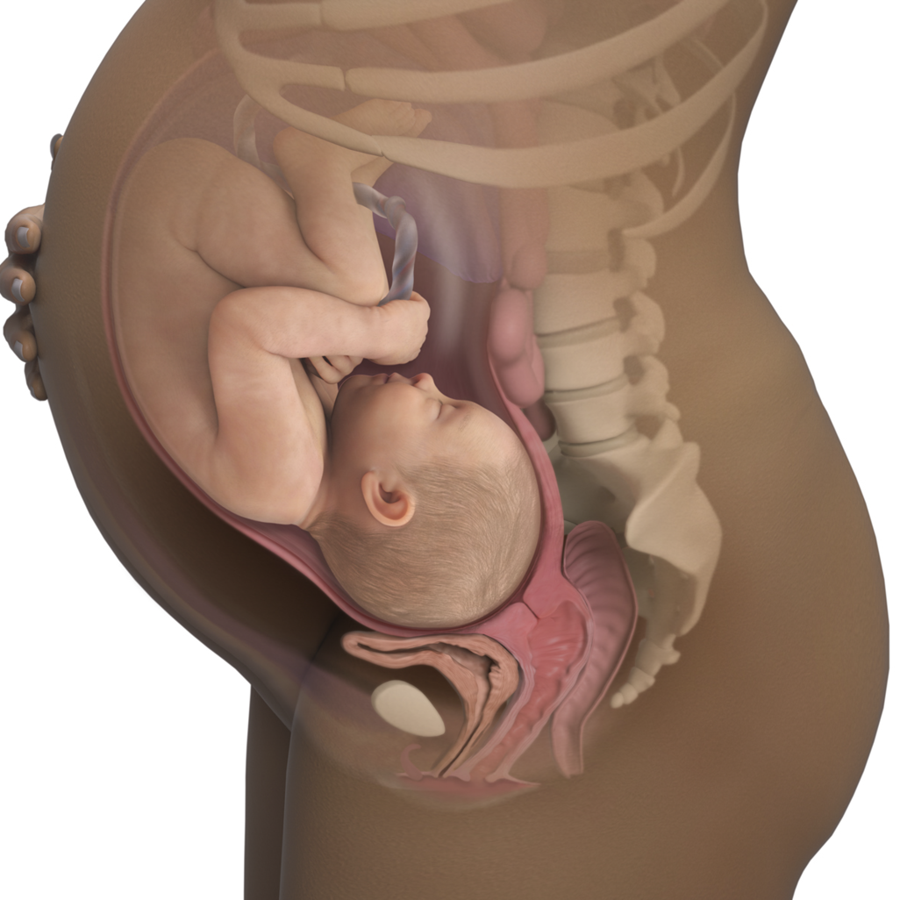




Community-Based QI Implementation and Roles of Influencers
Week 4
Adherence
Birth
Patient Experience
& Perception
Pregnancy Begins
Peer Influence

Slide 6
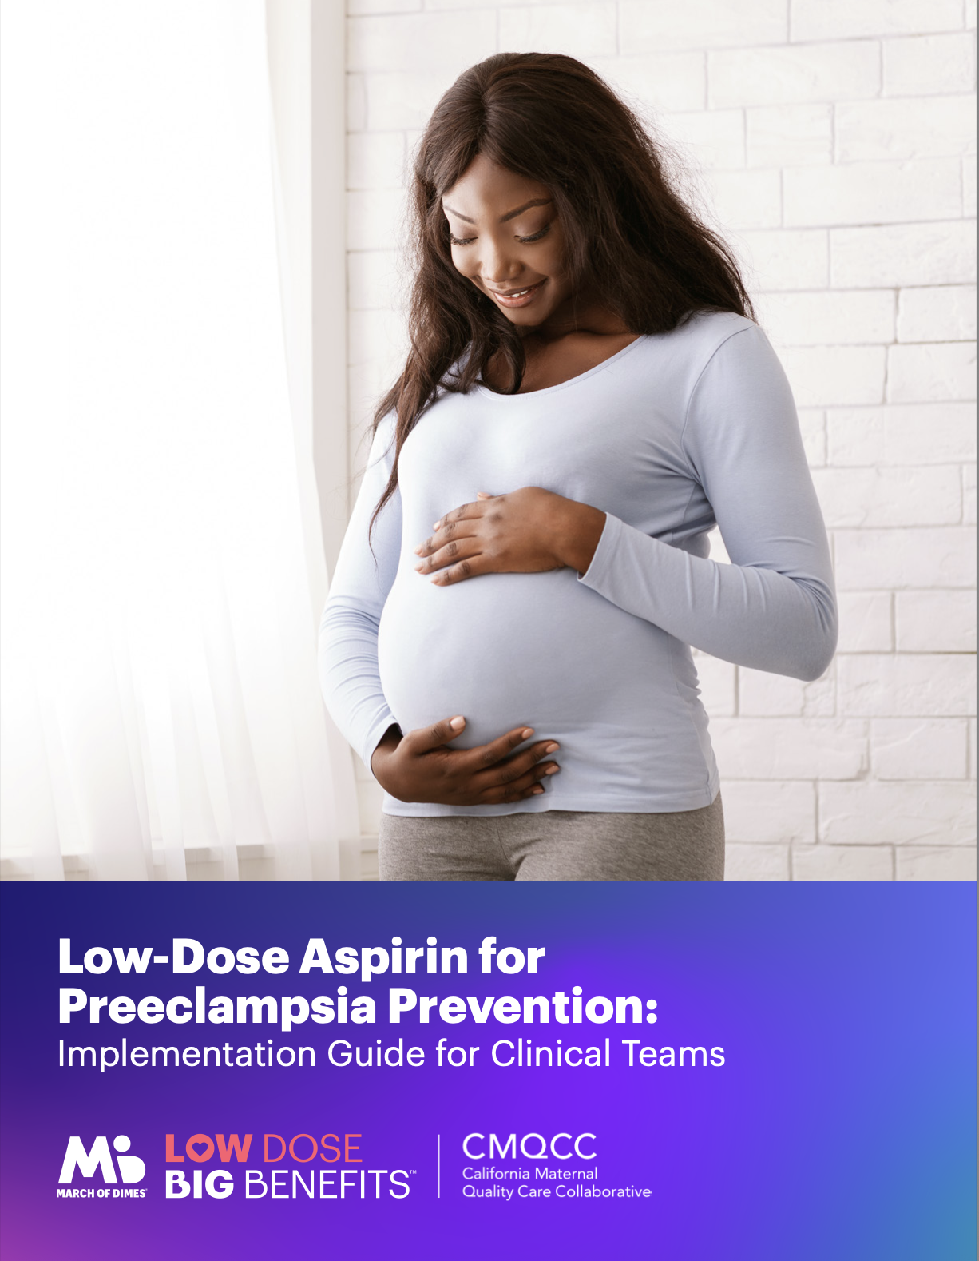
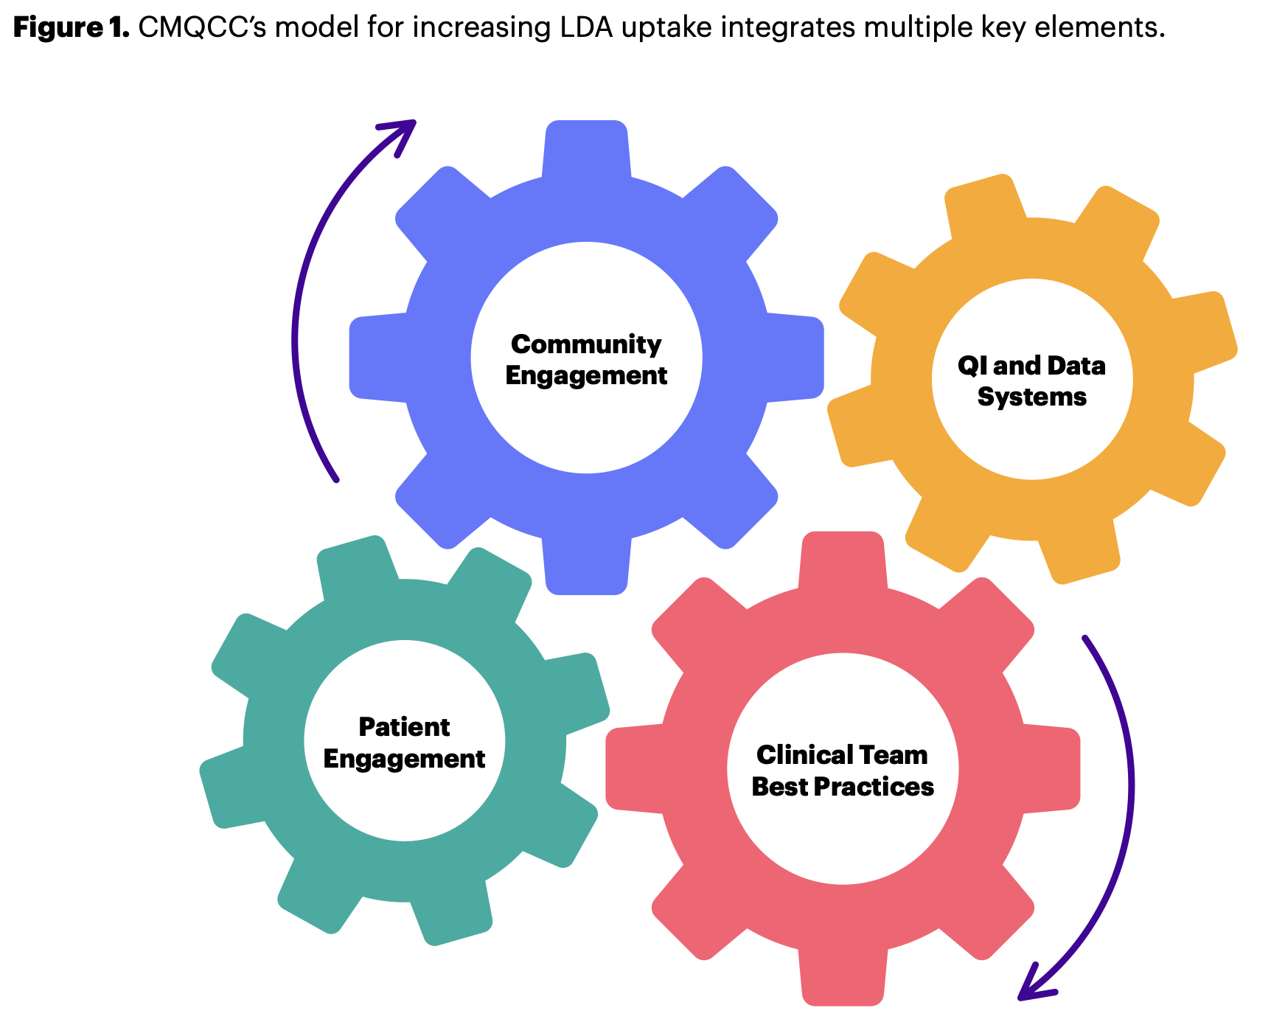
Improving Care: LDA Implementation Guide
https://www.marchofdimes.org/our-work/health-professionals/low-dose-aspirin-preeclampsia-prevention-implementation-guide
Notes:
https://www.marchofdimes.org/our-work/health-professionals/low-dose-aspirin-preeclampsia-prevention-implementation-guide

Slide 7
The Problem

Slide 8
LDA Recommendations to Prevent Preeclampsia
Low-Dose Aspirin 81mg should be recommended for those at risk for preeclampsia
This includes individuals with one or more high-risk factor or two or more moderate-risk factors
Some may consider prescribing LDA in the setting of one moderate risk factor
LDA can be started between 12 and 28 weeks, though is most effective if initiated between 12 and 16 weeks
LDA should be taken daily and continued until delivery
American College of Obstetricians and Gynecologists, Committee Opinion Number 743, 2018, Reaffirmed 2023

Slide 9
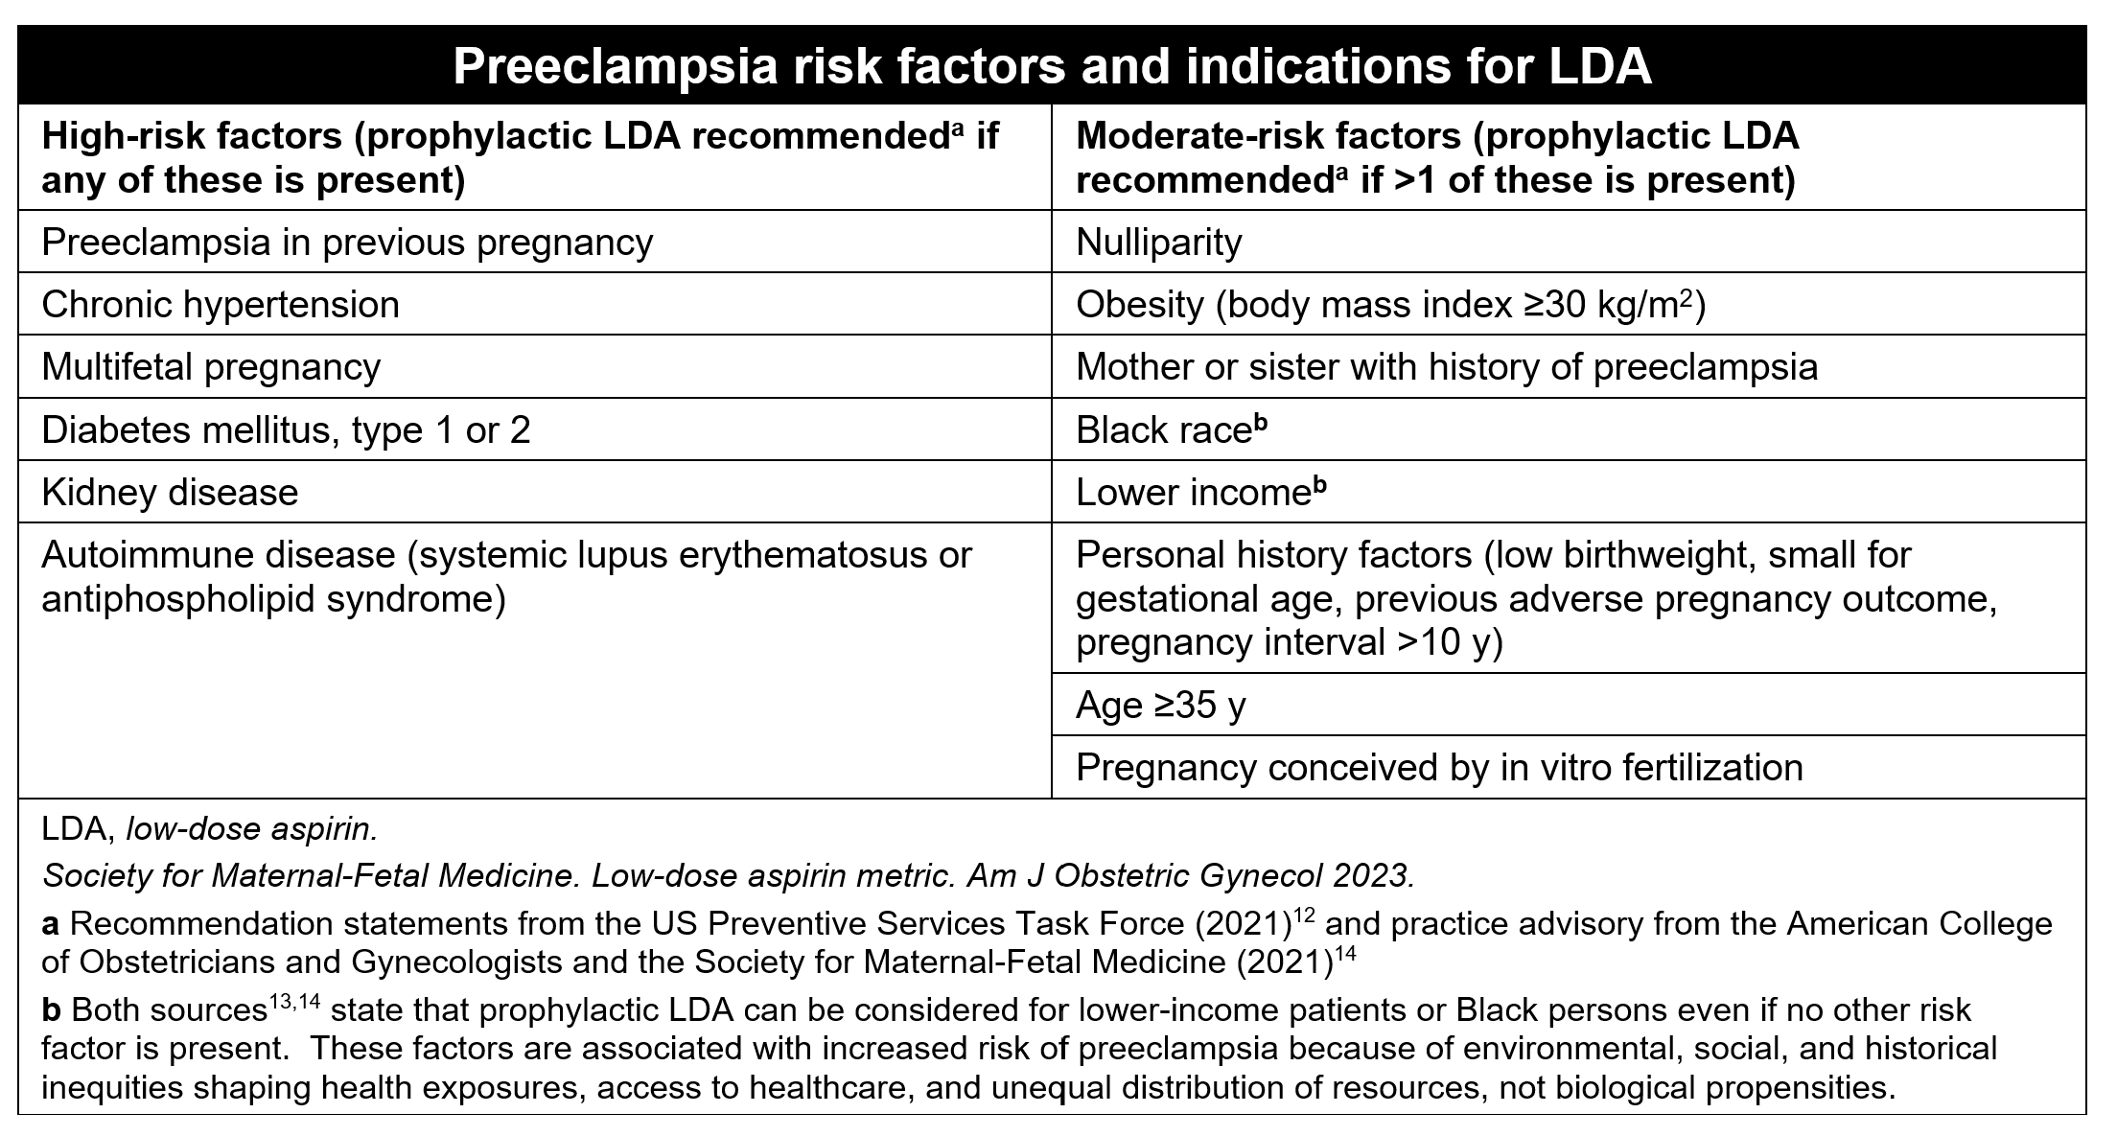
1
or more
more than
1

Slide 10
Clinical Team Best Practices for
LDA Uptake and Adherence
Preeclampsia Risk Factor Screening
Patient Education
Prescription of LDA
Support for Adherence

Slide 11
Barriers to LDA Use
Uptake and Adherence
Confusing, mixed messaging
Misunderstanding of individual risk- understanding of preeclampsia
Exposure to misinformation
Fear of medication in pregnancy
Distrust of the healthcare system

Slide 12
Common Questions and Misconceptions
I can start LDA later in pregnancy if problems arise.
Natural or holistic approaches can replace LDA.
LDA will harm the baby.
I am not a high-risk pregnancy, so I do not need to take LDA.

Slide 13

Why is this such a difficult problem to address?
Limited time
More complex than LDA specifically
Factors outside of our control
Community engagement is not usually included in solutions
So, what can we feasibly do to support patients in making informed decisions about LDA?

Slide 14
Approach to Communication

Slide 15
Goals in the Patient Encounter
Develop and maintain trusting relationship between patient and clinician
Promote autonomy and patient engagement
Provide accurate information through respectful discussions

Slide 16
Spectrum of Acceptance
Accept
Movable Middle
Decline
Notes:
Add logistics slide

Slide 17
Common Questions and Misconceptions
LDA will harm the baby.
Safety of LDA in pregnancy
Preeclampsia Prevention
Understanding of risk
I can start LDA later in pregnancy if problems arise.
I am not a high-risk pregnancy, so I do not need to take LDA.

Slide 18

Motivational Interviewing
“MI is a collaborative, goal-oriented style of communication with particular attention to the language of change. It is designed to strengthen personal motivation for and commitment to a specific goal by eliciting and exploring the person’s own reasons for change within an atmosphere of acceptance and compassion.” (Miller & Rollnick)
MI assumes that we all deeply want what is best for us.
We don’t need to “get” motivation from someone outside of us.
Instead, another can help us elevate and amplify our own intrinsic motivation

Slide 19

The spirit of MI is non-judgmental, & empathetic
Notes:
https://www.cambridge.org/core/journals/behavioural-and-cognitive-psychotherapy/article/evolution-of-motivational-interviewing/F5B114B2592BE1B55AE39247545F1166

Slide 20

MI Strategies
Nonverbal empathy
Eye contact
Smiling
Mirroring
Handshake

Slide 21
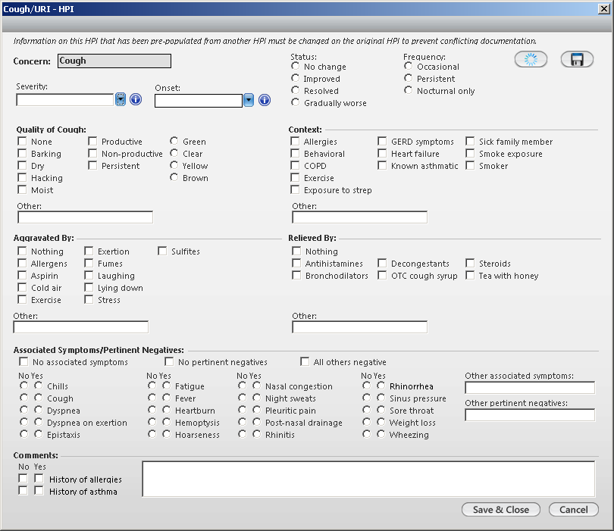

Open Ended Questions
How do you feel…?
Tell me more about…
What do you know about LDA in pregnancy?
Help us identify:
Confusion, Fear
Specific information or misinformation guiding patient’s decision
Logistical barriers to starting or continuing LDA.
WHY?
Notes:
Sources information – tie in community

Slide 22
Verbalizing Empathy
Reflect
Ensure you heard what the patient said/meant
Can help highlight ambivalence
“I hear you say…”
”It sounds like…”
Acknowledge and Normalize
“It’s really normal to be worried about medication in pregnancy.”
“I hear this concern/question from many of my patients.”

Slide 23
Affirming Strengths
Build trust and confidence
Affirm behaviors, motivation, intentions that the patient is already doing well.
Parts of this conversation that are positive health behaviors:
Asking questions
Looking for information
Considering the health of self and baby
Making decisions that feel right for them
Examples:
“That’s a great question.”
“It’s great that you are considering this decision so carefully.”
”I’m impressed by…"

Slide 24
Tips for misconceptions and misinformation
Find the underlying emotion, self-perception, or goals
Validate, affirm strengths
Provide accurate information
Safety concerns→ may be fear of medication in pregnancy
Misunderstanding of prevention → may be avoidance of thinking of poor outcomes
Misunderstanding of risk → may have a self-perception of being healthy, not ”high-risk”

Slide 25
Common Pitfalls to Avoid
Righting Reflex
Giving advice: instead of providing accurate information
“If I were you..” , ”you should…”, ”you must…”
Both of these approaches are not correlated with behavior change
Instead,
Channel the spirit of MI- empathy and non-judgement
Center the patient’s experience- feelings, goals, motivations, concerns
Provide information and promote patient autonomy

Slide 26

Wrapping up the conversation
“What other questions do you have?”
“Is there something that was confusing?”
”Is there something important today that I didn’t bring up?”
”How are you feeling about the low-dose aspirin recommendation?”

Slide 27
What if the patient declines?
Remember our objectives:
Build and maintain trust
Promote patient autonomy
Provide accurate information
Some options:
I hear that you’re not interested/comfortable in LDA. If you end up having any questions later on, let me know.
LDA is the best way we know to prevent preeclampsia, but there are other things we can do that promote health like:
Healthy lifestyle
Checking our blood pressures
Looking out for preeclampsia symptoms
Notes:
If a patient declines, we want them to feel supported in their decision so they continue engaging in the rest of their care.

Slide 28
Putting It All Together
Review Risk Factor Screening
Based on your preeclampsia risk factor screening, it looks like you would be a good candidate for LDA because of these risk factors..
Open Ended Question
What do you know about LDA? or How do you feel about LDA?
Reflect, Acknowledge, Normalize
It sounds like ..., That's a really common concern.
Affirm Strengths
Provide Accurate Information
Wrap Up
That’s a great question! Or I’m so impressed with…
Provide information that addresses specific concerns of the patient.
What other questions do you have? How do you feel about starting LDA?

Slide 29
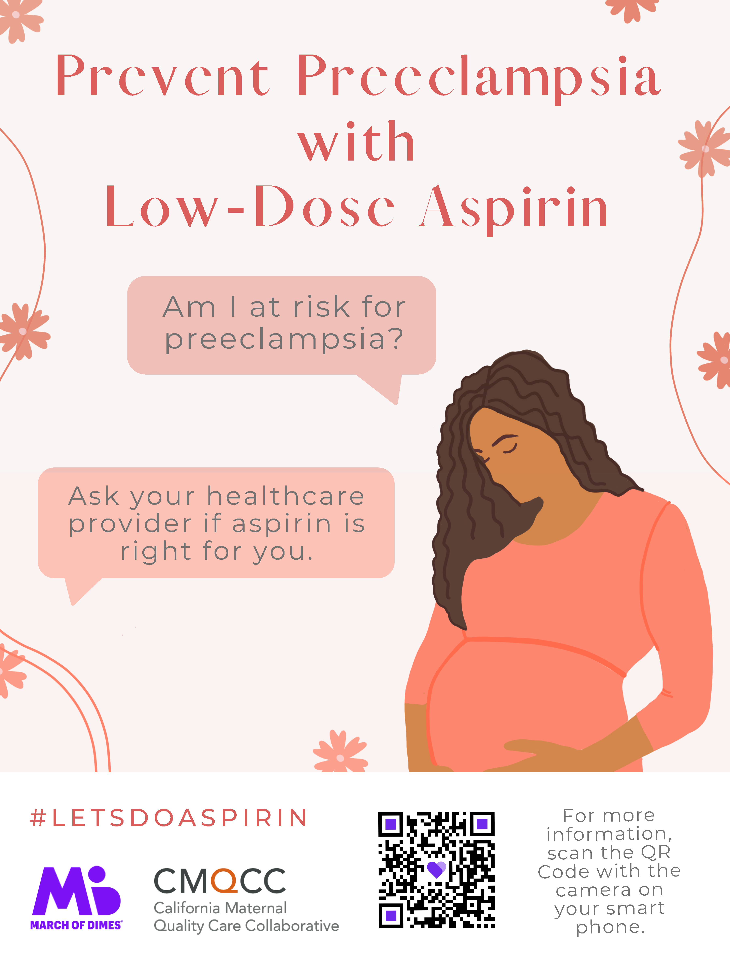
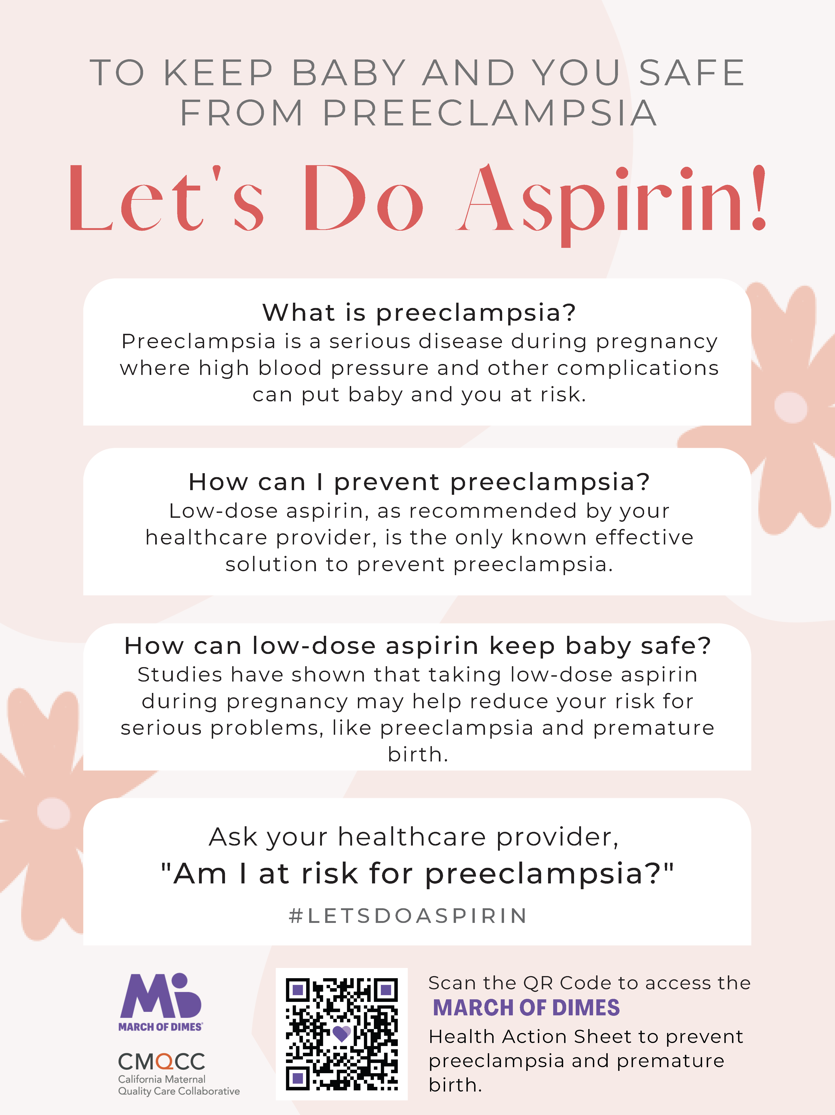
Tips for Patient Education
Address in multiple visits
Engage the expanded care team
Consider engaging family members
Provide other sources of information
Tips for practicing new strategies!
Pick one and start using it!
Build up over time
Practice with colleagues

Slide 30
Common Misconceptions

Slide 31
Safety of LDA
Misconceptions
Accurate Information
No medication is safe in pregnancy
It’s reasonable to be cautious about medications in pregnancy, but there are medications in pregnancy that are safe, including LDA. Because we are concerned about safety of medication in pregnancy, there has been a lot of attention to safety of LDA.
LDA will harm the baby.
Not only is LDA safe for the fetus, it actually benefits the fetus because it reduces the risk of preeclampsia and early delivery (preterm birth).

Slide 32
Safety of LDA
Misconceptions
Accurate Information
LDA increases risk of bleeding.
There have been lots of attention to risk of bleeding related to LDA in pregnancy. There is no evidence that LDA causes bleeding for mom/birthing person or infant.
If full dose aspirin isn’t safe in pregnancy, how is LDA safe in pregnancy?
High dose aspirin (300mg) works differently than low-dose aspirin (81-162mg). LDA reduces inflammation and promote development of the placenta. High dose aspirin can result in issues for the fetus’ heart, but this does not happen at the low dose.

Slide 33
Preeclampsia Prevention
Misconceptions
Accurate Information
Natural or holistic approaches can replace LDA.
Healthy lifestyle can help support pregnancy, but there is not a known alternative to LDA that results in prevention of preeclampsia.
I can start LDA later in pregnancy if problems arise.
LDA actually works by preventing high blood pressure and related issues before they occur. If we wait to start, the LDA won’t be able to work to prevent issues.
Prevention is when we can stop something from happening before it occurs.
I don’t have high blood pressure, so I do not need to take LDA.

Slide 34
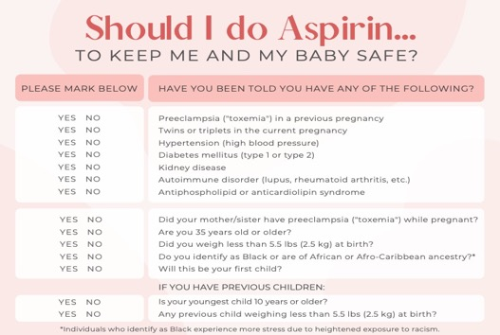
Understanding Risk
Misconceptions
Accurate Information
LDA is only needed if I had preeclampsia in a prior pregnancy.
There are risk factors for preeclampsia that we may have that do not put us in a “high-risk pregnancy” category. But, we know that these risk factors can result in more rates of preeclampsia. LDA can help reduce this risk.
I am not a high-risk pregnancy, so I do not need to take LDA.
Additional Resource:
WEBINAR: Discussing Risk Respectfully

Slide 35
Additional Resources: LDA Implementation Guide
https://www.marchofdimes.org/our-work/health-professionals/low-dose-aspirin-preeclampsia-prevention-implementation-guide

Slide 36
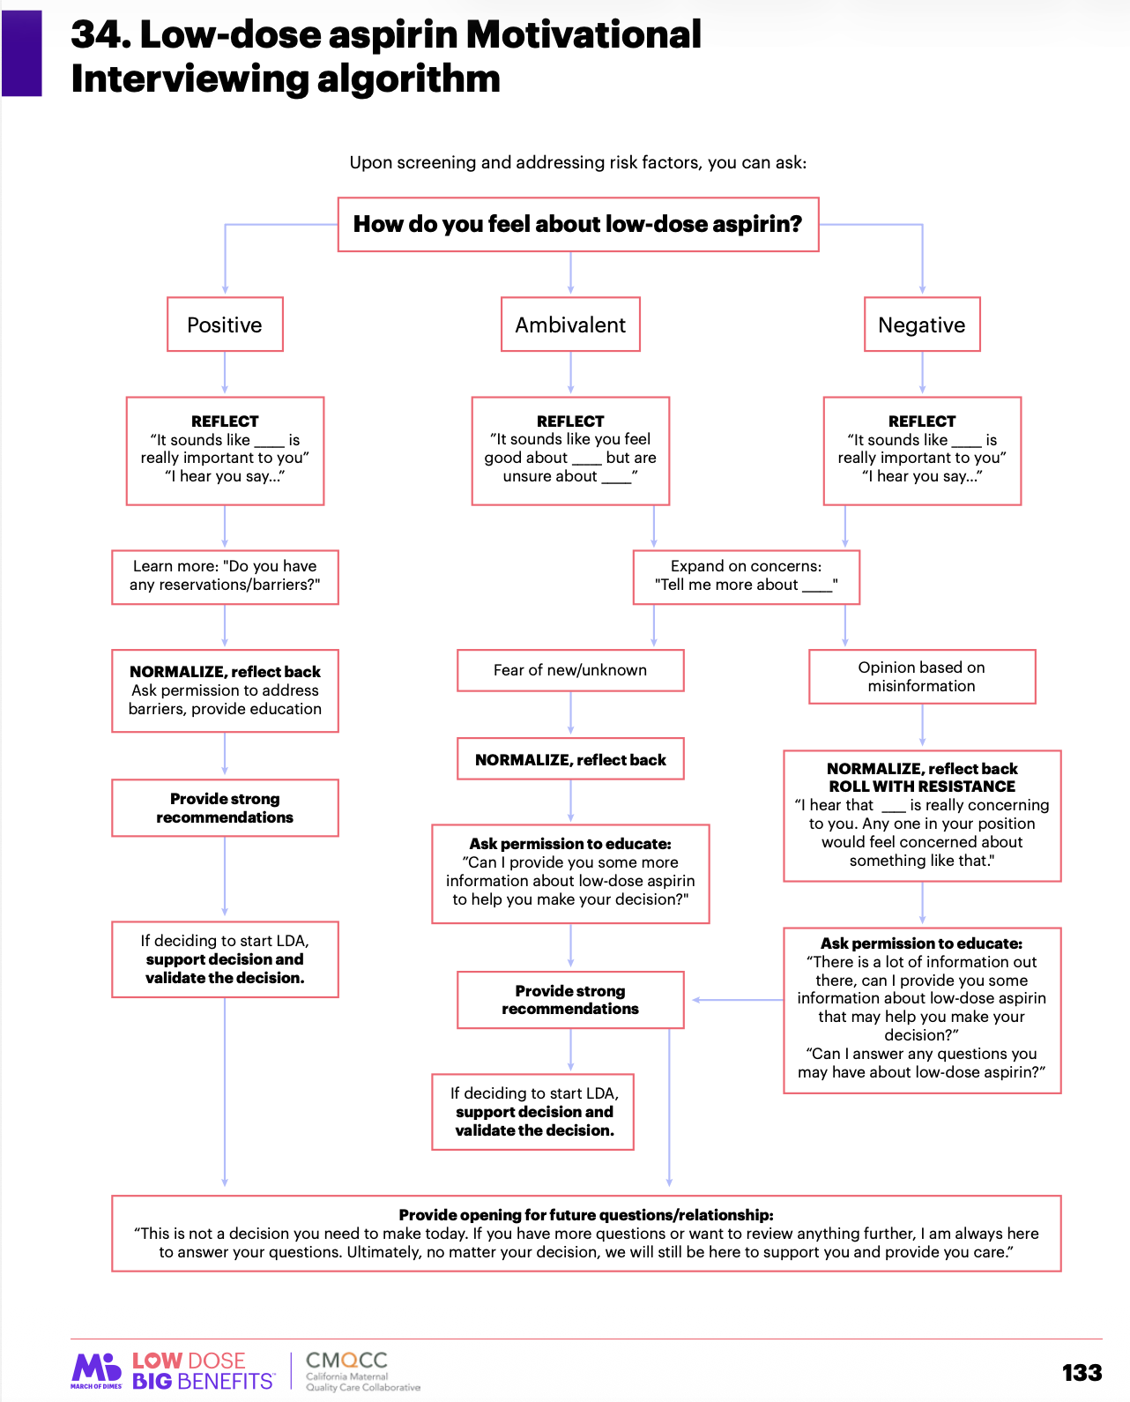
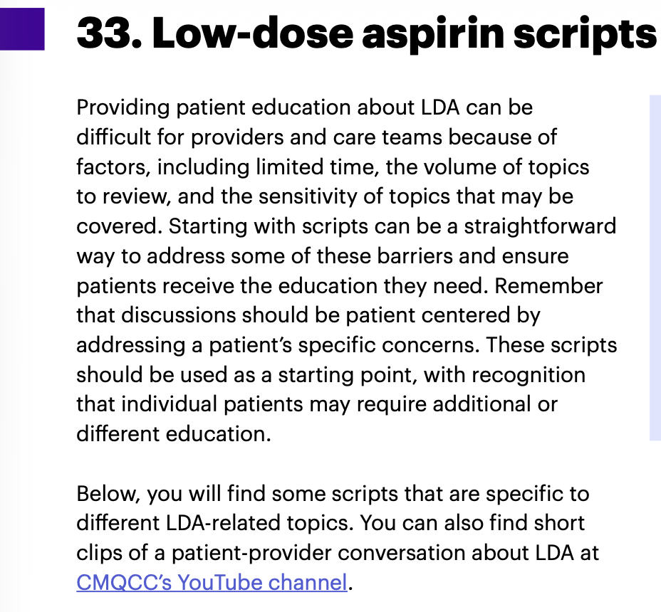
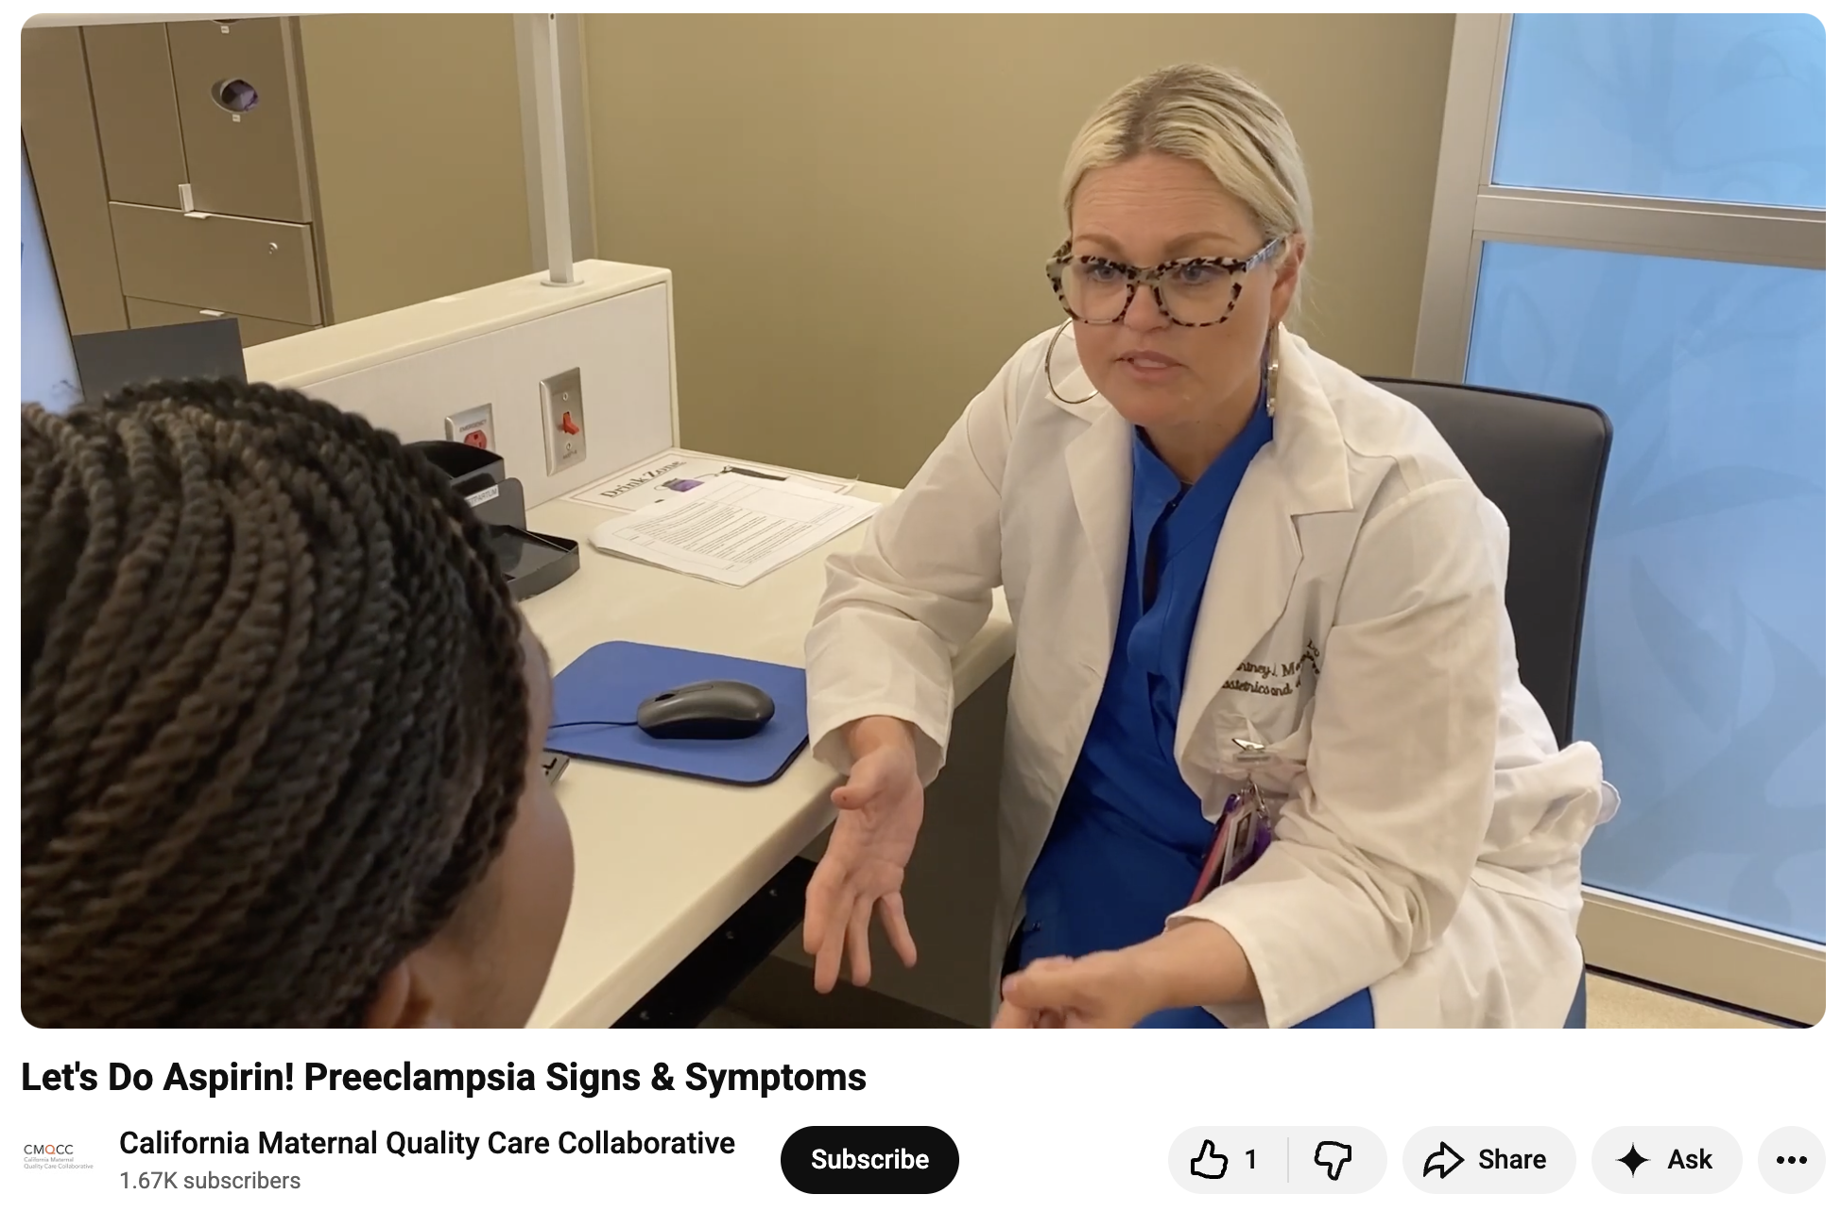
Resources

Slide 37
Putting It All Together- Example 1
Open Ended Question
Based on your screening for preeclampsia risk, you are a candidate for low-dose aspirin due to being over 35 years old and having a BMI over 30. What have you heard about low-dose aspirin before?
Patient Response
I have never taken it a previous pregnancy and I don’t think I’m high risk, so I am not sure I need it?
Reflect, Normalize, Acknowledge
So it sounds like the idea of LDA is new to you. That’s really common, I hear that from patients a lot. The recommendations have been around for a while but are now being more widely applied.
Affirm Strength
You’re right in that you are not a ”high-risk” pregnancy. Your attention to your health through healthy lifestyle is really great, and something that will continue to promote your pregnancy.
Provide Accurate Information
In addition to those healthy behaviors, LDA can give as an even better chance of not developing preeclampsia, which can make mom sick and can cause early delivery. Your risk factors don’t put you at “high-risk,” they just tell us that you would be a candidate for LDA.
Wrap up the conversation
Did you have any other questions about LDA? How do you feel about the LDA recommendation?

Slide 38
Putting It All Together- Example 2
Open Ended Question
Based on your screening for preeclampsia risk, you are a candidate for low-dose aspirin due to this being your first pregnancy and having a BMI over 30. What have you heard about low-dose aspirin before?
Patient Response
I heard that LDA isn’t actually safe to take in pregnancy.
Open Ended Question
Okay, tell me more about what you’ve learned.
Patient Response
Well, there were some other things, but I did hear that aspirin can cause bleeding. That doesn’t seem like a good idea in pregnancy.
Reflect, Normalize, Acknowledge
Okay, so your concerned about the safety of LDA, specifically related to bleeding. LDA does affect platelets, so that’s a reasonable concern.
Provide Accurate Information
Because we know that LDA has an impact on platelets, there has been a lot of attention paid to bleeding in pregnancy. The research shows that there is no increased of bleeding for mom or baby.
Affirm Strength
It’s great that you are looking for information to make decisions in pregnancy. If you ever come across something that you want to talk about in more detail, feel free to bring it up in our appointments.
Wrap up the conversation
What other questions do you have any other questions about LDA? How do you feel about the LDA recommendation?

Slide 39
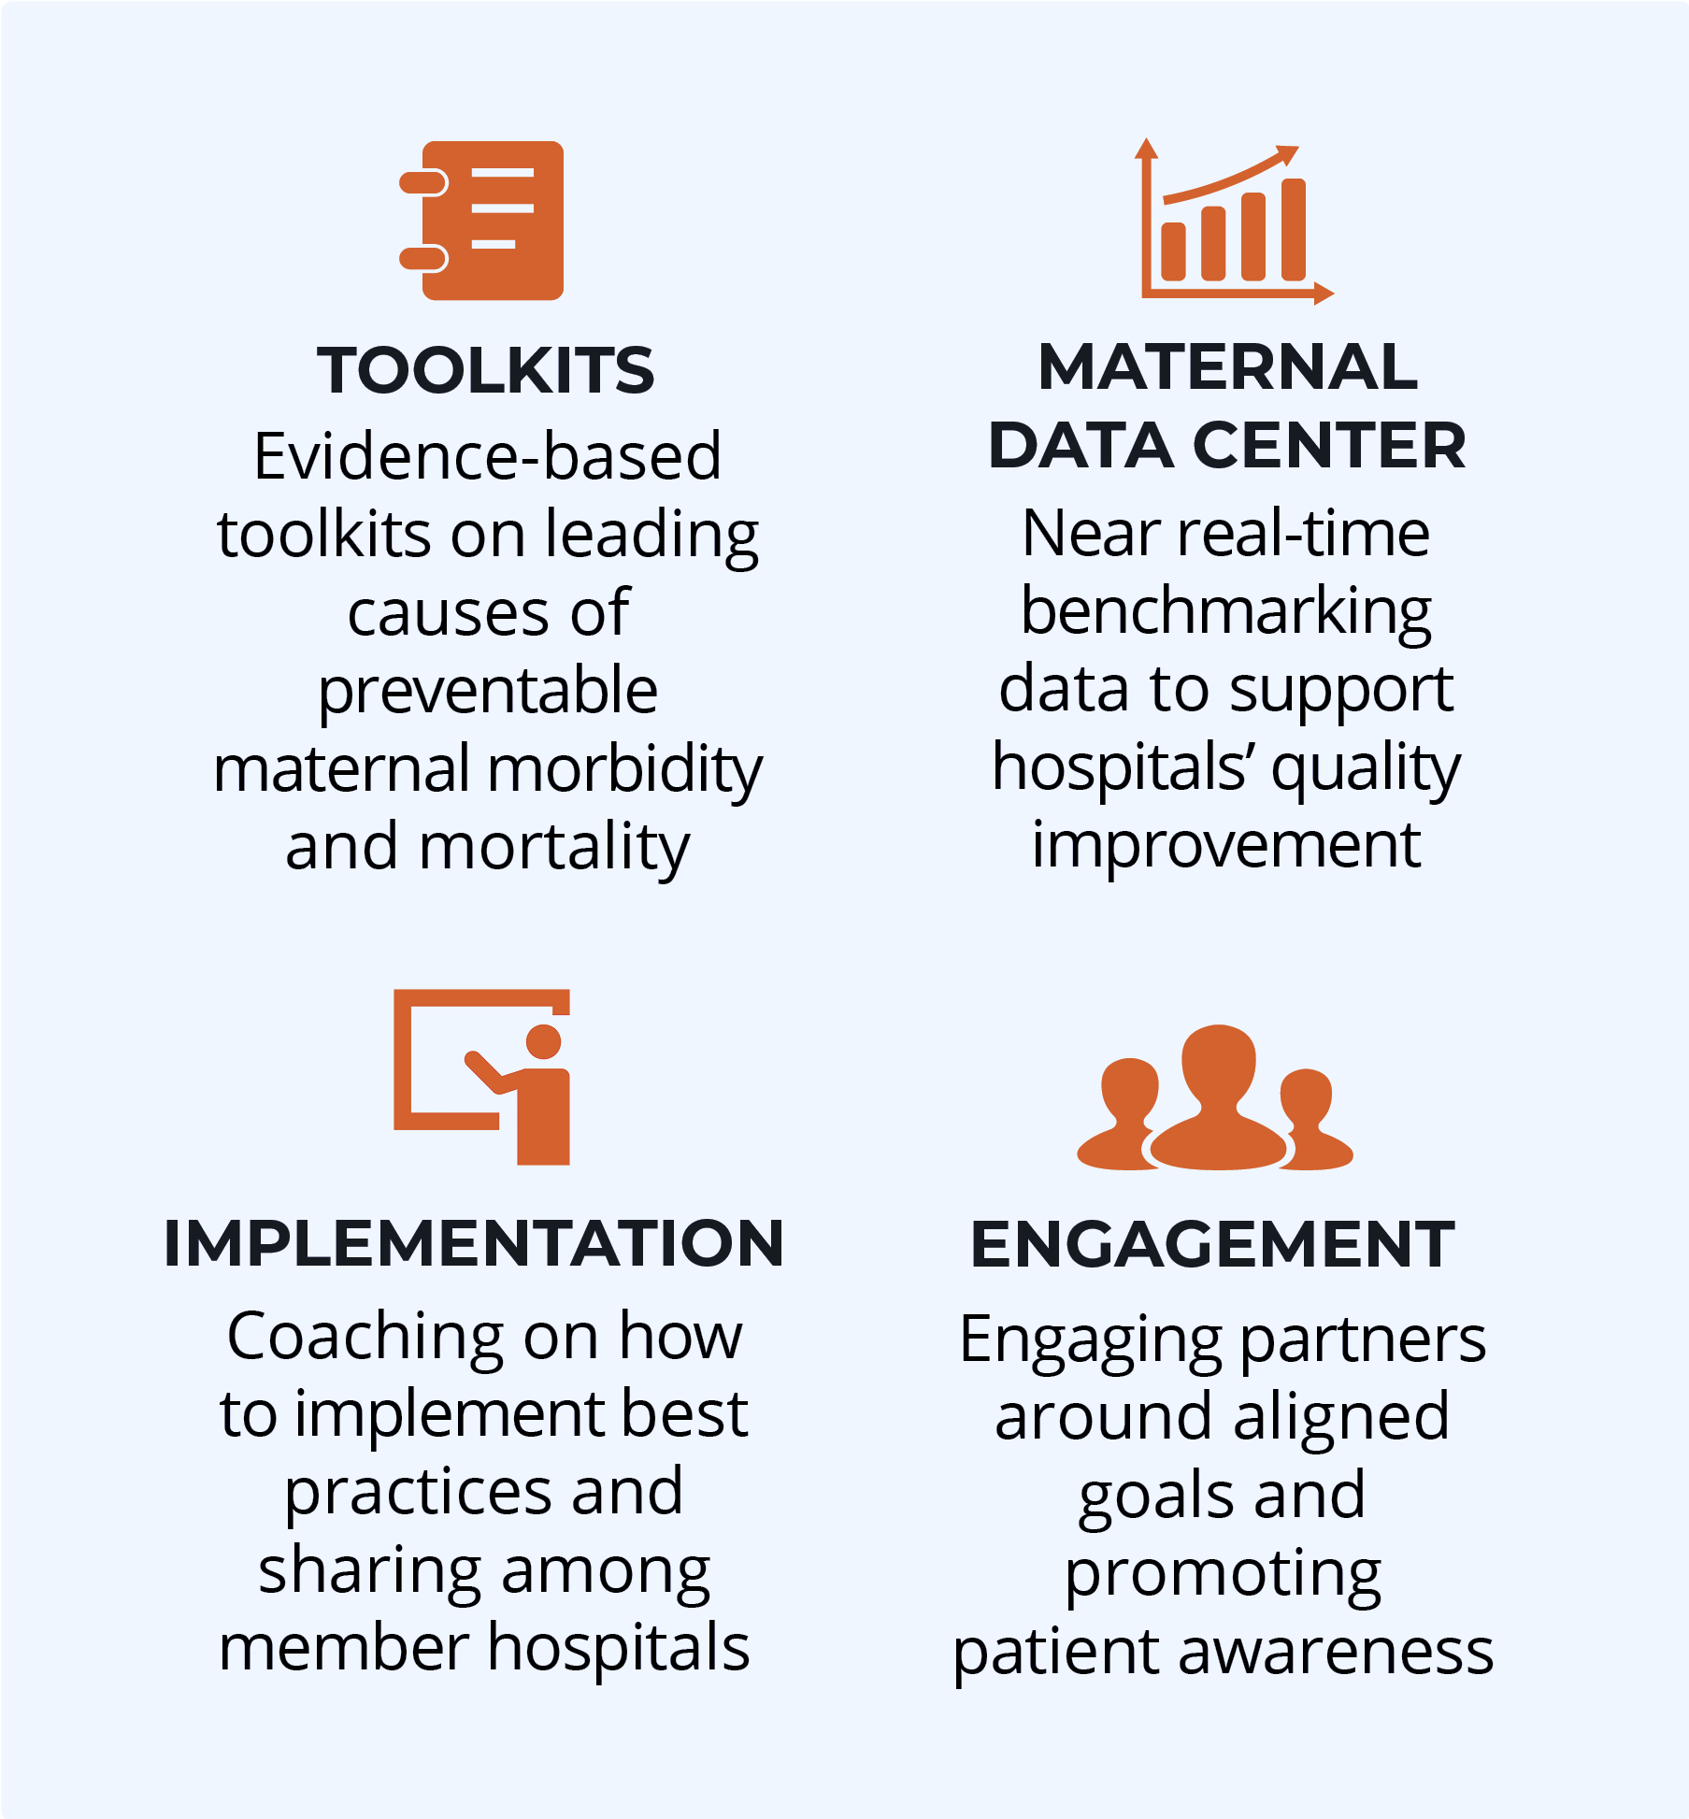
Thank You!
Follow us! Facebook, Instagram, X (Twitter), and LinkedIn: @CMQCC
https://www.cmqcc.org/quality-improvement-toolkits/low-dose-aspirin-prevent-preeclampsia-and-preterm-birth-initiative
Notes:
Access the LDA Project Resources

Slide 40
References
Boakye, E., MD, MPH, & Obisesan, O., MD, MPH (2021, December 20). Nativity-Related Disparities in Preeclampsia and Cardiovascular Disease Risk Among a Racially Diverse Cohort of US Women. JAMA Network Open. Retrieved November 30, 2023, from doi:10.1001/jamanetworkopen.2021.39564
Combs, C. A., MD, Ph.D., Kumar, N. R., MD, Morgan, J. L., MD, & SMFM Patient Safety and Quality Committee (2023). Society for Maternal-Fetal Medicine Special Statement: Prophylactic low-dose aspirin for preeclampsia prevention—Quality metric and opportunities for quality improvement. American Journal of Obstetrics and Gynecology, Volume 229(Issue 2), PB2-B9. https://doi.org/10.1016/j.ajog.2023.04.039
Henderson, J.T., PhD, MPH, Vesco, K.K. MD, MPH, Senger, C.A., MPH (2021). Aspirin Use t Prevent Preeclampsia and Related Morbidity and Mortality, Updated Evidence Report and Systematic Review for the US Preventive Services Task Force. Journal of the American Medical Association (JAMA), 326(12), 1192-1206.
Johnson, J. D., MD, & Louis, J. M., MD, MPH (2020). Does race or ethnicity play a role in the origin, pathophysiology, and outcomes of preeclampsia? An expert review of the literature. Ajog.org.
March of Dimes (2021, May 11). High blood pressure, preeclampsia and pregnancy. Healthy Mom Strong Babies. Retrieved October 1, 2023, from https://www.marchofdimes.org/find-support/blog/high-blood-pressure-preeclampsia-and-pregnancy
Parrinella, K., Wong, M.S., Wells, M., Gregory, K.D. (2022), Identification of criteria missed by clinicians among patients not prescribed aspirin prophylaxis for preeclampsia. American Journal of Obstetrics & Gynecology, 226(1).
Poniedziałek-Czajkowska, E., Ren Y., Zhao, Y., Yang, X., Shen, C., & Luo H. (2023). Application of low dose aspirin in pre-eclampsia. Frontiers in Medicine (10), https://www.frontiersin.org/journals/medicine/articles/10.3389/fmed.2023.1111371/full
Singh, N., MD, Shuman, S., MHS, Chiofalo, J., MPA, Cabrera, M., MD, & Smith, A., DO (2023). Missed opportunities in aspirin prescribing for preeclampsia prevention. BMC Pregnancy and Childbirth, 23(717), 1-6. https://bmcpregnancychildbirth-biomedcentral-com.laneproxy.stanford.edu/articles/10.1186/s12884-023-06039-w
SMFM Patient Safety and Quality Committee, Combs, C. A., MD, PhD, & Montgomery, D. M., MD (2019). American Journal of Obstetrics and Gynecology, Volume 223(Issue 3), PB7-B11. https://doi.org/10.1016/j.ajog.2020.06.003
Vinogradov, R., Smith, V.K., Robson, S.C.., Araujo-Soares, V. (2021). Aspirin non-adherence in pregnant women at risk of preeclampsia (ANA): a qualitative study. Health Psychology & Behavioral Medicine, 9(1), 681-700.

