Slide 1
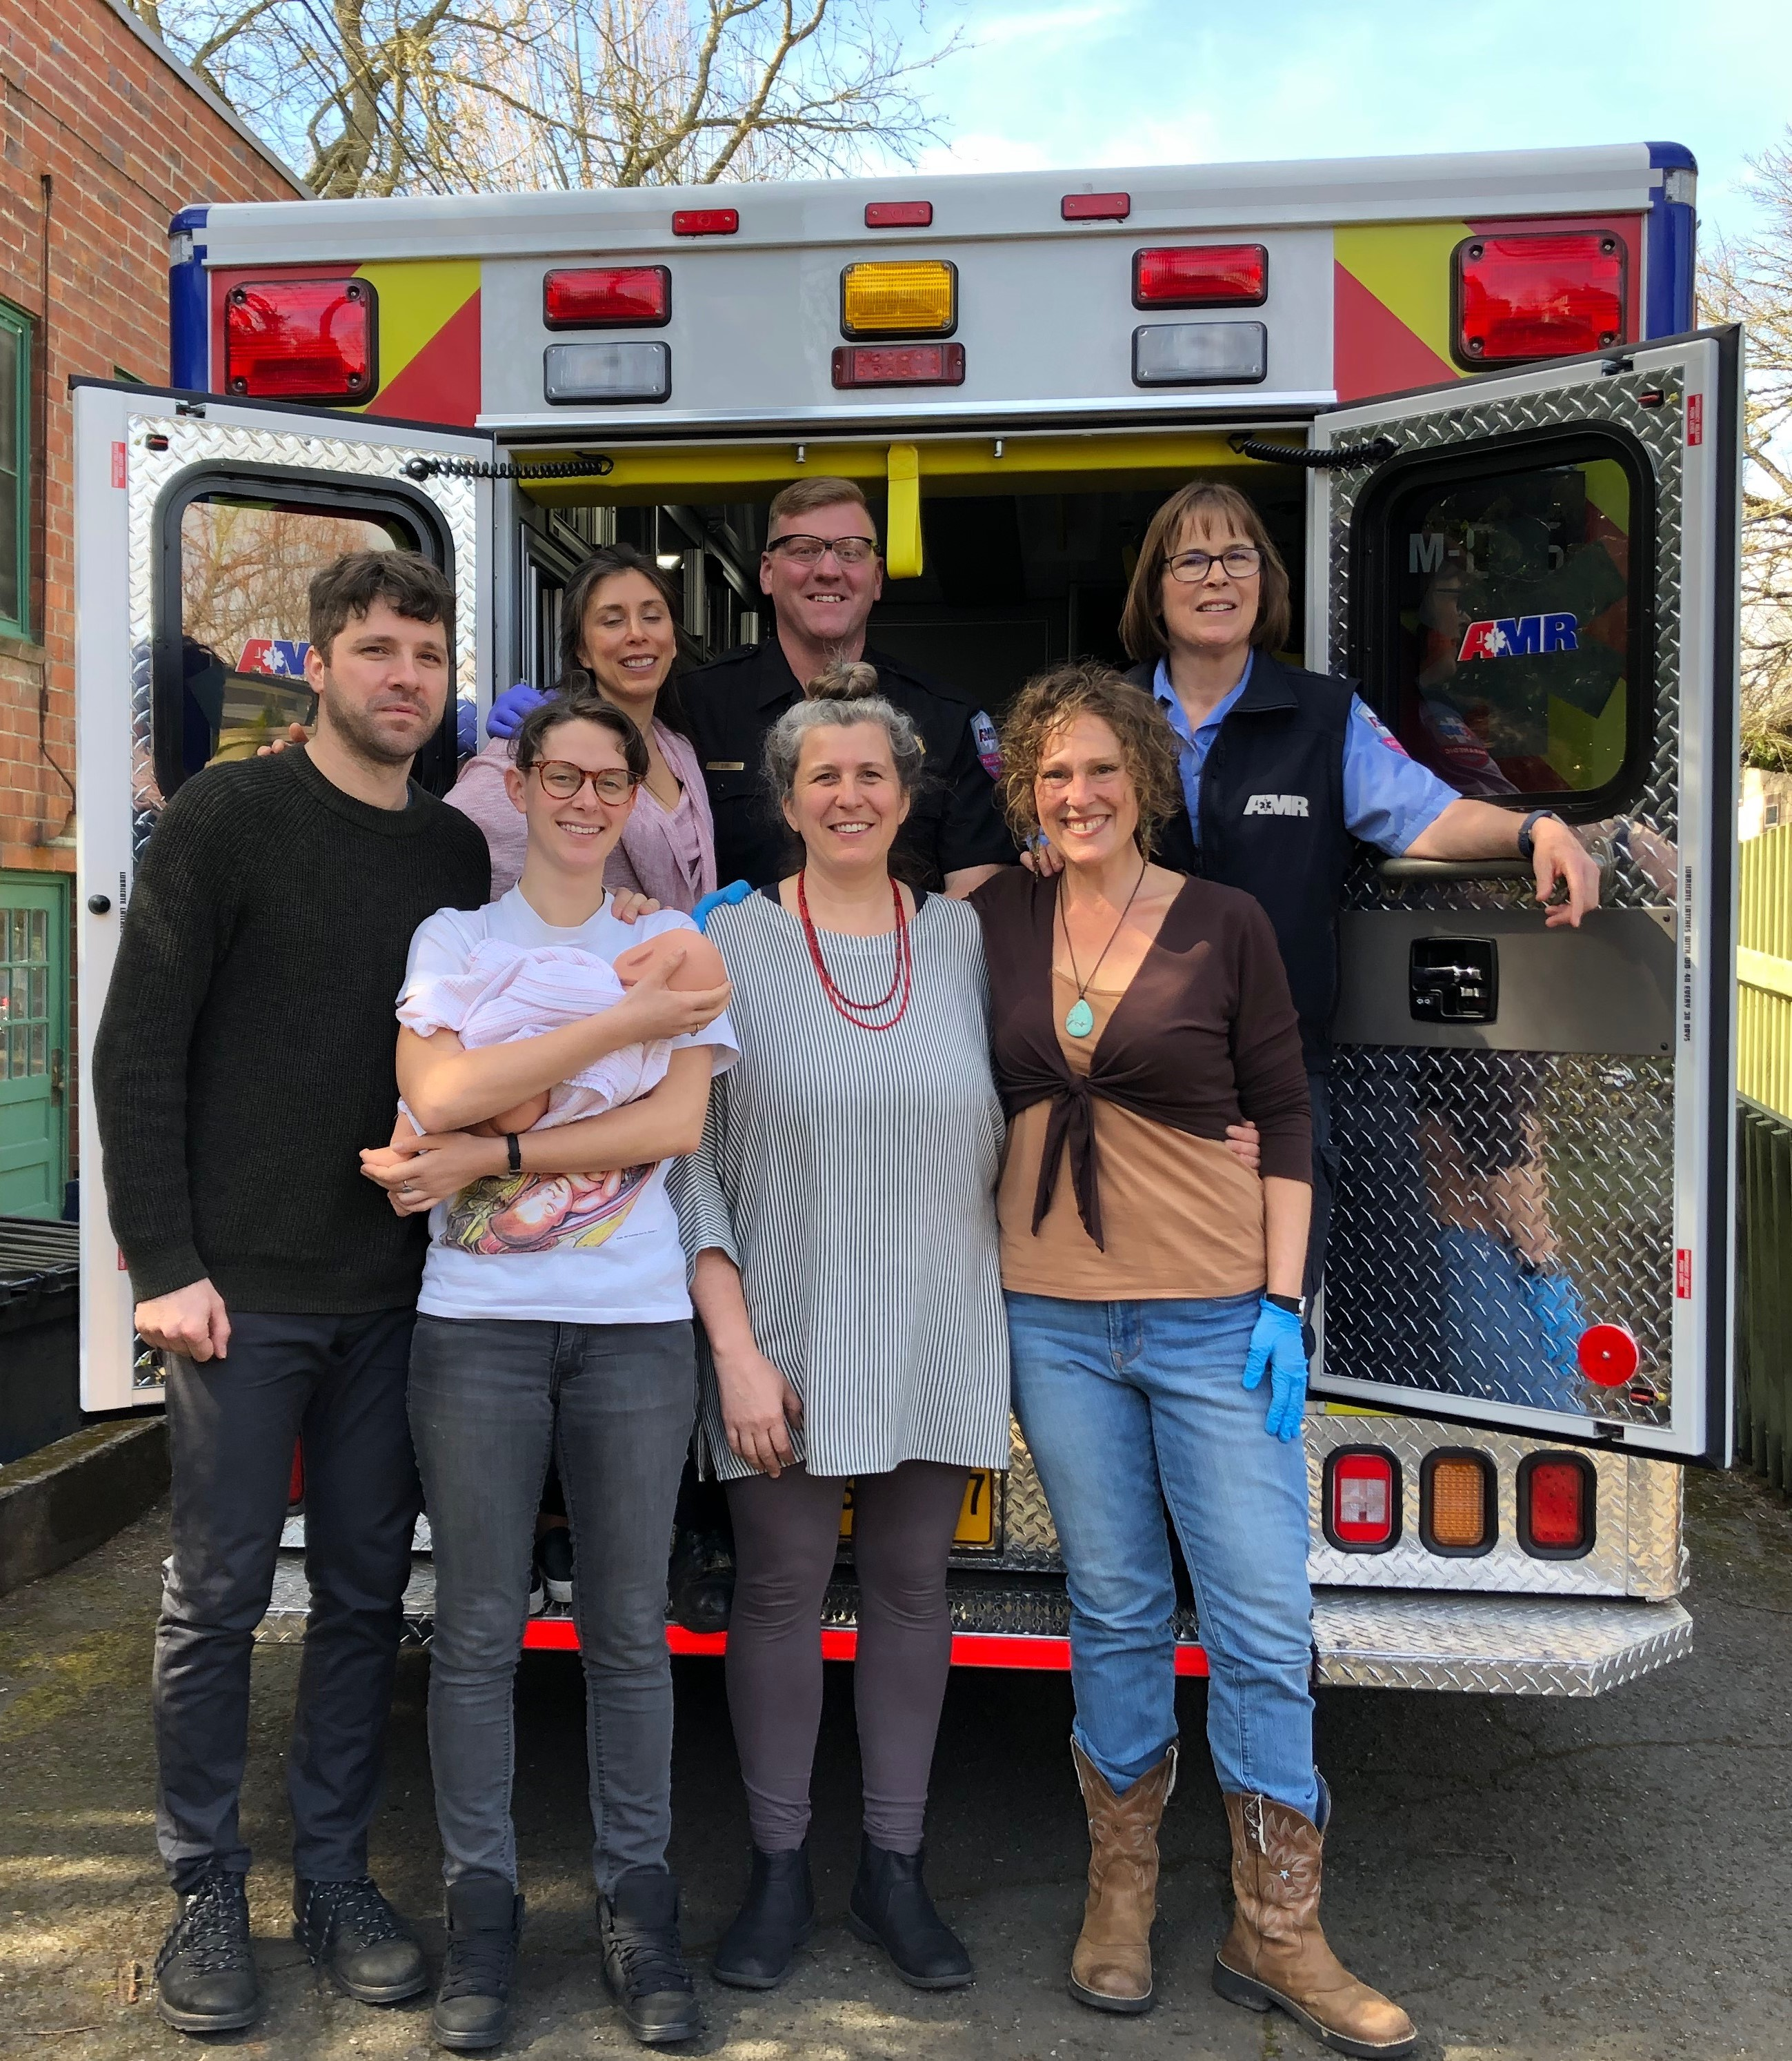
The Role of Community Birth in Improving Outcomes:
Insights, Strategies, & Tools for an Integrated Care Continuum
Presenters:
Silke Akerson, MPH, CPM, LDM
Blair Dudley, MPH
Panelists:
Melissa Denmark, LM, CPM
Kimberly Durdin, LM, CPM, IBCLC
Madeleine Wisner, LM, RM, IBCLC
Facilitator: Holly Smith, MPH, CNM, FACNM
Notes:
1

Slide 2

Housekeeping
All attendees are muted upon entry
Questions will be answered at the end of the webinar and as time allows
The webinar is recorded and will be available from the CMQCC website within 3-7 business days
The slides will also be available for free download from the CMQCC website, www.cmqcc.org

Slide 3
Instructions
You are welcome to use any of the slides provided for educational purposes
If you modify or add a slide, please substitute your institutional logo and do not use the CMQCC logo
We welcome your feedback and recommendations for improving the slide set

Slide 4
This slide set is considered an educational resource but does not define the standard of care in California or elsewhere. Readers are advised to adapt the guidelines and resources based on their local facility’s level of care and patient populations served and are also advised to not rely solely on the guidelines presented here.

Slide 5
Continuing Education Notice
In order to receive contact hours (RN) for this webinar, please complete the evaluation via the link, which will be sent to you 24 hours after this webinar.
You must be in attendance on the webinar for a minimum of 50 minutes for a contact hour to be awarded.

Slide 6

Inclusive Language Notice
Currently recognized identifiers such as “birthing people,” “mother,” “maternal,” “they,” “them,” “she,” “her.” and “pregnancy-capable person” are used in reference to a person who is pregnant or has given birth.
We recognize not all people who become pregnant and give birth identify as mothers or women and will use the above-recognized terms interchangeably to represent all those present in this space receiving care for pregnancy services. All persons are equally deserving of respectful patient-centered care that helps them attain their full potential and live authentic, healthy lives. The healthcare team should respect individual patient preferences regarding gendered language throughout the course of their care.
The term “family” is used to refer to any persons the pregnant or postpartum patient designates as such (alternatives: partners, husbands, wives, support persons, loved ones).
The term “clinician” is used to denote nursing and medical staff, whereas the term “provider” refers to a clinician with diagnosing and prescribing authority.

Slide 7
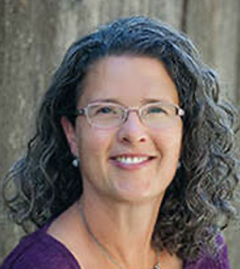


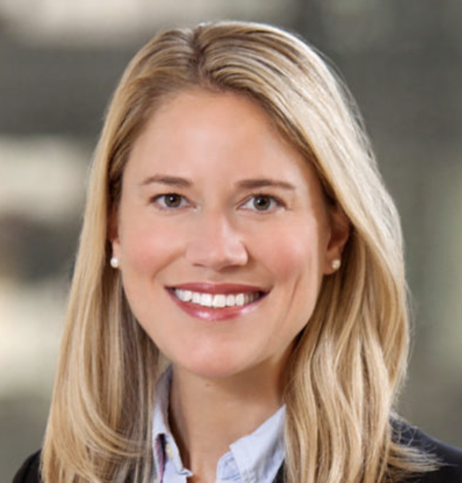


Today’s Presenters
Today’s Panelists
Silke Akerson, MPH, CPM, LDM
Blair Dudley, MPH
Melissa Denmark, LM, CPM
Kimberly Durdin, LM, CPM, IBCLC
Facilitator:
Holly Smith, CNM, MPH, FACNM
Madeleine Wisner, LM, RM, IBCLC

Slide 8
Objectives
Define community birth
Describe how community birth can improve access to care and lessen disparities in birth outcomes
Summarize the reasons for community birth to hospital transfers
Outline strategies for partnering with community birth providers to improve safety across birth settings
Review model programs for improving transfers
Identify resources for community birth partnership improvement

Slide 9
Community Birth:
  Planned home or freestanding birth center birth. Also referred to as out-of-hospital birth.
How Common is it?
  1.34 % of births in California and 2% of births nationally are community births.
  The rate of planned community births is increasing.
What is community birth?
Cheyney, M., Bovbjerg, M.L., Leeman, L. and Vedam, S. (2019), Community Versus Out-of-Hospital Birth: What's in a Name?. Journal of
Midwifery & Women's Health, 64: 9-11. https://doi.org/10.1111/jmwh.12947
MacDorman, M. F., Barnard‐Mayers, R., & Declercq, E. (2022). United States community births increased by 20% from 2019 to 2020. Birth.

Slide 10
Desire for a natural, unmedicated birth
Individualized, relationship-based care
Desire to avoid cesarean or other interventions
Fear of hospital/negative experiences in hospital
Longer appointments
Autonomy and informed choice
Direct access to care provider
Continuity of care
Religious or cultural reasons
Desire for control over their birth
Why do people choose community birth?

Slide 11
Community birth with a trained midwife can be a safe option for healthy people experiencing low-risk pregnancies.
Large body of research shows that low-risk community birth is :
  Safe for moms and birthing people
  Safe for babies
  Leads to fewer cesareans and other interventions…
When midwives can practice to their full scope, have access to smooth consultation and transfer, and are well-integrated into health care systems
National Academies of Sciences, Engineering, and Medicine. (2020) Birth settings in America: Outcomes, quality, access, and choice
Is community birth safe?

Slide 12
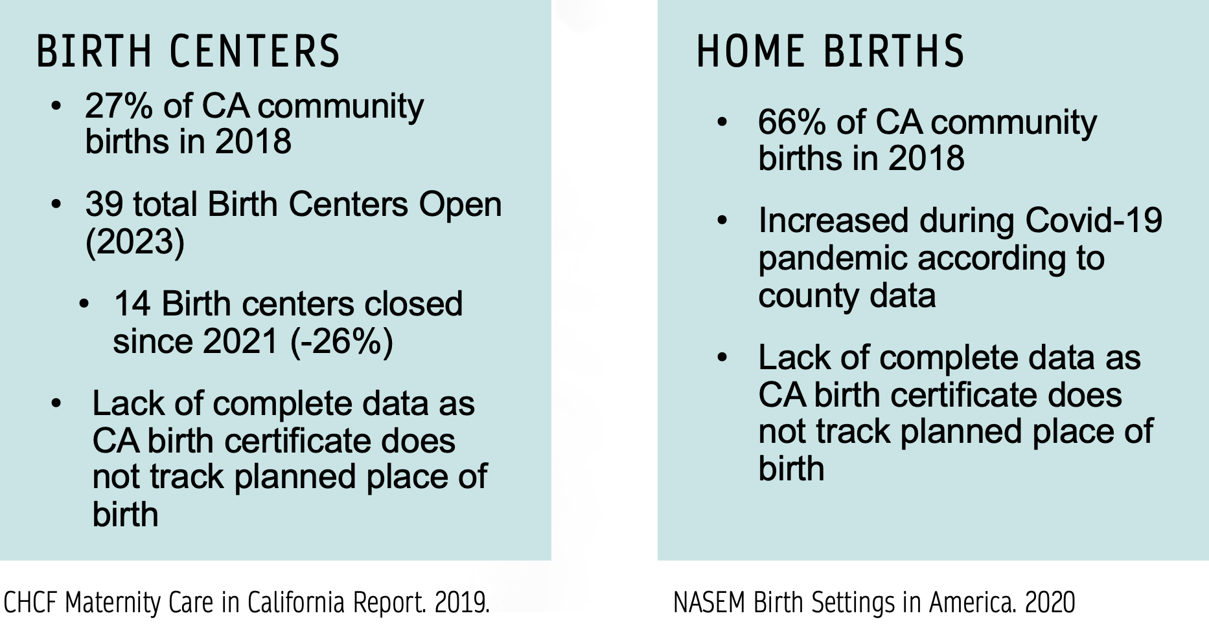
Community Birth in California
4,975 total births in 2018

Slide 13
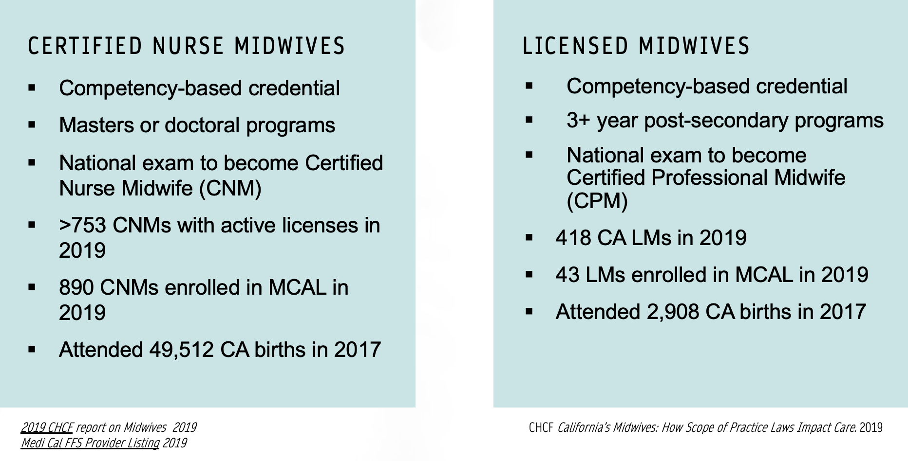
Midwives in California

Slide 14
Community Midwife Scope
Community midwives in CA (both LMs and CNMs):
Order labs, ultrasounds, and fetal surveillance tests
Monitor maternal vitals, fundal height, fetal position, + FHT prenatally
Monitor FHT during labor using Intermittent Auscultation with a doppler
Carry oxygen and equipment for newborn and maternal resuscitation
Carry antihemorrhagic medications including oxytocin, methylergonovine, misoprostil, and TXA
Can access IV fluids, antibiotics for GBS prophylaxis, and Rho(D) Immune Globulin
Carry local anesthetic and suture most lacerations

Slide 15
Community Midwife Newborn Scope
Community midwife scope includes well newborn care through 6 weeks
Community midwives provide
  Newborn exams Vitamin K prophylaxis
  Eye prophylaxis Newborn screening
  CCHD screening Assessment of jaundice
  Breastfeeding support Vitals checks
  Weight checks Assessment of development
Most babies who were born in the hospital after a transfer or who were transferred to the hospital after birth are cared for by their midwife after discharge
Community midwives refer to pediatric providers for concerns

Slide 16
More families are choosing community birth
Community birth with midwives can improve outcomes
    In low-risk pregnancies
    For BIPOC families
    In communities with poor access to care
    In rural areas
Integration of midwives and community births improves outcomes
Why does community birth matter?

Slide 17

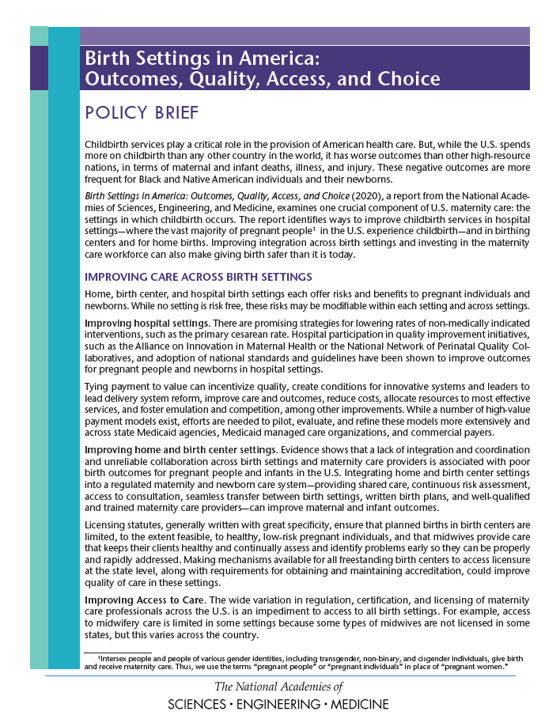


Increased access to community birth, integration of midwives, improved transfers are all possible solutions to our maternal health crisis

Slide 18
Integration of Midwives Improves Outcomes

Slide 19
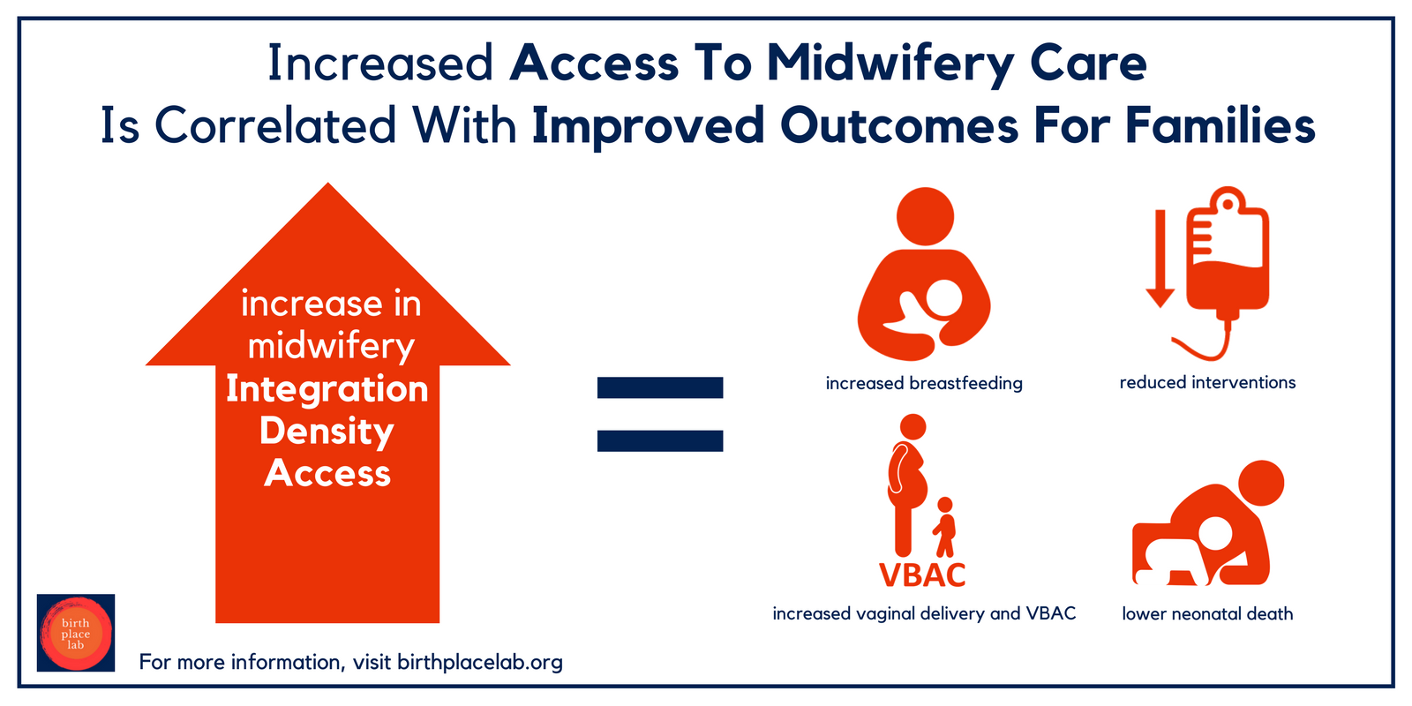
https://www.birthplacelab.org/mapping-collaboration-across-birth-settings/

Slide 20
14-20% of planned community births involve transfer of care for the birthing person or baby
Reasons for transfer:
      Pain relief or labor augmentation
  Complications arise
      Prolonged ROM, labor, or 2nd stage
      Hypertension or preeclampsia
      Postpartum hemorrhage
      Newborn respiratory issues
  Emergent transfers are rare
Smooth transfers are essential to community birth outcomes
Community Birth Transfers

Slide 21
Receiving Provider Experiences of Community Birth Transfers
“The biggest fear is that something bad will happen to a mother or baby and you will have to carry that. . . . During a transport, we get exposed to practices we are not comfortable with, like women declining antibiotics for group B strep or not wanting a baby to have vitamin K administered. In our typical patient base, these things are declined relatively infrequently. What we are used to is what we are most comfortable with. It is scary to work outside our comfort zone.”
“It is true that few transports are emergencies, but what really frustrates me is what I would call mismanagement. You know, the water has been broken for three days, or she’s been dilated to six centimeters for twelve hours. That’s not an emergency, but it’s also not good care! Why gamble with high-risk situations?”
(Cheyney, et al. 2014)

Slide 22
Midwives, EMS, receiving providers, and nurses work as a care team during transfers, and we need training and systems to support this
Midwives transfer sooner when they have good relationships and positive experiences with receiving hospital providers
Clinical outcomes and patient experience are both improved when midwives and hospital providers work smoothly together
Community birth transfer reception and relationships vary widely between hospitals
So how can we improve community birth transfers?
Community Birth Transfers

Slide 23
ACOG Committee Opinion
Although the American College of Obstetricians and Gynecologists believes that hospitals and accredited birth centers are the safest settings for birth, each woman has the right to make a medically informed decision about delivery.
Several factors are critical to reducing perinatal mortality rates and achieving favorable home birth outcomes (including) ready access to consultation and access to safe and timely transport to nearby hospitals.
When antepartum, intrapartum, or postpartum transfer of a woman from home to a hospital occurs, the receiving health care provider should maintain a nonjudgmental demeanor with regard to the woman and those individuals accompanying her to the hospital.
Committee Opinion Number 697, April 2017

Slide 24

Stakeholder summits to improve safety and accessibility of home birth
Met in 2011, 2013, 2014, and 2019
Included midwives, physicians, nurses, consumers, researchers, insurers, and lawyers
Consensus materials developed including Best Practice Transfer Guidelines:
    Maternal and newborn transfer forms
    Model practices for community midwives
    Model practices for hospital providers and staff
    Recommendations for quality improvement and policy
    https://www.homebirthsummit.org/ (Vedam et al., 2014)
Home Birth Summit

Slide 25


First US statewide transfer improvement program
  Created by Washington State Perinatal Collaborative and Midwives Association of Washington
  Now housed within the Foundation for Health Care Quality
Model program for other states:
  Statewide coordination and facilitation
  Hospital-level transfer improvement committees
  Data collection through surveys and annual hospital data
Valuable wisdom from Smooth Transitions:
  Data collection is essential to transfer improvement
  Transfer improvement is a systems issue
  We have shared responsibility for patient safety
  Transfer improvement needs to involve policymakers, public health, and health systems, not just community midwives and providers
  https://www.qualityhealth.org/smoothtransitions/ (Washington State Perinatal Collaborative, 2015)
Smooth
TransitionsTM

Slide 26
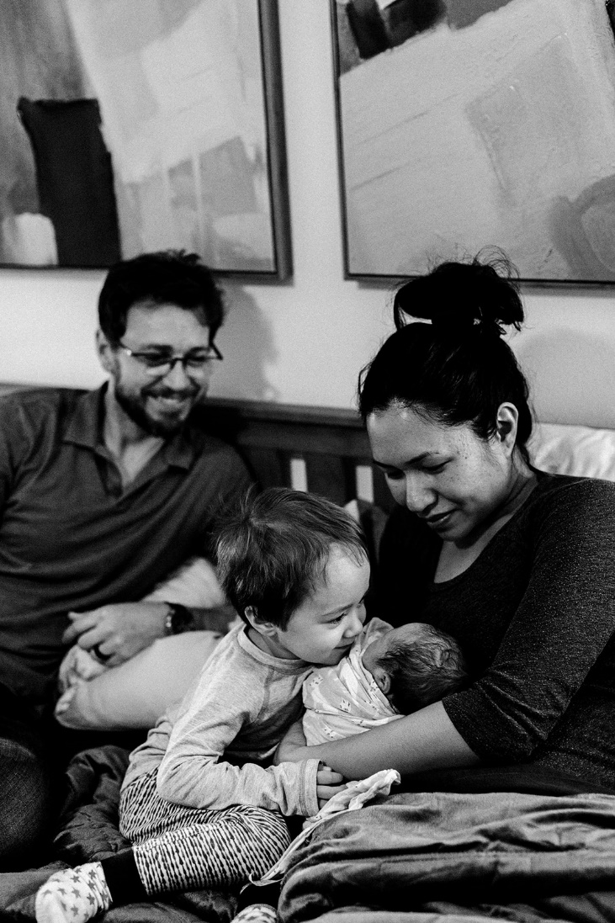
Mission: To realize a mutually respectful and integrated healthcare system that supports patient/client safety and satisfaction and increases community midwife and hospital collaboration when transfer occurs from community birth to hospital settings.
Goals:
Eliminate barriers to safe and timely transfers from planned community birth settings to in hospital care settings.
Increase consumer engagement in advocacy and quality improvement efforts related to safe transfers of care.
Promote interprofessional collaboration to encourage productive, collegial relationships grounded in respectful, patient/client-centered care.
Expand skills, knowledge, and relationships through meaningful interprofessional case reviews and continuing education.
Oregon Community Birth Transfer Partnership

Slide 27
Getting Started with Transfer Improvement
1
2
3
4
Host a transfer improvement presentation
Identify clinician champions
Establish a Transfer Improvement Committee
Develop and adopt transfer tools
Notes:
Silke

Slide 28
Transfer Improvement Committees meet 2-4 times a year to:
  Strengthen relationships
  Review what is and is not working with transfers
  Start using transfer surveys
  Address safety concerns
  Improve tools and practices
  Engage in joint continuing education and simulation
  Review annual benchmarking data
^{Transfer Improvement}
^{Next Steps}

Slide 29
Oregon CBTP Program Development and Equity
Goal: Create a program that is responsive to the lived experience of patients/clients who experienced community birth transfer with special attention to BIPOC, LGBTQ, and disabled people
Actions:
Convened statewide, broad stakeholder steering committee
Distributed survey with equity questions to patients/clients
Held focus groups
          Persons of color
          Maternal transfers
          Admission to NICU

Slide 30
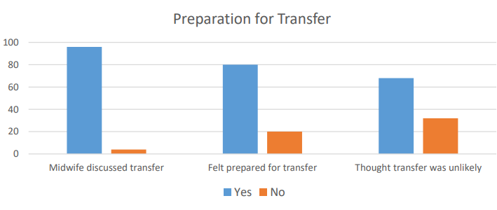
CBTP Key Findings: Preparation for Transfer

Slide 31
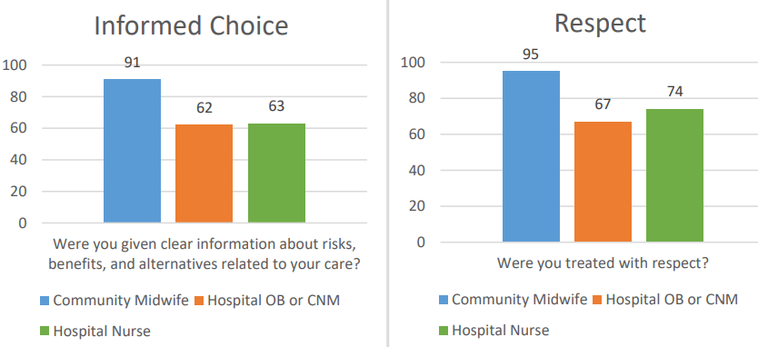
CBTP Key Findings: Informed Choice + Respect

Slide 32
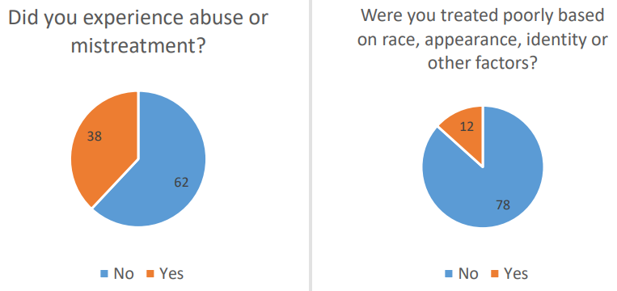
CBTP Key Findings: Mistreatment + Abuse

Slide 33
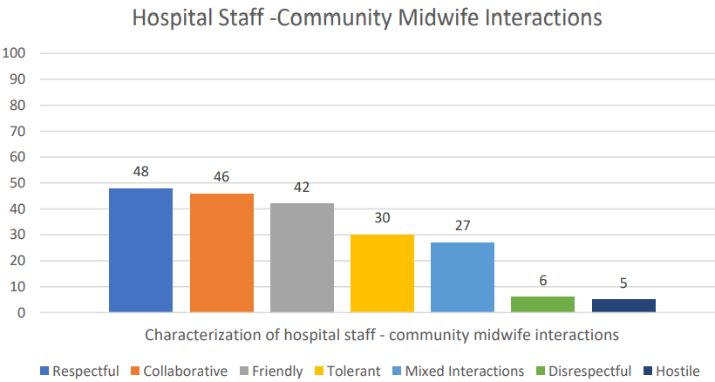
CBTP Key Findings: Hospital-Midwife Interactions

Slide 34
People want their community midwife with them and experienced her presence as supportive, comforting, and protective.
Many described their midwife as an interpreter between the two worlds/cultures/approaches.
Kindness, respect, and autonomy related to informed decisions were the most important elements of the transfer experience
Mothers felt positive about their transfer experience when they felt like their midwife was included in collaborative care.
People wanted their community midwife with them in the OR during a cesarean section
^{CBTP Survey Takeaways}

Slide 35
CBTP Focus Group Recommendations
SLOW DOWN AND LISTEN
RECOGNIZE US AS WHOLE PEOPLE
TALK US THROUGH WHAT IS ABOUT TO HAPPEN
OFFER KINDNESS AND GENTLENESS
DON’T SHARE INFORMATION OR TALK ABOUT DECISIONS DURING CONTRACTIONS
PARTNER WITH THE BIRTHING PERSON AS AN ACTIVE MEMBER OF THE CARE TEAM
OFFER EMPATHY ABOUT WANTING A HOME BIRTH AND ABOUT THE CHALLENGES OF A HOSPITAL TRANSFER
CHECK-IN AND ANSWER QUESTIONS AFTER AN EMERGENCY OR SURGERY

Slide 36
CBTP BIPOC Focus Group Key Points
Fear of giving birth in the hospital because of the experiences of black individuals who have not been listened to or believed about their concerns in hospital care.
Cultural roots/origins of community birth:
“I think that the medical community, hospitals and clinics specifically need to have an awareness that some people’s preference for more like natural or low-intervention birth is cultural and not just like some hippie new age movement. That it’s actually a return to roots and actually very important on like a spiritual level for people.”
Felt looked down upon for choosing an “unsafe” option in seeking community birth by hospital providers who didn’t understand that real fear of hospital care exists.
Trust relationship with their midwives that they relied on in an unfamiliar or distressing situation. They described their midwife as a translator, explaining things in language they understood. When their community midwife had relationships with the hospital, they felt like it eased the experience of transfer

Slide 37
“Treat someone else how you want to be treated… like I am a human being, you are a human being, I am capable of making decisions, you are capable of making decisions…. We might have completely different beliefs and we might have completely different value systems and like that's fine and that's something that… Yes, I may believe something different, but that doesn't mean that my belief is wrong and that doesn't mean that I am any less than anybody else.”
Notes:
RACHEL

Slide 38

Community midwives prepare clients for the possibility of hospital transfer
EMS and community midwives train to work as a coordinated team
Community midwives provide a warm hand-off at hospital and use transfer forms
Hospital-level transfer improvement committees meet regularly to prepare for transfers
  Committees include community midwife, EMS, maternal, and newborn teams
Hospital staff receive transferring patients without judgement
Hospital staff acknowledge potential fear/stress of change in birth plan:
  “I know this is not what you planned. Is there anything we can do to help you in this transition to the hospital?”
Birthing people are treated with respect as autonomous decision-makers
Community midwives are welcomed as members of the team during hospital transfers
Community midwives are included in state PQCs and other QI work
Transfer Improvement Best Practices
(See also the CMQCC Toolkit To Support Vaginal Birth, Table 43 – Key Strategies for Integration and Improved Safety Across Birth Settings)

Slide 39
“Amazing! The obstetrician really respected my midwife's knowledge and let her be actively involved in helping me labor. They collaborated and explained things together for me. I was so impressed, pleased and grateful.”
“The nurse-midwives at the hospital were amazing. They let me push in many different positions and were such cheerleaders. Also, my home birth midwives were in the room the whole time and that really helped. Especially when we had decisions to make that we hadn't thought out yet, it was great to get information from them.”
^{When Transfers}
^{Go Well}

Slide 40


Transfer Tools for Hospital Providers
1.5 hour CE course
Consensus curriculum co-created by midwives, physicians, and EMS providers
https://www.hivece.com/courses/tools-for-receiving-transfers
Oregon EMS and Trauma Webinar Series: Working with Community Midwives for Smooth Hospital Transfers
Free 1-hour CE webinar for the Oregon Health Authority EMS and Trauma program
https://tinyurl.com/OHAEMS
^{Continuing Education Resources}

Slide 41

Alliance for Innovation on Maternal Health
Community Birth Transfer Improvement Toolkit
^{Coming Soon in 2024!!}

Slide 42
What is possible if we work together?
We know that improvement is possible and there are resources
We know that integration of midwives improves outcomes for the whole state
We know that consulting and receiving physicians, nurse-midwives, and nurses are important for safe community midwifery care
We know that the practices and attitudes of receiving hospitals can impact outcomes and experience of care
We can work together to create a collaborative and integrated system to support excellent and safe care in all birth settings!

Slide 43
Thank you!
Silke Akerson, MPH, CPM, LDM
silkeakerson@gmail.com

Slide 44
The Role of Community Birth in Improving Access and Outcomes
October 25, 2023
Notes:
Blair

Slide 45
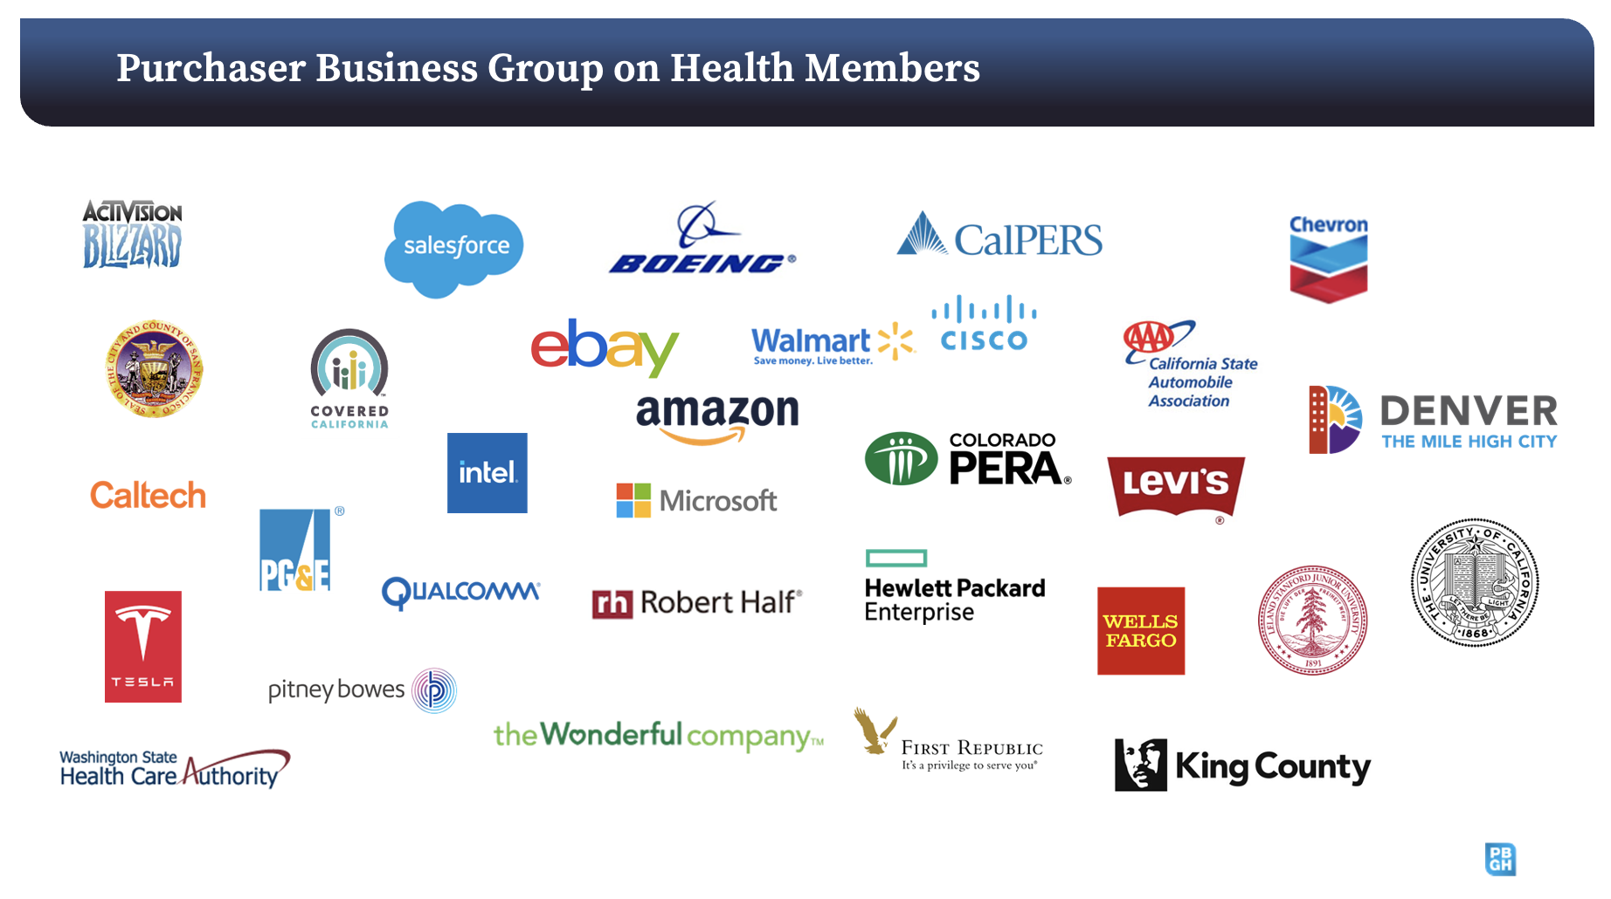
Notes:
Blair

Slide 46

Notes:
Blair

Slide 47
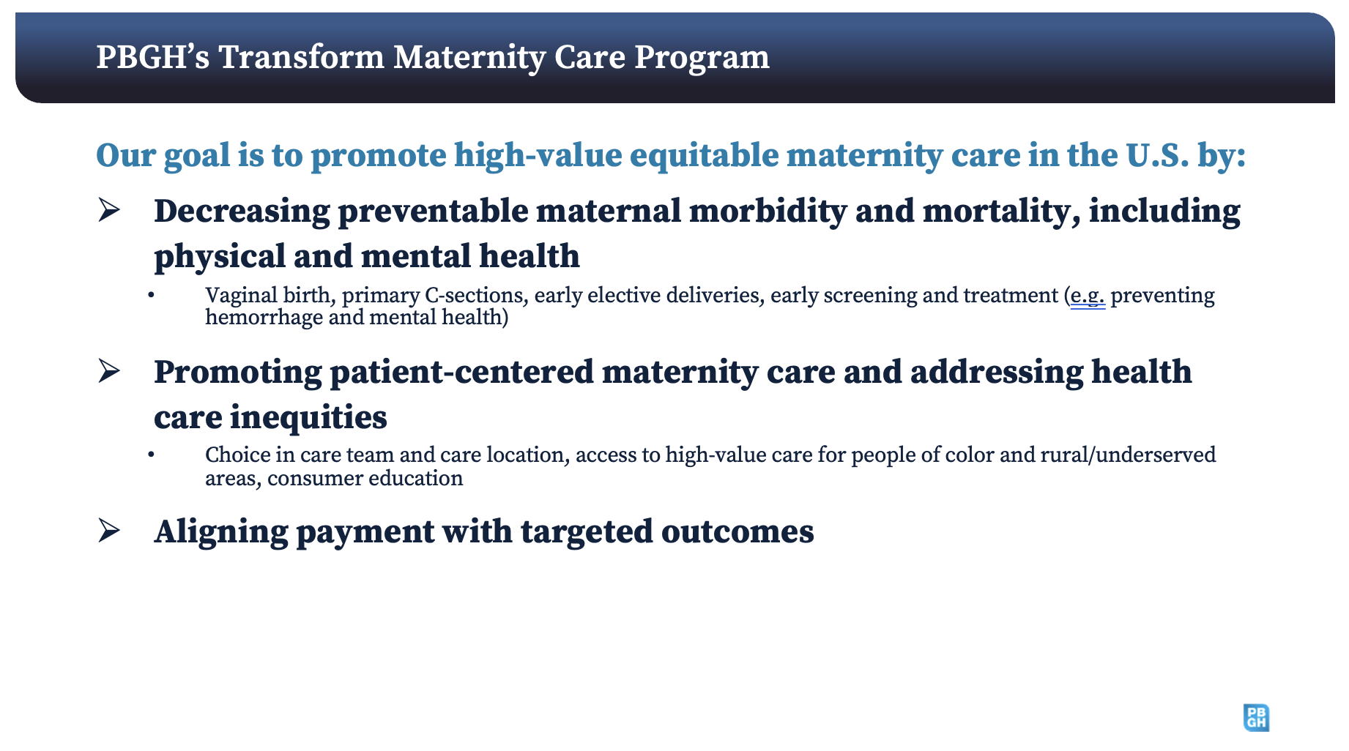
Notes:
Blair

Slide 48
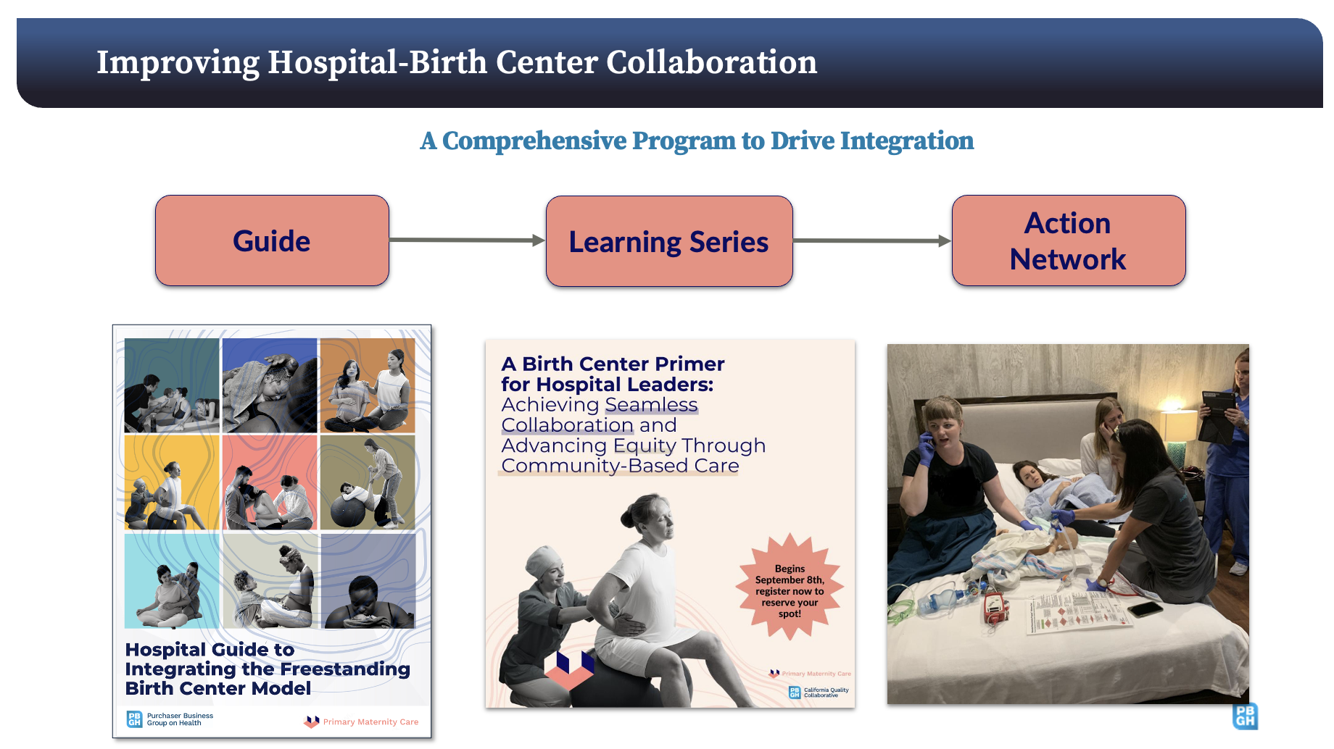
Notes:
Blair

Slide 49
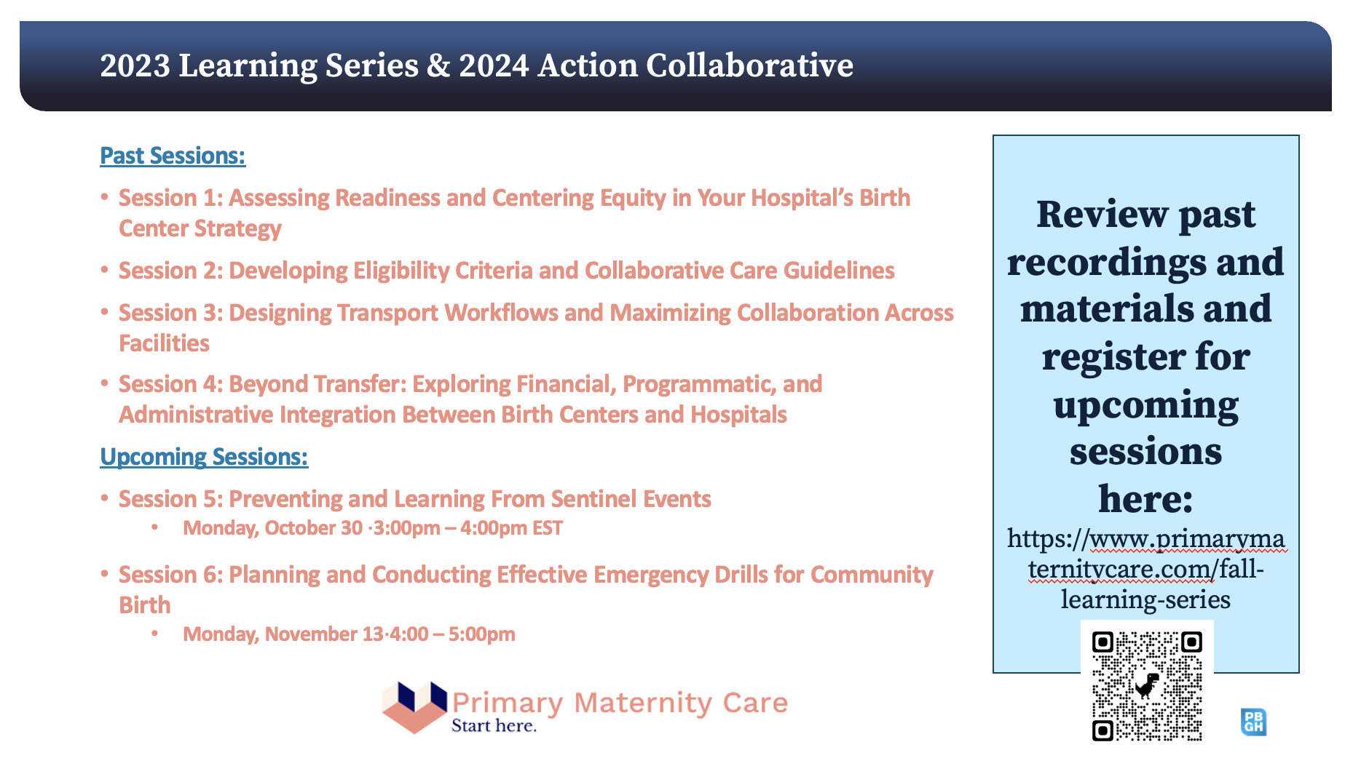
Notes:
Blair

Slide 50
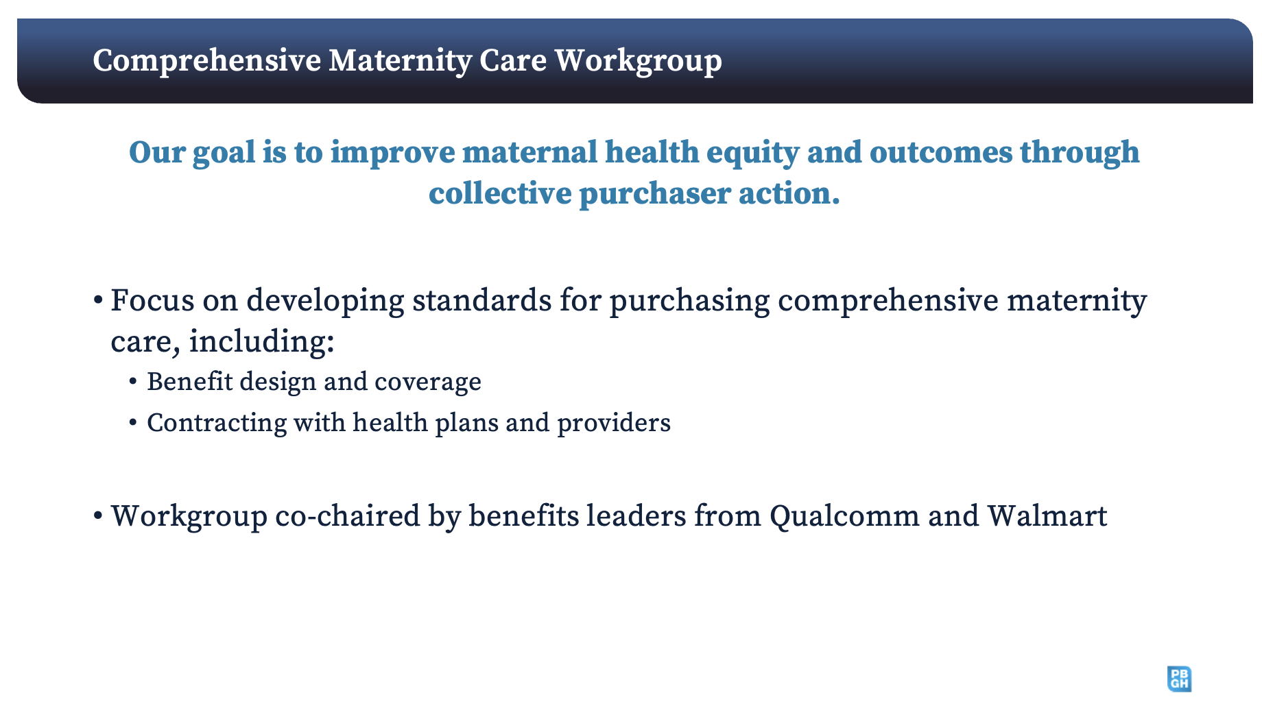
Notes:
Blair

Slide 51
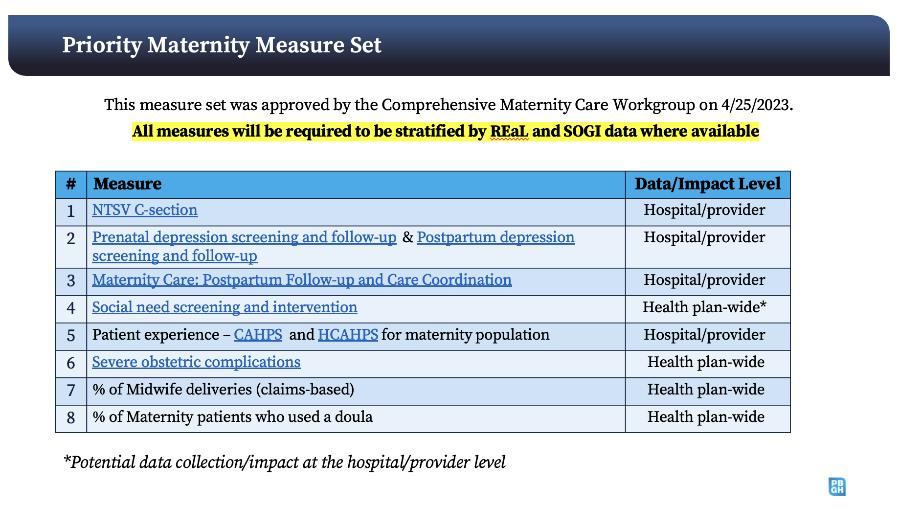
Notes:
Blair

Slide 52


Slide 53
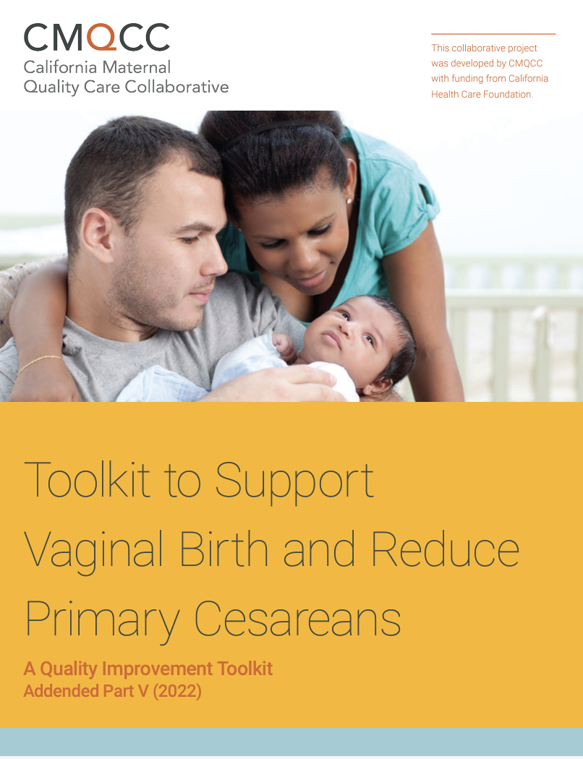

More Community Birth and Transfer Resources in Part V of the Toolkit to Support Vaginal Birth! visit https://www.cmqcc.org/VBirthToolkit
The previous 3 webinars in this series are located here:
https://www.cmqcc.org/resources-tool-kits/webinars
(Team-based care, Midwifery Integration, and Partnering with Doulas)
Notes:
Holly

Slide 54
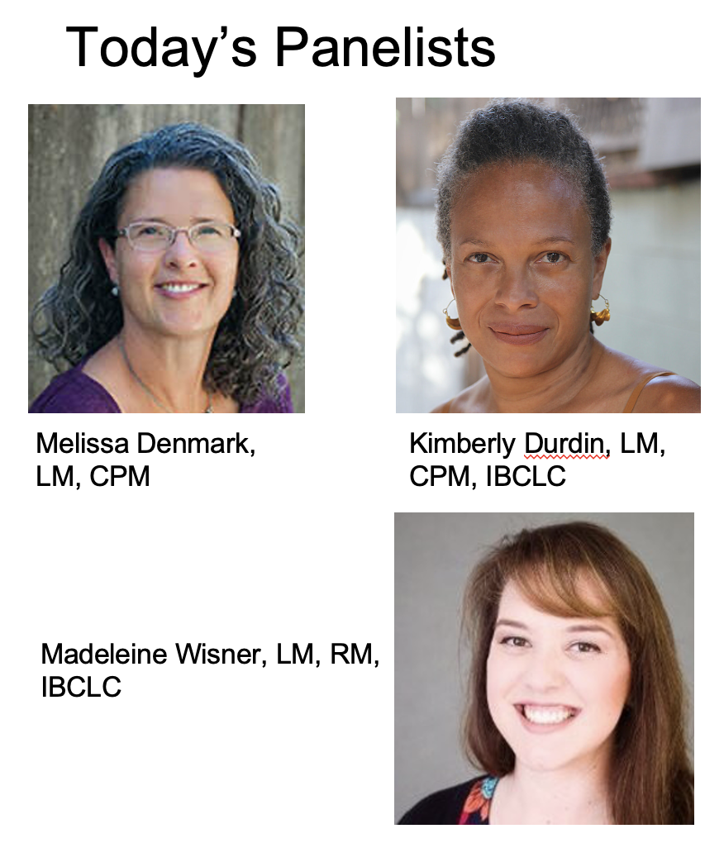
^{Panelist Discussion}

