Slide 1


Slide 2
Inclusive Language Notice
Currently recognized identifiers such as “birthing people,” “mother,” “maternal,” “they,” “them,” “she,” “her.” and “pregnancy-capable person” are used in reference to a person who is pregnant or has given birth.
We recognize not all people who become pregnant and give birth identify as mothers or women and will use the above-recognized terms interchangeably to represent all those present in this space receiving care for pregnancy services. All persons are equally deserving of respectful patient-centered care that helps them attain their full potential and live authentic, healthy lives. The healthcare team should respect individual patient preferences regarding gendered language throughout the course of their care.
The term “family” is used to refer to any persons the pregnant or postpartum patient designates as such (alternatives: partners, husbands, wives, support persons, loved ones).
The term “clinician” is used to denote nursing and medical staff, whereas the term “provider” refers to a clinician with diagnosing and prescribing authority.

Slide 3

Continuing Education Notice
In order to receive contact hours (RN) for this webinar, please complete the evaluation via the link, which will be sent to you 48 hours after this webinar.
You must be in attendance on the webinar for a minimum of 50 minutes for a contact hour to be awarded.

Slide 4

Poll

Slide 5
Logistics & Slide Deck
All attendees are muted upon entry
Please use the Q & A function – we will do our best to answer questions during the webinar.
You are welcome to use any of the slides provided for educational purposes
If you modify or add a slide, please substitute your institutional logo and do not use the CMQCC logos
We welcome your feedback and recommendations for improving the slide set

Slide 6
Webinar Objectives
Provide understanding about the current state of maternal health inequities in California.
Build knowledge of the data available for stratification in the Maternal Data Center and how to use the data to drive maternal health quality improvement in their hospital setting.
Share knowledge of tools, resources, and support about new CMQCC initiatives coming soon for hospitals in CA.

Slide 7
Poll
Results

Slide 8




Meet the
Presenters
Kendra Smith
Ph.D., MPH
Amanda Williams
MD, MPH
Rev. Candace Kelly
Ph.D.
Leslie Kowalewski

Slide 9
Setting the Path for Equity-Centered
Quality Improvement
Kendra Smith, Ph.D., MPH
Birth Equity Advisor, California Maternal Quality Care Collaborative

Slide 10

Recognition of need for more equity-centered Quality Improvement in California
CMQCC is a well-known quality improvement (QI) organization.
Recognition that strides made in maternal health in California were unequal and there were disparate poor health outcomes, most affecting people of color.
Issues like microaggressions, racism, disrespect, and overall unequal treatment were not adequately addressed in maternal care.
Required transition in thinking and understanding about our approach to QI.

Slide 11
Preparing Ourselves to Rollout Equity-Centered Support
Completion of an internal assessment
Creation of birth equity team
Continuous all-team Diversity Equity &Inclusion learning
Creation of a birth equity agenda

Slide 12
Preparing Ourselves to Rollout Equity-Centered Support
Equitable care does not happen on its own
Elevate the voices of patients
Create new opportunities for healthcare teams to engage with patients
Why Equity-centered care?

Slide 13

What we mean by an equity-centered approach
Equity in health is the absence of systematic disparities in health between groups with different levels of underlying social advantage/disadvantage.
An equity-centered approach is looking at policies, practices, and norms that might appear neutral but, in fact, have disparate and harmful impacts on marginalized or minoritized groups.
Elimination of “a rising tide will lift all boats” approach.

Slide 14

Our New Journey
Grow our QI work to aid our hospital partners in achieving equity.
Address disparities in maternal care through concrete and accessible tools.
Test new models for patient care.
Analyze and address aspects of care that exist within the purview of clinicians and clinical staff to assess the widening or closing of gaps.
Integrate community engagement to elevate patient and community voice.

Slide 15
Improving Maternal Health Equity at Scale:
Where do we stand in California and how can CMQCC help?
Amanda P. Williams, MD, MPH, FACOG
Clinical Innovation Advisor, California Maternal Quality Care Collaborative
Adjunct Clinical Associate Professor, Dept. of OB GYN, Stanford University
Medical Director, Mahmee

Slide 16
Disclosures
Medical Director, Mahmee
  venture backed, tech-enabled pregnancy and postpartum wrap around services company aimed at elevating maternal health equity and supplementing traditional perinatal care
Clinical Advisor, RiskLD
  obstetric alerts and decision support software

Slide 17
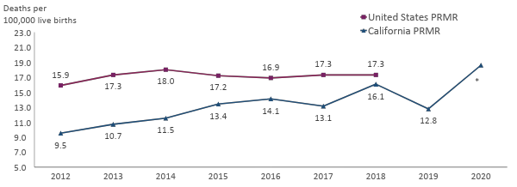
Pregnancy-Related Mortality Ratio in U.S. and California 2012-2020
Pregnancy-related mortality ratio (PRMR) = Number of pregnancy-related deaths per 100,000 live births, up to one year after the end of pregnancy. Pregnancy-relatedness determinations were made through a structured expert committee case review process. Data on U.S. PRMR are published by CDC Pregnancy Mortality Surveillance System (accessed at Pregnancy Mortality Surveillance System | Maternal and Infant Health | CDC on February 7, 2023).
* The 2020 PRMR is significantly higher than the PRMRs in 2012 and 2013
Notes:
UPDATE notes below
Alt Text:
Line chart showing the pregnancy-related mortality ratio in the U.S. and California from 2012 through 2020
California’s pregnancy-related mortality ratio was consistently lower than the U.S. PRMR from 2012 through 2018 (the latest available data for U.S.).
In 2020, California’s pregnancy-related mortality ratio was 18.6 deaths per 100,000 live births.
California’s pregnancy-related mortality ratio began to rise gradually in 2013 and peaked in 2020
Other notes:
CA’s PRMR remained consistently lower than the US PRMR from 2009 to 2017. (Though unknown if the differences were statistically significant - could not test)
Note – the US PRMR from the CDC PMSS may be an underestimate… CDC has access to fewer data sources than individual states. CA identified 1/3 of the deaths through patient discharge and ED data alone.

Slide 18
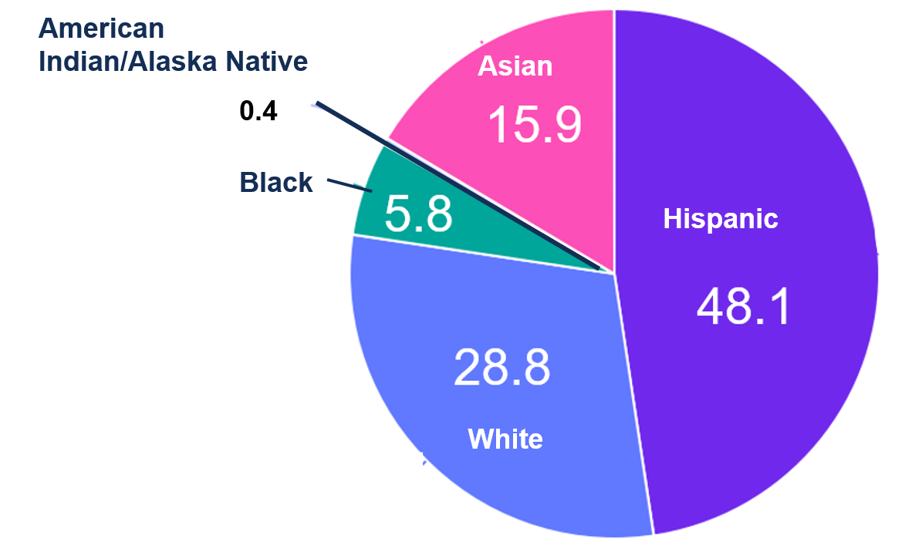

California: Births by race/ethnicity 2018-2020
2020 Total California Births: 420,259
1 in 8 US Births
are in CA

Slide 19
But are these improvements for all Californians?

Slide 20
Building Upon Past Improvements to Achieve Equity-Centered Obstetric Care
Hemorrhage Collaborative
  28% reduction in Severe Maternal Morbidity among Black gravidas and 50% reduction in B:W differences
Cesarean Collaborative
  15% reduction in NTSV CS rates among Black gravidas and but only a limited reduction in B:W differences
Pregnancy-related Mortality (1yr)
  After initial 30% reduction among Black gravidas, rates have remained static without reducing B:W differences
  Shift to postpartum deaths away from L&D
Role of Quality Improvement
Care can be improved by QI initiatives (and variation reduced), BUT don’t fully addressed inequities
Equity initiatives when combined with clinical QI projects can have the greatest impact on disparities
Key Connections are Lacking
Connect communities and health systems
Connect medical model and the public health model
Connect in-patient with out-patient worlds
  Equity, prevention of anemia, preeclampsia and cardiac complications all need to start in the office

Slide 21
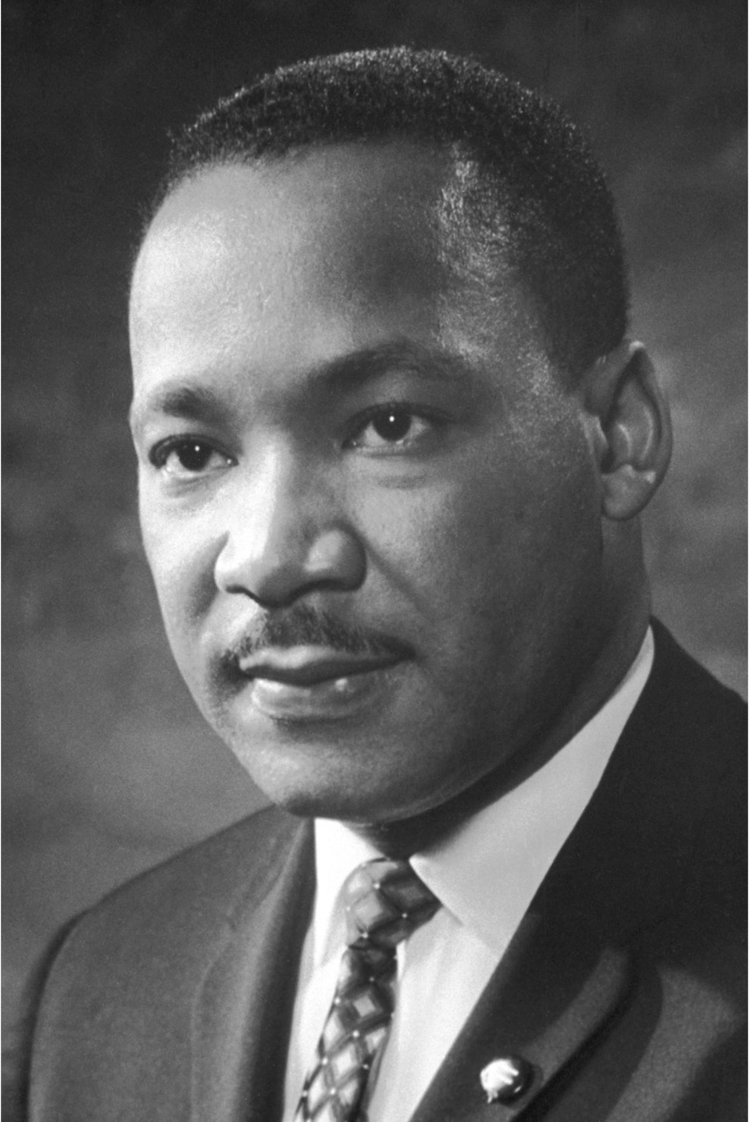
  “Of all the forms of inequality, injustice in healthcare is the most shocking and inhumane.”
  --Martin Luther King Jr, 1966

Slide 22
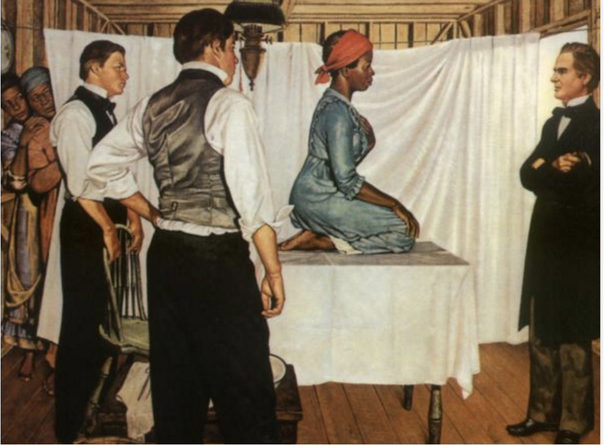


Slide 23
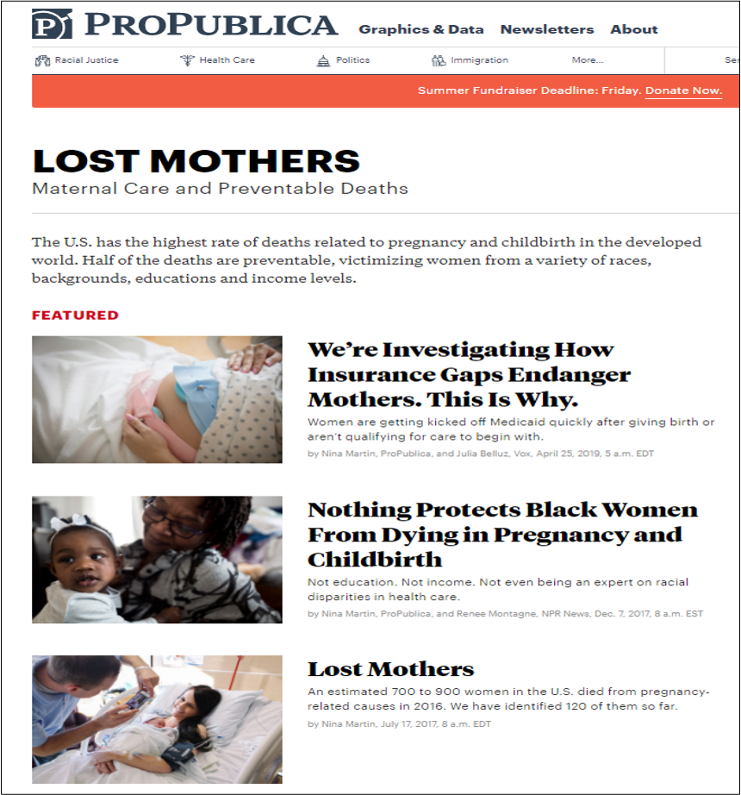
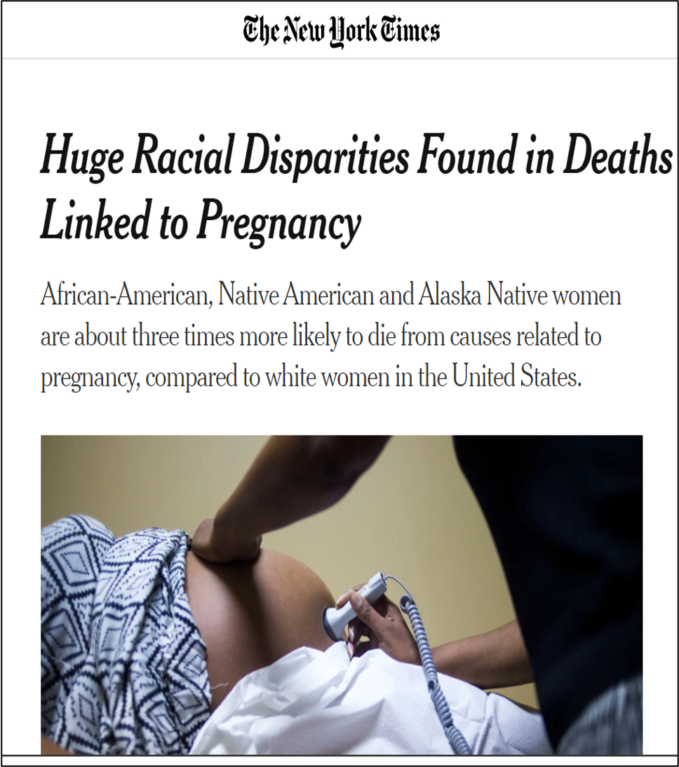



Slide 25
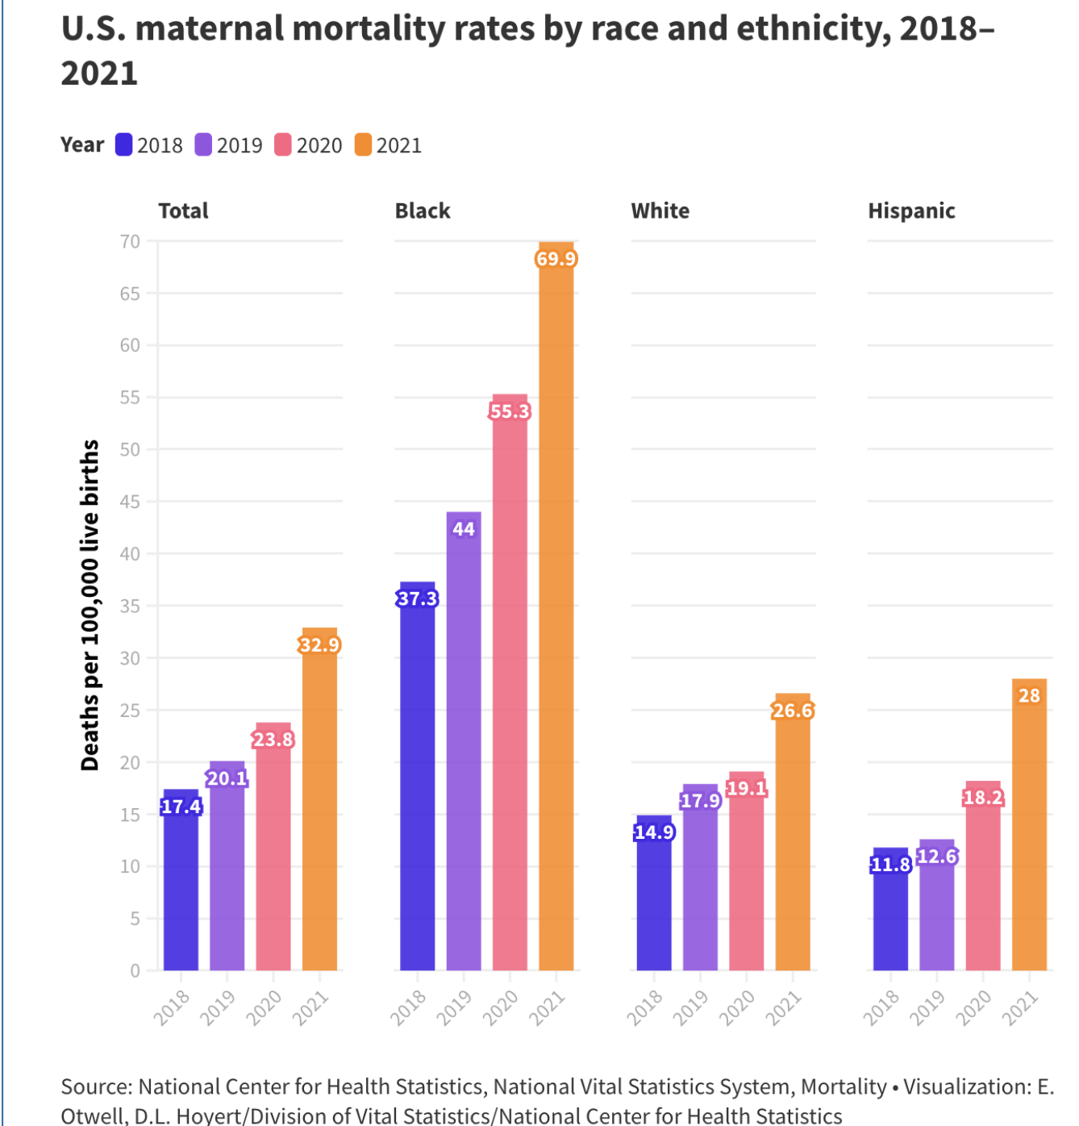
U.S. Maternal Mortality Rates by Race and Ethnicity,
2018-2021
US Maternal Deaths per 100,000 live births

Slide 26
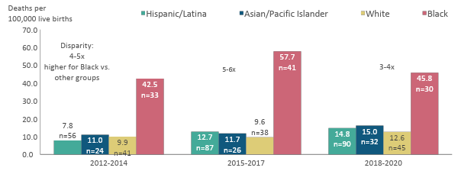

Pregnancy-Related Mortality Ratio by Race/Ethnicity
California 2012-2020
Pregnancy-related mortality ratio (PRMR) = Number of pregnancy-related deaths per 100,000 live births. Pregnancy-related deaths include deaths within a year of pregnancy from causes related to or aggravated by the pregnancy or its management, as determined by expert committee review.

Slide 27

The Maternal Data Center: 2023
Washington plus 5 in AK & MT
Launched 2014
43 Hospitals
~75% of Delivery Volume
288 Hospitals
500,000 deliveries per year
~15% of births nationally
Launched in 2015
29 Hospitals
~75% of Delivery Volume
Launched in 2012
216 Hospitals
99% of CA Delivery Volume
NEW!
National MDC
1 Hospital To Date
Counts as of 3/10/23
Notes:
As I noted, we started with California hospitals in 2012; we now serve 214 hospitals that account for 99% of the delivery volume in California—all of whom actively submit data with incredible timeliness.
In 2014, state perinatal collaboratives in WA and OR got wind of the Maternal Data Center, and asked if we would be willing to bring the MDC to hospitals in their states—to support their QI collaborative work.
We worked with OGC representatives to make that happen, and now serve over 70 voluntarily participating hospitals in those states, as well as a few in Alaska and Montana that have joined through the WA MDC. The result is a database that includes over 500,000 deliveries a year, which makes for incredible benchmarking statistics, as we can create aggregates for like facilities.

Slide 28
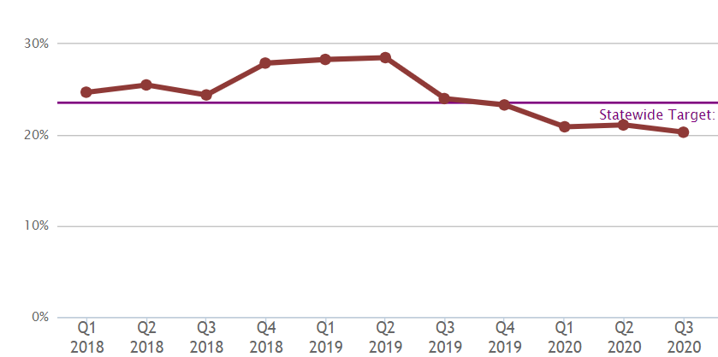
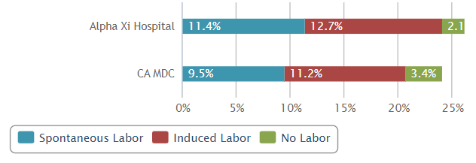
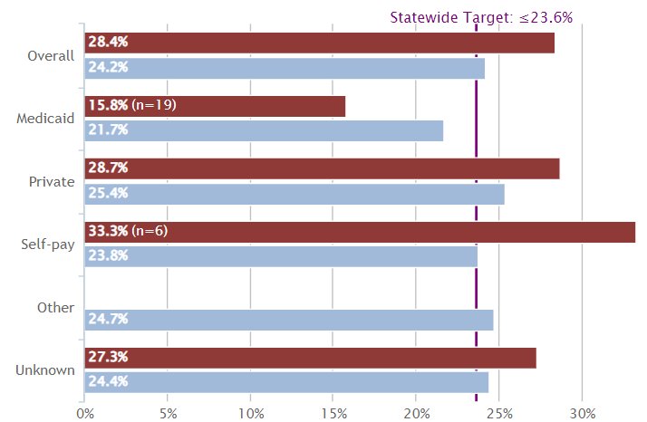
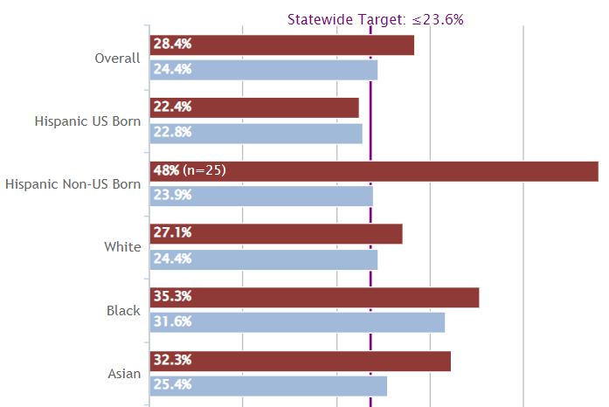
MDC Tools to Support Hospital QI
Run Charts
Measure Analysis Tools
Stratifications by Payer
Stratifications by Race

Slide 29
NTSV Cesarean Birth (PC-02: Period Specific)
Source: The California Maternal Quality Care Collaborative (CMQCC) based on 2017-2021 Patient Discharge Data from the Department of Health Care Access and Information linked to Birth Certificate Data from the California Department of Public Health-Vital Records.
Note: These numbers are unofficial estimates; due to differences in data sources and/or methods of data cleaning, the numbers may not align with other current or future publicly-available estimates. Any analyses, interpretations, or conclusions reached regarding these data reflect those of the author and not CMQCC or CDPH.
Notes:
One column layout

Slide 30
Exclusive Breastfeeding
Source: CDPH Data Dashboard

Slide 31
Severe Maternal Morbidity
Rate per 10,000
Source: CDPH Data Dashboard

Slide 32
Current CMQCC efforts imbued with maternal health equity focus, prioritizing community partnerships

Slide 33

Comprehensive Approach to Addressing Disparities
CMQCC Initiatives & Projects
Anemia
Community Birth Partnership
  Team-Based Care
  Midwife Integration
  Partnering with Doulas
  Improving Transfer of Care
Preeclampsia
  Low-Dose Aspirin Campaign
Pregnancy Associate Mortality Review
Sepsis
Post Partum Redesign

Slide 34

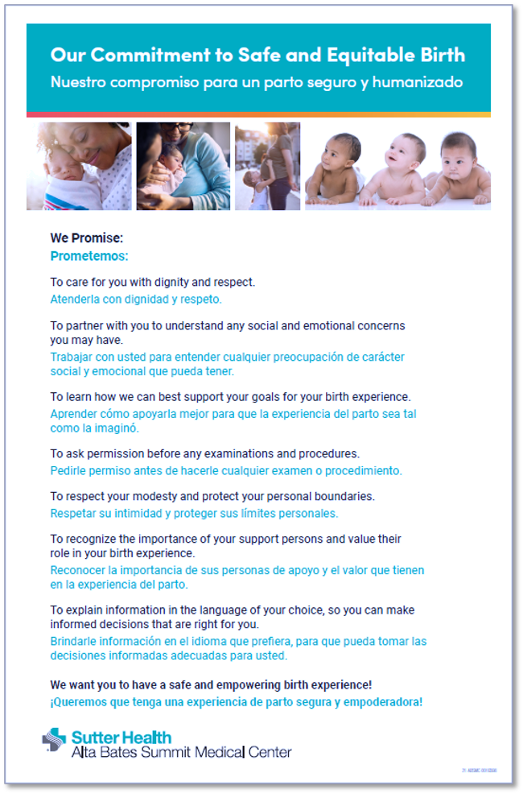
Pilot Birth Equity Initiative
Tools Used By Five Pilot Hospitals
Move beyond Implicit Bias training
  Hospital Action Guide
Instill accountability
  Sharing “Commitment to Safe and Equitable Care”
  Collection of patient narratives/stories
Practice Active Listening
  CDC Hear HER Campaign
Use Data to Drive Change
  Stratify outcomes by race/ethnicity
  (CMQCC Maternal Data Center)
Change Unit Culture
  Culture of equity survey
  Address microaggressions
Notes:
To reach our goal of eliminating racial disparities in maternal outcomes we have to change culture. Implicit bias training and education is only a beginning. We have worked with 5 pilot hospitals and communities to develop action tools that are designed to change unit attitudes and culture.
Creating accountability is critical. For one example, with our hospitals and community partners, we created a commitment document for mothers describing the promises we make as nurses and doctors for the care they will receive in labor and provide it to every woman on admission. It emphasizes care with dignity, respect, active listening, and shared decision making. Before discharge, we survey the mothers to see if our care lived up to our promises. This has been extraordinarily popular with patients, and it has transformed the attitudes of the staff.
Race-stratified data analysis from our data center plays a central role. Surprisingly, Most hospitals have no clue that their Black or Hispanic mothers have different outcomes than their White mothers. Quote: ”It doesn’t happen here”
They continue to work with the common delusion that QUOTE “We treat all mothers the same”.
Another key tool set, addresses micro-aggressions. Micro-aggressions, including demeaning comments, are commonplace both toward patients and towards other staff and need to be called out.
Our 5 pilot hospitals have made great strides and we need to scale it up to a statewide initiative, and beyond.

Slide 35


Pilot Birth Equity Initiative
Tools Used By Five Pilot Hospitals
Martin Luther King, Jr. Community Hospital
(Los Angeles)
Miller Children’s Hospital – Memorial Care
(Long Beach)
Alta Bates Summit Medical Center
(Bay Area)
Ronald Reagan UCLA Medical Center
(Los Angeles)
UCLA Santa Monica Medical Center
(Santa Monica)
Notes:
Thank you to our five birth equity collaborative pilot hospitals

Slide 36
New maternal health equity tools for CMQCC California member hospitals

Slide 37
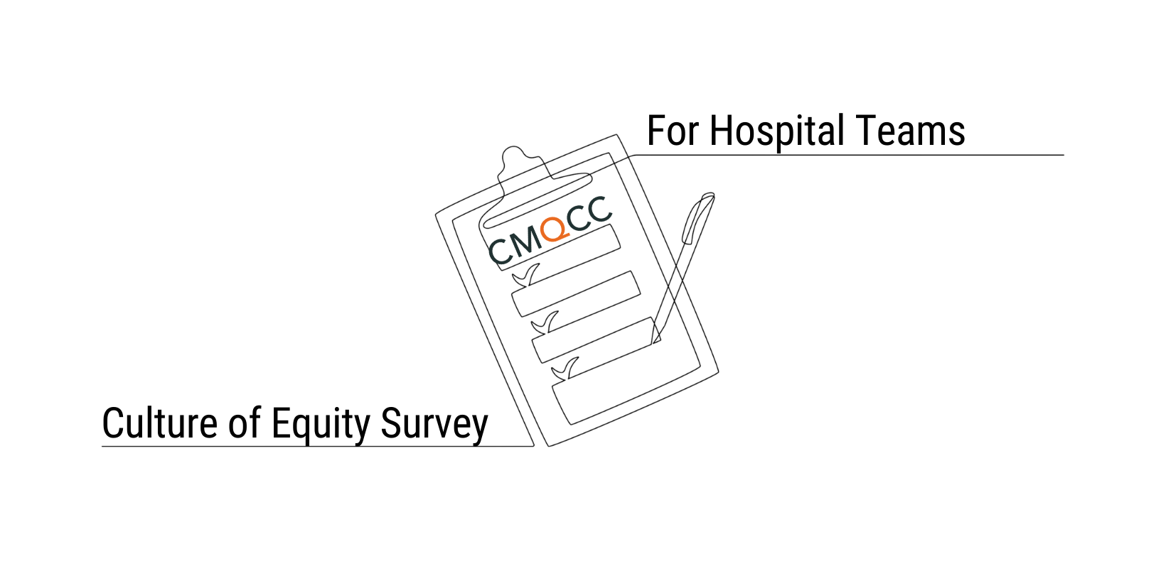
Equity Tool - Culture of Equity Survey
Launching
Fall 2023
  Survey captures perspectives on and experiences
  with:
    Bias
    Comfort addressing bias, racism, and disrespectful care
    Healthcare team members’ behaviors toward patients and other staff members
    Shared decision-making with patients
    Experience with microaggressions, bias, and racism
    Organizational structure that supports respectful and equity-centered care
Designed to be administered to units to understand team members’ perspectives on equity

Slide 38
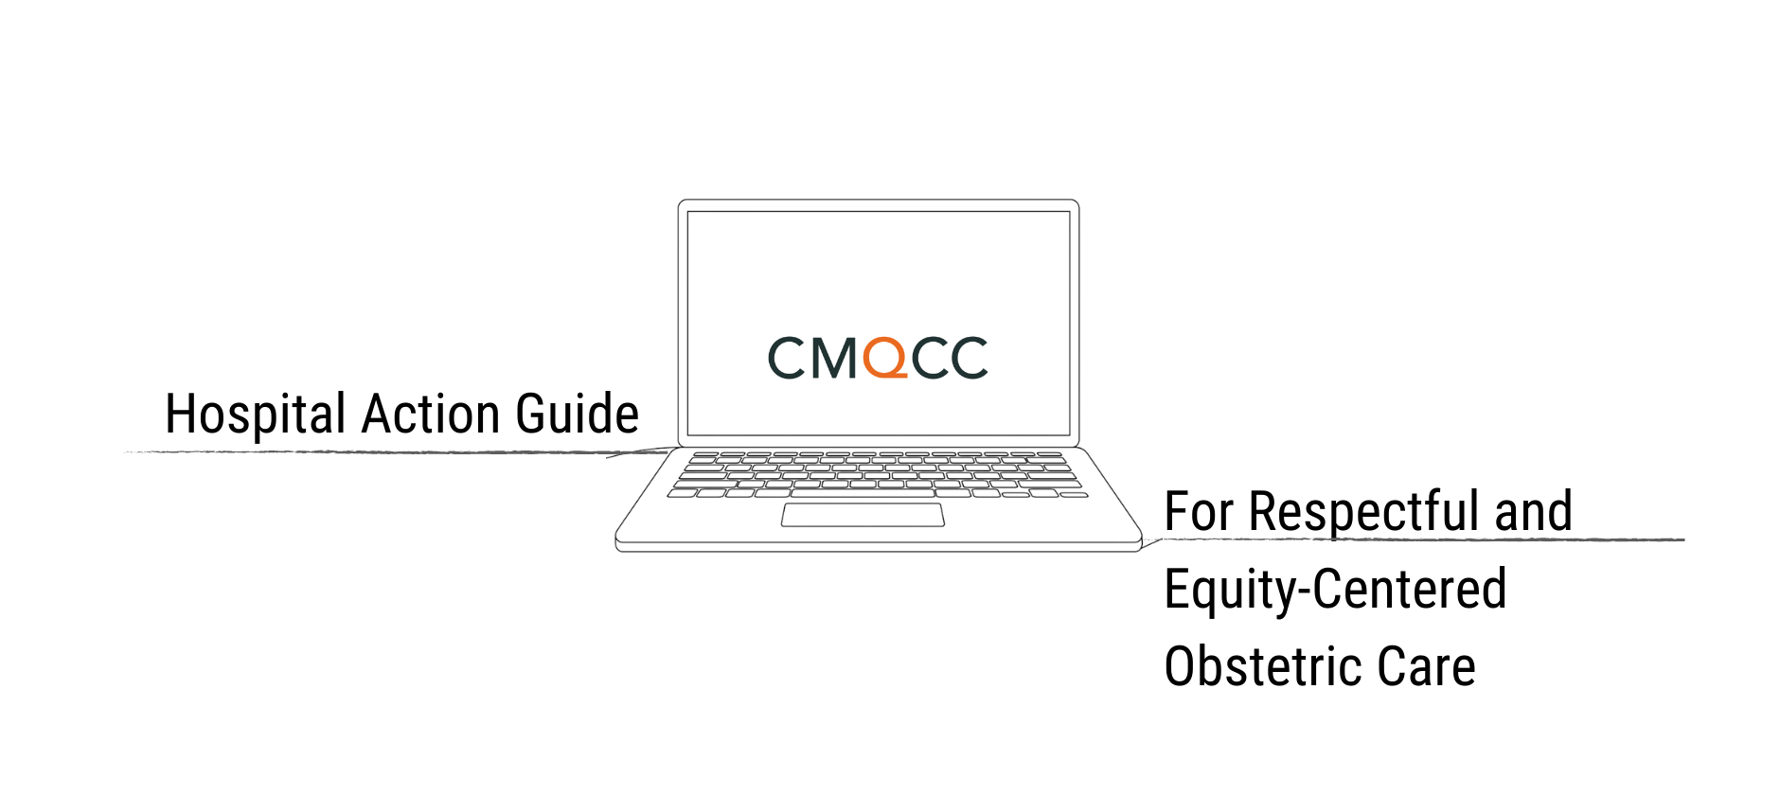
Equity Tool - Hospital Action Guide for Respectful and Equity-Centered Obstetric Care
Launching
Summer 2023
  Modules will include resources for:
    Understanding the Need for Birth Equity
    Identify Opportunities for Collecting and Sharing Stratified Data and Patient Experience and Outcomes
    Examine Current Equity Practices
    Leverage Patient Care Process and Outcome Data to Address Obstetric Disparities
    Create a Culture of Respectful Care
    Build Partnerships with the Community
Resources and tools to guide to get started or continue equity-centered care.

Slide 39
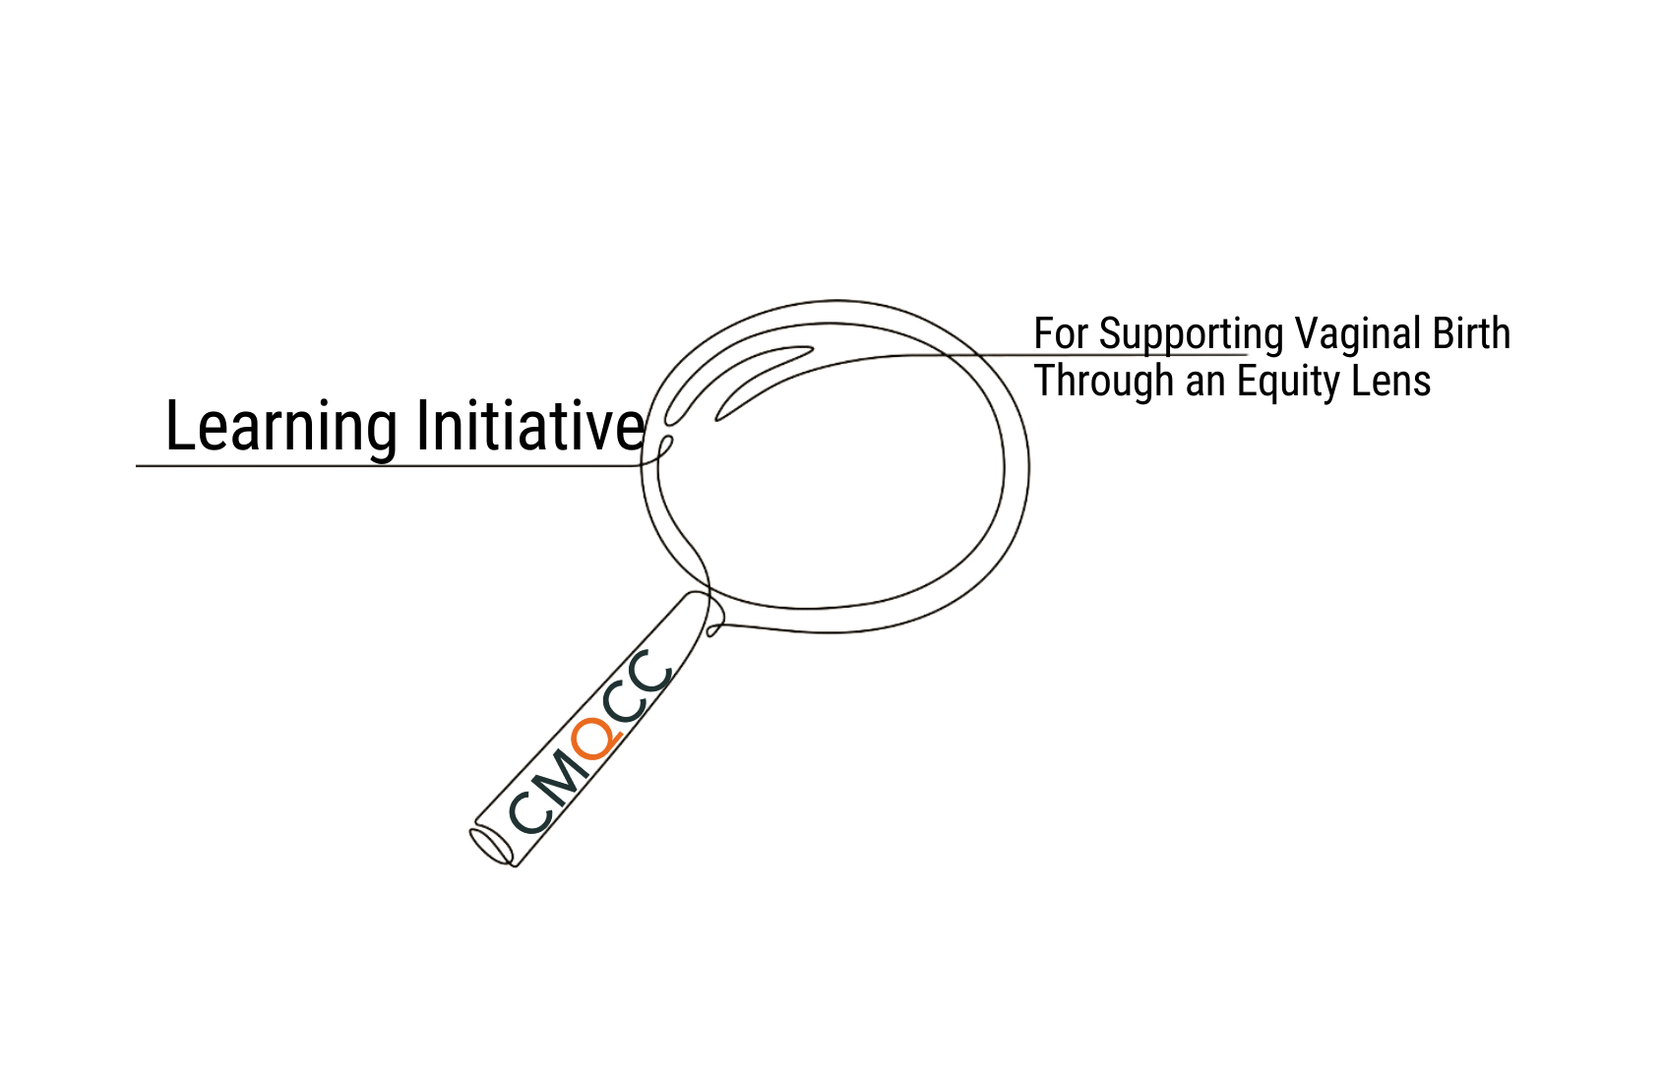
Equity Tool - CMQCC Learning Initiative for Supporting Vaginal Birth with an Equity Lens
Launching
June 2023
Reduce disparities in NTSV Cesarean rates through a renewed focus on NTSV structure/process metrics and introducing equity-based concepts and tools.
Plan: Conduct Learning Initiative rounds for 18 months staggering new rounds every 9 months with 2 cohorts in each round.
Curriculum to follow CMQCC Hospital Action Guide
CDC grant funded initiative for 5 years beginning September 30, 2022 – 2027

Slide 40

The Gift of Collaboration
Rev. Dr. Candace Kelly, Hospital CHAPLAIN, Researcher, Author, Advocate, conference Speaker, and Social Justice Conscious Playwriter.
member of the CMQCC Birth Equity Pilot Collaborative Team, Cherished Futures for Black moms, and serves as Chair of the Miller Children’s and Women’s Hospital Respectful Maternity Care Initiative.

Slide 41

CMQCC
COLLABORATIVE
Our Hospital was honored to be invited to join the CMQCC’s Birth Equity Pilot along with 4 additional hospitals.
The purpose of the Collaborative was to build a toolkit to aid hospitals around the nation which was transformative for each hospital who participated in the collaborative.
What was very encouraging was the collaborative demonstrated in so many ways that we were not alone and though we had a long ways to go; we were encouraged to start right where we were, together.
The Gift of Collaboration

Slide 42
Benefits of the Collaborative Model
Outcomes stratified by race and ethnicity provided by CMQCC
Initial educational opportunity:
equity terms & definitions
the conversation followed
Assimilating the comments and experiencing the new environment
brainstorming how to move forward with change efforts
Initiated the new patient reported experience metric (prem) survey with patients
Monthly sessions - five hospitals - report out on
the status of our qi efforts

Slide 43

Our Current Culture & BIAS Training
  Creation of a Survey
  Completion of the Diversity Science Training

Slide 44
Survey responses
“What about me, I’ve been treated unfairly also and discriminated against as a white woman.” - Nurse
“It’s about time we are doing something about this. I am so thankful to see it.” -Nurse
“Thank you. What can I do to help?” – Coordinator
“Why are we doing all of this, “I’m not a racist, I treat all my patient’s the same.” - Nurse
“I have to admit, I have been challenged with my implicit biases and really have to do some inner reflection and work. Thank you for the education and the terms listed on our EMB Board.”
-Nurse

Slide 45




"Accountability is the glue that ties commitment to the result.”
Source: Proctor, B. (n.d.) Accountability.
Proctor Gallagher. https://www.proctorgallagherinstitute.com/17557/accountability

Slide 46



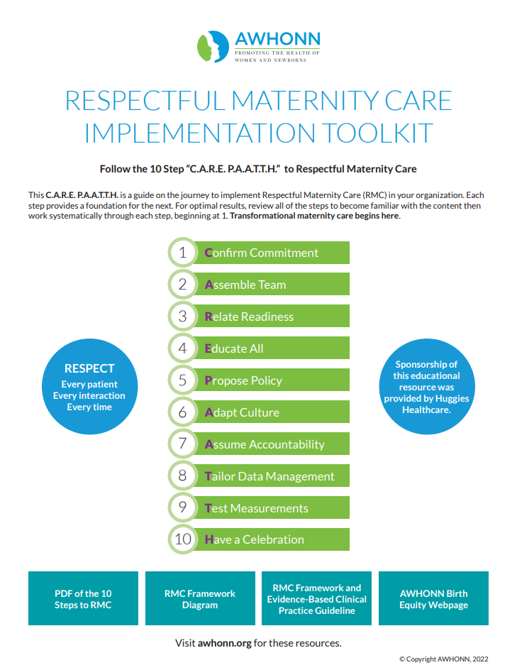



Slide 47

“Solidarity is not the same as support. To experience solidarity, we must have a community of interests, shared beliefs and goals around which to unite, to build Sisterhood. Support can be occasional. It can be given and just as easily withdrawn.
Solidarity requires sustained, ongoing commitment.”
-bell hooks
Source: Hooks, b. Moving beyond words: What is meaningful solidarity? (Part 1). Amnesty International.
The Gift of Collaboration

Slide 48

Why we work through the tension…
It’s Honorable Work: It’s the professional role we chose to hold: to sit with our patients to listen, and act upon their needs.
It’s Hard Work: What I have learned through this pilot is that we can not, not do this work. That’s not optional, not as long as there is disproportionate maternal mortality and morbidity in black mothers birthing babies.
It’s Heart Work: The Heart is an organ that is deep and hence we will have to go deep inside ourselves to do the work.

Slide 49
Clinical Lead Guidance
Access to peer support
Ability to reflect in order to address the denialist
Space to have the hard conversations about racism
How the Collaborative Model Empowered Our Work
Notes:
Access to peer support
Space to have the hard conversations about racism
And what we found we all had in common were those we coined the denialist; those who didn’t see value in doing the work because they could not see beyond themselves to see the suffering and the pain of others.

Slide 50
Why is it so important to do Birth Equity Work?
Because...
To compassionately listen to the concerns of black mothers birthing babies is respectful.
To be shaken by the historical data of maternal mortality and infant loss is empathic.
To understand how social determinants lead to healthcare disparities is educational.
To consider one’s own implicit biases illustrates personal humility.
To acknowledge that there is a clear link between racism and mistreatment and poor maternal-fetal outcomes is truth.
To proactively change nursing philosophies to integrate an equity lens is extraordinary.
To have the audacity to want to change structural racism in healthcare, one hospital at a time, one obstetric unit at a time, ONE PATIENT at a time, in order to transform our world, is possible. Now let’s listen to the hearts of our black mothers birthing babies and let’s Beat structural racism together.

Slide 51

PUTTING HEART IN HEALTHCARE
By putting some skin in the game…
H – Honor
E – Empathy
A – Advocacy
R– Respect
T - Trust

Slide 52
Closing and Call To Action
Leslie Kowalewski
Executive Director,
Perinatal Outcomes Collaborative,
Stanford School of Medicine
(California Maternal Quality Care Collaborative &
California Perinatal Quality Care Collaborative)

Slide 53









Community Birthing Advocates, Doulas and Midwifes
Professional Groups (California sections of national organizations)
Funders
Key Medical and Nursing Leaders
State and Federal Government Agencies
Health Plans
Membership Associations
Public, Patient, Consumer and Community Groups
CMQCC
Hospitals
Spectrum of Stakeholders & Active Partners

Slide 54
What to Expect
Slides
Website – 1 Week
Replay
Video
Website/YouTube – 1 Week
Evaluation
Coming within 48 hours via email

Slide 55
Call To Action
Data
Maternal Data Center
Stratify Data By Race/Ethnicity
Assess
Prepare to discuss and conduct baseline assessment
Register
Equity Webinars (Quarterly) Starting in August
21- Day Challenge
Racial Equity Habit Building Challenge
Source: American & Moore, LLC
Team
Build your internal equity team

Slide 56

Stay Tuned
Let’s Talk Perinatal Equity: Moving Beyond Implicit Bias Training Webinar Series for California Hospitals
Conducting Baseline Assessments
August 2023
More details via email, cmqcc.org and on social media soon

Slide 57

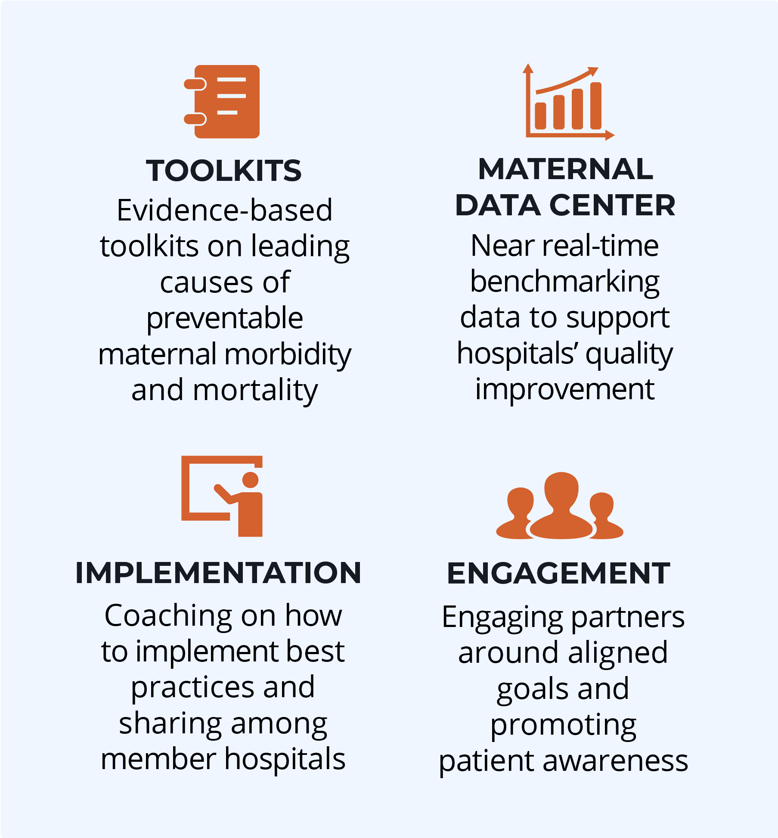
Thank you for Joining Us Today!
End preventable morbidity, mortality, and racial disparities in California maternity care
Follow us! Facebook, Instagram, Twitter and LinkedIn

