Slide 1


Slide 2

Logistics & Slide Deck
All attendees are muted upon entry.
Q & A – We will do our best to answer questions during the webinar using the Q & A function/button.
You are welcome to use any of the slides provided for educational purposes.
If you modify or add a slide, please substitute your institutional logo and do not use the CMQCC logos.
We welcome your feedback and recommendations for improving future webinars.

Slide 3
Inclusive Language Notice
Currently recognized identifiers such as “birthing people,” “mother,” “maternal,” “they,” “them,” “she,” “her.” and “pregnancy-capable person” are used in reference to a person who is pregnant or has given birth.
We recognize not all people who become pregnant and give birth identify as mothers or women and will use the above-recognized terms interchangeably to represent all those present in this space receiving care for pregnancy services. All persons are equally deserving of respectful patient-centered care that helps them attain their full potential and live authentic, healthy lives. The healthcare team should respect individual patient preferences regarding gendered language throughout the course of their care.
The term “family” is used to refer to any persons the pregnant or postpartum patient designates as such (alternatives: partners, husbands, wives, support persons, loved ones).
The term “clinician” is used to denote nursing and medical staff, whereas the term “provider” refers to a clinician with diagnosing and prescribing authority.

Slide 4
Continuing Education Notice
In order to receive contact hours (RN) for this webinar, please complete the evaluation via the link, which will be sent to you 48 hours after this webinar.
You must be in attendance* on the webinar for a minimum of 50 minutes for a contact hour to be awarded.
*We do not offer Contact hours for on-demand webinar viewing.

Slide 5
Webinar Objectives
Understand the importance of patient experience outcomes as a baseline assessment for equity quality improvement.
Connect how patient experience is essential to improving birthing quality outcomes and reducing disparities.
Understand how patient experience surveys can serve as one method of collecting patient feedback regarding birthing experiences.
Provide a framework for connecting patient experience outcomes to organizational values, staff education and commitment to equity practices.
Identify non survey methodologies to elevate patient voices and collect patient experience data.
Notes:
Today’s focus

Slide 6


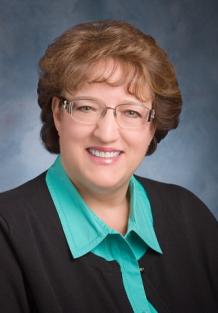


Today’s
Speakers
Kim Gregory, MD, MPH
Cedars-Sinai
Medical Center
Chair, CA-PARC
Christa Sakowski
MSN, RN, C-ONQS, C-EFM, CLE
Clinical Lead
CMQCC
Learning Initiative Co-Lead
Terri Deeds
RN, MSN, NE-BC, C-ONQS
Clinical Lead
CMQCC
Learning Initiative Co-Lead
Amanda Williams
MD, MPH
Clinical Innovation Advisor
Learning Initiative Medical Lead CMQCC
Sharilyn Kelly
DNP, MSN/MSHA, RN, NE-BC, C-ONQS, RNC-OB
MemorialCare Miller
Children’s & Women’s Hospital

Slide 7
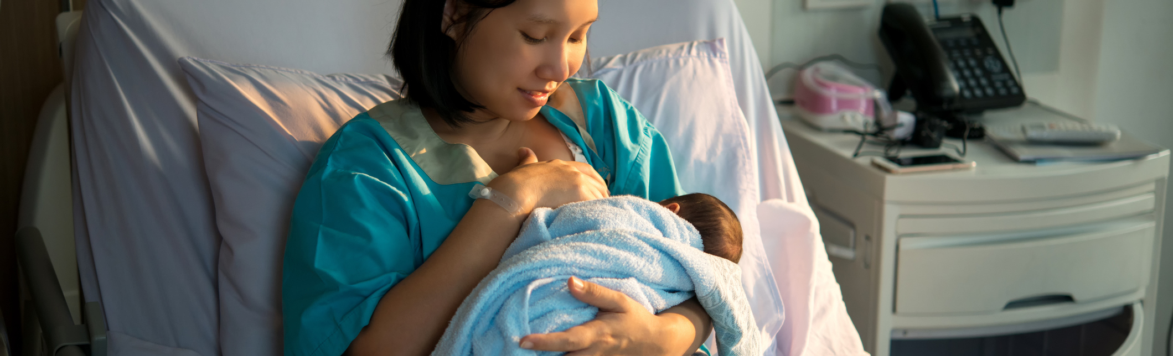
Patient reported experience:
Maternity Matters
Amanda P. Williams, MD, MPH, FACOG
Clinical Innovation Advisor, CMQCC

Slide 8

CDC
HEAR HER™️ Campaign
Sanari started to experience pain two days after delivery and was initially told it was caused by gas. But when her symptoms continued to worsen, she knew something was wrong. An abscess was eventually found on her uterus, which could have been fatal.
“I’m glad I didn’t stop at no,” she says. I’m glad someone finally listened to me.

Slide 9
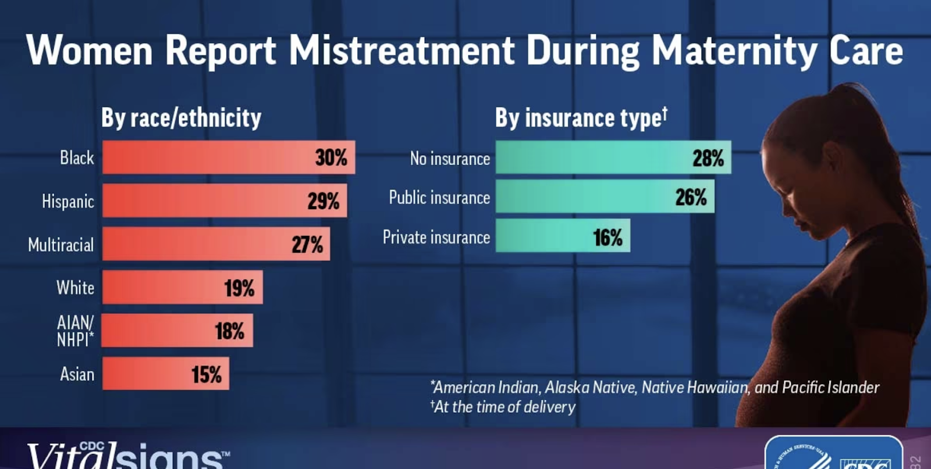
Notes:
In August of 2023, a pivotal paper was published by the Centers for Disease Control and Prevention (CDC) on mistreatment during the maternity experience. Approximately 20% of all women and almost 30% of Black and Hispanic women experienced mistreatment during maternity care. Women with no insurance or public insurance also reported more mistreatment than those with private insurance.

Slide 10
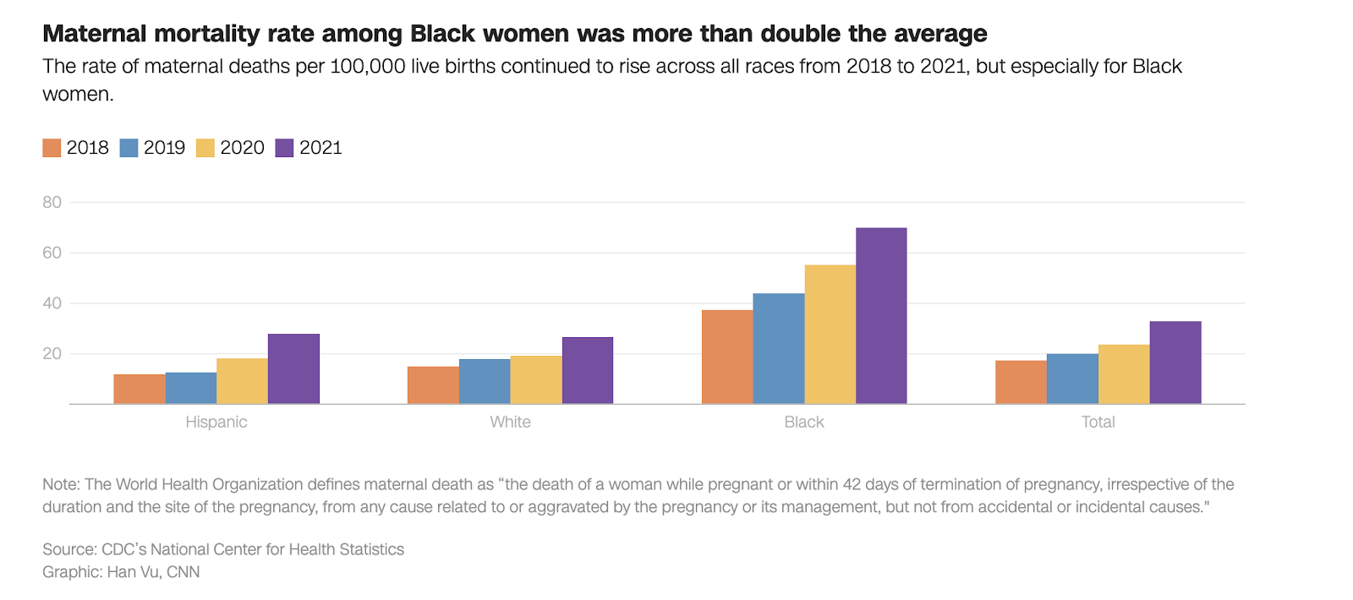
Notes:
This new data around the prevalence of perinatal mistreatment amplifies the already distressing situation of racialized maternal mortality disparities.
We know that patient satisfaction and clinical safety and quality for parents and babies are connected. When patients feel comfortable asking questions, when they have been educated about medical warning signs and when they feel empowered to advocate for themselves, pregnancy and postpartum complications can be rapidly identified and addressed.

Slide 11
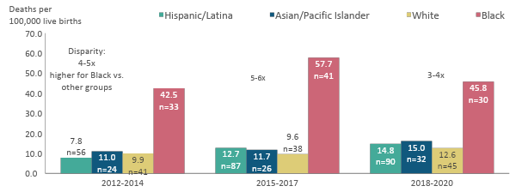
Pregnancy-Related Mortality Ratio by Race/Ethnicity
California 2012-2020
Pregnancy-related mortality ratio (PRMR) = Number of pregnancy-related deaths per 100,000 live births. Pregnancy-related deaths include deaths within a year of pregnancy from causes related to or aggravated by the pregnancy or its management, as determined by expert committee review.
Notes:
NOTES from earlier version - UPDATE:
Alt Text:
Bar chart showing pregnancy-related mortality ratios by race-ethnicity in California across 3-year periods: 2012-2014, 2015-2017, and 2018-2020.
Racial-ethnic disparities in pregnancy-related mortality ratios narrowed in 2018-2020 but persisted. Black birthing people continued to have the highest pregnancy-related mortality ratio of all racial-ethnic groups in California.
In 2018-2020, the pregnancy-related mortality ratio for Black birthing people was 3 to 4 times higher than the pregnancy-related mortality ratios for Hispanic/Latinx, Asian/Pacific Islander and White birthing people – a decrease from the 5 to 6-fold difference seen in 2015-2017
The pregnancy-related mortality ratios gradually increased for White, Asian/Pacific Islander and Hispanic/Latinx birthing people across the three 3-year periods.

Slide 12


HCAHPS: Hospital Consumer Assessment of Healthcare Providers and Systems
CMS and AHRQ survey of patients' experiences
Pros: standardized across hospitals, validated
Cons: not maternity specific, not equity focused, data lag

Slide 13
Approaches to gathering patient feedback
Leader rounding
Town halls
Patient advisory groups
Discharge telephone calls
Patient surveys
Patient reported experience measures

Slide 14

Hospital Action Guide: How can it assist you gathering patient experience?
Module 5: Learning Opportunity 4
"Comprehending the Linkage Between Patient Data and Improvements in Respectful Care In Order to Evaluate Progress"

Slide 15
Childbirth Experience Survey (CBEX)
Kim Gregory, MD, MPH
The Miriam Jacobs Chair in Maternal-Fetal Medicine and Vice Chair, Women's Healthcare Quality and Performance Improvement, Department of Obstetrics and Gynecology
Cedars-Sinai Medical Center
Chair, CA-Pregnancy Associated Review Committee

Slide 16

Patient Reported Experience Metrics Lived Experiences
Shari Kelly, DNP, MSN/MSHA, RN, NE-BC, C-ONQS, RNC-OB
Executive Director, Perinatal Services
MemorialCare Miller
Children’s & Women’s Hospital

Slide 17

Patient Reported Experience Metrics (PREM) Lived Experiences
Shari Kelly, DNP, MSN/MSHA, RN, NE-BC, C-ONQS, RNC-OB
Executive Director, Perinatal Services
CMQCC Perinatal Equity Webinar
November 15, 2023

Slide 18


Patient Reported Experience Metric
As part of the CMQCC Birth Equity (BE) Collaborative, our BE team was tasked with selecting questions from a large list that we felt would best provide information about how they perceived their care and birth experience. Data collected included some demographic information which included race/ethnicity, and whether this was their first birth experience.
The doctors, nurses, and midwives listened to and respected my wishes
I trusted my doctors, nurses and other staff at the hospital to take the best care of me.
The health care team helped create a comfortable, caring environment
Doctors, nurses or other staff at the hospital asked my permission before carrying out procedures and examinations
The healthcare team supported my cultural or family traditions
The staff made me feel cared for as an individual
When the health care team could not meet my wishes, they explained why
Overall, during my labor and birth I felt my personal preferences were respected.

Slide 19


PREM SURVEY
Birth Certificate Clerks presented the survey flyer to the patient using a standard script to mitigate any perceptions of coercion or intimidation to participate
The QR code enabled the patient to scan the survey link into their smartphone or a hospital-provided device.
Data collection began during the summer of 2020. To date, we have received 982 responses

Slide 20

What we do:
How we do it:
Commitment for Safe and Equitable Birth
We promise to ask permission before carrying out procedures and examinations, and always protect your personal boundaries.
YOUR BODY, YOUR RULES
MemorialCare Values: iABCs
Integrity
Accountability
Best Practices
Compassion
Synergy

Slide 21
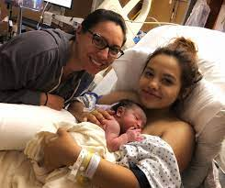
What we do:
How we do it:
Commitment for Safe and Equitable Birth
We promise to partner with you to understand any social and emotional concerns you may have and assist you with community resources you may find helpful.
MemorialCare Values: iABCs
Integrity
Accountability
Best Practices
Compassion
Synergy

Slide 22
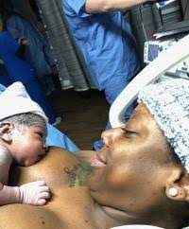
What we do:
How we do it:
Commitment for Safe and Equitable Birth
We promise to provide explanations and information in the language of your choice so we can make an informed decision that is right for you
MemorialCare Values: iABCs
Integrity
Accountability
Best Practices
Compassion
Synergy

Slide 23

What we do:
How we do it:
Commitment for Safe and Equitable Birth
We promise to care for you with dignity and respect and provide you safe and equitable care, in a non-discriminatory way
MemorialCare Values: iABCs
Integrity
Accountability
Best Practices
Compassion
Synergy

Slide 24

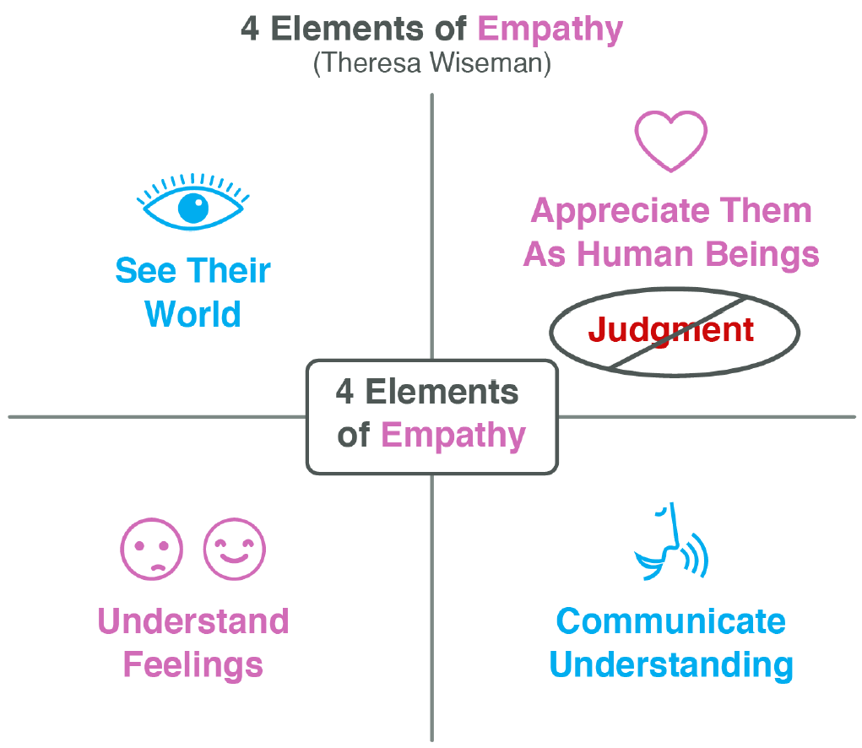
What we do:
How we do it:
Anti-bias Strategy:
Practice perspective-taking
“I am wondering how I might see it if I were looking through your eyes…”
“I was imagining being in your shoes, and it occurred to me that I would feel this way..”
Check your accuracy by asking the patient.

Slide 25


What we do:
How we do it:
Commitment for Safe and Equitable Birth
We promise to recognize the importance of your support persons and value their role in your birth experience
MemorialCare Values: iABCs
Integrity
Accountability
Best Practices
Compassion
Synergy

Slide 26


What we do:
How we do it:
Anti-bias Strategy:
Do NOT think about whether you are biased during the encounter.
Instead:
Focus on the person and take a moment to understand their perspective.
Think of yourself as on the same team as this person and try to communicate that sense to them.

Slide 27

What we do:
How we do it:
Anti-bias Strategy:
Listen for and interrupt/Replace biased
We tell ourselves stories about other people which can lead to explanations that blame the patient – our brains want to make sense of others’ behavior. These blame narratives take time to unlearn – listen for them in yourself and notice them in the way others talk about patients. Since you now know this is harmful to patients, you can recognize your responsibility to gently point out automatic assumptions and offer alternatives

Slide 28




We value your opinion, If you have comments about your birthing experience you would like to share with us, please add it below:
Here are some of the words our patients used to describe the care you provided to them

Slide 29
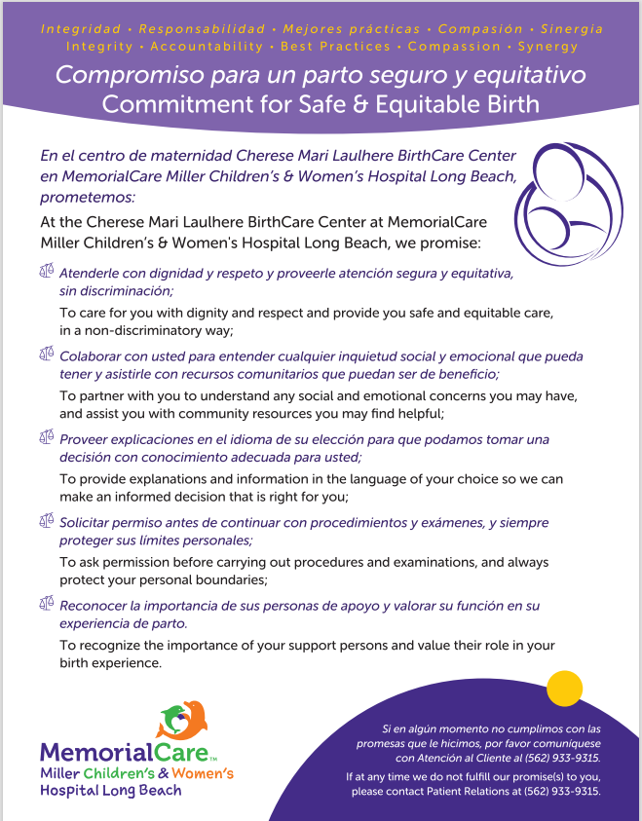
Our baseline data and current data demonstrates our care teams’ commitment to Birth Equity.
Are we ready to declare and display our promise to our patients and families?
MCWH BIRTHCARE CENTER
Commitment for Safe and Equitable Birth
We Promise;
  To care for you with dignity and respect and provide you safe and equitable care, in a non-discriminatory way;
  To partner with you to understand any social and emotional concerns you may have, and assist you with community resources you may find helpful;
  To provide explanations and information in the language of your choice so we can make an informed decision that is right for you;
  To ask permission before carrying out procedures and examinations, and always protect your personal boundaries;
  To recognize the importance of your support persons and value their role in your birth experience.
If at any time we fall short of our promise, please contact Patient Relations at (562) 933-9315

Slide 30

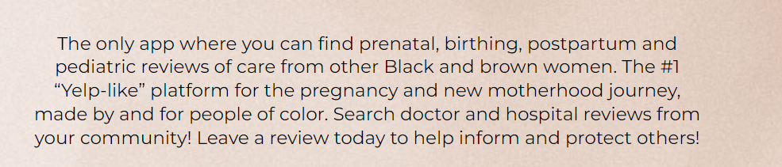
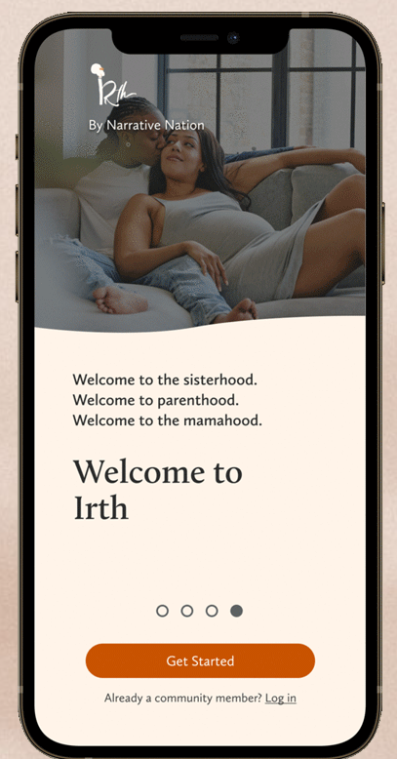

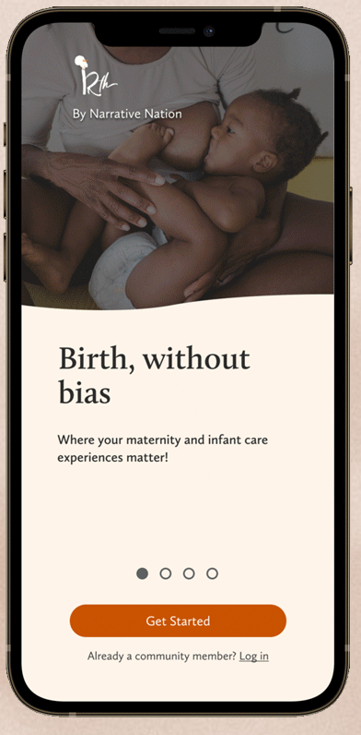


Next steps

Slide 31


Questions?

Slide 32

Next Steps
Terri Deeds, MSN, RN, NE-BC, C-ONQS
Clinical Lead, CMQCC

Slide 33

Baseline Equity Assessments
Organization Structural Assessment
  SWOTT Analysis, IHI Organizational assessment
Culture of Equity Staff/Provider assessment
  Currently in pilot phase with Learning Initiative participating hospitals.
Patient Reported Experience Assessment
Notes:
One column layout

Slide 34
Patient Reported Experience Assessment
Listening to patient voices is a cornerstone of any equity initiative
Essential to be included as a baseline assessment to establish current state.
Assessment should be a structured process but can exist in a variety of formats…..
Notes:
Two column layout

Slide 35

Collecting Patient Equity Experience Examples…
Formal PREM survey
Leadership Rounds with structured questions around respectful care and stratification ability
Patient forums
Post discharge phone calls
Town Halls
Others
HCAHPS in its current form is not sufficient to obtain patient voices around equity and respectful care.
Potential new version in process?
Notes:
Two column layout

Slide 36

Next Steps
Outline your process for collecting patient experience.
  Responsible parties
  Methodology
Determine staff/provider education program.
Outline process for results interpretation and dissemination to staff/providers.
What are you going to do by next Friday?

Slide 37

Next Webinar, Other Virtual Events & Closing
Christa Sakowski, MSN, RN, C-ONQS, C-EFM, CLE
Clinical Lead, CMQCC

Slide 38

Next Equity Webinar
Notes:
Christa
SAVE the DATE:
Perinatal Equity Webinar #4
Understanding Bias
Introduction to the Maternal Data Center Equity/NTSV C/S Structure Standards Checklist
February 21, 2024 @ 12:00 – 1:30p

Slide 39

Virtual Support

Slide 40
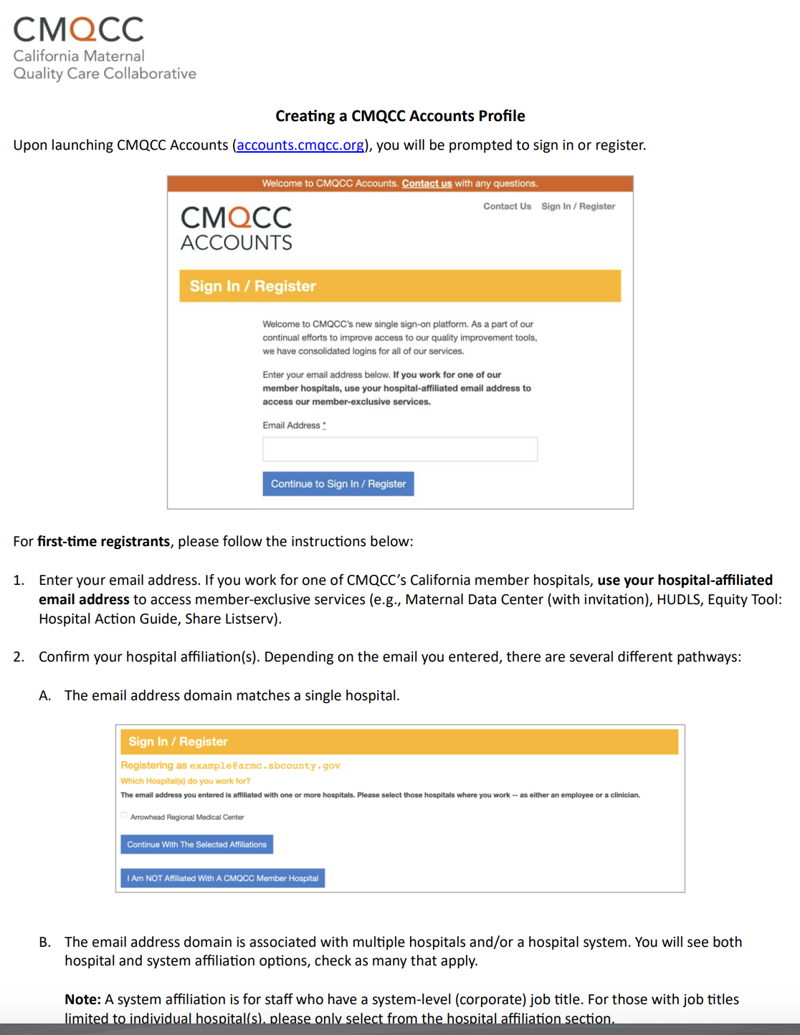

CMQCC Accounts
Profile
https://tinyurl.com/createcmqccacct
Notes:
We launched the Hospital Action Guide in August and we want to remind you that the Action Guide is intended for CMQCC California Member Hospitals. These more than 215 hospital members have access to various tools, but their staff must have what we call a “CMQCC Account Profile.”
We have developed an easy tutorial about how to create your account profile shown here. If you are affiliated with a hospital and you do not yet have a CMQCC Account, please follow this step-by-step process. To access this document, enter the Tiny URL link or point your phone camera at the QR code and you can bring it up on your phone.

Slide 41
Resources and Feedback
Slides
Website – Within 1 Week
On Demand
Video
Website & YouTube – Within 1 Week
Evaluation
Coming within 48 hours via email

Slide 42

Next Webinar

Slide 43

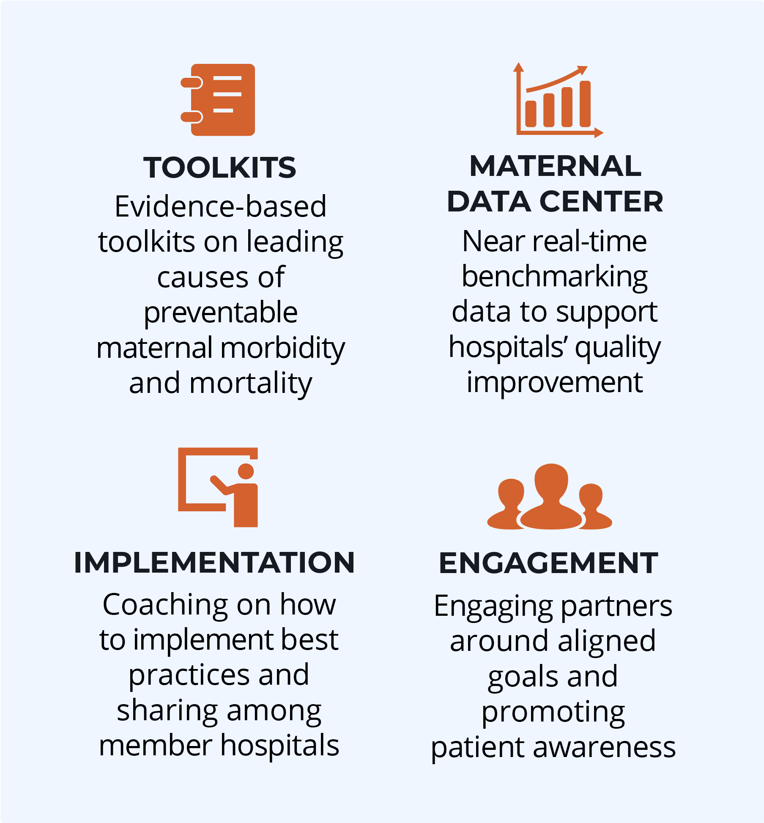
Thank you for joining us today!
End preventable morbidity, mortality, and racial disparities in California maternity care
Follow us! Facebook, Instagram, X and LinkedIn

