Slide 1
Improving Health Care
Response to
Obstetric Hemorrhage V3.0
A California Quality Improvement Toolkit
April 2022
Notes:
Title Slide layout

Slide 2
Terminology Throughout the Presentation
The terms ‘mother’ or ‘maternal’ or ‘she’ or ‘her’ are used in reference to the birthing person. We recognize not all birthing people identify as mothers or women. We believe all birthing people are equally deserving of patient-centered care that helps them attain their full potential and live authentic, healthy lives.
The term family is used to refer to any persons the pregnant or postpartum patient designates as such (alternatives: partners, husbands, support persons, loved ones).
The term clinician is used to denote nursing and medical staff; whereas the term providers refers to clinicians with diagnosing and prescribing authority.
The language around disclaimers and terminology are committee opinions and your own institution should be consulted for appropriate language to utilize.

Slide 3
Learning Objectives
Know the impact of obstetric hemorrhage on morbidity and mortality
Describe the management guidelines for obstetric hemorrhage
Identify systems of support for women, families and caregivers after an obstetric hemorrhage
Understand the importance of debriefs, case reviews, process measures and outcome measures in obstetric quality improvement
Learn implementation strategies for best practices
Notes:
TALKING POINTS:
The objectives of this educational slide deck are for the learner to:
Know the impact of obstetric hemorrhage on morbidity and mortality
Describe the management guidelines for obstetric hemorrhage
Identify systems of support for women, families and caregivers after an obstetric hemorrhage
Understand the importance of debriefs, case reviews, process measures and outcome measures in obstetric quality improvement
Learn implementation strategies for best practices

Slide 4
Introduction
Elliott Main, MD
Stanford University School of Medicine
CMQCC Medical Director

Slide 5
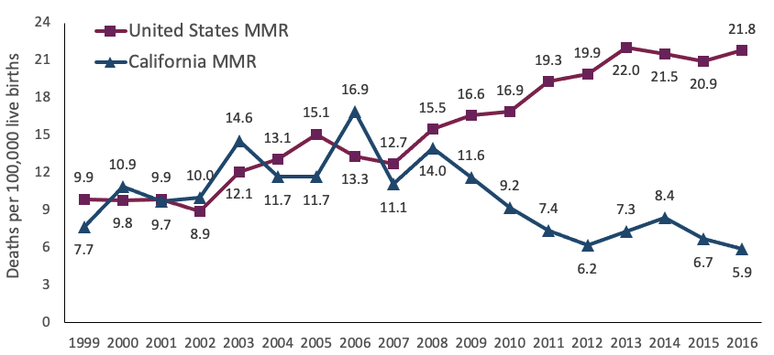
Maternal Mortality Ratios in U.S. and California, 1999-2016
California Maternal
Quality Care Collaborative
Multi-stakeholder collaborative founded in 2006, Celebrating 15 years!
Launched with funding from California Department of Public Health to address rise in maternal mortality
Maternal Mortality Reviews to Action:
  Quality Improvement Toolkits
  Large-scale QI Change Collaboratives
  Partner with everyone
  Maternal Data Center
CA-PMSS Surveillance Report: Pregnancy-Related Deaths in California, 2008-2016. Sacramento: California Department of Public Health, Maternal, Child and Adolescent Health Division. 2021.
CMQCC Mission: End preventable morbidity, mortality and racial disparities in maternity care
Notes:
TALKING POINTS
•CA’s Maternal Mortality rate has been significantly lower than the US sine 2010/2011. Note that the maternal mortality rate is defined by deaths during pregnancy or within 42 days of delivery that are related to or aggravated by the pregnancy. CMQCC started doing large scale quality collaboratives in 2009.

Slide 6
CMQCC Obstetric Hemorrhage Task Force Chairs
Providence St. Joseph Health
David Lagrew, MD
Jennifer McNulty, MD
MemorialCare™ Miller Children’s and Women’s
Hospital Long Beach
Huntington Hospital
Christa Sakowski, MSN, RN, C-EFM, CLE
Valerie Cape
Stanford SoM, CMQCC
Stanford SoM, CMQCC

Slide 7
CMQCC HDP Task Force Members
Susan McKamy Adams, Pharm D, BCPS | MemorialCare™ Miller Children’s and Women’s Hospital Long Beach
Alexander Butwick, MBBS, FRCA, MS | Stanford University Medical Center
Nadia Carrasco, RN, MS | University of California, Davis
Stephen Girolami, MD | Providence St. Joseph Health
Elliott Main, MD | Stanford University School of Medicine, CMQCC
Courtney Martin, DO | Loma Linda University
Emily McCormick, MPH, BSN, RNC-MNN, C-ONQS | Stanford University School of Medicine, CMQCC
Christine H. Morton, PhD | Stanford University School of Medicine, CMQCC
Diana Ramos, MD, MPH | California Department of Public Health Center for Health Communities
Dianne Redell | Providence St. Joseph Health, Orange
Leah Romine, RN | Torrance Memorial Medical Center
Melissa G. Rosenstein, MD | University of California San Francisco
Angelyn Thomas, MD | Sutter Alta Bates Medical Center
Tammy Turner, RN | Martin Luther King Jr. Community Hospital
Kristen Terlizzi | National Accreta Foundation
Jamie Vincent, RNC-OB, C-EFM | John Muir Medical Center
Notes:
TALKING POINTS
A fabulous Multidisciplinary group of clinicians of many specialties, nurses, and patients with lived experience.

Slide 8

Obstetric Hemorrhage in the U.S. and California

Slide 9
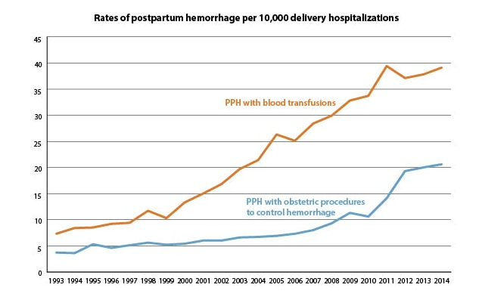
Postpartum Hemorrhage Rates in the U.S., 1993-2014 (CDC data)
CDC: https://www.cdc.gov/reproductivehealth/maternalinfanthealth/severematernalmorbidity.html
Notes:
TALKING POINTS:
“PP Hemorrhage is reported to occur between 2-5% of all births depending definition and completeness of data collection. This is interesting data from the CDC showing PPH hemorrhage that required serious treatments, either blood transfusions or additional procedures to control the bleeding such as balloons, arterial ligations or hysterectomy. The rates reported here (2 to 4 per 1,000) are low in comparison to other studies but the trends are quite concerning. More recent data suggest that the rates are still rising.”
This figure shows the rate of postpartum hemorrhage (PPH) per 10,000 delivery hospitalizations from 1993 through 2014. Postpartum hemorrhage is when a woman has heavy bleeding after delivery.
PPH with obstetric procedures to control hemorrhage include
Surgical repair of a deep cut or tear of the uterus.
Uterine artery ligation/embolization (tying off the vessel or identifying and injecting material into the bleeding vessel).
Obstetric tamponade of uterus or vagina (packing with gauze or using a medical device).
Hysterectomy (surgery to remove the uterus).
PPH with blood transfusions is when a patient with PPH is given donated blood.
The rate of PPH with procedures to control hemorrhage increased from 4.3 in 1993 to 21.2 in 2014, with sharper increases in later years. The rate of PPH with blood transfusions also increased noticeably over time, from 7.9 in 1993 to 39.7 in 2014.
*Obstetric procedures to control PPH and blood transfusion were coded hierarchically, meaning that only blood transfusions were used to control PPH for the blood transfusion group, while procedures with or without blood transfusion could be used for the obstetric procedure group.

Slide 10
Pregnancy-Related Deaths by Cause, California
2011-2019 (N=549)
Pregnancy-related deaths include deaths within a year of pregnancy from causes related to or aggravated by the pregnancy or its management, as determined by expert committee review.
Abbreviations: CVD = Cardiovascular disease; Sepsis = Sepsis or infection; Hem = Hemorrhage; HDP = Hypertensive disorders of pregnancy; AFE = Amniotic fluid embolism; TPE = Thrombotic pulmonary embolism; CVA = Cerebrovascular accident; Anes = Anesthesia complications; Other = Other medical condition(s).
CA-PMSS: Pregnancy-Related Deaths in California, 2011-2019. Sacramento: California Department of Public Health, Maternal, Child and Adolescent Health Division. 2022.
Notes:
TALKING POINTS:
“The leading causes of pregnancy-related mortality that extends out to a year are similar in California data and in the US as a whole. Hemorrhage and Sepsis compete for the number 2 position after cardiovascular disease and ahead of hypertensive disorders thrombotic pulmonary embolisms and amnionic fluid embolisms. What makes Hemorrhage stand out is that in study after study it is judged to be 70-90% preventable.” Hemorrhage is the #2 cause of maternal mortality and is highly preventable.”
Cardiovascular disease (CVD) was the leading cause of pregnancy-related mortality among California women, accounting for 29% of deaths. Cardiomyopathy accounted for 16% of deaths, and 13% were due to other cardiovascular disease. Additional leading causes of pregnancy-related mortality were hemorrhage (15%) sepsis or infection (14%), and hypertensive disorders (10%). “Other” causes of death comprised a spectrum of underlying medical conditions including epilepsy, diabetes, liver diseases, respiratory conditions, lupus and other autoimmune conditions, among others.
Pregnancy-related mortality ratio (PRMR) = Number of pregnancy-related deaths per 100,000 live births, up to one year after the end of pregnancy. Pregnancy-relatedness determinations were made through a structured expert committee case review process. Data on U.S. PRMR are published by CDC Pregnancy Mortality Surveillance System (accessed at Pregnancy Mortality Surveillance System | Maternal and Infant Health | CDC on January 19, 2022).
Figure notes: Pregnancy-related deaths include deaths within a year of pregnancy from causes related to or aggravated by the pregnancy or its management, as determined by expert committee review.
Abbreviations: CVD = Cardiovascular disease; Sepsis = Sepsis or infection; Hem = Hemorrhage; HDP = Hypertensive disorders of pregnancy; AFE = Amniotic fluid embolism; TPE = Thrombotic pulmonary embolism; CVA = Cerebrovascular accident; Anes = Anesthesia complications; Other = Other medical condition(s).

Slide 11
Underlying Causes of Death from Obstetric Hemorrhage, CA-PAMR 2002-07, N=33
Obstetric hemorrhage accounted for 10% of all pregnancy-related deaths with a pregnancy-related mortality rate 0.8 deaths per 100,000 live births
OB Hemorrhage as complication
in other causes of death: 36 (11%)
  Amniotic Fluid Embolism (n=17)
  Preeclampsia (n=5)
  Sepsis (n=3)
  Acute Fatty Liver (n=2)
  Other cause (n=9)
The California Pregnancy-Associated Mortality Review. Report from 2002-2007 Maternal Death Reviews. Sacramento: California Department of Public Health, Maternal, Child and Adolescent Health Division. 2017
Notes:
TALKING POINTS:
“While uterine atony accounts for the majority of postpartum hemorrhages, it is important to remember the full differential diagnosis. As the less common causes have higher mortality rates either because of their severity such as placenta accreta or they may have blood loss hidden from view, such as uterine rupture, cervical laceration, and surgical injury that presents in the recovery room or later. In addition, severe postpartum bleeding can occur as part of other disease presentations including amniotic fluid embolism, severe preeclampsia, sepsis, and acute fatty liver”
Obstetric (or postpartum) hemorrhage (HEM) accounted for 10% (N=33) of all pregnancy-related deaths, and the overall pregnancy-related mortality rate was 0.8. Among the 33 hemorrhage deaths, the root causes were uterine atony in 14 cases (including two with retained placenta), placental issues (accreta/percreta) in 11 cases, uterine rupture in 5 cases, and surgical complications in 3 cases.
While the Committee determined that 33 (10%) of all the pregnancy-related deaths from 2002 through 2007 should be classified as obstetric hemorrhage, there were an additional 36 cases in which hemorrhage was a contributing cause of the death, for a total of 69 cases (21% of pregnancy-related deaths) where large amounts of blood products were transfused. For example, among the 24 cases grouped as amniotic fluid embolism, 17 (71%) involved extensive hemorrhage as a co-morbid issue. Severe hemorrhage was an important complication among other causes of death, including acute fatty liver, preeclampsia and sepsis
In a number of cases of deaths from hemorrhage, there was concealed bleeding which is especially dangerous—these are classically related to uterine rupture or vascular injury at the time of cesarean delivery.
Figure from the report:
The California Pregnancy-Associated Mortality Review. Report from 2002-2007 Maternal Death Reviews. Sacramento: California Department of Public Health, Maternal, Child and Adolescent Health Division. 2017

Slide 12
Health Care Provider Factors Contributing to Pregnancy-Related Deaths from Obstetric Hemorrhage, CA-PAMR, 2002-07, N=33 Cases
The California Pregnancy-Associated Mortality Review. Report from 2002-2007 Maternal Death Reviews. Sacramento: California Department of Public Health, Maternal, Child and Adolescent Health Division. 2017
Notes:
TALKING POINTS:
“In an in-depth review of a series of deaths from postpartum hemorrhage, the California maternal mortality review committee identified multiple contributing factors leading to the deaths. Delays in recognition leading to delayed or ineffective care each occurred in 3 quarters of cases. Misdiagnoses, lack of consultation and other factors occurred each occurred in an additional 20-30% of cases. Overall, over 90% of cases had at least one of these provider-level factors supporting the high level of preventability. These data are one of the underlying drivers for this toolkit.”
The quality improvement opportunities (QIOs) identified among the hemorrhage deaths in regards to health care providers included lack of recognition and response to clinical warning signs of severe bleeding, including not quantitatively assessing cumulative blood loss, missing the significance of low oxygen saturation levels and other abnormal vital signs. Several QIOs addressed issues around level of care and the need for smaller hospitals to either transfer patients requiring higher level of care or have a lower threshold for calling a rapid response team to address an emergent situation.
A key opportunity to improve outcomes involved communication issues among nurses and physicians, especially in situations where the obstetrician is not in the facility. Nursing staff need to understand when to notify the physician of a woman’s deteriorating status and be empowered to utilize the chain of command in their facility in the absence of timely response.
Six women who died of hemorrhage-related causes were Jehovah’s Witnesses who refused blood products that might have saved their lives. The Committee identified several quality improvement opportunities for these patients, including assessment for risk of hemorrhage, monitor prenatal levels of anemia and ensure adequate iron stores before birth, plan for delivery at a facility with the resources and skilled personnel to manage a severe hemorrhage and consider the use of cell saver or autologous blood donation prior to the delivery.
The most common alternative approach among the QIOs in the hemorrhage deaths was the need for standardized protocols to address severe hemorrhage. Delays in administration of life-saving blood products resulted from systems issues around communication between labor and delivery units and the blood bank. Patients with known risk for hemorrhage require a plan for delivery at a hospital with capacity to address their needs, and all obstetric physicians and nurses need training and education on how to manage postpartum hemorrhage using standardized protocols.
The most common quality improvement opportunity related to patient factors was around the need for patient education of the signs and symptoms that require immediate clinical care.
Figure from the report: The California Pregnancy-Associated Mortality Review. Report from 2002-2007 Maternal Death Reviews. Sacramento: California Department of Public Health, Maternal, Child and Adolescent Health Division. 2017

Slide 13
Impact of Racism on Maternal Health, Healthcare, and Outcomes
Race and ethnicity are social, not biologic, constructs: Dark skin does not increase a patient’s physiologic risk for hemorrhage
Black and Native American women have higher rates of morbidity and, most concerningly, Black women have higher case fatality rates
Non-Hispanic Black and Hispanic birthing people with a diagnosis of hemorrhage are 4.7 and 3.7 times more likely to die than white women
Clinicians should receive education about structural and institutional racism embedded in health policies and medicine, and how it manifests in maternity care
Gyamfi-Bannerman C, et al. Am J Obstet Gynecol 2018;219(2):185 e181-185 E110. Tucker ML, et al. Am J of Public Health 2007;97(2):247-251. Rosenberg D, et al. Ann Epidem 2006;16(1):26-32. Main E, et al. Obstet Gynecol 2015 Apr;125(4):938-947
Notes:
TALKING POINTS:
Anthropologists and other social sciences have long debunked the biological significance of race, noting that ‘race’ is a social construct, and its meaning within any culture reflects the values and priorities of that society.
Observed rates of worse outcomes for Black/Native women does not reflect their biological risk. Rather, the maternal and perinatal outcomes observed are the cumulation of a series of policy decisions that left those populations to live on impoverished lands, lacking access to sufficient health, education and safety.
Suggested Reading: Dorothy Roberts Fatal Invention: How Science, Politics, and Big Business Re-create Race in the Twenty-First Century
Many clinicians are unaware of this vast literature of research that demonstrates these points. However, clinicians would benefit from opportunities to learn about what is called the social determinants of health (economic and social conditions that influence individual and group differences in health status) and how the populations they serve have been affected by inequitable health care. Change is required at the policy level, but as institutional racism is called out as a factor in quality care we have an opportunity to improve maternity care for vulnerable women and their families.
Suggested Reading:
Gyamfi-Bannerman C, Srinivas SK, Wright JD, et al. Postpartum hemorrhage outcomes and race. Am J Obstet Gynecol. 2018;219(2):185 e181-185 e110.
Tucker ML, Berg CJ, Callaghan WM, Hsia J. The black-white disparity in pregnancy-related mortality from 5 conditions: Differences in prevalence and case-fatality rates. American Journal of Public Health. 2007;97(2):247-251.
Rosenberg D, Geller SE, Studee L, Cox SM. Disparities in mortality among high risk pregnant women in Illinois: a population based study. Ann Epidemiol. 2006;16(1):26-32.
Main E. et al. Pregnancy-related mortality in California. Causes, characteristics, and improvement opportunities. 2015;125:938-947. DOI: 10.1097?AOG.0000000000000746

Slide 14
Reducing Racial Disparities in Outcomes
In a CMQCC 130-hospital hemorrhage collaborative, hospitals that implemented the CMQCC hemorrhage safety bundle
  Reduced rates of SMM due to hemorrhage for all races
  Narrowed the outcome disparities between black and white women by > 60% (as measured by SMM and transfusion rates)
Black women are at increased risk for SMM for additional reasons:
  SMM is highly driven by transfusions – both anemia and cesarean increase transfusion risk
    Anemia is a risk factor for hemorrhage and more Black women (2-4x) are anemic at term
    Black women are more likely to have an NTSV cesarean
Main, EK, , et al. American Journal of Obstetrics and Gynecology. 2020;223(1):123 e121-123 e114. Smith, CT, et al. Obstetrics and Gynecology. 2019;134(6):1234-1244.
Notes:
TALKING POINTS
“Following the introduction of version 2 of the CMQCC Hemorrhage toolkit in 2015 we supported implementation with an intensive learning collaborative that engaged 120 California hospitals over an 18 month period. Enrolled hospitals had over a 20% reduction in severe complications from hemorrhage while hospitals that were not enrolled had only a 1% reduction. On follow-up analysis, implementing the toolkit appeared to improve outcomes for women of all races and ethnicities. In fact, while Black gravidas had the highest rates of severe maternal morbidity at the start, they had the greatest reduction of severe morbidity following introduction of the toolkit. The Black/White gap was closed by over 60%. This underscores the importance of standardized approaches to OB emergencies as a key part of the efforts to reduce disparities. Of note much of the residual SMM excess among Black gravidas was related to significantly higher rates of prenatal anemia and the much higher rates of primary cesarean deliveries. Both of these are being targeted for their own quality improvement efforts.”
Disparities exist, and reflect inequitable care for for Black /Native women. How can we address this in obstetrics?
One way is through overall implementation of a maternal safety bundle. Not all implementations result in reduced disparity- it is important to ensure that the implementation doesn’t worsen disparities
Another way is to ensure that women, especially Black women, are not anemic in late pregnancy. A shared decision making model should structure the conversation with the patient about the need for iron and the risks of anemia.

Slide 15

Introducing the Toolkit
Christa Sakowski, RN, MSN
CMQCC Clinical Lead
Notes:
TALKING POINTS

Slide 16
Summary of Changes in this Edition
* Equity issues recognized throughout the toolkit
Obstetric Hemorrhage Risk Factor Assessment
Parameters added for ongoing risk assessment
Definition, Early Recognition and Rapid Response to Obstetric Hemorrhage Using Triggers
Emphasizes importance of assessment for concealed hemorrhage
Best Practice Techniques to Assess Quantitative Cumulative Blood Loss
Underscores strong support for quantitative blood loss, along with definition clarification
Medications for Prevention and Treatment of Postpartum Hemorrhage
Recommendation changes for misoprostol; updated recommendations for use of tranexamic acid (TXA)
Blood Product Replacement: Obstetric Hemorrhage
Discusses decrease in enthusiasm for rFactor VIIa
Notes:
TALKING POINTS:
Updates have been made to previous toolkit content such as:
Parameters added for ongoing risk assessment at admission, the start of the 2nd stage of labor, transfer to postpartum care, and as the patient’s status changes during the birth hospitalization
Emphasizes the importance of assessment for concealed hemorrhage
Strong support for quantitative blood loss , along with clarification of definitions
Changes in the recommendation for misoprostol and updated recommendations for use of tranexamic acid (TXA) as an adjunctive therapy
Further decrease in enthusiasm for rFactor VIIa
Birth Equity Integration throughout the toolkit

Slide 17

NEW Sections in this Edition
Implementing and Sustaining Maternal Quality, Safety and Performance Improvement for Maternal Hemorrhage
Using the Electronic Health Record (EHR) to Improve the Management of Obstetric Hemorrhage
Management of Iron Deficiency Anemia
Secondary Obstetric Hemorrhage and Readmission
Using Outcome Metrics for Hemorrhage-Related QI Projects
Notes:
TALKING POINTS:
NEW Sections added including:
Implementing and Sustaining Maternal Quality, Safety and Performance Improvement for Maternal Hemorrhage
Using the Electronic Health Record (EHR) to Improve the Management of Obstetric Hemorrhage
Management of Iron Deficiency Anemia
Secondary Obstetric Hemorrhage and Readmission
Using Outcome Metrics for Hemorrhage-Related QI Projects

Slide 18
4 Rs: Components of Quality Improvement*
Readiness
  Every Facility
  Preparations/supplies
  Medication access
  MTP and emergency blood release
  Education/Simulations
Recognition & Prevention
  Every Patient
  Assessment, diagnosis and classification
  Measurement of quantitative, cumulative blood loss
  Active management 3rd stage
Response
  Every Hemorrhage
  Unit-standard, stage-based emergency management plans with checklists
  Support for patients, families and staff
Reporting and Systems Learning
  Every Unit
  Established huddle culture including debriefs
  Multidisciplinary reviews
  QI measures
  Outcome monitoring and process metrics
  Documentation and coding
*National efforts are underway to define a 5th R: Respectful Care to be interwoven into the original 4 Rs, underscoring the importance of patient experience
ACOG. Obstetric hemorrhage patient safety bundle. https://safehealthcareforeverywoman.org/aim/patient-safety-bundles/maternal-safety-bundles/obstetric-hemorrahage-patient-safety-bundle-2/. Published 2015.
Notes:
TALKING POINTS:
The revised Toolkit introduces guidelines on best practices for obstetric hemorrhage and is organized using the 4R principles of Readiness, Recognition, Response, and Reporting to align with national maternal safety bundles from the Alliance for Innovation in Maternal Health (AIM).
*National efforts are underway to define a 5th R: Respectful Care to be interwoven into the original 4 Rs, underscoring the importance of patient experience
The revised content of the Toolkit has been aligned with:
National Partnership for Maternal Safety Hemorrhage Bundle
Quality Improvement framework 4Rs: Readiness Recognition, Response and Reporting
The Joint Commission Standards for Maternal Safety

Slide 19
Readiness
Implementation
Risk Factor Assessment
Iron Deficiency Anemia
Placenta Accreta Spectrum
Inherited Bleeding Disorders
Declining of Blood Products
Hemorrhage Carts, Kits
Simulation and Drills
EHR Integration
Low-resource Considerations

Slide 20
Implementation is not a ‘one-size fits all’ endeavor
Perinatal quality, safety, and performance improvement is a continuous and adaptive process
Identify and optimize existing data resources such as internal/external databases or dashboards, data reports, patient safety incident reporting systems and department review workflows
Develop a data monitoring and communication plan that clarifies what measures to track, trend, and monitor; and where they need to be reported to align with regulatory and system goals
Notes:
TALKING POINTS:
“Implementation is not a ‘one size fits all’ endeavor, and each facility will need to address unique challenges depending on local resources and organizational priorities. Bundle implementation—whether it occurs all at once or incrementally over time—is critical to achieve meaningful, sustainable and systems-level improvements that will improve hospital-based perinatal outcomes. We encourage a rapid-cycle Plan-Do-Study-Act (PDSA) approach to implementation. It is important to remember that quality improvement work should never be dependent on a single person, but rather operate as an integrated unit-level process that can be easily replicated to ensure ongoing success!
Data resources should be used to monitor key clinical criteria and interventions for hemorrhage. Each hospital will need to address unique challenges dependent upon their local resources and organizational priorities utilizing a multidisciplinary team approach.”
Implementation is not a ‘one size fits all’ endeavor, and each facility will need to address unique challenges depending on local resources and organizational priorities. Bundle implementation—whether it occurs all at once or incrementally over time—is critical to achieve meaningful, sustainable and systems-level improvements that will improve hospital-based perinatal outcomes. We encourage a rapid-cycle Plan-Do-Study-Act (PDSA) approach to implementation. Learn about PDSA cycle here: Institute of Healthcare Improvement (IHI). It is important to remember that quality improvement work should never be dependent on a single person, but rather operate as an integrated unit-level process that can be easily replicated to ensure ongoing success!
Data resources should be used to monitor key clinical criteria and interventions for severe hypertension/preeclampsia. Each hospital will need to address unique challenges dependent upon their local resources and organizational priorities utilizing a multidisciplinary team approach.

Slide 21
The Joint Commission Standards for Maternal Safety
These can function as a bundle checklist to guide this toolkit’s implementation
Complete an assessment using an evidence-based tool for determining maternal hemorrhage risk on admission to labor and delivery and on admission to postpartum.
Develop written evidenced-based procedures for managing pregnant and postpartum patients who experience maternal hemorrhage.
Each obstetric unit has a standardized, secured, and dedicated hemorrhage supply kit that must be stocked per the hospital’s defined process.
Provide role-specific education to all staff and providers who treat pregnant/postpartum patients about the hospital’s hemorrhage procedure.
Conduct drills at least annually to determine system issues as part of ongoing quality improvement efforts. Hemorrhage drills include a team debrief.
Review severe hemorrhage cases that meet criteria established by the hospital to evaluate the effectiveness of the care, treatment, and services provided to the patient during the event.
Provide printed education to patients.
Provision of care, treatment, and services standards for maternal safety.
https://www.jointcommission.org/-/media/tjc/documents/standards/r3-reports/r3_24_maternal_safety_hap_9_6_19_final1.pdf2019.
Notes:
TALKING POINTS:
Reporting and systems learning content highlighted in the Alliance for Innovation on Maternal Health (AIM) and the California Maternal Quality Care Collaborative (CMQCC) hemorrhage and maternal safety bundles informed The Joint Commission (TJC) in developing Standards for Maternal Safety (PC.06.01.01) to reduce the likelihood of harm related to obstetric hemorrhage. TJC Standards for Maternal Safety, effective January 1, 2021, go beyond metric benchmarks and require leaders of hospitals, health systems and birth facilities to examine the processes and procedures surrounding the care of women experiencing maternal hemorrhage and hypertension/preeclampsia with severe features. While the intention of these standards is to improve the quality and safety of perinatal care in TJC-accredited hospitals, standards such as these are useful for all birth facilities to review and adopt, regardless of the accreditation body, to ensure quality care for women and their newborns.
The Joint Commission Standards for Maternal Safety dedicated to obstetric hemorrhage are organized around 7 Elements of Performance (EP), which are closely aligned with the 4R Framework of this Toolkit. These seven EPs are recommended as a bundle to guide the implementation of this Toolkit. This approach will organize and focus implementation efforts and ensure that the birth facility is ready for the TJC accreditation process.
Those that have participated in CMQCC hemorrhage collaboratives will find these standards familiar and in alignment with structure and process measures introduced during that work.
Joint Commission. Provision of care, treatment, and services standards for maternal safety. https://www.jointcommission.org/-/media/tjc/documents/standards/r3-reports/r3_24_maternal_safety_hap_9_6_19_final1.pdf2019.

Slide 22
Ongoing Risk Factor Assessment
All pregnant patients should have a prenatal evaluation for key risk factors associated with major obstetric hemorrhage, such as placenta accreta spectrum, placenta previa, coagulation disorders, anticoagulation medication(s), and anemia
All patients should undergo intrapartum obstetric hemorrhage risk assessment on admission, at the start of the second stage of labor, at transfer to postpartum care, and any time the patient’s condition changes
Up to 40% of patients who experience PPH have no identifiable risk factors¹
Dilla AJW, et al. Obstet & Gynecol 2013;122(1):120-126. Ruppel HL, et al. Am J of Perinatol, 2020. Kawakita T, Obstetrics and Gynecology. 2019;134(6):1308-1316. Ende HB, et al. Obstetrics and Gynecology. 2021;137(2):305-323.
Notes:
TALKING POINTS:
Obstetric hemorrhage is considered the most preventable cause of maternal death, with some estimates saying up to 70% of cases were preventable.¹ Using an obstetric risk assessment tool can raise awareness about hemorrhage prevention and treatment for clinicians and patients. In its guidelines for Standards for Maternal Safety, The Joint Commission mandates that hemorrhage risk assessment be performed for every pregnant person on admission to labor and delivery, as well as on admission to postpartum. Therefore, hemorrhage risk assessment is now a process measure for every patient in labor.
If a patient is identified as high-risk for obstetric hemorrhage, experienced staff and key resources can be mobilized in advance of delivery. Decisions about the timing, mode and location for delivery may be influenced by each patient’s risk. For example, patients at high risk for severe hemorrhage, such as placenta accreta spectrum, may be advised to plan to give birth at a high level of care center that has in-house surgical and anesthesia staff, a well-stocked blood bank, and the necessary equipment and resources for managing severe obstetric hemorrhage.
Performing risk assessments may allow the maternity team to better prepare for the majority of hemorrhages, although no risk assessment guide has been proven to capture every patient who experiences an obstetric hemorrhage.
California Department of Public Health. The California Pregnancy-Associated Mortality Review. Report from 2002 - 2007 maternal death reviews. 2019.
New York City Department of Health and Mental Hygiene. Women’s experiences with severe maternal morbidity in New York City: A qualitative report. New York, NY2020.

Slide 23
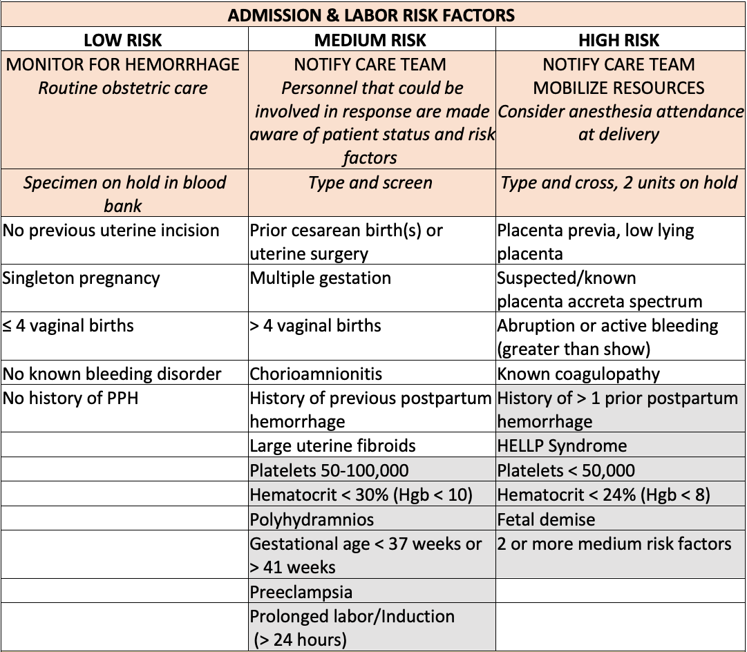
The risk factors
shaded in gray have been added since OB Hemorrhage Toolkit V2.0 (2015)
Notes:
TALKING POINTS:
CMQCC’s Risk Assessment V3.0 has been updated to reflect the latest research.^{8,16-20} Several risk assessment tools have been promoted by maternal safety agencies, including CMQCC, the Association of Women’s Health, Obstetrics and Neonatal Nurses (AWHONN) and the Safe Motherhood Initiative (SMI).^{23,24} Based on expert opinion, these tools classify patients as low-, medium- and high-risk for obstetric hemorrhage to guide resource preparedness at the facility level. Ultimately, performing risk assessments serve to increase surveillance and vigilance so that response and treatment can be timely. While there will always be sudden, severe hemorrhages that require activation of a massive transfusion protocol, foreknowledge of high hemorrhage risk status can allow resources to be readily available, whether blood products, hemorrhage carts, staff, or an open OR. This represents a proactive, rather than reactive, approach to hemorrhage response.
Many of these risk factors will look familiar to you if you have utilized CMQCC’s risk factor assessment. Those shaded in gray have been added since OB Hemorrhage Toolkit V2.0
Blood bank recommendations should be highly localized. Many institutions no longer hold a specimen in the blood bank, while others utilize automated technology to type and screen all obstetric patients. An example of a risk-based approach is included in the table below.
Ruppel, HL, V. X.; Gupta, N. R.; Soltesz, L.; Escobar, G. J. Validation of postpartum hemorrhage admission risk factor stratification in a large obstetrics population. American Journal of Perinatology. 2020.
16. Wu, SK, M.; Hibbard, J. U. Abnormal placentation: Twenty-year analysis. American Journal of Obstetrics and Gynecology. 2005;192(5):1458-1461.
17. Dilla, AJW, Jonathan H.; Yazer, Mark H. Clinical validation of risk stratification criteria for peripartum hemorrhage. Obstetrics and Gynecology. 2013;122(1):120-126.
18. Kawakita, TM, N.; Huang, J. C.; Landy, H. J. Evaluation of risk-assessment tools for severe postpartum hemorrhage in women undergoing cesarean delivery. Obstetrics and Gynecology. 2019;134(6):1308-1316.
19. Ende, HBL, M. J.; Chestnut, D. H.; Osmundson, S. S.; Walden, R. L.; Shotwell, M. S.; Bauchat, J. R. Risk factors for atonic postpartum hemorrhage: A systematic review and meta-analysis. Obstetrics and Gynecology. 2021;137(2):305-323.
20. Pressly, MAP, R. S.; Waters, J. H.; Beck, S. L.; Jeyabalan, A.; Clermont, G. Improvements and limitations in developing multivariate models of hemorrhage and transfusion risk for the obstetric population. Transfusion. 2021;61(2):423-434.
23. ACOG District II. Safe Motherhood Initiative: Obstetric hemorrhage. Published 2021. Accessed 2/18/2021.
24. Association of Women’s Health Obstetric and Neonatal Nurses. Postpartum hemorrhage (PPH) risk assessment table 1.1. https://cdn-links.lww.com/permalink/aog/b/aog_134_6_2019_10_06_kawakita_19-1065_sdc2.pdf. Published 2017. Accessed 2/18/2021.

Slide 24
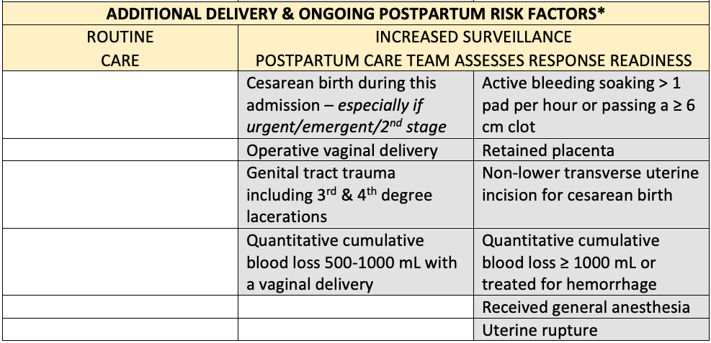
*TJC requires that an assessment using an evidence-based tool for determining maternal hemorrhage risk be completed on admission to labor and delivery and on transfer to postpartum
Notes:
TALKING POINTS:
TJC requires that an assessment using an evidence-based tool for determining maternal hemorrhage risk be completed on admission to labor and delivery and on transfer to postpartum. The risk assessment table as ben updates to include delivery and ongoing PP risk factors.
Postpartum providers should be trained in risk assessment and coordinated resource activation. The care team responsible for hemorrhage response should communicate medium- and high-risk status and risk factors with the patient and their support team.

Slide 25
What resources to mobilize based on risk?
Hemorrhage cart outside of the room
Consideration of hemorrhage risk in staffing ratios
Ensure QBL equipment is available and present at delivery
Prepare for the possibility of emergency
  Communication to affected team
  Blood bank orders per hospital protocol
  Room geographically close to the OR
  Area cleared of obstructions
Consider potential use of rapid infuser or cell saver technology as applicable
Increase patient surveillance
  Frequent rounding
  Vital sign and fundal checks
  Bleeding assessments
Psychosocial well-being of patient and family
Notes:
TALKING POINTS:
While the care plan will depend on the cause of the elevated hemorrhage risk (i.e., planning interventions for placenta accreta spectrum is different than planning interventions for chorioamnionitis), it is important to develop a standardized approach for communicating hemorrhage risk within the care team.
Communication to the team may be done in the following ways:
Add an alert to the EHR banner to identify high-risk patients.
Identify patients who decline blood or blood products and review their advance medical directive or refusal checklist. Patient preferences regarding transfusion should be communicated to the care team and actively incorporated into the care plan. (See section Planning for Women who may Decline Blood and Blood Products.)
Clearly identify the patient’s risk on the labor and delivery whiteboard
Make the hemorrhage risk assessment a standard data element included in safety huddles and patient handoffs
Before birth, the care team should ensure that all providers are aware of patient risk levels. For patients considered high-risk, individual staff should be assigned specific roles (i.e., QBL measurement, activating the MTP, administrating uterotonic medications, preparing necessary supplies/equipment, opening the OR, scribing, patient reassurance and communicating with the family). We advise appraising team members of the potential for obstetric hemorrhage and for planning appropriate mitigation strategies.
REVIEW SLIDE

Slide 26
Jennifer McNulty, MD
MemorialCare™
Miller Children’s and Women’s Hospital
Long Beach

Slide 27
Prenatal Considerations
Iron Deficiency Anemia (IDA)
  Anemia is an important, modifiable contributor to SMM
  Tx with (IV) iron products should be considered for women with IDA who are not successfully treated with oral iron, or in whom rapid iron repletion is indicated, such as in the third trimester
Inherited Coagulation Disorders
  Identify inherited coagulation disorders early in care and plan in advance for treatment
Declining Blood Products
  Prenatal optimization of hemoglobin and a detailed management plan for delivery/postpartum are critical steps for patients who may decline transfusion of some or all blood products
Placenta Accreta Spectrum (PAS)
Notes:
TALKING POINTS:
Iron Deficiency Anemia is defined as a hemoglobin <11.0 gm/dL in the first trimester The first line treatment for IDA is typically oral iron supplementation. Ferrous iron compounds have the highest bioavailability compared to ferric iron and carbonyl iron. Oral iron must be taken with an empty stomach (such as at bedtime) and at least one hour before food is ingested, otherwise absorption is substantially reduced. Repletion of iron stores and normalization of serum ferritin may require 4-6 months of treatment, so early identification of anemia is important – and especially important for those that will not accept blood or blood products. Intravenous iron, usually a 1 gram total dose, should be given when barriers to oral iron therapy are apparent such that achieving the goal hemoglobin of > 11.0 gm/dL at childbirth appears unlikely, and rapid iron repletion is needed. Examples might include first trimester anemia which has worsened or failed to improve with oral iron therapy by the second trimester, a hemoglobin of < 10.0 gm/dL in the third trimester or in the context of anticipated preterm birth.
Although relatively rare in pregnant women, Inherited Coagulation Disorders can lead to maternal hemorrhage events during antepartum, birth or postpartum and can have deleterious effects on the health of both the mother and baby. Identifying patients with inherited coagulation disorders and carefully planning their care is crucial for optimal outcomes.
In order to effectively prepare and plan for patients who decline the use of blood products, discussions regarding alternatives should occur in advance of emergencies. In order to optimize hemoglobin and coordinate care in advance of birth, patients need to be asked about their attitude towards blood transfusions in the prenatal care setting. The Task Force recommends an optimal hemoglobin level of at least 12.0 gm/dL for a patient who refuses blood or blood products in order to buffer blood loss at birth. As noted in the Toolkit section on Management of Iron Deficiency Anemia, it may take 4-6 months to replete iron stores and normalize serum ferritin. Therefore, early identification of prenatal anemia is important, and those who refuse blood products may need iron supplementation even if their hemoglobin is within normal limits.

Slide 28
Management of Iron Deficiency Anemia
IDA prevalent in pregnant persons and disproportionately affects Black and Hispanic women
Care should focus on engaging the patient in the goals of:
  Reducing anemia at childbirth
  Decreasing risks of transfusion
  Potentially improving postpartum recovery
Providing detailed information about how to correctly take oral iron therapy is crucial
Oral ferrous iron compounds are the first line treatment
Treatment intravenous (IV), typically with a total dose of 1 gm, can be considered if oral iron unsuccessful or when rapid iron repletion is indicated
Notes:
TALKING POINTS:
Anemia in pregnancy was identified as an important and potentially modifiable contributor to severe maternal morbidity (SMM).²
The main cause of anemia world wide, and in pregnancy specifically, is iron deficiency. Anemia in pregnancy is defined by the World Health Organization (WHO) as a hemoglobin concentration < 11.0 gm/dL. However, given the hemodilution that occurs in pregnancy, using hemoglobin alone to detect IDA and iron status in pregnant women is of uncertain sensitivity and specificity. Pregnancy requires a marked increased physiologic demand for iron. To meet both maternal and fetal needs, typically an additional 1 gm of elemental iron is needed during the pregnancy.⁵
Potential drivers for disparities in anemia rates by race/ethnicity may include social determinants of health, conditions associated with increased menstrual blood loss including earlier age of menarche, the prevalence of symptomatic fibroids and obesity, and systemic and institutionalized racism.¹¹⁻¹³ Race-based definitions for anemia cutoffs are no longer considered valid.¹⁴
Repletion of iron stores and normalization of serum ferritin may require 4-6 months of treatment, so early identification of anemia is important – and especially important for those that will not accept blood or blood products.
Daily dosing of 60 mg of ferrous iron, taken on an empty stomach after appropriate patient counseling and close follow-up for compliance is likely sufficient to treat most pregnant women identified with IDA defined as a hemoglobin < 11.0 gm/dL in the first trimester.
2. Ray JG, Davidson A, Berger H, Dayan N, Park AL. Haemoglobin levels in early pregnancy and severe maternal
morbidity: Population-based cohort study. British Journal of Obstetrics and Gynecology. 2020;127(9):1154-1164.
5. Georgieff MK. Iron deficiency in pregnancy. American Journal of Obstetrics and Gynecology. 2020;223(4):516-524.
11. Salsberry PJ, Reagan PB, Pajer K. Growth differences by age of menarche in African American and White girls. Nursing
Research. 2009;58(6):382-390.
12. Sekhar DL, Murray-Kolb LE, Kunselman AR, Weisman CS, Paul IM. Differences in risk factors for anemia between
adolescent and adult women. Journal of Women’s Health. 2016;25(5):505-513.
13. ACOG. Management of Symptomatic Uterine Leiomyomas: Practice Bulletin No. 228 of the American College of
Obstetricians and Gynecologists. Obstetrics and Gynecology. 2021;137(6):e100-e115.
14. ACOG. Anemia in pregnancy. Practice Bulletin No. 95 of the American College of Obstetricians and Gynecologists
Obstetrics and Gynecology. 2008 reaffirmed 2017;112(1):201-207.

Slide 29
Inherited Bleeding Disorders in Pregnancy
Inherited bleeding disorders present a risk for obstetric hemorrhage
It is crucial to identify inherited coagulation disorders early in care and to plan in advance of birth
Maternal-fetal medicine, hematology and anesthesia consultation should be obtained in advance of delivery to coordinate care
Notes:
TALKING POINTS
Recommendations
1. Review family, surgical and pregnancy history for possible clinical symptoms of excessive bleeding following surgery (including dental procedures), noticeable easy bruising, joint
hemorrhage, or menorrhagia (heavy menstrual bleeding).
2. Request the following laboratory screening tests^{20,23} for patients with suspected disorders:
- vWD: measurement of ristocetin co-factor activity and von Willebrand antigen (VIII:Ag) activity
- Hemophilia A: measurement of factor VIII activity (factor VIII:C assay)
- Hemophilia B: measurement of factor IX activity (If factor VIII:C is normal)
- Hemophilia C: measurement of factor XI activity
Additional laboratory tests to consider are complete blood count (especially platelet counts), activated partial thromboplastin time (APTT), prothrombin time, thrombin time and fibrinogen level. Note that patients with vWD typically display normal prothrombin time and variable prolongation of partial thromboplastin.
3. Affected patients or carriers, or patients with suspected history should consult with a hematologist who has specific interest and knowledge of coagulation disorders.^{5,9}
4. Obtain perinatal and anesthesia consultation for planning and coordination of antepartum and intrapartum management of patients with bleeding disorders.^{5,9,30} In general, regional anesthesia must be given with caution given the risks of spinal hematoma. Individualized decisions should be made in a multidisciplinary fashion. Current guidelines do not suggest the use of ROtational ThromboElastoMetry (ROTEM) or ThromboElastoGraphy (TEG) in decisionmaking for the use of regional anesthesia.³¹
5. Route of delivery for most patients with carrier status, which may cause neonatal coagulation disorders (e.g., factor VIII deficiency), should still be based on obstetric indications since studies have not shown a protective effect of cesarean for the neonate.^{2,3}
6. Refer patients for genetic counseling regarding possible testing and evaluation of the fetus and newborn if genetic etiology is suspected.^{5,9,29}
7. Develop intrapartum and postpartum management plans well in advance of the anticipated date of birth so specific medications and blood components are available at the time of delivery and given in consultation with a hematologist.^{5,9}
- vWD: Mild forms are often treated with desmopressin acetate (DDAVP) and more severe forms require vWF and VIII factor replacement.3 To identify whether patients will respond to DDAVP, perform a DDAVP challenge test.
- Hemophilia A/B: Concentrates of clotting factor VIII (for hemophilia A) or clotting factor IX (for hemophilia B) are slowly infused or injected into a vein. Consider DDAVP adjunctive therapy.
- Hemophilia C: Fresh frozen plasma (FFP) is the first product used to treat patients with hemophilia C. The main advantage of FFP/plasma is its availability. Disadvantages of its use include the large volumes required, the potential for transmission of infective agents and the possibility of allergic reactions.
- Factor XI activity: Factor XI concentrates provide the best source for factor XI replacement.
2. Gojnic M, Fazlagic A, Likie I, Stefanovic A, et al. New approach of the treatment of von Willebrand’s disease during
pregnancy. Archives of Gynecology and Obstetrics. 2005;273(1):35-38.
3. Michiels JJ, van Vliet HH, Berneman Z, Gadisseur A, et al. Intravenous DDAVP and factor VII-von Willebrand factor
concentrate for the treatment and prophylaxis of bleeding in patients with von Willebrand disease type 1, 2 and 3.
Clinical and Applied Thrombosis and Hemostasis. 2007;13(1):14-34.
5. Lee CA, Chi C, Pavord SR, Bolton-Maggs PH, Pollard D, et al. U. K. Haemophilia Centre Doctors’ Organization. The
obstetric and gynaecological management of women with inherited bleeding disorders--review with guidelines
produced by a taskforce of UK Haemophilia Centre Doctors’ Organization. Haemophilia. 2006;12(4):301-336.
9. Dunkley SM, Russell SJ, Rowell JA, et al. A consensus statement on the management of pregnancy and delivery in
women who are carriers of or have bleeding disorders. The Medical journal of Australia. 2009;191(8):460-463.
20. Sadler JE. A revised classification of von Willebrand disease. For the Subcommittee on von Willebrand Factor of the
Scientific and Standardization Committee of the International Society on Thrombosis and Haemostasis. Thrombosis
and Haemostasis. 1994;71(4):520-525.
23. Verbruggen B, Meijer P, Novakova I, Van Heerde, W. Diagnosis of factor VIII deficiency. Haemophilia. 2008;14 Suppl
3:76-82.
29. Tarantino MD, Gupta SL, Brusky RM. The incidence and outcome of intracranial haemorrhage in newborns with
haemophilia: Analysis of the Nationwide Inpatient Sample database. Haemophilia. 2007;13(4):380-382.
30. Katz D, Beilin Y. Disorders of coagulation in pregnancy. British Journal of Anaesthesia. 2015;115 Suppl 2:ii75-88.
31. Bauer ME, Arendt K, Beilin Y, et al. The Society for Obstetric Anesthesia and Perinatology Interdisciplinary Consensus
Statement on Neuraxial Procedures in Obstetric Patients With Thrombocytopenia. Anesthesia and Analgesia. 2021.

Slide 30
Planning for Patients Who May Decline Blood and Blood Products
Assess patient attitudes toward blood products in advance of labor or planned surgery
  Incorporate into standard anticipatory guidance and birth planning, ideally at the initiation of prenatal care
Facilitate care coordination and preparation for alternative interventions if blood products are not desired
Prenatal optimization of hemoglobin is a critical step
  The Task Force recommends an optimal hemoglobin level of
  > 12.0 gm/dL for a patient who refuses blood or blood products
Notes:
TALKING POINTS
There can be a range of blood interventions that patients will accept, and many may not be aware of alternatives to the traditional packed red blood cell (PRBC) transfusion. Therefore, it is imperative to begin discussions prenatally to educate and review all possible options that are available at the time of birth.
Use the risk assessment to plan interventions and availability of resources accordingly. Declining blood transfusion alone does not make patients at higher risk of hemorrhage but may increase their risk of morbidity and mortality and influences what treatment options are available.⁶
Review previous discussions of options and patient wishes, or have a discussion based on shared decision-making if not done prior to admission. Review their advanced medical directive or blood refusal form with any acceptable alternatives identified.
Limit blood draws/laboratory testing when possible (e.g., use low-volume pediatric microtainers).
Instead of using a specific hemoglobin level as a prompt for transfusion, identify a hemoglobin level that will prompt medical management or other alternative interventions.⁷
Consider earlier utilization of uterotonics or other interventions (e.g., TXA, intraoperative fibrin glues).
When surgical intervention is necessary, select minimally invasive procedures when possible. Consider bloodless management strategies like use of cell saver if given the opportunity, though this may not be available in an urgent/emergent cesarean setting.⁶
6. Van Wolfswinkel ME, Zwart JJ, Schutte JM, Duvekot JJ, Pel M, Van Roosmalen J. Maternal mortality and serious maternal morbidity in Jehovah’s witnesses in The Netherlands. British Journal of Obstetrics and Gynaecology. 2009;116(8):1103-1108; discussion 1108-1110.
7. Zeybek B, Childress AM, Kilic GS, Phelps JY, et al. Management of the Jehovah’s Witness in obstetrics and gynecology: A comprehensive medical, ethical, and legal approach. Obstetrical & Gynecological Survey. 2016;71(8):488-500.

Slide 31
Placenta Accreta Spectrum (PAS)
The risk for PAS is highest in women with a history of prior CS and current placenta previa
PAS risk increases with each subsequent cesarean
Ultrasound is the preferred tool for diagnosis of PAS
Best outcomes occur with planning in a Level III or IV center experienced in the care of mothers with PAS
Counseling should be offered for those patients with PAS to help diminish trauma associated with their birth experience
Attempts to remove the placenta prior to initiation of the hysterectomy should be avoided when PAS is diagnosed antenatally or is clearly evident at the time of delivery
ACOG; SMFM; Cahill AGB,et al. American College of Obstetricians and Gynecologists, Society for Maternal-Fetal Medicine. American Journal of Obstetrics and Gynecology. 2018;219(6):B2-B16. Martin JAH, et al. National Vital Statistics Reports. 2019;68(13):1-47.
Notes:
TALKING POINTS:
Placenta accreta spectrum (PAS), formerly referred to as morbidly adherent placenta, encompasses the full extent of pathologic adherence of the placenta, including placenta accreta, placenta increta and placenta percreta.¹ Placenta accreta spectrum is classified pathologically by the degree of invasion into the uterine wall. There are three variants of this condition: 1) accreta, which denotes the invasion of the placenta into the endometrium; 2) increta, where the placenta extends into the myometrium; and 3) percreta, where the placenta extends through the myometrium and uterine serosa. The rising incidence of placenta accreta spectrum is due to the rapidly rising numbers of cesareans.¹ The U.S. total cesarean rate peaked in 2009 at 32.9% and has slightly fallen since. In 2019 it was 31.6%.² As 86.2% of all US women with a prior cesarean have had a repeat cesarean, the impact of elevated rates of primary cesarean is enduring and affects subsequent pregnancy outcomes for millions of women.²
1. ACOG; SMFM; Cahill, AGB, R.; Heine, R. P.; Silver, R. M.; Wax, J. R. Placenta accreta spectrum. American College of Obstetricians and Gynecologists, Society for Maternal-Fetal Medicine. American Journal of Obstetrics and Gynecology. 2018;219(6):B2-B16.
2. Martin, JAH, B. E.; Osterman, M. J. K.; Driscoll, A. K. Births: Final data for 2018. National Vital Statistics Reports. 2019;68(13):1-47.

Slide 32
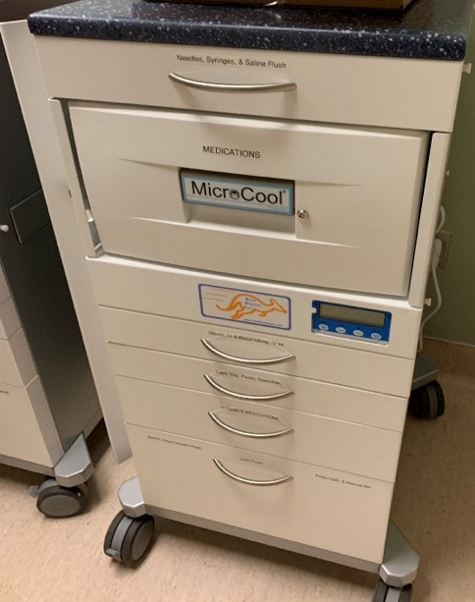

Hemorrhage Cart
Maintain carts containing obstetric hemorrhage treatment supplies that are stored in a readily accessible location(s)
Consider additional carts in care areas that are remote from the obstetric unit, or have a process in place to transport a cart from a central location
Photos used with permission of Jennifer McNulty, MD
Main EK, et al. Journal of Midwifery and Women's Health. 2015;60(4):458-464.
Notes:
TALKING POINTS:
A hemorrhage cart centralizes all of the supplies commonly used in the treatment of obstetric hemorrhage, significantly reducing the time needed for supportive staff to locate supplies.
Staff are able to stay at the bedside where they are most needed and care of the patient is streamlined. For ideal response to the emergency, the team should have rapid access to medications, devices and surgical instruments designed to treat PPH. Equipment and instruments contained in obstetric hemorrhage carts and trays are designed to perform uterine tamponade, complete uterine/ovarian artery ligation and repair of vaginal/cervical lacerations. Carts throughout the facility should be identical so that the Obstetric Rapid Response Team can move seamlessly through the emergency with ready access to all supplies and equipment.

Slide 33
Simulation and Drills
All team members who respond to obstetric emergencies should participate in multidisciplinary simulation/drill programs for effective response and debriefing of critical incidents
In situ drills are simulations that occur in the patient care area and can be a cost-effective way to maximize time and resources while improving the quality and safety of patient care
  May improve ability to address systems issues and provides practice in one’s own hospital setting with familiar resources
  Enables more team members to participate in simulation more frequently
Lutgendorf MA, et al. Military Medicine 2017;182(3):e1762-e1766. Main EK, et al. Obstet Gynecol. 2015 Jul;126(1):155-62. Andreatta PB, et al. Clinical Obstetrics and Gynecology. 2010;53(3):532-544. ACOG. Obstetric Drill Program Manual Postpartum Hemorrhage. Published 2019. Accessed 2/18/2021.
Notes:
TALKING POINTS:
Simulation has the potential to decrease maternal and neonatal morbidity and mortality by providing an opportunity to assess system weaknesses, identify opportunities for improvement and test new or modified policies and procedures. Simulation involves the entire team practicing in a realistic environment wherein the focus is not on a live patient but on the team, learners and methods.¹
Because hemorrhage is an infrequent event, simulation can provide an opportunity for teams to maintain proficiency and identify systems issues that impact care. Participants have the opportunity to practice skills and team communication, improve readiness and collaborate, and identify issues, concerns and barriers to care, all while in their actual working environment.⁷ Simulations also offer participants a safe space to practice how to communicate with a patient and family during an emergency, and the debrief addresses any gaps in team performance. It is critical that areas of care that have less opportunity to develop skills associated with identifying and responding to hemorrhage, such as postpartum units, participate in simulation and drills.
1. Andreatta PB, Bullough AS, Marzano D. Simulation and team training. Clinical Obstetrics and Gynecology. 2010;53(3):532-544.
7. ACOG. Obstetric Drill Program Manual Postpartum Hemorrhage. Published 2019. Accessed 2/18/2021.

Slide 34
Implicit Bias Training
Perinatal healthcare providers may benefit from participation in an implicit bias training designed to curtail the impact of bias on maternal health
While bias training alone will not lead to immediate improvements in disparities for birthing people of color, it can:
  Improve patient-provider communication
  Highlight behaviors that can be corrected
  Begin the work of providing more equitable care for pregnancy-capable people
Staff Education Resources
  Office of Minority Health (US HHS)
  Diversity Sciences
  March of Dimes
Notes:
TALKING POINTS:
In an effort to address bias in maternal health care, perinatal healthcare providers should participate in implicit bias training. While bias training alone will not lead to immediate improvements in disparities for birthing people of color, it can improve patient/provider communication, highlight behaviors that can be corrected, and begin the work of providing more equitable care for pregnancy-capable people. This is one strategy in this important work, and should be considered alongside other efforts to address inequities in obstetric care.
In California, these implicit bias trainings are mandatory as part of the SB 464 "California Dignity in Pregnancy and Childbirth Act", and must be repeated, at minimum, every 2 years. There are three examples of implicit bias trainings included here. The Office of Minority Health in the US Department of Health and Human Services created a module titled "Culturally and Linguistically Appropriate Services (CLAS) in Maternal Health Care. Diversity Sciences, in conjunction with the California Health Care Foundation, created an implicit bias training as part of their "Eliminating Inequities in Perinatal Health Care Project", and the March of Dimes developed a course titled "Breaking Through Bias in Maternity Care". These courses all fulfill the California requirement.

Slide 35
David Lagrew, MD
Providence St. Joseph Health

Slide 36
Electronic Health Record (EHR) to Improve Hemorrhage Management
Electronic health records (EHR) can provide a safety infrastructure for common conditions by utilizing tools:
  Documentation templates
  Best practice advisories/alerts (BPAs)
  Standardized order sets utilizing management algorithms
  Communication tools
  Reports communicating current status/evolving trends
EHR can automate vital sign assessment monitoring (early warning systems)
Care pathways and artificial intelligence associated with EHR have the potential to maximize and improve quality infrastructure in obstetric care, including hemorrhage
ACOG. Committee Opinion no. 621 of the American College of Obstetricians and Gynecologists. 2015. Atallah F, et al. Risk Management and Healthcare Policy. 2020;13:35-42.
Notes:
TALKING POINTS:
Utilization of the EHR may assist with decision support, improve efficiency of care, and make quality and safety metrics and up-to-date clinical guidelines for common conditions easily obtainable.⁴ In addition to improving outcomes, proper management techniques can mitigate risk.⁵ As EHR tools are developed and implemented, it is important to continually evaluate its effectiveness and safety. It is also recommended that quality improvement teams and leaders track metrics before and after implementation of EHR tools to ensure the purpose of the tools are realized and that there are no unintended consequences that affect the system or patients. Finally, providers and health care teams should be reminded that these systems and tools are intended as safety infrastructure and should not take the place of thorough history taking, in-person examinations and clinical judgement. Not every patient will be a candidate for EHR-guided care or fit into the care pathway recommendations.
4. ACOG. Patient safety and health information technology. Committee Opinion no. 621 of the American College of Obstetricians and Gynecologists. 2015.
5. Atallah, F, Goffman, D. Improving healthcare responses to obstetric hemorrhage: Strategies to mitigate risk. Risk Management and Healthcare Policy. 2020;13:35-42.

Slide 37
Hemorrhage Preparedness Considerations for
Small and Low-Resource Hospitals
Consideration for birth at a hospital with a higher maternal level of care should be discussed for prenatal conditions at high risk for hemorrhage
Communication and collaboration between departments and disciplines is essential
All staff need a clear picture of response times, blood product availability and time to obtain blood products
Teams should be mobilized early
Notes:
TALKING POINTS
Pre-planning for women at high risk for an obstetric hemorrhage to give birth at level III or IV hospitals will not prevent all hemorrhages from occurring at small hospitals, however, clinicians at the latter may be able to safely treat women with high-risk conditions if they have the appropriate resources and staffing availability (e.g., surgeons available with expertise in
managing placenta accreta spectrum). Patients with active bleeding will typically present to the closest hospital and up to 40% of women with no identified risk factors will develop a postpartum hemorrhage.3,4 Emergency scenarios should be practiced, simulated, discussed, and a plan developed to facilitate an optimal response to these situations.
There may be limited nursing resources available in the labor and delivery unit, emergency department (ED) and general hospital operating room(s) (OR). OR personnel may not be in-house at all times especially during nights, weekends, and holidays. There should be an expectation that OR personnel and staff home on call will be requested early in the event of a hemorrhage and for high-risk situations, not just when an emergency is already in progress.
Consider all hospital staff when mobilizing resources during an obstetric hemorrhage. A nursing supervisor or administrator may be able to assist with mobilizing personnel from other areas of the hospital or from home, and may find space in the OR, post anesthesia care unit, or a bed in the intensive care unit (ICU) to care for the patient. Nurses from the ED and ICU have critical care skills that are helpful during a hemorrhage. Medical-surgical nurses may be able to care for postpartum patients during an emergency or be a scribe during a hemorrhage. Trauma/general surgeons may be available as a surgical assist during a laparotomy and can also assist with obtaining vascular access in emergencies. Regardless of the size of the facility or personnel included, it is imperative that you have a designated rapid response team (RRT) in place to respond to obstetric emergencies. This team does not need to be entirely made up of obstetric-specific clinicians, but those expected to respond need to be prepared to address the specific needs of this patient population.
All types of blood products may not be stored at a facility; for example, platelets may need to be brought in from a central regional location outside of the hospital. Blood bank personnel should consult with the blood bank to identify the availability of each type of blood product and the processing time frames for each and communicate this information to the care team. Information about blood products should be posted in an easily accessible location on the unit and is critical education for all obstetric and anesthesia providers. This information may be
especially important to communicate to providers that are unfamiliar with the hospital’s specific processes, as it may impact their clinical decision-making process.
Conducting routine inter-departmental obstetric hemorrhage drills may assist the team in developing a shared mental model of response times, identifying opportunities for system
improvement, and ensuring there is adequate cross training in cases of emergency or unexpected hemorrhage.

Slide 38
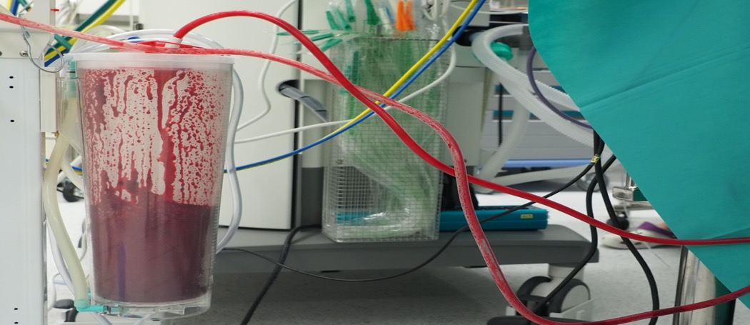
Recognition
Stage 3 Labor Management
Definition, Early Response
Best Practices to Assess Quantitative Cumulative Blood Loss

Slide 39
The American College of Obstetrics and Gynecology (ACOG) defines obstetric hemorrhage as
Cumulative Blood Loss
  1,000 mL for either vaginal or cesarean birth
  > 500 mL in a vaginal delivery is abnormal
The OB Hemorhage Task Force recommends enhanced surveillance and early interventions, as needed, in a vaginal delivery with ≥ 500 mL of blood loss with continued bleeding.
ACOG. Practice Bulletin #183. Obstet & Gynecol 2017;130(4):e168-186.
Notes:
TALKING POINTS:
There has been no change in the DEFINITION for obstetric hemorrhage in the toolkit from Version 2. Greater emphasis has been made that the need for response to abnormal blood loss should occur prior to meeting the definition of hemorrhage.

Slide 40
Active Management of Third Stage Labor (AMTSL)
Evidence-based analysis has established that AMTSL can reduce obstetric hemorrhage
  Studies evaluating individual components of AMTSL have confirmed only oxytocin administration as effective
Delayed cord clamping does not increase the risk for hemorrhage
Unit standardization of prophylactic oxytocin is recommended
Notes:
TALKING POINTS
In a 2019 Cochrane review of third stage of labor, the authors looked at eight studies representing a total of 8,892 patients and concluded that severe hemorrhage (> 1000 mL) could be reduced by active management of labor but was supported by weak evidence. For patients at low risk for hemorrhage, the benefits of implementing AMTSL were unclear aside from
oxytocin administration. The review concluded by recommending a shared decision-making approach for women at low-risk.
Evidence-based analysis has established a clear benefit of oxytocin prophylaxis in the third stage of labor for reducing maternal hemorrhage, but studies evaluating the individual components have not clearly demonstrated benefit of nonoxytocin components of AMTSL including uterine massage, immediate cord clamping and cord traction in low-risk women.
Based on the current evidence, management protocols should continue to support variations of AMTSL in all women but not allow the individual components to interfere with the
labor processes with the exception of the use of oxytocin. The World Health Organization recommends prophylactic oxytocin for all women, advises against sustained uterine massage for hemorrhage prevention when prophylactic oxytocin has been used, and recommends delayed cord clamping for all births unless there is an immediate need for neonatal resuscitation.¹
1. World Health Organization. WHO recommendations for the prevention and treatment of postpartum haemorrhage.
Updated from 2012. Geneva, 2018.
2. Begley CM, Gyte GM, Devane D, McGuire W, Weeks A, Biesty LM. Active versus expectant management for women in
the third stage of labour. Cochrane Database of Systematic Reviews. 2019;2:CD007412.

Slide 41
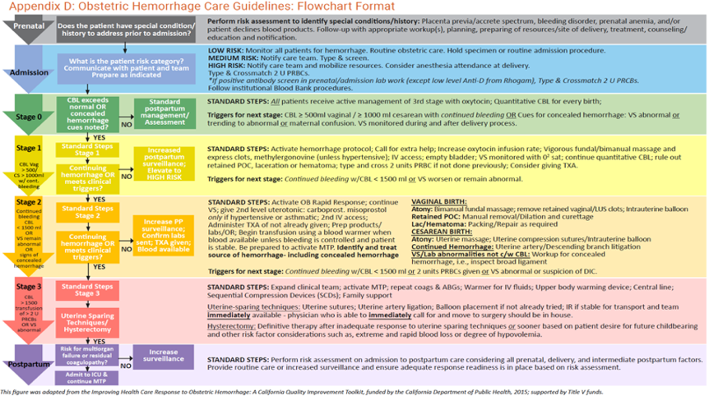
Clinical Triggers
Stage 0 – All Births
Stage 1 –
  CBL ≥ 500mL vaginal / ≥ 1000 mL cesarean with continued bleeding or
  Signs of concealed hemorrhage: VS abnormal or trending (HR ≥ 110, BP < 85/45, O2 sat < 95%, shock index 0.9) or
  Confusion
Stage 2 –
  Continued bleeding w/ CBL < 1500 mL or
  VS remain abnormal
Stage 3 –
  Continued bleeding with CBL > 1500mL or
  > 2 units PRBCs given or
  Abnormal VS or
  Suspicion of DIC
Notes:
TALKING POINTS:
While absolute numbers are important for Maternal Early Warning Systems, the following scenarios warrant elevated levels of concern from nursing and physician staff even if the cut off “parameters” are not yet met.
Vital signs are trending towards abnormal compared to the patient’s baseline
A febrile patient with tachycardia, especially post-cesarean, should be considered for a concealed hemorrhage coexistent with endometritis
Vital sign abnormalities that are not responsive to usual resuscitative measures
Patient confusion, lethargy, or change from baseline mental status
Pain unrelieved by standard postpartum medications

Slide 42




Terms and Techniques of Describing Blood Loss
EBL
QBL Gravimetric
QBL Volumetric
QBL Colorimetric
CBL
ESTIMATED BLOOD LOSS: Traditional estimation of blood loss by looking at the items such as sponges, drapes, blood in containers and determining blood loss. Tends to be normalized by over-estimating small losses and under-estimating large losses.
EBL measurements typically done at the end of the case by multiple observers. Research has shown training can improve the technique but that accuracy fades unless repeatedly trained.
QUANTITATED BLOOD LOSS BY GRAVIMETRIC TECHNIQUE: The blood loss is determined by weighing items and subtracting the dry weight of the sponge, gauze or contained to determine weight.
The method of QBL measurement has been made easier by imbedded calculation tools in the electronic record and by making sure scales are readily available.
QUANTITATED BLOOD LOSS BY VOLUMETRIC TECHNIQUE: The blood loss is determined by observing the total amount of volume containing blood and subtracting the volume represented by amniotic fluid or irrigation.
QBL measurement can be made more accurate and easier if workflow observations, such as brief determinations of volumes of amniotic fluid collection before blood suctioning at CS or before shoulders delivered in vaginal delivery.
QUANTITATED BLOOD LOSS BY COLORMETRIC TECHNIQUE: The blood loss is determined by a device which scans items or containers and estimates the amount by the size of spot (pixels) and intensity of color.
The method of QBL measurement requires specialized equipment and training. Workflow adjustments should be made to ease staff work in the OR and postpartum units.
∑
CUMULATIVE BLOOD LOSS: The ongoing blood loss is determined by adding up the individual EBL or QBL measurements for the events and is used to drive management steps and transfusion.
CBL is the best term to communicate the patient’s blood loss and should be visible in the patient electronic record and verbalized in communication between providers during events and handoffs.
Notes:
TALKING POINTS:
With the introduction of multiple methods for measuring blood loss, there are now more terms to define blood loss. This has created an issue of confusing terms describing various methods. Estimated blood loss (EBL) is a traditional term used in documentation and communication between providers. With the move toward the refinement of volume estimation, the term quantitative blood loss (QBL) has been introduced in an attempt to delineate that a presumably more accurate assessment has occurred. Additionally, the term cumulative blood loss (CBL) is utilized as a clinical trigger measurement. Because these are new and evolving terms there is significant confusion with communication and documentation using these terms, particularly in electronic format. These terms should be imbedded into all written and electronic documentation regarding blood loss assessment to improve communication between providers and staff.

Slide 43
Rationale for Routine Quantification of Blood Loss
Delay in diagnosis of obstetric hemorrhage remains the most significant factor in patients being at higher risk of severe morbidity
If QBL is performed only in severe cases, staff may be unfamiliar with the procedures and less likely to obtain valid data
Expecting QBL at each delivery removes opportunity for disagreement about initiating the processes
Incorporating QBL into every delivery emphasizes the importance of interdisciplinary communication
When hemorrhage happens outside of the delivery room (AP, IP, PP), underestimation of blood loss is particularly common
Quantitative intake and output measurement should be documented/ communicated regularly during active bleeding and in the first 4-6 hours after arrest of active blood loss
Steinberg MC. Nursing for Women's Health 2019;23(5):390-403. Harrison P, et al. Anaesth Assoc Glasgow May11-12, 2008. 2005;15(Suppl):S1-S43. Swanton R, et al. Intl J of Obstet Anesth 2009;18(3):253-257. Conry, JA. Obstetrics and Gynecology. 2013;122(1):3-6. Katz DF, et al. International Journal of Obstetric Anesthesia. 2021.
Notes:
TALKING POINTS:
While there is limited data on clear clinical improvement with the implementation of QBL, replacing visual estimation with more precise quantification of blood loss at birth has been proposed as one of seven safety objectives of the National Maternal Health Initiative.²³ Quantitative cumulative blood loss is a key component of stage-based assessment of obstetric hemorrhage and should be implemented as a routine practice on all units caring for obstetric patients and therefore, all facilities should provide resources and standardized education on the calculation and documentation of quantitative, cumulative blood loss.²⁸
23. Conry, JA. Every woman, every time. Obstetrics and Gynecology. 2013;122(1):3-6.
28. Katz, DF, M.K. Can measuring blood loss at delivery reduce hemorrhage-related morbidity? International Journal of Obstetric Anesthesia. 2021.

Slide 44
Cumulative blood Loss (CBL) should not be used in isolation to confirm or rule out obstetric hemorrhage.
It is one parameter of many that should be given equal emphasis as key changes occur in vital signs over time (↑ HR, ↓ BP, ↓ urine output) and alterations in key hematological and biochemical indices.
Patient or family concerns should be part of the criteria to identify concealed hemorrhage.
Notes:
TALKING POINTS:
Bedside evaluation and validation of vitals is crucial. The team must ensure that vital sign abnormalities are not discounted as “normal” due to “anxiety” or due to “pain.” Patient or family concerns regarding blood loss, clots and discomfort must be thoroughly evaluated and addressed. In addition to clinical techniques for recognizing hemorrhage, it is critically important for clinicians to practice active listening regarding patient experiences as experts of their own bodies. Validation and response to the voices of women has been suggested as an equity opportunity. Implicit biases may lead to providers being more or less receptive to patient reported concerns. Ensuring early recognition and intervention of hemorrhage is key.

Slide 45
Evaluation Checklist for Cause - OB Hemorrhage
Vaginal examination (appropriate lighting and instruments, assistants are critical)
  Cervical laceration(s), vaginal laceration(s), evaluate for vaginal hematoma(s)
Placental examination
  Potential succenturiate lobe or other evidence of retained placental fragments
Uterine examination
  Ultrasound - retained placenta/membranes, accessory placental lobes, occult/partial accreta
  Bimanual - Assessment for atony, perform massage and manual focal exploration of the uterus
Abdominal examination
  Symptoms of intra-abdominal bleeding (uterine rupture, post-operative complication, concealed hemorrhage)
  Intra-abdominal or retroperitoneal bleeding/hematoma with ultrasound or CT scan, if clinically stable
Evaluation for coagulopathy
  Ascertain patient or family history of bleeding disorders
  Laboratory evaluation with CBC, PT/PTT/INR, fibrinogen level
Belfort, MA. Secondary (late) postpartum hemorrhage. UpToDate. Published 2020. Accessed 3/1/2021, 2021.
Notes:
TALKING POINTS:
A systematic approach to identify the cause of the hemorrhage is important and a checklist to support this process is recommended. Performing a thorough examination of the vagina, uterus and abdomen and potentially assessing coagulation status are critical steps in identifying the cause of the hemorrhage. Although the majority of obstetric hemorrhage is related to uterine atony, other causes like vaginal and cervical lacerations, hematomas, uterine rupture, abnormally adherent placenta, uterine inversion and coagulopathies are included in the differential diagnosis.² More than one issue can simultaneously contribute to hemorrhage. To have the best chance of preventing the progression of heavy bleeding to massive hemorrhage, which carries the risk of more devastating sequelae, all of these possible etiologies should be considered.
2. Belfort, MA. Secondary (late) postpartum hemorrhage. UpToDate. Published 2020. Accessed 3/1/2021, 2021.

Slide 46

DON’T DISMISS!
Notes:
TALKING POINTS
Early warning triggers: VS abnormal or trending (HR ≥ 110, BP ≤ 85/45, O2 sat < 95%, shock index 0.9) or Confusion
Evaluate patient complaints of pain which can be associated with intraabdominal bleeding or hematoma.
For patients undergoing a cesarean section, potential causes of PPH include refractory uterine atony in a very thin lower uterine segment (which does not respond to first or second-line uterotonic therapy); an extension of the hysterotomy incision into the broad ligament, cervix or vagina; major cervical and/or vaginal lacerations; and/or traumatic bleeding from adjacent organs or viscera. Care providers should be vigilant for more than one potential bleeding etiology in this clinical scenario and have a low threshold to call for additional surgical assistance when managing severe PPH in this clinical situation.
Intra-abdominal or pelvic bleeding may warrant input from an experienced general, trauma and/or gynecologic-oncologic surgeon, depending on local staffing and availability. For patients undergoing instrumental delivery, hemorrhage causes may include direct trauma to the genital tract, cervix or adjacent tissues.

Slide 47
Concealed Hemorrhage
Always consider differential diagnosis
Prior cesarean section (both VBAC or repeat)
Post-op cesarean section
  Tachycardia and hypotension in recovery room
Abdominal pain - abdominal wall hematoma
Cervical/vaginal laceration
Rectal/perineal pain - pelvic hematoma
Unexplained confusion
Chorioamnionitis

Slide 48

Response
Medications
Blood Product Replacement
Procedures
Women’s Experience
Secondary Hemorrhage
Jennifer McNulty, MD
MemorialCare™
Miller Children’s and Women’s Hospital
Long Beach

Slide 49
Rapid Response Team (RRT) and Emergency Activations
OB hemorrhage requires rapid mobilization of trained team members with obstetric-specific training
Recommend predetermined minimum criteria describing when to activate the OB-RRT
Any clinical team member involved in the care of a patient is empowered to activate the OB-RRT
Activation of an OB-RRT requires a predetermined process to notify all team members simultaneously whenever possible
OB-RRT members need to have a working understanding of their specific roles during an OB hemorrhage
Drills and simulations should include processes for activating OB-RRT
Al Kadri, HM. Journal of Emergencies, Trauma, and Shock. 2010;3(4):337-341.
Notes:
TALKING POINTS:
Rapid response teams (RRT) are typically not designed to respond to specific obstetric conditions, given the uniqueness of the field and special training required to manage obstetric emergencies, in particular obstetric hemorrhage. Evidence suggests that an obstetric-specific rapid response team (OB-RRT) can have a positive impact on patient safety. An OB-RRT team, with a standardized mechanism for activation, ensures a standardized response of appropriate personnel to obstetric-specific emergencies, and provides situational awareness to the rest of the unit that a critical event is occurring. Hospitals that utilize a hospital-wide RRT to respond to obstetric emergencies should include these teams in simulation and training so that there is no role confusion among team members.
Examples of OB-RRT activation include an overhead page or an emergency pager, however each hospital will have different choices available to them.
25. Al Kadri, HM. Obstetric medical emergency teams are a step forward in maternal safety! Journal of Emergencies, Trauma, and Shock. 2010;3(4):337-341.

Slide 50
Medications for Prevention and Treatment of PPH
Oxytocin is medication of choice for both prophylaxis and treatment of postpartum hemorrhage
Second-line uterotonics for treatment of refractory uterine atony include Methergine® or Hemabate®
Misoprostol is not a preferred second-line uterotonic agent – use only in patients with asthma and HTN
TXA has been shown to reduce mortality due to PPH if given within 3 hours after recognition of hemorrhage
When there is an inadequate or lack of response to uterotonics, clinicians should move promptly to next steps such as surgical methods of treatment
Butwick AJ, et al. American Journal of Obstetrics and Gynecology. 2015;212(5):642 e641-647. Bateman BT, et al. Anesthesia and Analgesia. 2014;119(6):1344-1349. Tang, OSG-D, et al. International Journal of Gynaecology and Obstetrics. 2007;99 Suppl 2:S160-167. Blum JW, et al. Lancet. 2010;375(9710):217-223. Widmer MB, et al. Lancet. 2010;375(9728):1808-1813. Parry Smith WRP, et al. Cochrane Database of Systematic Reviews. 2020;11:CD012754. Chong YS, et al. European Journal of Obstetrics and Gynecolpgical Reproductive Biology. 2004;113(2):191-198. Khan RU, et al. Obstetrics and Gynecology. 2003;101(5 Pt 1):968-974. Meckstroth KR, et al. Obstetrics and Gynecology. 2006;108(3 Pt 1):582-590. Woman Trial Collaborators Lancet. 2017;389(10084):2105-2116. Shakur HB, Det al. Cochrane Database of Systematic Reviews. 2018;2:CD012964.
Notes:
TALKING POINTS:
Uterotonic medications should be used aggressively in an effort to minimize blood loss and prevent the need to progress through the hemorrhage algorithm. If there is a poor initial response to oxytocin, providers should have a low threshold for transitioning to a second-line uterotonic agent. There is little data to evaluate which second-line therapy is preferable. There are no prospective studies comparing the efficacy of Methergine® versus Hemabate.® However, in an observational study of 1,335 women who underwent cesareans, women with uterine atony who received carboprost had a 1.7-fold increased risk of hemorrhage-related morbidity compared to those receiving methergine.¹⁶ In the absence of contraindications, these data suggest that methergine may be the preferred second-line uterotonic. A previous study also reported that methergine is the most commonly used second-line uterotonic compared with carboprost (1.0%) and misoprostol (median usage rates: 5.2%, 1.0% and 1.2%, respectively).¹⁷
Recent data has called into question the role of misoprostol as a uterotonic in management of PPH. For the treatment of postpartum hemorrhage from uterine atony, two large randomized controlled trials (RCTs)^{19,20} demonstrated oxytocin had the best efficacy, for both prophylaxis and first-line treatment of postpartum hemorrhage caused by uterine atony.⁴ In the first study by Blum, et al., women allocated to misoprostol following prophylactic oxytocin were significantly more likely to have serious ongoing hemorrhage (> 1000 mL) compared to those who received additional oxytocin. In the second study by Widmer et al., the addition of sublingual misoprostol to oxytocin did not improve outcomes over oxytocin alone and led to high rates (22-58%) of shivering and fever.⁴ Based on the results of these RCTs, Gibbons et al. concluded that misoprostol should be infrequently used in the developed world. A recent Cochrane Review in 2020, which included the aforementioned studies, concluded that giving misoprostol together with oxytocin probably does not improve effectiveness and merely increases the likelihood of significant fever, diarrhea and vomiting.²¹
Based on this data, the use of misoprostol as a second line uterotonic can no longer be routinely recommended. It may be reserved for those patients with contraindications to Methergine® or Hemabate®, such as those with asthma or hypertension, or in a birth setting where other uterotonics are difficult to maintain or stock. When misoprostol is administered rectally, compared to oral or sublingual routes, it takes a longer time to reach maximum serum concentration. This results in lower maximum serum concentrations, and is associated with lower measured uterine activity and longer time to onset. Therefore, this route is not recommended in the setting of postpartum hemorrhage should misoprostol be utilized.^{18,22-24}
TXA use is adjunctive and can be considered for all episodes of postpartum hemorrhage (PPH). Tranexamic acid (TXA) is a lysine analog and antifibrinolytic agent and may reduce bleeding in the setting of coagulation abnormalities. The hemostatic process is reliant on a combination of coagulation factors and a tight net of fibrin covering the damaged areas. Tranexamic acid has been used in many settings such as in elective surgical cases and trauma. The WOMAN international RCT showed a 31% reduction in death from hemorrhage when one gram of TXA was administered intravenously within three hours after the diagnosis of PPH in vaginal or cesareans.²⁵ The trial included over 20,000 women with PPH from 21 low and high-resource countries. A 2018 Cochrane Review, for which most of the data came from the WOMAN trial, concluded that TXA reduces mortality from bleeding in women with primary PPH, regardless of mode of birth and without increasing thromboembolic events.²⁶
In an addendum to the CMQCC Obstetric Hemorrhage Toolkit 2.0, TXA was considered to be an adjunctive treatment and not a primary treatment for PPH. The recommendations suggested use of TXA if bleeding continued after methergine and a higher dose of oxytocin had been administered or additional interventions (e.g., Hemabate® or compression balloons) were being considered (See Appendix B: Emergency Management Plan Checklist Format.) The WOMAN trial demonstrated that TXA is most effective when given within three hours of hemorrhage diagnosis, warranting consideration relatively early in the hemorrhage protocol.
16. Butwick, AJC, B.; Blumenfeld, Y. J.; El-Sayed, Y. Y.; Nelson, L. M.; Bateman, B. T. Second-line uterotonics and the risk of hemorrhage-related morbidity. American Journal of Obstetrics and Gynecology. 2015;212(5):642 e641-647.
17. Bateman, BTT, L. C.; Liu, J.; Butwick, A. J.; Huybrechts, K. F. Patterns of second-line uterotonic use in a large sample of hospitalizations for childbirth in the United States: 2007-2011. Anesthesia and Analgesia. 2014;119(6):1344-1349.
18. Tang, OSG-D, K.; Ho, P. C. Misoprostol: Pharmacokinetic profiles, effects on the uterus and side-effects. International Journal of Gynaecology and Obstetrics. 2007;99 Suppl 2:S160-167.
19. Blum, JW, B.; Raghavan, S.; Dabash, R.; Ramadan, M. C.; Dilbaz, B.; Dao, B.; Durocher, J.; Yalvac, S.; Diop, A.; Dzuba, I. G.; Ngoc, N. T. Treatment of post-partum haemorrhage with sublingual misoprostol versus oxytocin in women receiving prophylactic oxytocin: A double-blind, randomised, non-inferiority trial. Lancet. 2010;375(9710):217-223.
20. Widmer, MB, J.; Hofmeyr, G. J.; Carroli, G.; Abdel-Aleem, H.; Lumbiganon, P.; Nguyen, T. N.; Wojdyla, D.; Thinkhamrop, J.; Singata, M.; Mignini, L. E.; Abdel-Aleem, M. A.; Tran, S. T.; Winikoff, B. Misoprostol as an adjunct to standard uterotonics for treatment of post-partum haemorrhage: A multicentre, double-blind randomised trial. Lancet. 2010;375(9728):1808-1813.
Parry Smith, WRP, A.; Thomas, E.; Tobias, A.; Price, M. J.; Meher, S.; Alfirevic, Z.; Weeks, A. D.; Hofmeyr, G. J.; Gulmezoglu, A. M.; Widmer, M.; Oladapo, O. T.; Vogel, J. P.; Althabe, F.; Coomarasamy, A.; Gallos, I. D. Uterotonic agents for first-line treatment of postpartum haemorrhage: A network meta-analysis. Cochrane Database of Systematic Reviews. 2020;11:CD012754.
22. Chong, YS, Chua, S, Shen, L, Arulkumaran, S. Does the route of administration of misoprostol make a difference? The uterotonic effect and side effects of misoprostol given by different routes after vaginal delivery. European Journal of Obstetrics and Gynecolpgical Reproductive Biology. 2004;113(2):191-198.
23. Khan, RU, El-Refaey, H. Pharmacokinetics and adverse-effect profile of rectally administered misoprostol in the third stage of labor. Obstetrics and Gynecology. 2003;101(5 Pt 1):968-974.
24. Meckstroth, KR, Whitaker, AK, Bertisch, S, Goldberg, AB, Darney, PD. Misoprostol administered by epithelial routes: Drug absorption and uterine response. Obstetrics and Gynecology. 2006;108(3 Pt 1):582-590.
25. Woman Trial Collaborators. Effect of early tranexamic acid administration on mortality, hysterectomy, and other morbidities in women with post-partum haemorrhage (WOMAN): An international, randomised, double-blind, placebo-controlled trial. Lancet. 2017;389(10084):2105-2116.
26. Shakur, HB, D.; Pavord, S.; Gayet-Ageron, A.; Ker, K.; Mousa, H. A. Antifibrinolytic drugs for treating primary postpartum haemorrhage. Cochrane Database of Systematic Reviews. 2018;2:CD012964.

Slide 51
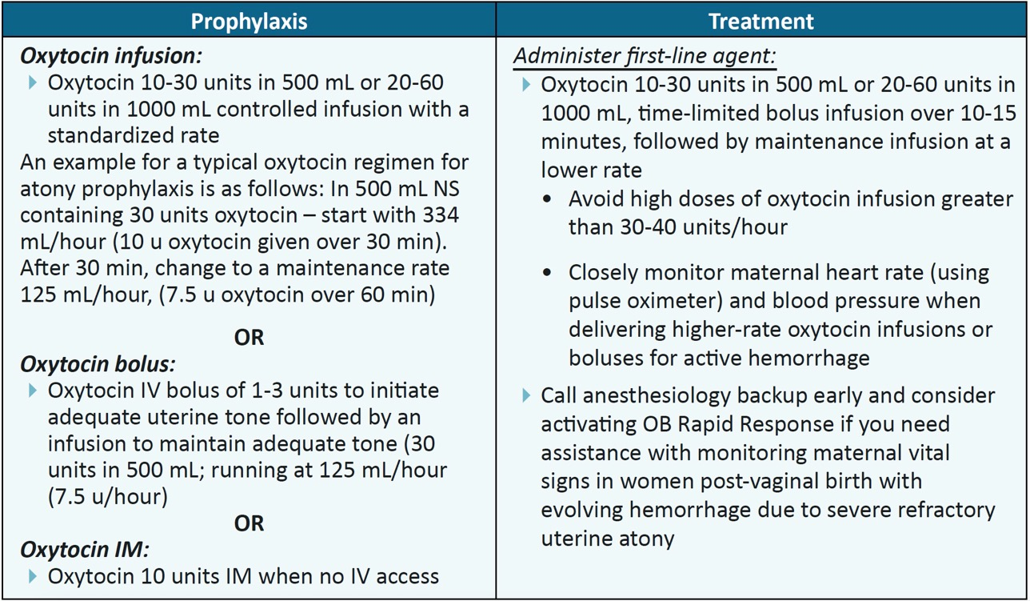
There are no Clear Recommendations for Oxytocin Dosing Regimens
Doyle JL, et al. Joint Commission Journal of Quality and Patient Safety. 2019;45(2):131-143.
Notes:
TALKING POINTS:
There are not clear recommendations for oxytocin dosing regimens. To investigate dosing standardization for prophylaxis, a retrospective cohort study published in a 2019 evaluated a protocol that delivered a total of 60 units of oxytocin using a 30u/500 mL dilution , administered using three sequential and decreasing doses over the course of 5.25 hours postpartum.⁶ The study included over 16,000 women. Postpartum hemorrhage treatment rates (signified by a composite of need for additional uterotonics, transfusion, intrauterine balloon, uterine artery embolization, and hysterectomy) were lower after introduction of the protocol for all subjects as well as in a subset of women at low risk for PPH (adjusted odds ratio 0.63 for all women and 0.33 for low-risk women). The study investigators highlighted the importance of standardizing institution practices to improve safety and reduce variability in care.
Doyle JL, Kenny TH, Gothard MD, Seagraves E, McCarroll M, Silber A. A Standardized oxytocin administration protocol after delivery to reduce the treatment of postpartum hemorrhage. Joint Commission Journal of Quality and Patient Safety. 2019;45(2):131-143.

Slide 52
Blood Product Replacement
Indicators for transfusion include:
  Evidence of hemodynamic compromise
  High rate and/or magnitude of blood loss
  Etiology of bleeding
  Response to medical/surgical measures to control bleeding
  Type and degree of cardiovascular support
  Laboratory or point-of-care data (if available)
Do not wait for laboratory results to begin transfusion
Shields, LE, et al. American Journal of Obstetrics and Gynecology. 2015;212(3):272-280.
Notes:
TALKING POINTS:
If transfusion therapy is delayed or if inadequate blood product support is given to patients with a major or life-threatening hemorrhage, then there is a significant risk of major morbidity from severe hypoperfusion, severe anemia and coagulopathy.¹¹
11. Shields, LE, Wiesner, S, Fulton, J, Pelletreau, B. Comprehensive maternal hemorrhage protocols reduce the use of blood products and improve patient safety. American Journal of Obstetrics and Gynecology. 2015;212(3):272-280.

Slide 53
Emergency release and MTP should be in place
Two pathways for blood product mobilization
  Emergency release of PRBCs
    2 units PRBCs are immediately released from the blood bank
    If typed and crossmatched, use crossmatched blood when possible
  Massive transfusion protocol (MTP)
    Consider activating if there is continued bleeding
    Commonly includes 4-6 units Type O PRBCS, 4 units plasma, and 1 unit of platelets
    Critically important when the rate and magnitude of blood loss outpace the time required to prepare and transport blood products
    Once bleeding controlled, deactivate the MTP and transition to cross-matched compatible
    PRBCs as needed
If the patient has not been typed and crossmatched,
do not delay transfusion to wait for crossmatched blood
Green LK, et al. British Journal of Haematology. 2016;172(4):616-624. Apelseth TO,et al. Transfusion. 2020;60(12):2793-2800. AABB. Recommendations on the use of group O red blood cells. AABB Association Bulletin #19-02. 2019. Yazer MH, et al. Transfusion. 2019;59(12):3794-3799. Goodnough, LT et al. Transfusion. 2011;51(12):2540-2548. Joint Commission. Provision of care, treatment, and services standards for maternal safety. 2019. Butwick AJ, et al. Transfusion. 2020;60(5):897-907. Meyer DE, et al. Journal of Trauma and Acute Care Surgery. 2017;83(1):19-24.
Notes:
TALKING POINTS:
In an emergency release protocol, at least two units of PRBCs are immediately released from the blood bank and brought to bedside. If the patient has already been typed and crossmatched, use crossmatched blood when possible. (See section Obstetric Hemorrhage Risk Factor Assessment.) If the patient has not been typed and crossmatched, do not delay transfusion to wait for crossmatched blood. In this scenario, the use of un-crossmatched O type blood is recommended.²⁰⁻²² The Joint Commission now requires hospitals providing obstetric care to have a massive transfusion protocol in place.²⁴ Having an MTP is critically important when the rate and magnitude of blood loss outpace the time required to prepare and transport cross matched blood products to the labor and delivery unit. An MTP provides sufficient volumes and types of products to the primary care team in coolers.^{6,23,25} Once bleeding has been controlled, the care team can deactivate the MTP and transition to cross-matched compatible PRBCs as needed.
***The demand for O negative type blood is significantly higher than the available supply. Because of this, the allocation of O negative packed red blood cells (PRBCs) requires thoughtful management. The optimal massive transfusion pack contains O negative PRBCs for pregnancy-capable individuals of childbearing age who are RhD negative or their RhD status is unknown. However, when making a decision between a lifesaving treatment and the risks of alloimmunization in the future, transfusing RhD negative obstetric patients with RhD positive PRBCs may be a viable option in the setting of obstetric hemorrhage requiring transfusion. Hemolytic disease of the fetus and newborn (HDFN) is often a completely treatable condition. Accurate assessment of fetal anemia, the procedure of intrauterine transfusion (IUT), and early detection of severe fetal anemia before hydrops fetalis develops has improved through the use of modern technology lowering the rate of erythroblastosis fetalis in developed countries (0.3%).} While the very low risk of a future treatable condition is a consideration of treatment, it is not the primary factor. The Pragmatic Randomized Optimal Platelet and Plasma Ratios (PROPPR) trial found a 5% increase in mortality for every minute that blood products were not provided to a trauma patient after the massive transfusion protocol (MTP) had been activated.²⁶ RhD negative patients (or those with an unknown RhD type) who are massively hemorrhaging should not have treatments withheld for fear of affecting the health of a future pregnancy.^{22***}
Green, LK, M.; Seeney, F.; Hopkinson, C.; Collins, P. W.; Collis, R. E.; Simpson, N. A.; Weeks, A.; Stanworth, S. J. The haematological features and transfusion management of women who required massive transfusion for major obstetric haemorrhage in the UK: A population based study. British Journal of Haematology. 2016;172(4):616-624.
20. Apelseth, TO, Strandenes, G, Kristoffersen, EK, Hagen, KG, Braathen, H, Hervig, T. How do I implement a whole blood-based blood preparedness program in a small rural hospital? Transfusion. 2020;60(12):2793-2800.
21. AABB. Recommendations on the use of group O red blood cells. AABB Association Bulletin #19-02. 2019.
22. Yazer, MH, Delaney, M, Doughty, H, et al. It is time to reconsider the risks of transfusing RhD negative females of childbearing potential with RhD positive red blood cells in bleeding emergencies. Transfusion. 2019;59(12):3794-3799.
23. Goodnough, LTD, K.; Wong, A. E.; Viele, M.; Fontaine, M. F.; Butwick, A. J. How we treat: Transfusion medicine support of obstetric services. Transfusion. 2011;51(12):2540-2548.
24. Joint Commission. Provision of care, treatment, and services standards for maternal safety. 2019.
25. Butwick, AL, D.; Goodnough, L. How do I manage severe postpartum hemorrhage? Transfusion. 2020;60(5):897-907.
26. Meyer, DE, Vincent, LE, Fox, EE, et al. Every minute counts: Time to delivery of initial massive transfusion cooler and its impact on mortality. Journal of Trauma and Acute Care Surgery. 2017;83(1):19-24.

Slide 54
Disseminated Intravascular Coagulopathy (DIC)
Traditionally providers have used DIC to describe coagulopathy which occurs with PPH. While certain cases can have a DIC diagnosis, there are many causes of coagulopathy; most notably, dilutional coagulopathy, which occurs in most clinical scenarios vs. DIC.
DIC may occur in specific obstetric conditions such as amniotic fluid embolus, severe placental abruption, or sepsis. It is likely that most women who experience postpartum hemorrhage develop coagulopathy due to dilution or consumption of coagulation factors associated with loss of significant blood volumes.
Notes:
TALKING POINTS:
It is likely that most women who experience postpartum hemorrhage develop coagulopathy due to dilution or consumption of coagulation factors associated with loss of significant blood volumes. Treatment for these conditions differs, therefore it is an important distinction to make.

Slide 55
Uterine Balloon Tamponade
Recommended for Tx of uterine atony-related hemorrhage in situations where uterotonics are contraindicated, ineffective, or unavailable
Plans should simultaneously be made for next steps, should placement be unsuccessful
  Mobilizing additional personnel
  Activating MTP
  OR preparations for possible hysterectomy
Success rates range from 68%-88%
Placement with ultrasound guidance for placement and post placement monitoring may reduce complications and should be considered
Aibar LA, et al. Acta Obstet et & Gynecol Scandinavica 2013;92(4):465-467. Gronvall MT, et al. Acta Obstet Et & Gynecol Scandinavica 2013;92*4):433-438. Kong MTC, et al. Hong Kong Med J 2013;19(6):484-490. Laas EB, et al. Am J Obstet & Gyn. 2012;207(4):281 e281-287. Olsen RR, et al. J of MFM & Neo Med 2013;26(17):1720-1723. Vitthala ST, et al. Aus & NZ J of Obstet & Gynaec 2009;49(2):191-194. Vrachnis NS, et al. Intl J of Gynaecol & Obstet 2013;122(3):265-266. Suarez SC, et al. American Journal of Obstetrics and Gynecology. 2020;222(4):293 e291-293 e252. Mezei, GC. Bakri balloon placement. Medscape. https://emedicine.medscape.com/article/2047283-overview. Published 2016. Accessed 3/10/2021.
Notes:
TALKING POINTS:
Tamponade has been demonstrated to be effective in controlling hemorrhage in 87% of atony related cases.¹ Successful use of a balloon catheter is defined in most case series as diminished bleeding such that no additional non-pharmacologic interventions are needed. Placement of tamponade balloons at the time of cesareans is possible and a viable option to manage hemorrhage due to uterine atony. If the hysterotomy is closed, the procedure is similar to placement after vaginal birth, but done by an assistant gloved and underneath the surgical drapes. Placement can be done with an open hysterotomy by threading the balloon catheter down into the vagina through the cervix.
Post-procedure monitoring includes continuing with the hemorrhage protocol including the measurement of blood via the drainage bag. The next 20-30 minutes should be devoted to creating a plan for next steps should the bleeding not be controlled and consideration for ultrasound evaluation post placement to ensure blood is not collecting behind the balloon tip. Also, consistent with standard practice, checking fundal heights and marking them. Fortunately, in 60-80% of cases, the balloon will be the last major intervention needed. Although there is not specific data to support a maximum indwelling time for the uterine tamponade, it is generally 24 hours or less to reduce concern for infection and tissue necrosis. The rate of deflation during discontinuation can either be all at once or incrementally over several hours. Because prolonged balloon use may involve continued prophylactic antibiotic administration and indwelling Foley catheter use, consideration for removal of the balloon at 6-12 hours is encouraged.¹⁴
1. Suarez, SC-A, A.; Borovac-Pinheiro, A.; Suarez-Rebling, D.; Eckardt, M.; Theron, G.; Burke, T. F. Uterine balloon tamponade for the treatment of postpartum hemorrhage: A systematic review and meta-analysis. American Journal of Obstetrics and Gynecology. 2020;222(4):293 e291-293 e252.
14. Mezei, GC. Bakri balloon placement. Medscape. https://emedicine.medscape.com/article/2047283-overview. Published 2016. Accessed 3/10/2021.

Slide 56
When intrauterine balloon placement is being considered, the OB Hemorrhage Task Force recommends considering mobilization of additional personnel via activation of an obstetric rapid response team (OB-RRT), activation of the massive transfusion protocol, transfer to OR and preparation for possible hysterectomy.
Notes:
TALKING POINTS:
A critical first step is a thorough and well-lit examination for lacerations. Often this is best done in the OR with surgical stirrups, long retractors, assistants, superior lighting and anesthesia capabilities. This is also the opportunity to rule out retained placental fragments. If it is to be done in a birth room, one should assemble similar resources. (See Box 1 in section Definition, Early Recognition and Rapid Response Using Triggers.)
The maximal uterine balloon fill volumes are varied depending on the device being used, but it is important to keep in mind that the volume required will change depending on the patient situation as well.
Care should be taken not to inadvertently “kink” the short length of tubing connecting the fill device (syringe or IV bag) and stopcock to the main balloon catheter.
Have one person hold the catheter in place while assessing the uterine filling and tone while an assistant draws up the saline syringes, turns the stopcocks and pushes the fluid.
Immediately prior to placement, perform bimanual massage and evacuate clots in the uterine cavity. Clots ahead of the balloon catheter tip may cause occlusion. Document the amount of fluid used to fill the balloon, the number of vaginal packs (if used) and the blood loss out. The catheter should be attached to a drainage bag and not plugged or clamped (i.e., urometer from traditional Foley catheter set up).

Slide 57
Compression Sutures
B-Lynch is the most commonly used and studied, followed by Cho Square and Hayman
Available evidence has not demonstrated whether a certain approach achieves better results than other methods or if a certain suture material is better than another
Protocols for the timing and method of placement of sutures (and balloons) should be added to institutional policies and procedures
Diagrams with the techniques may be helpful if posted in L&D and in large laminated size in an obstetric hemorrhage cart
Matsubara SY, et al. Acta Obstet et Gynecol Scandinvacia 2013;92(4):378-385.
Notes:
TALKING POINTS:
Compression sutures are another approach for refractory uterine atony that should be available for implementation in every institution is the use of uterine compression sutures.

Slide 58
Indications, complications and effectiveness of vaso-occlusive balloons and embolization techniques are not well established and therefore must be approached with caution.
If UAE for the treatment of PPH is utilized:
Patient must be stable for transport to IR and accompanied by a RN skilled in the assessment and treatment of hemorrhage
A physician who is able to immediately call for and move to laparotomy should be in house
Anesthesiology services must also be immediately available
Coulange, LB, et al. Acta Obstetricia et and Gynecologica Scandinavica. 2009;88(2):238-240. Shrivastava, VN, et al. American Journal of Obstetrics and Gynecology. 2007;197(4):402.e401-405. Maassen, MSL, et al. BJOG: British Journal of Obstetrics and Gynaecology. 2009;116(1):55-61. Sadashivaiah, JW, et al. International Journal of Obstetric Anesthesia. 2011;20(4):282-287.
Notes:
TALKING POINTS:
Complications have been reported from the placement of prophylactic arterial balloon devices in known placenta accreta spectrum cases. Complications are also reported after use of uterine artery embolization to treat hemorrhage, including ischemic complications such as uterine necrosis.¹⁰ In one case-control study of balloon catheter devices, the authors found that 3 out of 19 subjects (15.8%) had complications from catheter placement and two required stent placement and/or arterial bypass.¹¹ Additional reported complications of UAE have included thromboembolic events and fistulae.¹² In one study of prophylactic balloons, a case of fetal bradycardia requiring immediate delivery (15.4%) occurred.¹³ One should use these techniques only when sufficient expertise is available and after full review of the risks and benefits with the patient or surrogate decision maker.¹⁴ Uterine artery embolization techniques can be considered for a specific subset of patients receiving treatment in centers with adequate interventional radiology expertise and routine use of prophylactic balloon catheter occlusive devices are not recommended.
10. Coulange, LB, N.; Loffroy, R.; Filipuzzi, L.; Cercueil, J. P.; Douvier, S.; Sagot, P.; Krause, D.; Tixier, H. Uterine necrosis following selective embolization for postpartum hemorrhage using absorbable material. Acta Obstetricia et and Gynecologica Scandinavica. 2009;88(2):238-240.
11. Shrivastava, VN, M. ; Major, C.; Haydon, M. ; Wing, D. Case-control comparison of cesarean hysterectomy with and without prophylactic placement of intravascular balloon catheters for placenta accreta. American Journal of Obstetrics and Gynecology. 2007;197(4):402.e401-405.
12. Maassen, MSL, M. D.; Tutein Nolthenius, R. P.; van der Valk, P. H.; Elgersma, O. E. Complications and failure of uterine artery embolisation for intractable postpartum haemorrhage. BJOG: British Journal of Obstetrics and Gynaecology. 2009;116(1):55-61.
13. Sadashivaiah, JW, R.; Thein, A.; McLure, H.; Hammond, C. J.; Lyons, G. Role of prophylactic uterine artery balloon catheters in the management of women with suspected placenta accreta. International Journal of Obstetric Anesthesia. 2011;20(4):282-287.
14. Dilauro MD, Dason S, Athreya S. Prophylactic balloon occlusion of internal iliac arteries in women with placenta accreta: Literature review and analysis. Clinics in Radiology. 2012;67(6):515-520.

Slide 59
Christa Sakowski, RN, MSN
CMQCC Clinical Lead

Slide 60
Communicating with Patients After an Obstetric Hemorrhage
Formal discussions about patient experience/prognosis should occur throughout the hospitalization and during PP visits
There is a significant and clinically relevant increased risk for women to develop post-traumatic stress disorder (PTSD) after experiencing severe postpartum hemorrhage
Ensure patients who experience hemorrhage receive a detailed discharge summary in writing
Prior to D/C, patients who experience hemorrhage should receive contact information of a resource person who can answer questions about care/ongoing concerns
Policies and guidelines addressing disclosure should be developed in accordance with state laws
Elmir RS, et al. Midwifery. 2012;28(2):228-235.
Notes:
TALKING POINTS:
“After a traumatic birth event, women seek to understand what happened to them, make sense of the reasons behind their experience, and think about implications for their long-term health and future childbearing. Research on women’s experience of obstetric hemorrhage shows that a significant proportion of women report not receiving adequate information about their condition and recovery.^{2,3,13} While women report feeling grateful to health professionals for the life-saving care provided to them and their babies, they often report feelings of anger and frustration about not receiving sufficient information and/or at the quality of the emotional care they received.^{4,6}
Women of color report high rates of feeling disrespected and unheard.^{15-17”}
A 2017 population-based survey conducted with over 2,500 California mothers in English and Spanish asked if they “perceived unfair treatment due to race or ethnicity.” A total of 11.5% of Black mothers answered in the affirmative, and 8.5% of Asian/Pacific Islander (PI) mothers and 5.5% of Latina mothers also reported unfair treatment as a result of race or ethnicity. White mothers almost never (1%) reported being treated unfairly on the basis of race or ethnicity.¹⁸ Asked, “During your recent hospital stay, did you experience harsh or threatening language?” affirmative responses were highest among Asian/PI and Black women, each with 9%. For the question whether they “perceived unfair treatment due to language,” affirmative responses varied: Asian language speakers, 12%; Spanish speakers, 10%; and other non-English speakers, 9%.
After a traumatic birth event, women seek to understand what happened to them, make sense of the reasons behind their experience, and think about implications for their long-term health and future childbearing. Research on women’s experience of obstetric hemorrhage from studies conducted in Australia, the United Kingdom and other countries shows that a significant proportion of women report not receiving adequate information about their condition and recovery.^{2,3,13} While women report feeling grateful to health professionals for the life-saving care provided to them and their babies, they often report feelings of anger and frustration about not receiving sufficient information and/or at the quality of the emotional care they received.^{4,6}
Women of color report high rates of feeling disrespected and unheard.¹⁵⁻¹⁷ A 2017 population-based survey conducted with over 2,500 California mothers in English and Spanish asked if they “perceived unfair treatment due to race or ethnicity.” A total of 11.5% of Black mothers answered in the affirmative, and 8.5% of Asian/Pacific Islander (PI) mothers and 5.5% of Latina mothers also reported unfair treatment as a result of race or ethnicity. White mothers almost never (1%) reported being treated unfairly on the basis of race or ethnicity.¹⁸ Asked, “During your recent hospital stay, did you experience harsh or threatening language?” affirmative responses were highest among Asian/PI and Black women, each with 9%. For the question whether they “perceived unfair treatment due to language,” affirmative responses varied: Asian language speakers, 12%; Spanish speakers, 10%; and other non-English speakers, 9%.

Slide 61
Physical and emotional considerations
Women with PAS or other significant hemorrhage experience may experience significant mental health issues that may or may not improve at the same rate as their physical recovery.
A 2021 study about the impact of PAS on quality of life found women who experienced complications of PAS had improved physical health 24-36 months after birth, yet low mental health scores persisted. Low mental health scores did not correlate with an antenatal diagnosis of PAS, clinical severity, or outcomes.
Women who experience obstetric hemorrhage may or may not feel traumatized by the events; however, providers need to normalize the need for mental health care after a medical trauma, and provide resources for women and their families.
Bartels HC, et al. Austral & NZ J of Obstet & Gynaecol. March 2021, 1-7. Wu S, Ket al. American Journal of Obstetrics and Gynecology. 2005;192(5):1458-1461. Meng XX, et al. Ultrasound and Medical Biology. 2013;39(11):1958-1965. Oyelese YS, et al. Obstetrics and Gynecology. 2006;107(4):927-941. Warshak CR, et al. Obstetrics and Gynecology. 2006;108(3 Pt 1):573-581.
Notes:
TALKING POINTS:
Providers caring for patients with prenatally suspected or diagnosed PAS should counsel patients extensively about potential risks and complications as early as possible in pregnancy. Patients with accreta are at increased risk for hemorrhage, blood transfusion, bladder/ureteral damage, infection, need for intubation, prolonged hospitalization, ICU admission, need for reoperation, thromboembolic events and death.^{4,11,14,15} Discussions should involve relative likelihood for hysterectomy and subsequent infertility. It is also important for providers to be aware of mental health support needs for their patients with PAS.
4. Wu, SK, M.; Hibbard, J. U. Abnormal placentation: Twenty-year analysis. American Journal of Obstetrics and Gynecology. 2005;192(5):1458-1461.
Meng, XX, L.; Song, W. Comparing the diagnostic value of ultrasound and magnetic resonance imaging for placenta accreta: A systematic review and meta-analysis. Ultrasound and Medical Biology. 2013;39(11):1958-1965.
14. Oyelese, YS, Smulian, J. C. Placenta previa, placenta accreta, and vasa previa. Obstetrics and Gynecology. 2006;107(4):927-941.
15. Warshak, CRE, R.; Hull, A. D.; Scioscia, A. L.; Mattrey, R. F.; Benirschke, K.; Resnik, R. Accuracy of ultrasonography and magnetic resonance imaging in the diagnosis of placenta accreta. Obstetrics and Gynecology. 2006;108(3 Pt 1):573-581.

Slide 62
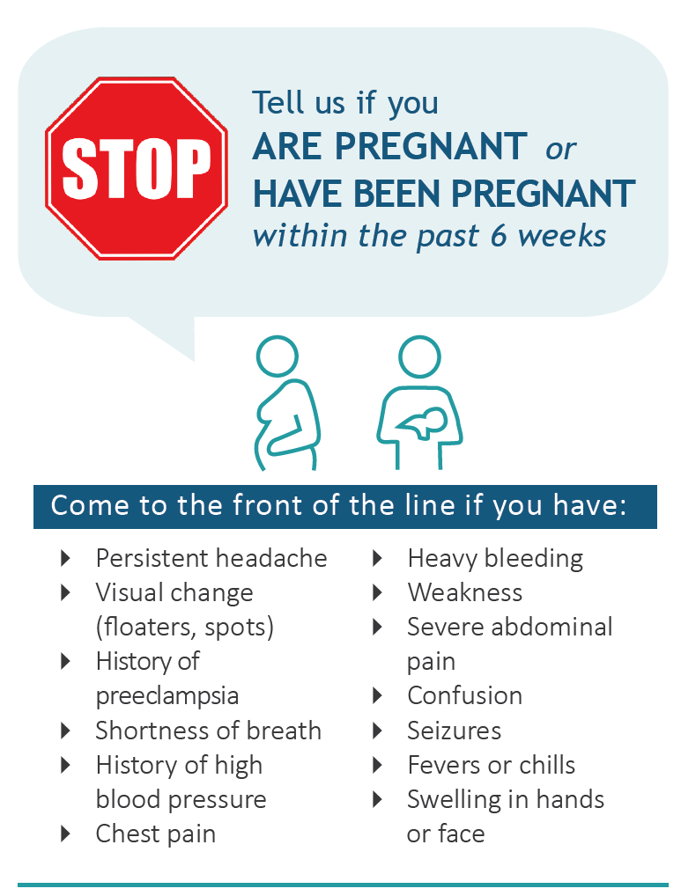
Secondary PPH - 24 hours to 12 weeks Postpartum
Common causes - retained products of conception, infection, and subinvolution of the placental bed
Often present to the emergency department (ED) after discharge
Important to identify whether patients that present to the ED have been pregnant in the last 6 weeks
ED personnel should be familiar with the risk factors and signs and symptoms of PPH, including evaluation of PP bleeding/assessment of clots
Patel NR, J of Emerg Med 2018;55(3):408-410. Debost-Legrand A, et al. Birth. 2015;42(3):235-241. ACOG. Practice Bulletin No. 183. Obstetrics and Gynecology. 2017;130(4):e168-e186. Clapp MA, et al. American Journal of Obstetrics and Gynecology. 2016;215(1):113 e111-113 e110. Fein A, et al. Journal of Maternal-Fetal and Neonatal Medicine. 2021;34(2):187-194.
Notes:
TALKING POINTS:
There has been relatively little investigation of the incidence and risk of secondary hemorrhage, or severe bleeding that occurs between 24 hours and 42 days after birth, and occurs in 1% of pregnancies.^{1,2} The overall risk for postpartum readmission is increasing – from 1.72% in 2004 to 2.16% in 2011, and hemorrhage or retained products of conception are the primary or associated diagnoses in 13% of all postpartum readmissions.³ A study using population data on births occurring between 2010-2014 was the first to focus on how postpartum hemorrhage is associated with hospital readmission and found that 82% of readmissions occurred < 20 days after discharge.⁴
This study also found that PPH during birth was a risk factor for readmission, and PPH with transfusion was associated with a particularly high likelihood of readmission.⁴ Factors associated with PPH readmissions included maternal age, public insurance, pre-gestational diabetes and hypertensive diseases of pregnancy.⁴
1. Debost-Legrand, A, Riviere, O, Dossou, M, Vendittelli, F. Risk factors for severe secondary postpartum hemorrhages: A historical cohort study. Birth. 2015;42(3):235-241.
2. ACOG. Postpartum hemorrhage. Practice Bulletin no. 183 of the American College of Obstetricians and Gynecologists. Obstetrics and Gynecology. 2017;130(4):e168-e186.
3. Clapp, MA, Little, SE, Zheng, J, Robinson, JN. A multi-state analysis of postpartum readmissions in the United States. American Journal of Obstetrics and Gynecology. 2016;215(1):113 e111-113 e110.
4. Fein, A, Wen, T, Wright, JD, et al. Postpartum hemorrhage and risk for postpartum readmission. Journal of Maternal-Fetal and Neonatal Medicine. 2021;34(2):187-194.

Slide 63

Reporting
Debriefs & Case Reviews
Outcome Metrics
David Lagrew, MD
Providence St. Joseph Health

Slide 64
Debriefs and Case Reviews
Debriefs and multidisciplinary reviews are foundational learning improvement activities for creating a highly-reliable clinical team and maintaining a culture of safety
Debriefs
  Allows the team to reflect on performance and problem-solve in real time
  Should become a routine part of activities on the unit
Case Reviews
    Thorough and structured evaluation of patient care
    Identified deficits are used to inform and guide system-level improvements to prevent similar morbidities in the future
A multi-faceted communication plan is needed to share meaningful learnings and subsequent process improvement work to the clinical team
Notes:
TALKING POINTS
Debrief questions address:
“What went well?”
“What could have gone better?”
“What needs to be followed up on later and by whom?”
Routine debriefing is easy to incorporate into the unit culture if the format is kept simple and some key barriers are proactively addressed. An example of a rapid debrief is provided in the toolkit appendix.
Communication plan
A team communication plan is needed to share valuable insights and subsequent performance/process improvement results with all team members and also and patient advocates. The communication plan serves as a critical piece of an ongoing feedback/learning loops that helps maintain engagement and supports a culture of continuous quality improvement. It is important to ensure that the key systems learnings and results of improvement efforts are shared with frontline staff and patient advocates. Ongoing communication lets staff know and patient advocates that their concerns are heard, and that debriefs, drills, and multidisciplinary case reviews are more than a box to check and actually improve patient care.

Slide 65
Outcome Measures
Monitoring outcomes is an essential part of the QI process
These measures reflect the health outcomes resulting from the care provided
It is recommended that all SMM cases be reviewed for QI opportunities
Measure | Definition
Severe Maternal Morbidity (including and excluding transfusion-only cases) | Cases with one of 21 severe complications (as defined by the CDC) among all deliveries
Severe Maternal Morbidity among Hemorrhage Cases (including and excluding transfusion-only cases) | Cases with one of 21 severe complications among those deliveries that had a hemorrhage
Massive Transfusions (as a case review indicator) | Cases who received 4+ units of blood products among all deliveries
Important Note: Some hospital teams have struggled with transfusion coding through the transition from ICD-9 to ICD-10. It is critical that transfusions be coded because these ICD-10 codes serve as the basis for several maternal quality metrics.
Notes:
TALKING POINTS:
Monitoring outcomes is an essential part of the quality improvement process. Outcome metrics reflect the health outcomes experience by patients that result from the care provided. Note that these metrics do not reflect whether care was provided or not, but rather reflect the patient's outcomes.
There are three outcome measures to consider when evaluating obstetric hemorrhage. First is Severe Maternal Morbidity, or SMM – this metric is defined by the CDC, and reflects patients with any of 21 severe complications among all deliveries. These complications include shock, hysterectomy, sepsis, transfusion, DIC, etc. This metric can be viewed two ways: you can look at your rate including all transfusion cases, or you can look at only those cases where transfusion wasn't the only SMM complication. This will hopefully focus the metric on the most severe cases. Review the trend over time. While the rate may be low, CMQCC recommends that all severe maternal morbidity cases be reviewed for quality improvement opportunities.
To focus on hemorrhage-related morbidity, consider reviewing Severe Maternal Morbidity among Hemorrhage Cases. In this iteration, your denominator cases are all patients who were coded as having experienced a hemorrhage, and your numerator cases are those that experienced a severe maternal morbidity among your denominator cases. This measure can serve to evaluate how effectively your team can prevent hemorrhages from resulting in a severe maternal morbidity. Similarly, this metric may be viewed as a trend over time, or may serve to flag cases for review.
Finally, CMQCC recommends tracking Massive Transfusions at your facility or system, meaning patients that received 4 or more units of blood products among all deliveries. However, it is not advised that this metric be trended over time. Instead, utilize this metric as an indicator to flag cases for review. The incidence of massive transfusions is rare, but cases in which a massive transfusion occurred should be reviewed for QI opportunities, or may be referred for a full root cause analysis (RCA).
An important note about transfusion coding: Some hospitals have struggled with coding transfusions through the transition from ICD-9 to ICD-10. While transfusion information may be accessible form your internal blood bank system or medication administration record, this information is often not included in administrative data sets used to track and trend these metrics. Similarly, some metrics are solely based on ICD-10 codes, so cases may be erroneously excluded if the transfusion is not reflected in the ICD-10 coding. It is imperative that transfusions be coded.
There is not necessarily a target rate for these metrics, but instead should be reviewed for QI opportunities, with special attention to rates that are far above the average of your peer hospitals (i.e., those in your system, region, state, or those with the same NICU level or delivery volume).

Slide 66
Process Measures
Process measures focus on the elements of care linked to improved outcomes
Auditing even a sample of cases can ensure that the policies and procedures in place at your facility are being adhered to
Measure | Definition
Risk Assessment | The rate of patients with a hemorrhage risk assessment completed on admission to L&D and on admission to postpartum*
Quantified Blood Loss Performed | The rate of patients who had blood loss quantified at delivery*
Debriefs | The rate of debriefs completed after an obstetric hemorrhage
OB Hemorrhage Staff Education | The proportion of medical and nursing staff that have completed a training on OB hemorrhage
*CMQCC encourages auditing a minimum of 5 random cases per month (a higher number of cases may be more appropriate if your facility has a high delivery volume)
Notes:
TALKING POINTS:
While outcome metrics reflect the health outcomes experienced by the patient, process measures focus on the elements of care linked to improved outcomes. In using these process measures, you evaluate whether interventions designed to improve health outcomes are actually being done.
Four process measures may help evaluate whether recommendations are being followed. The first is risk assessment, which evaluates whether patients had a hemorrhage risk assessment completed on admission to labor and delivery and on admission to postpartum. This aligns with the Joint Commission's Maternal Safety Standards for Hemorrhage. The second is Quantified Blood Loss, or the rate of patients who had their blood loss quantified at delivery.
For both hemorrhage risk assessment and QBL, CMQCC encourages an audit of, at minimum, 5 random cases per month to evaluate adherence to the recommendation. If your facility has a high delivery volume, it may be more appropriate to audit more cases per month in order to accurately reflect what's occurring at your facility.
The next process measure evaluates the rate of debriefs completed after an obstetric hemorrhage. It's important to evaluate whether the cases that your policies, procedures, or practice dictate should be debriefed are actually getting debriefed.
Lastly, an OB Hemorrhage Staff Education metric serves to demonstrate the proportion of staff that have completed training on OB Hemorrhage.
All of these metrics have a goal rate of 100%.

Slide 67
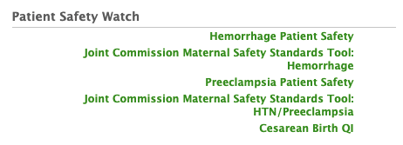
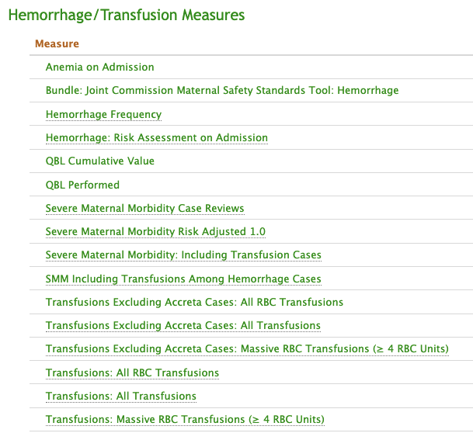
For Maternal Data Center Hospitals:
NEW!
NEW!
For MDC Hospitals
Questions? Email datacenter@cmqcc.org
MDC User Group Meeting on May 11th at 12pm to introduce the new measures (and others!)
Notes:
TALKING POINTS:
Hospitals that participate in CMQCC’s Maternal Data Center have access to a variety of measures to address obstetric hemorrhage. Two new measures have recently been added: Anemia on Admission, which enables you to submit admission hemoglobin values to evaluate the impact of anemia on your outcomes, and QBL Cumulative Value, which enables stratification by total blood loss.
The Maternal Data Center also has the Joint Commission Maternal Safety Standards built into the system, allowing you to track your hospital’s completion of the standards over time. The tool also includes sustainability guidance from CMQCC, including which measures may help you evaluate compliance with the standards, and relevant resources from the toolkit linked to each step to support implementation.

Slide 68
Thank you!
For More Information
and to Download the Toolkit
www.CMQCC.org/toolkits
Contact us:
info@cmqcc.org

Slide 69


REGISTRATION OPEN!
Asian American, Native Hawaiian, and Pacific Islander (AANHPI)
Birth Equity Conference
May 16th, 2022
ONLINE OR IN-PERSON
FREE TO ATTEND
#aanhpibirthequity
The goal of this conference is to convene researchers, clinicians and community groups to identify issues and generate solutions to disparities in quality of care for AANHPI mothers and babies identified in our data and through lived experience.
Together we hope to enhance mutual awareness and exchange knowledge about improvement in quality of care for all AANHPI mothers and babies through the development of a collaborative learning network.
Conference attendees will:
Exchange knowledge and experiences
Define research and improvement priorities
Engage with community leaders, clinicians, and researchers
Scan for more information and registration link
Hosted By

Slide 70
Notes:
Backdrop slide. Can also put this as the very first slide (before title slide) to be displayed on screen before you start talking.

