Slide 1
Lessons from the Learning Initiative
Community Engagement and Birth Support

Slide 2
Lessons from the Learning Initiative
Logistics and Slide Deck
All attendees are muted upon entry
Please do not copy the slides
The slides are the intellectual property of the presenting hospitals.
Please utilize the chat feature to share learnings and takeaways.
Please use the Q&A function
Send us your feedback
We will do our best to answer any questions during the webinar.
We welcome your recommendations for improving future webinars.

Slide 3
Lessons from the Learning Initiative
Webinar Recordings and Slides
The webinar recording and slides will be posted within 48 hours at:
https://www.cmqcc.org/education-research/webinars

Slide 4
Lessons from the Learning Initiative
Webinar Agenda
1
Introduction to the Learning Initiative
2
Hospital Presentations:
Member Advisory Committee - Kaiser Oakland
Labor Hopscotch - Eisenhower Medical Center
3
Q & A

Slide 5
Introduction to CMQCC’s Learning Initiative

Slide 6


Introduction to the Learning Initiative
The Learning Initiative to Support Safe and Respectful Vaginal Birth (LI)
CMQCC Quality Improvement Initiative
Funded by the Centers for Disease Control and Prevention (2022-2027)
Five cohorts, 18-months long each
Built upon
  Supporting Vaginal Birth Collaborative (2017-2019)
  Pilot Birth Equity Collaborative (2019)
Notes:
The LI is a different form of collaborative, focused on shared learning over expertise and being held to the same standard.
Trialing out 18-months
We took lessons, curriculum, and tools from SVB and BEC and combined them, based on feedback, maternal mortality and morbidity reviews.

Slide 7
The Learning Initiative
Goals
Goal: reduce disparity gaps in low-risk cesareans with a goal of all patient groups reaching or exceeding the Healthy People 2030 target rate of 23.6%.
Reduce racial and ethnic differences in NTSV Cesarean rates
Increase participation of hospitals with high NTSV Cesarean rates
Increase community and patient awareness of existing racial disparities in NTSV rates
Increase the number of hospitals with patient and community engagement practices
Notes:
We are aiming to create a community of learning where hospitals can share lessons, we can provide education on data, equity, RMC, etc to help hospitals reduce the differences.
Goals
Reduce racial and ethnic differences in NTSV Cesarean rates with a goal of all races and ethnicities reaching or exceeding the Healthy People 2030 target rate of 23.6%.
Increase participation of hospitals with high NTSV Cesarean rates among Black gravidas or patients from racial groups with similarly high rates
Increase community and patient awareness of existing racial disparities in NTSV rates and causes contributing to an NTSV Cesarean delivery
Increase the number of hospitals with patient and community engagement practices to inform the adoption of equitable care practices

Slide 8
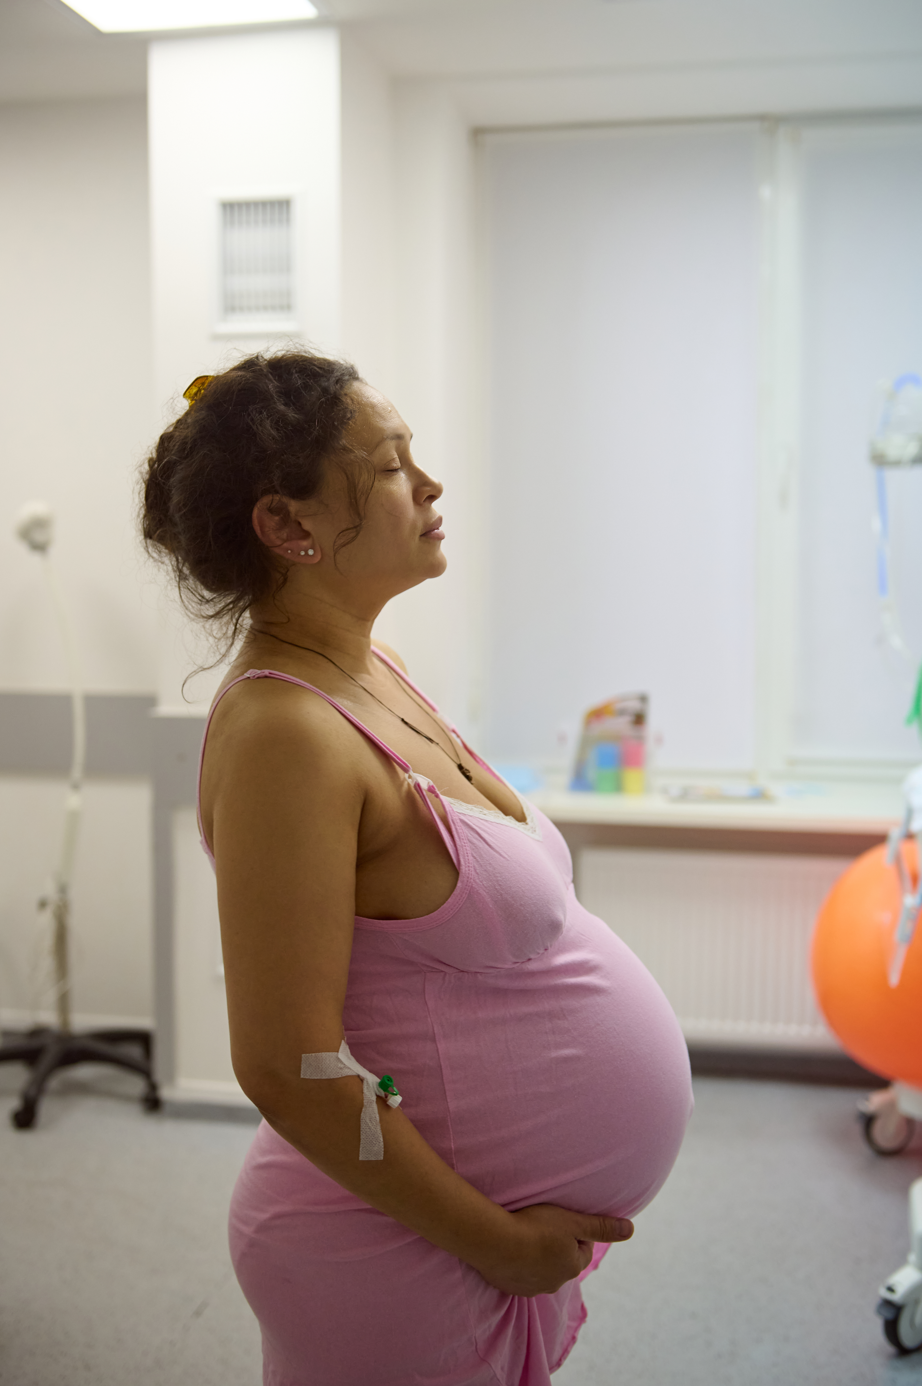
The Learning Initiative
Curriculum education and training
Monthly coaching providing education and capacity building
  QI Fundamentals
  Implementation Science
  Implicit Bias and Principles of Respectful Care
  NTSV-reduction strategies
  Technical assistance in leveraging CMQCC tools
    Maternal Data Center (MDC)
    Hospital Action Guide for Respectful and Equity-Centered Obstetric Care
Asynchronous quarterly webinars on health equity and cesarean rate reduction tools
Notes:
Try to stay up with the program as we move through it and not jump ahead, or it will be difficult to identify what changes have been the most impactful for your unit

Slide 9
Introduction to the Learning Initiative
Today’s Presenters
Kaiser Oakland
Eisenhower Medical Center
Oakland
Presenters:
Anya Rapoport, CNM
Mara Greenberg, MD
Shanelle House, RN
Rancho Mirage
Presenters:
Danny Castaneda, MSN-ED,RN, RNC-OB, PHN

Slide 10
Kaiser Oakland

Slide 11
Member Advisory Committee
Kaiser Oakland
Anya Rapoport, CNM
Mara Greenberg, MD
Shanelle House, RN

Slide 12
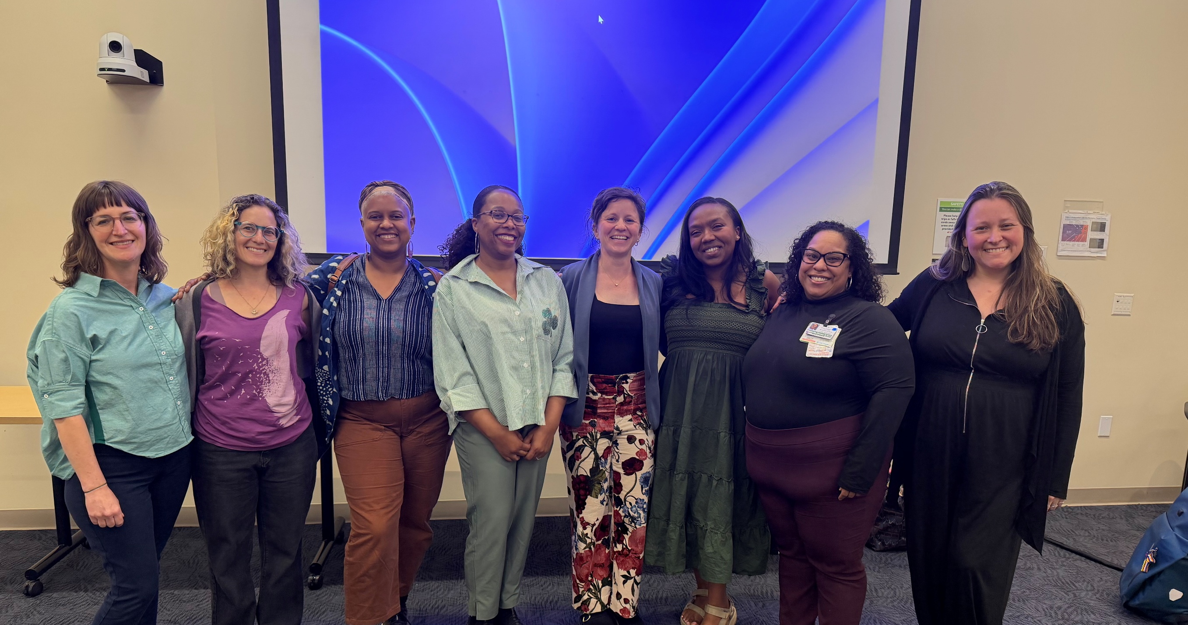

Slide 13

Roadmap to Success
Why ?
Who are your stake holders?
Who can help?
How to recruit
Meeting Guide
Successes

Slide 14

Why?

Slide 15
Stake Holders
Whose support do you need?
Who will lead the group?
Who will do admin support for the group?

Slide 16
Who can help?
Care Experience
Volunteer Services
Sister Facilities

Slide 17


Recruitment
Flyers
Press Tour
Dot Phrases
It was a pleasure seeing you today.
Kaiser Permanente East Bay is currently recruiting for The OBGYN Patient Advisory council and I think you could be a good fit, if you are interested.
This Patient Advisory Council is committed to enhancing the quality of care in the OBGYN space by ensuring that the voices of patients, their families, and their loved ones are at the heart of everything we do. Our goal is to improve the delivery of healthcare by fostering an environment that values patient experiences, insights, and strengths. By incorporating patient perspectives into our practices, we aim to create a compassionate, responsive, and patient-centered approach to OBGYN care. Together, we will shape a future where healthcare is guided not only by medical expertise but also by the lived experiences and values of those we serve.
If you are interested in becoming a member of our OBGYN Patient Advisory Council, please complete the application by following this link:https://forms.office.com/r/kL89RY2d3W
We Invite You to Join Our Member Advisory Council We are looking for individuals who have had
recent experiences in maternal and infant care to join our Maternal Child Health Member Advisory
Council.
As a Member Advisor, you will:
Partner with Kaiser Permanente leaders, physicians,
staff, members and families in the design and delivery of maternal and infant care
Make sure that the diverse voice of our members is front and center in all decisions

Slide 18
Interviews
Have an interview guide
Include those you've recruited in the interview process
Make sure you know what is involved in the onboarding process
Have a clear outline of the expectations

Slide 19
Meeting Guide
Introductions and group process
  Choose a day and time that is consistent
  Choose a format
Leave space for feelings
Less is More
Set expectations and timelines
Close the Loop
Meeting reminders

Slide 20
Successes
Equity Care Contract
Doula Integration
AA resource assessment and update
Postpartum Improvements
Quiet Hours

Slide 21
Contact Info
Anya.rapoport@kp.org
Shanelle.Renee.House@kp.org
Mara.Greenberg@kp.org

Slide 22
Eisenhower Medical Center

Slide 23
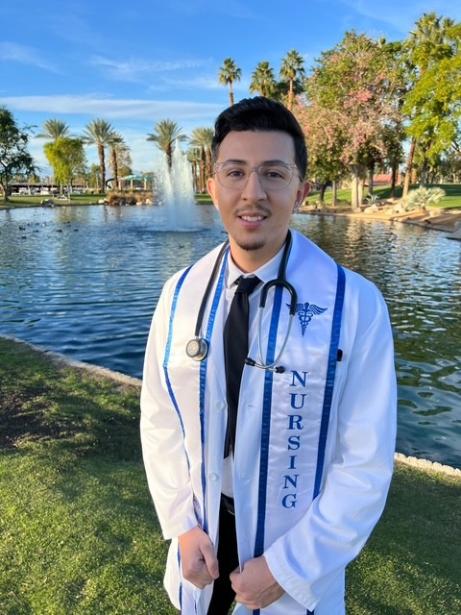

Danny began his nursing career at Eisenhower’s FBC as a nurse resident in 2023. As part of his nurse residency EBP project, Danny collaborated with two fellow nurse residents to develop the Labor Hopscotch project, an innovative educational tool designed to support labor and delivery nursing practice. The project earned first place at Eisenhower’s Spring 2024 Nurse Residency graduation.
Since then, Danny has shared the Labor Hopscotch project at several professional conferences, including as a podium presenter at Eisenhower’s Research Symposium in 2025 and as a poster presenter at the 2025 ANCC National Magnet Conference and the 2026 PAC/LAC Annual Conference. Danny is an exemplary labor and delivery nurse who has received 14 DAISY Award nominations – the most of any individual at Eisenhower Health. He serves as co-chair of the FBC unit – based council, contributes to Eisenhower’s new education podcast, and is both a unit preceptor and clinical instructor for the local community college nursing program.
Danny completed his MSN in Nursing Education in 2026. Danny and the FBC leadership team are currently collaborating with the developers of Labor Hopscotch on a research project for future publication and dissemination.
The leadership team at Eisenhower’s FBC includes Veronica Williams (Director); Rhia Ferrer (L&D Manager); and Dr. Lourdes Jamison (Nursing Professional Development Practitioner/Educator).
Notes:
Nationwide, there has been a growing concern regarding a decline in physiological birth. And an increase in operative deliveries. As a New Graduate nurse, I wanted to find a way to collaborate with our physicians and implement nursing interventions to assist birthing patients.
From the months of January 2023- July 2023, the average nullipara cesarean rate was 30% at Eisenhower’s family birth center. Which was slightly above the Healthy People 2030’s target goal 23.6%.
Although some operative deliveries can be medically necessary, they may also increase complications such as postpartum hemorrhage, maternal sepsis, Deep vein thrombosis, respiratory distress for the patient and infant, and even increase length of stay.
By Promoting physiological birth, we can reduce operative interventions and improve childbirth experiences.

Slide 24




LABOR HOPSCOTCH
DANNY CASTANEDA
MSN-ED,RN, RNC-OB, PHN
Notes:
Good morning, my name is Danny Castaneda. I have been working in Labor & Delivery at Eisenhower’s Family Birth Center since 2023. And I am excited to present my new grad project.

Slide 25




ABOUT
Eisenhower Medical Center
  1971 opened doors
  Not for profit
  roughly 400 beds
  PTAP Accredited
  Magent Designation
Family Birth Center
  2021
  100-120 average deliveries/month
  14 labor rooms, 7 postpartum, 4 OBED rooms, & 2 OR suites
Notes:
Eisenhower Medical Center is a small not-for-profit community hospital located in Rancho Mirage, CA. Serving the Coachella Valley since 1971.Eisenhower Medical Center has expanded since its initiation and has roughly 400-beds.
In 2021, Eisenhower opened the family birth center and currently averages 100-120 deliveries per month.
There are a total of 14 labor rooms, 7 postpartum, 4 OBED rooms, and 2 Operating rooms.
Eisenhower strives on clinical excellence and has achieved several designations such as Magnet, PTAP Accreditation, and High performance rating for Maternity services.
As I’ve mentioned before, my name is Danny Castaneda. I graduated my my Bachelor’s in nursing science in 2022 and began my nursing career at Eisenhower early 2023 where I have had the opportunity to grow professionally since. I recently obtained my master’s degree in nursing education from Grand Canyon University and recently joined a scholar program here at Eisenhower.

Slide 26
INTRODUCTION
  IN RECENT YEARS, THERE HAS BEEN A GROWING CONCERN REGARDING THE DECLINE OF PHYSIOLOGICAL BIRTH AND A SIGNIFICANT RISE IN INTERVENTIONS DURING LABOR AND BIRTH.
  When medically necessary, cesarean sections can save maternal and fetal life, but they can also increase complications and increase length of stay.
  Promoting physiological birth can reduce interventions and improve maternal childbirth experiences.
Notes:
Nationwide, there has been a growing concern regarding a decline in physiological birth. And an increase in operative deliveries. As a New Graduate nurse, I wanted to find a way to collaborate with our physicians and implement nursing interventions to assist birthing patients.
From the months of January 2023- July 2023, the average nullipara cesarean rate was 30% at Eisenhower’s family birth center. Which was slightly above the Healthy People 2030’s target goal 23.6%.
Although some operative deliveries can be medically necessary, they may also increase complications such as postpartum hemorrhage, maternal sepsis, Deep vein thrombosis, respiratory distress for the patient and infant, and even increase length of stay.
By Promoting physiological birth, we can reduce operative interventions and improve childbirth experiences.

Slide 27
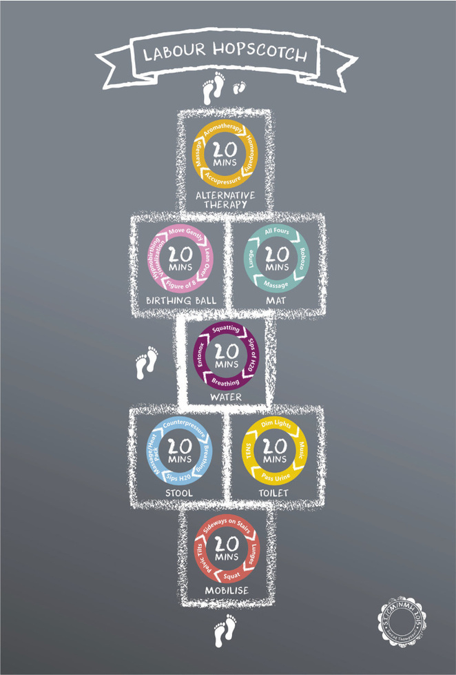
OBJECTIVE
Labor Hopscotch is a visual birthing tool that provides laboring women with a series of steps to undertake as labor progresses to promote optimal fetal position. Thus, supporting and promoting physiological birth processes that reduce instrumental birth and/or cesarean sections.
Notes:
Labor Hopscotch was created by Sinead O'Connor, a midwife from Dublin, Ireland. Her purpose was to create a visual birthing tool that provides laboring women with a series of steps to
undertake as labor progresses to promote optimal fetal positioning. Thus, supporting and
promoting physiological birth processes which reduce surgical births.
The fundamental principle of labor hopscotch is to inform the importance of steps necessary to
remain active during labor and to reduce surgical interventions.
In 2017, Sinead O'Connor conducted a study in Dublin, Ireland, in a maternity ward, evaluating the steps of Labor Hopscotch and identifying what women found most useful.
Furthermore, the study also found that upright positioning decreased the first stage of labor by an hour.
And more importantly, the maternity ward saw a cesarean delivery rate of 8.7%, compared to the hospital average of 27.1% and the national average of 31.3%.

Slide 28
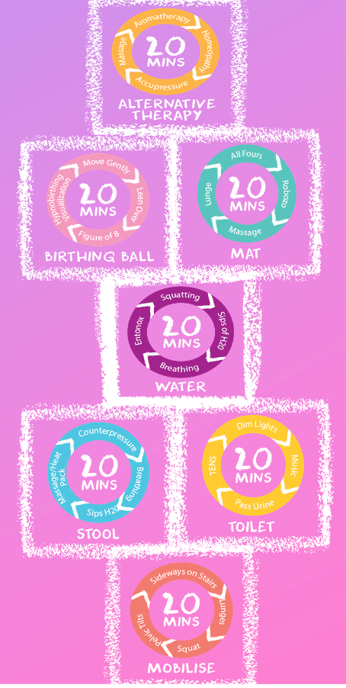
OBJECTIVE CONTD.
The objective of this Evidence-based project was to increase staff knowledge of this framework created by Sinead O’ Connor, which promotes physiological birth interventions to enhance spontaneous vaginal deliveries and reduce cesarean rates.
Notes:
Among LDRP unit staff (P), how does introduction and education on Labor Hopscotch (I) compare to current knowledge and practice (C) increase staff’s knowledge on physiological birth interventions (O) from October-February (T).
Increase knowledge of staff on promoting and encouraging physiological birth interventions to enhance spontaneous vaginal deliveries and reduce cesarean rate

Slide 29
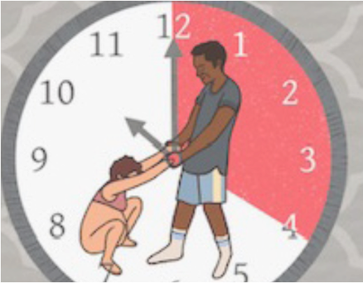
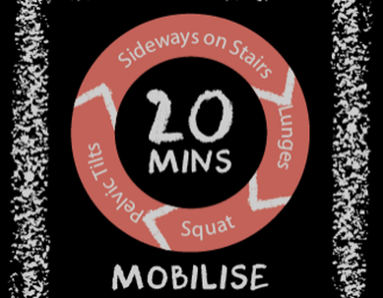
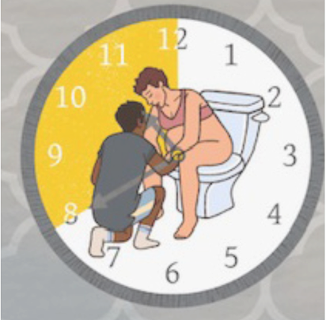
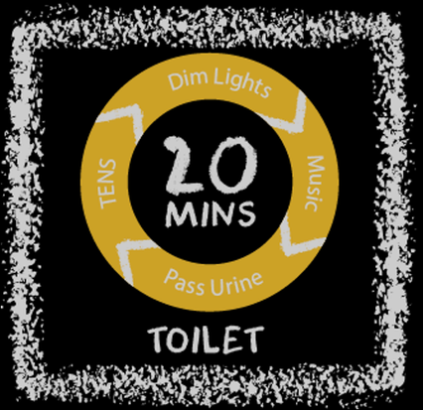
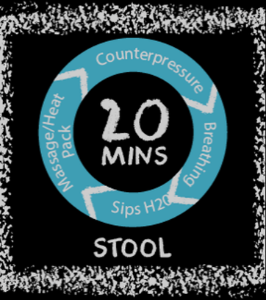
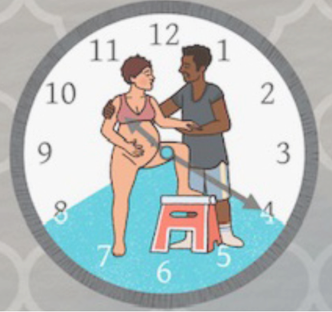
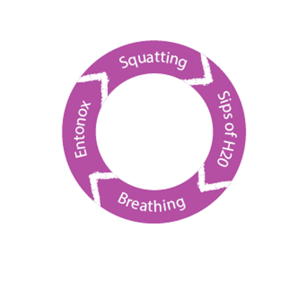
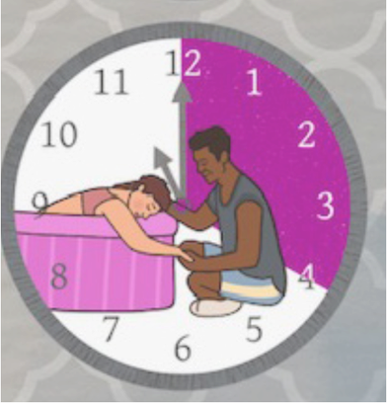
Mobilization
4 activities for 20 mins per activity
  Sideways on the stairs
  Lunges
  Pelvic tilts
  Deep squats
Toilet
Sit backward while straddling the toilet.
  Empty your bladder
  Helps relax pelvic floor muscles,
  Allows fetal head descent
STEPS OF FRAMEWORK
Stool
Utilization of stool
  Use birthing stool, or a low set stool, raise one leg on the stool at a time while standing.
  With the support person behind, lean backwards, and lift one leg up and keep it raised on the step while laying down
Water
Immersion or hydrotherapy
  Use pools, baths, showers for relaxation and pain management
  Lunge, squat, sit on a birthing ball while in the shower.
Notes:
Mobility and upright positioning during labor have been proven to contribute to less
interventions, higher patient satisfaction, less reported severe pain, and may shorten labor by
more than an hour. Upright positioning uses gravity, which allows the baby to descend more quickly. Our goal is to get mothers as active as possible during the early stages of labor. Upright positioning allows gravity to assist with descent of fetal head, improve pelvic opening, and increase comfort over lying in bed.
Activities such as walking, lunges, pelvic tilts, and sideways stairs help open the mid-pelvis and create more space between the ischial spines, the narrowest part of the pelvic passage. Often, mothers state sitting still in bed is NOT helpful for coping with pain. Allowing mothers to walk the hall or around the room assists with coping and pain scores.
Often called "Dilation station," use of the toilet can be an excellent way to enhance effectiveness of contractions. Clenching of the passage muscles instead of relaxation will prolong labor progression. Clients rely on these muscles to push their babies out; therefore, it is important that they remain as relaxed as possible. Sitting or straddling the toilet relaxes the pelvic floor muscles, which ultimately allows fetal descent into the pelvis.
Many of these steps intertwine with one another or can be done simultaneously. Using stools can assist with deep lunges, deep squats, kneeling, and stretching. The stool is a great way to prepare the muscles and ligaments for labor by allowing for better mobility and rotation of fetal head. Deep lunges and squats can increase pelvic space by 30%. Contractions are also often more effective, and labor time is shorter when a mother is allowed to choose upright positioning. Allowing birthing mothers to choose which positions they are most comfortable with allows them to feel in control of their pain and labor. Use of the stool aids in performing deep lunges. The lunge technique may be useful when labor
stalls and the baby is at 0 station. This is partly due to a narrow pelvic outlet. This simple
technique can open the mid pelvis and allow the baby to descend when the station is not
progressing.
Hydrotherapy is the action of immersion in warm water during labor. While Eisenhower does
not provide tubs for this practice, warm showers are a great alternative in reducing pain and
supporting upright positioning. Hydrotherapy is an effective non-pharmacological intervention
that increases relaxation and provides pain relief during all stages of labor.

Slide 30
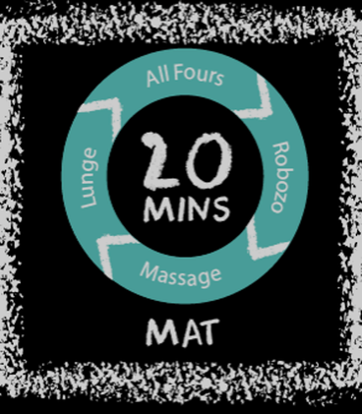
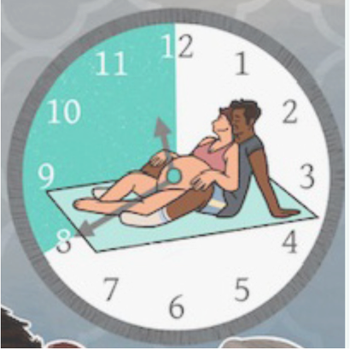
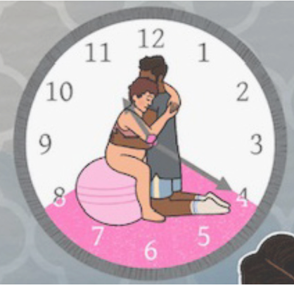
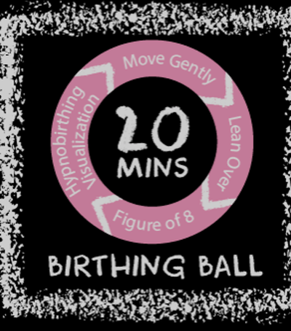
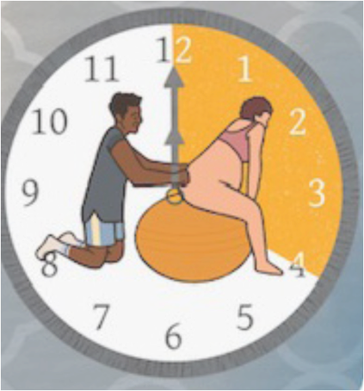
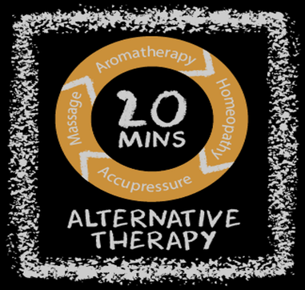
Mat
  Kneeling on all fours
  Lean over a birthing ball
  Perform pelvic tilt with partner while on mat
  These positions help place the baby in a great position to descend
Birthing Ball
STEPS OF FRAMEWORK
CONTD.
Encouraging movement and utilization of a birthing ball for
  While sitting on the birthing ball, performing a figure-8 rotation allows for rotation of the fetal head into the pelvis.
Alternative Therapy
Coping mechanisms for pain management
  Aromatherapy
  Homeopathy
  Acupressure
  Massage
Notes:
Use of maternal positioning is crucial during the second stage of labor. Maternal positions can
greatly improve their sense of control and create a positive labor experience. Certain positions
can even minimize obstetric complications. For instance, kneeling on all fours can contribute to
fewer perineal lacerations, shorten the second stage of labor, and even dislodge instances of
shoulder dystocia. Hands and Knees, contributes to the widest pelvic outlet and allows gravity
to move the shoulders forward over the sacral promontory.
Let’s rock and roll! Studies have shown, rocking movements on a birthing ball can significantly
reduce pain scores, specifically lower back pain. In addition, performing figure 8 movements
encourages fetal head rotation and allows further descent into the pelvis.
Complementary therapies can assist in delaying pharmacological pain relief and aid as a coping
mechanism for many. Aromatherapy, homeopathy, acupressure and massage can be used
during labor in conjunction with all other steps in Labor Hopscotch to provide the ultimate
labor experience.
1. Aromatherapy
There is a long history of using aromatherapy in the care of women. Among pregnant
women, essential oils can have significant physiological and neurological effects
through aromatic compounds. This provides laboring patients with means of coping and
pain relief.
2. Acupressure
Acupressure is an excellent way to decrease perception of pain and lower anxiety.
Performing acupressure is also a great way to give partners an active role in the labor
experience. Pressure applied to stimulation points for the duration of a contraction can
decrease discomfort and provide a sense of control.
3. Massage
Massage is another technique that can provide relaxation and comfort. Some benefits of
massage include reducing muscle tension, improving blood circulation and oxygenation
which can be beneficial for baby, and relief of pain in muscles and joints.

Slide 31
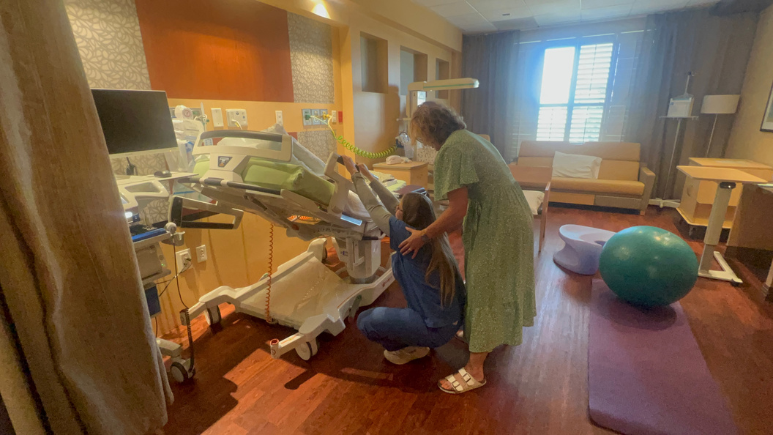
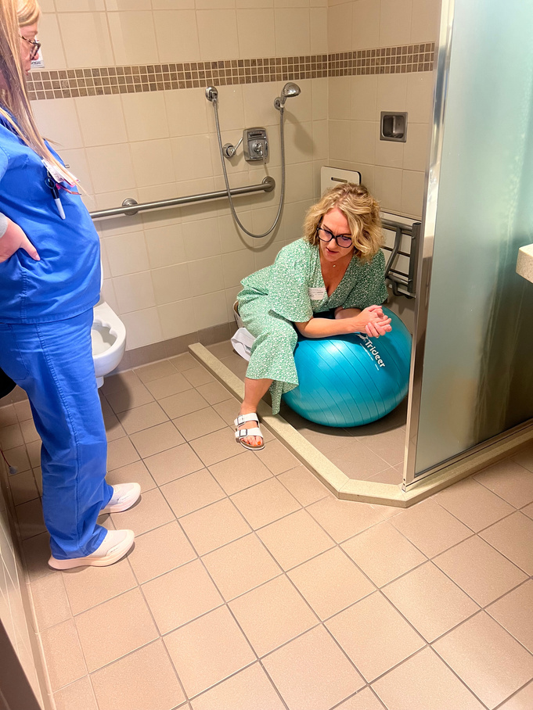
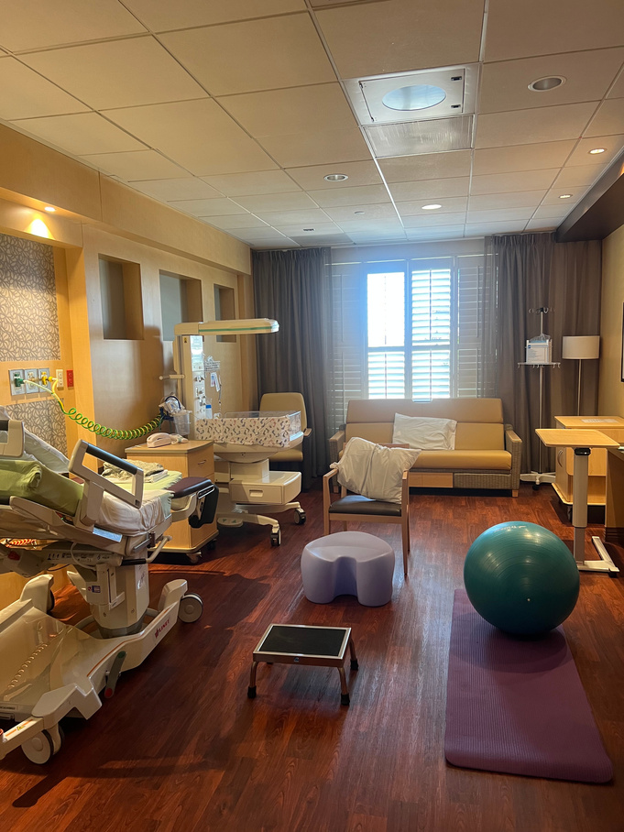
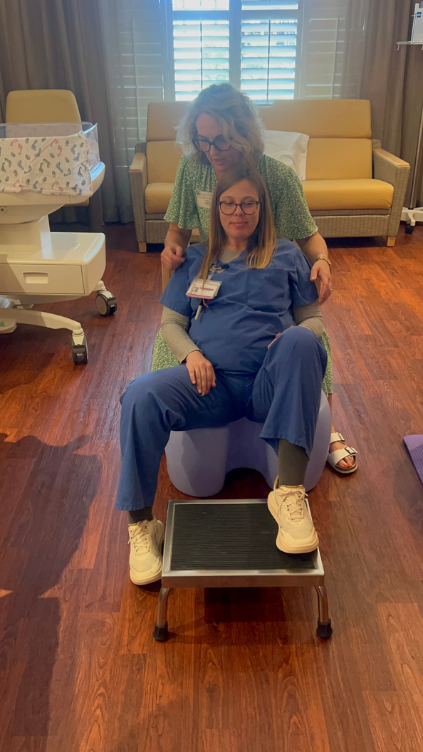
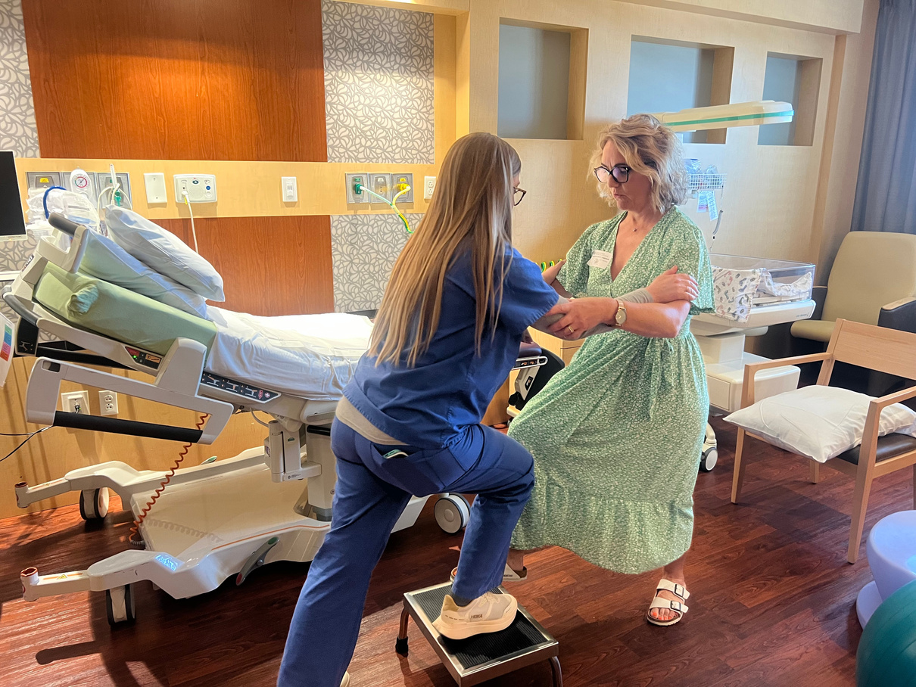
Notes:
I uploaded some photos here of Sinead and Denise, the creators of Labor Hopscotch, giving us an in-depth teaching of their framework.

Slide 32
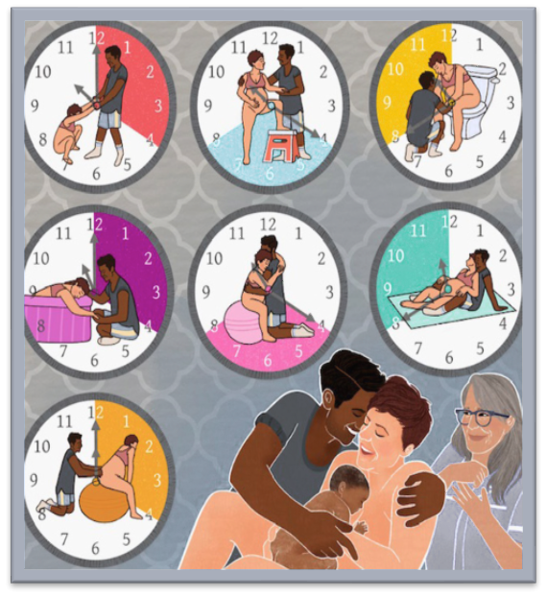
MATERIALS & METHODS
1
  Mix method used, Qualitative and quantitative
  Pre-survey conducted prior to education
  Education Presentation on Labor Hopscotch Framework was presented during unit-based council meeting
  Educational PowerPoint sent out to staff via email
  Author’s invited to educate and demonstrate framework
  Post survey provided after education
2
3
Notes:
To begin our project, we distributed 11 self-conducted questions to all LDRP unit staff via Shout. The questions were a mixture of closed and open-ended questions.
The pre-survey was conducted prior to education implementation and the post survey was conducted after implementation.
The Project design was a mixed quantitative
and qualitative.
Our methods that we used for our education were:
1.Education presentation on Labor
Hopscotch Framework, that was presented during unit-based council meeting. This is where we presented all our knowledge and evidence-based research. We educated our staff on the importance of Labor Hopscotch, and we shared the evidence on each step in the labor hopscotch framework and why this can ultimately reduce our cesarean rates. We also discussed the background of Labor hopscotch as I previously did, and why this was so successful in Ireland, and why it can be successful here at Eisenhower as well.
2. There was also an Educational PowerPoint sent out to all staff
via email - This was sent, in case they were not present during the council meeting, but also as a tool for them to reflect back on. This PP also covered all the answers from the pre-survey, in case our staff was interested in seeing the correct answers.
3. PowerPoints were also printed and kept at units' nurses’
station. This was for them to have easy access to the PowerPoint.
4. Educational posters were posted in the break room. This was to give our staff more of a visual tool.
5. Finally, Eisenhower's Family Birth Center was fortunate enough to invite the authors, Sinead O'Connor and Denise Thompson, to the unit to demonstrate hands-on skills and training to fully implement the framework on the unit. Eisenhower became the first hospital in the U.S to introduce this framework and initiated an international collaboration.

Slide 33
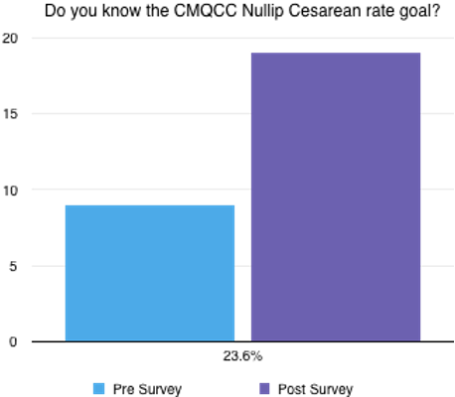
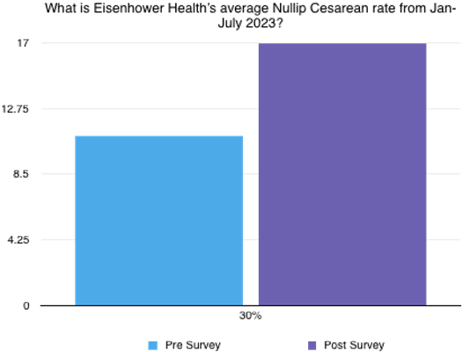
RESULTS
  Seen an average of 30% knowledge increase across LDRP staff
  100% of respondents are willing to incorporate the birthing tool
  After education, 100% of respondents feel competent to use Labor Hopscotch
  Although not directly measured, Eisenhower Health’s cesarean rate after education decreased to 25% in December 2023 and to 23.1% in January 2024. Successfully obtaining the target rate
Notes:
The analysis of the results from the pre-survey and post-survey highlighted a diverse range of outcomes in participant performance. Notably, several respondents exhibited positive trends, demonstrated by increases in their correct answer percentages. For instance, several answers showed a 3-10% increase in knowledge. These improvements suggest that participants likely enhanced their understanding or knowledge during the interval between the two surveys.
Conversely, there was also a noted decline in one instance, where performance fell by 8%, dropping from 96% in the pre-survey to 88% in the post-survey. This decline may point to challenges related to knowledge retention or its application.
Moreover, some respondents maintained consistent performance, evidenced by 100% correct answers in both surveys, indicating reliable knowledge retention over the evaluation period. In summary, the overall findings reflect a combination of improvements, consistent performance, and isolated declines, providing valuable insights into the participants' learning trajectory and areas for further development.
The comparison of results between the pre-survey and post-survey suggests that participants, particularly nurses, possess an adequate base of knowledge both before and after the intervention. The relatively high percentage of correct answers in both surveys—ranging from 73% to 100%—indicates a strong foundational understanding of the subject matter. The overall improvements seen in several cases further support the idea that the nurses were able to enhance their knowledge during the study period. Given the stable or positive results, it suggests that the implementation of training or initiatives targeting nurses' base knowledge could likely be successful. The increase in correct responses, particularly in instances where respondents reached perfect scores, reflects that the base knowledge was sufficiently solid, and there is potential for successful application of new information or strategies.

Slide 34
1
Lack of wireless monitoring
Intermittent monitoring orders
5
Wireless monitors provided in certain rooms due to connectivity issues.
Physicians set intermittent monitoring orders and exclusion list lengthy
2
Patient cooperation
Physician compliance
6
Patients less inclined to particpate and actively engage in some activities
Some Physicians were less inclined to participate and avoided orders for intermittent monitoring, showers, and/or ambulation
BARRIERS
3
Lack of resources
High nurse turnover
7
Aroma therapy, mats. tubs, sufficient stools & birthing balls for patient volume
During the study, there was a high rate of travel nurses, creating an inconsistent practice within unit
4
Limited Prenatal Education
High-Risk conditions
8
Limited education on expectations during labor and delivery stay.
Influx of high-risk patients, PPROM, MgSO4, etc.
Notes:
First, technology-related barriers played a role.
Wireless monitoring was only available in certain rooms due to connectivity limitations, which restricted our ability to consistently support mobility and intermittent monitoring.
Next, we encountered challenges with clinical workflows and provider practices.
Intermittent monitoring orders were not always utilized, and the exclusion criteria were quite extensive. Additionally, some physicians were less inclined to participate, often avoiding orders related to intermittent monitoring, ambulation, or patient showers.
Another major barrier involved patient participation.
Some patients were less willing to engage in activities such as movement or alternative labor interventions, which limited the effectiveness of our approach.
We also faced resource limitations.
There was a lack of essential supportive items like aromatherapy supplies, mats, tubs, stools, and birthing balls, especially considering the patient volume.
Staffing challenges were also significant.
A high number of travel nurses during the study period led to variability in practice, and overall nurse turnover contributed to inconsistency in implementation.
In terms of education, there was limited prenatal education for patients, as well as gaps in understanding expectations during labor and delivery, which affected engagement and participation.
Finally, the patient population itself presented challenges, with an influx of high-risk cases—such as PPROM and patients receiving magnesium sulfate—which often required more restrictive care and limited the ability to apply the intervention.

Slide 35
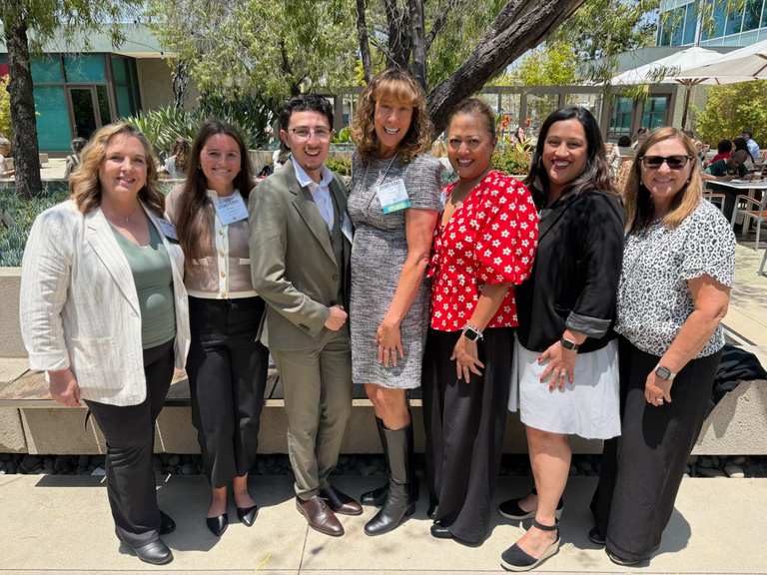
FACILITATORS
  Director: Veronica Williams
  Administrative support
  Financial support
  Staff participation
  Nurse Residency Program
Notes:
This project wouldn’t be possible without the tremendous support of our director, Veronica Williams.
The administrative support, such as our clinical educators and managers along the way.
The financial support and donors who generously donated for supplies and the opportunity to bring Sinead and Denise all the way from Ireland to educate us on their framework.
Staff engagement and participation, who were so willing and enthusiastic to learn and apply this knowledge to practice.
And most importantly, the Nurse Residency program that guided us, encouraged us, and supported us as new graduate nurses at the time to immerse ourselves in evidence based practice.

Slide 36

CONCLUSION
In conclusion, Labor Hopscotch has been proven to enhance physiological birth and reduce instrumental and operative deliveries.
We believe that incorporating this birthing tool and educating laboring clients about the benefits of Labor Hopscotch can reduce cesarean rates across hospitals nationwide.
Notes:
Implementing the Labor Hopscotch framework has had a meaningful impact on our unit, by promoting evidence-based labor management and fostering a culture of collaboration. Since implementation, we have seen a reduction in primary cesarean section rates through providing increased support for physiologic labor, patient mobility, and non-pharmacological comfort measures. The project has also strengthened staff engagement by encouraging nurses to take an active role in supporting labor progression and participating in shared decision making with providers. Overall, this initiative has demonstrated that simple, evidence-based interventions can improve maternal outcomes while creating a more engaged, empowered, and cohesive LDRP team.

Slide 37
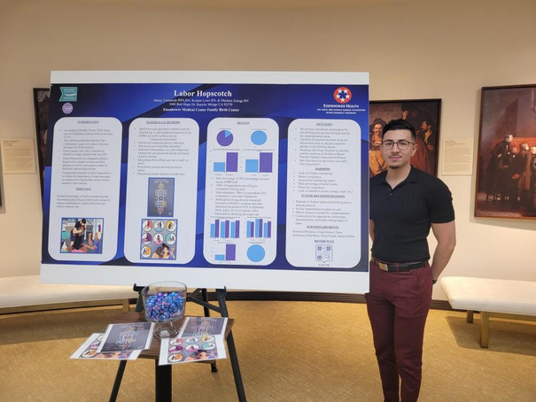
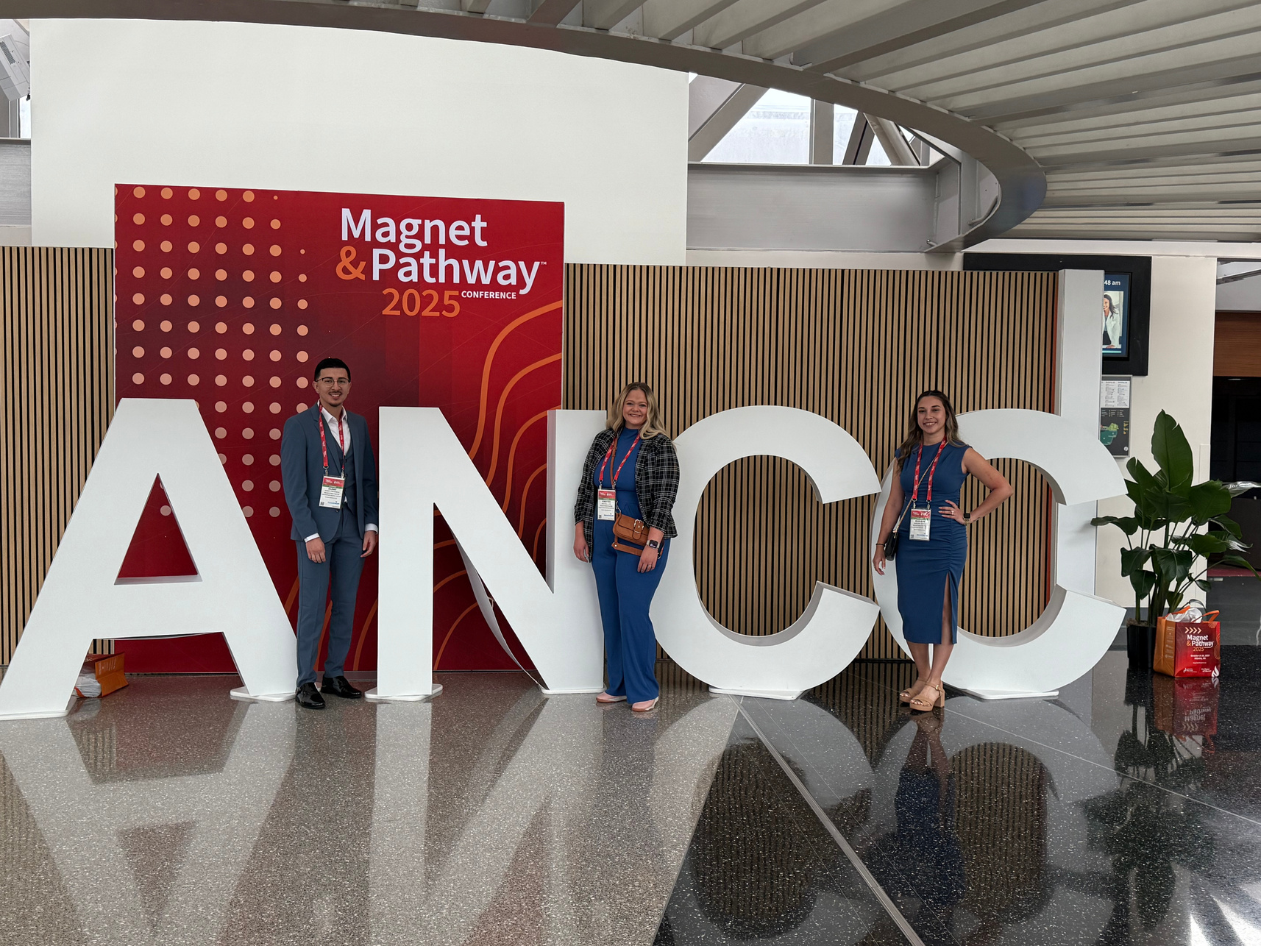
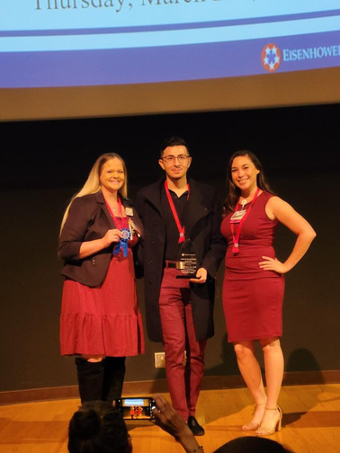
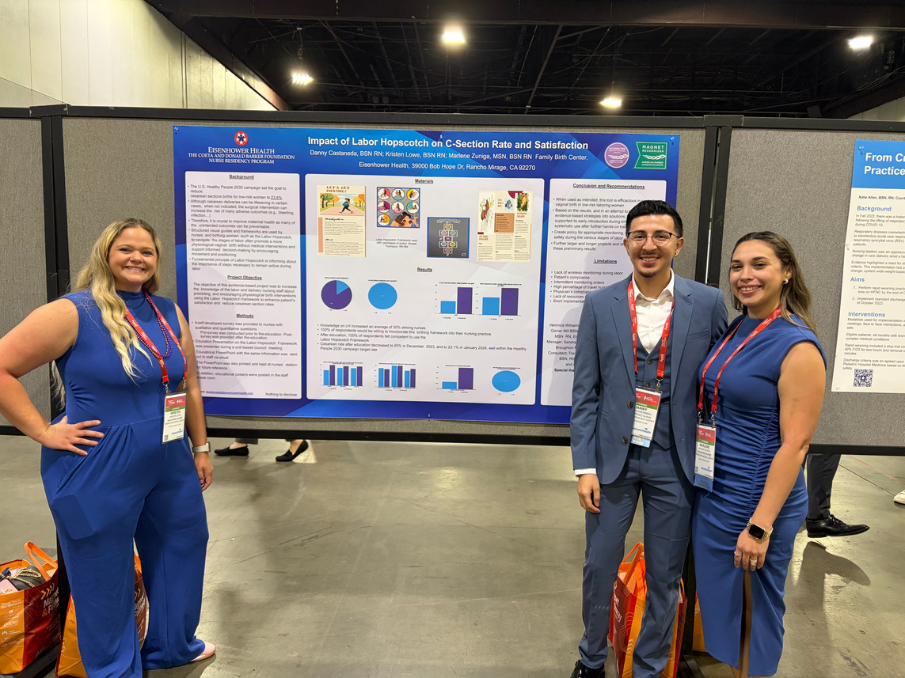
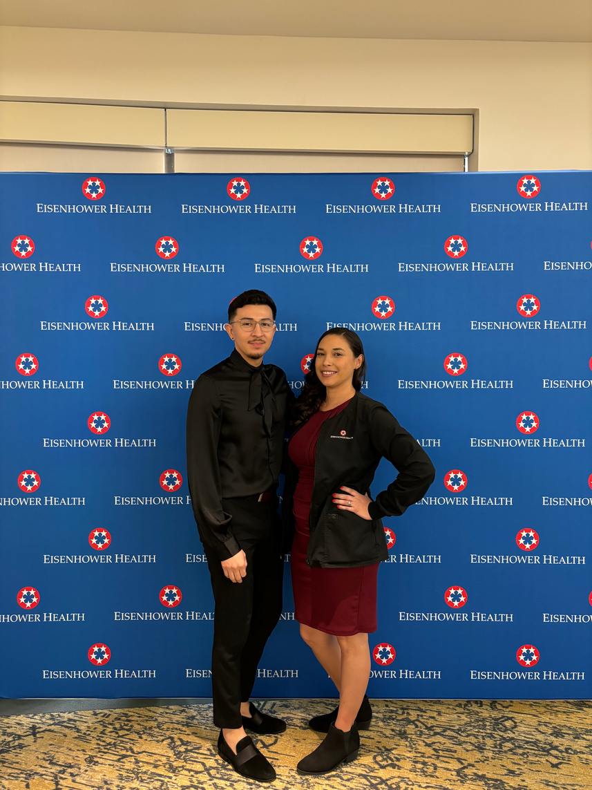
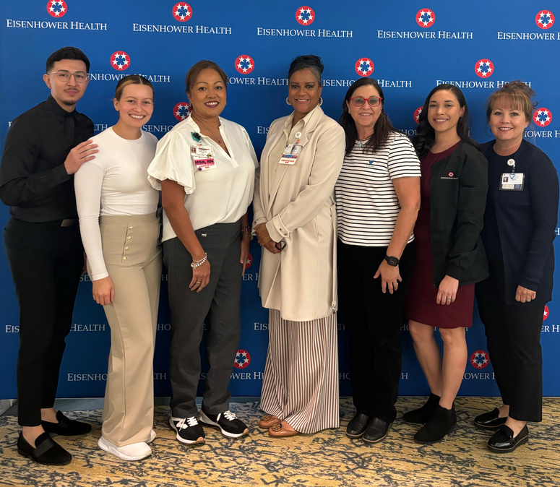
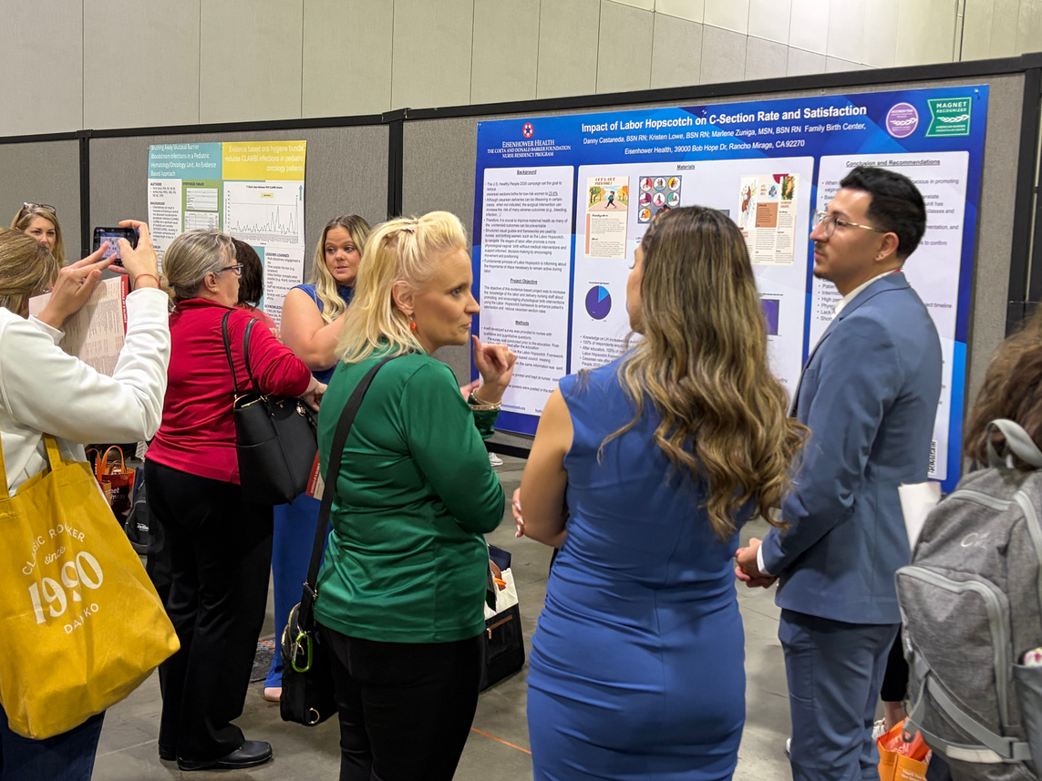
ACCOMPLISHMENTS
Notes:
Here I listed some photos to share some of our accomplishments. We achieved first place for Eisenhower’s Nurse Residency Evidence Based Project. We continued our project and had the pleasure to be poster presenters at the ANCC in 2025. We have also had the opportunity to present at several symposiums and perinatal conferences. This journey has been a long journey but one that I am extremely grateful for.

Slide 38
REFERENCES
Carroll L, Thompson S, Coughlan B, McCreery T, Murphy A, Doherty J, Sheehy L, Cronin M, Brosnan M, O'Brien D. 'Labour Hopscotch': Women's evaluation of using the steps during labor. Eur J Midwifery. 2022 Sep 9 ;6:59. doi: 10.18332/ejm/152492. PMID: 36132188; PMCID: PMC9460932.
O'Brien D, Coughlan B, Thompson S, Carroll L, Sheehy L, Brosnan M, Cronin M, McCreery T, Doherty J. Exploring midwives' experiences of implementing the Labour Hopscotch Framework: A midwifery innovation. Eur J Midwifery. 2022 Apr 4;6:18. doi: 10.18332/ejm/146081. PMID: 35515090; PMCID: PMC8988070.
THOMPSON, S.; O’BRIEN, D. Labour hopscotch: Supporting physiological births. World of Irish Nursing & Midwifery, [s. l.], v. 23, n. 8, p. 64–65, 2015. Disponível em: https://research.ebsco.com/linkprocessor/plink?id=61996c2d-7186-3b21-9b76-9cd9f32eb5a0. Acessoem: 4 out. 2023.
THOMPSON, S. et al. A Positive Birth Experience: Midwives Empowering Women
and Their Partners during the Birth of Their Baby with the Steps of the Labour Hopscotch Framework. Practising Midwife, [s. l.], v. 25, n. 3, p. 8–14, 2022. DOI 10.55975/bpax3273. Disponívelem: https://research.ebsco.com/linkprocessor/plink?id=bcd0062a-643b-34c3-a5b1-0a0619fbd301.Acesso em: 4 out. 2023.

Slide 39
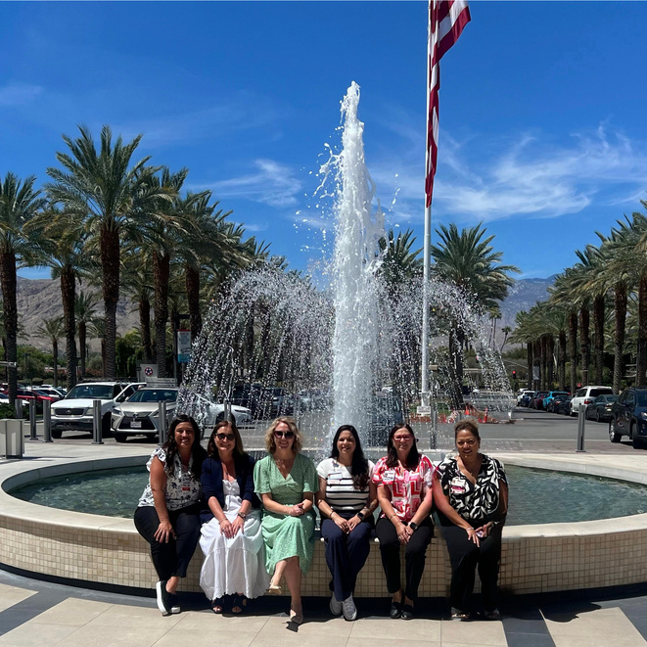
THANK YOU
Special thanks to Sinead Thompson RN RM and Denise O’Brien RN RM - Original authors of the Labor Hopscotch framework

Slide 40
Q & A
Please submit questions in the chat!

Slide 41
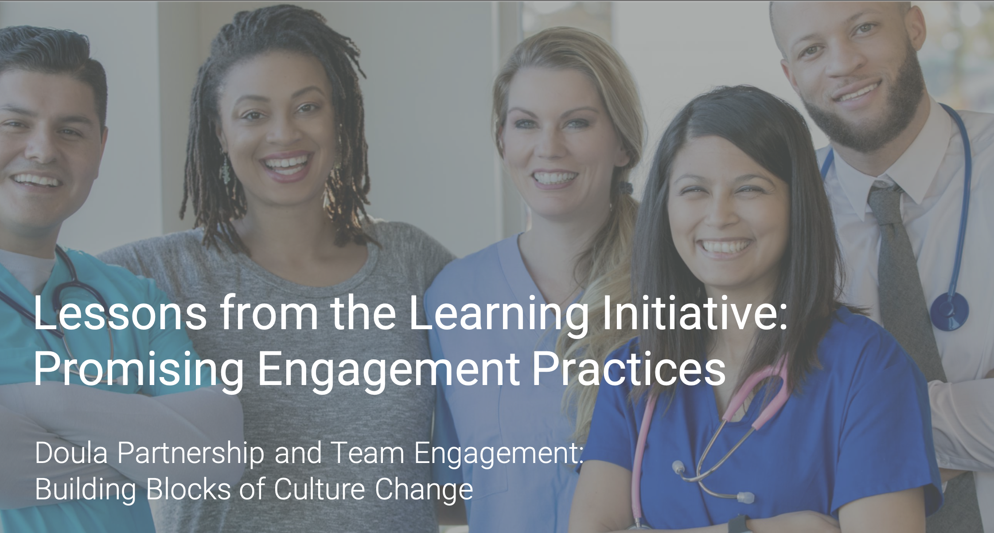
Lessons from the Learning Initiative Webinar Sprint
Round 1 and 2 highlights
Doula Partnership and Team Engagement: Building Blocks of Culture Change
Doula Engagement and Patient Advocacy
Staff and Leadership Engagement

Slide 42
Thank you for joining us!
Stay involved with CMQCC
TOOLKITS
IMPLEMENTATION
MATERNAL DATA CENTER
ENGAGEMENT
Evidence-based toolkits on leading causes of preventable maternal morbidity and mortality.
Coaching on how to implement best practices and sharing among member hospitals.
Near real-time benchmarking data to support hospitals’ quality improvement.
Engaging partners around aligned goals and promoting patient awareness.

Slide 43
ChristaWalczak
@Stanford.edu
Tdeeds@
Stanford.edu

