Slide 1
Lessons from the Learning Initiative

Slide 2
Lessons from the Learning Initiative
Logistics and Slide Deck
All attendees are muted upon entry
Please do not copy the slides
The slides are the intellectual property of the presenting hospitals.
Please utilize the chat feature to share learnings and takeaways.
Please use the Q&A function
Send us your feedback
We will do our best to answer any questions during the webinar.
We welcome your recommendations for improving future webinars.

Slide 3
Lessons from the Learning Initiative
Webinar Recordings and Slides
The webinar recording and slides will be posted within 72 hours at:
https://www.cmqcc.org/education-research/webinars

Slide 4
Lessons from the Learning Initiative
Webinar Agenda
1
Introduction to the Learning Initiative
2
Presentations:
“Battle of the Births”- Eisenhower Medical Center
Culturally Humble Childbirth Education – El Camino Health
3
Q & A

Slide 5
Introduction to CMQCC’s Learning Initiative

Slide 6


Introduction to the Learning Initiative
The Learning Initiative to Support Safe and Respectful Vaginal Birth (LI)
CMQCC Quality Improvement Initiative
Funded by the Centers for Disease Control and Prevention (2022-2027)
Five cohorts, 18-months long each
Built upon
  Supporting Vaginal Birth Collaborative (2017-2019)
  Pilot Birth Equity Collaborative (2019)
Notes:
The LI is a different form of collaborative, focused on shared learning over expertise and being held to the same standard.
Trialing out 18-months
We took lessons, curriculum, and tools from SVB and BEC and combined them, based on feedback, maternal mortality and morbidity reviews.

Slide 7
The Learning Initiative
Goals
Goal: reduce disparity gaps in low-risk cesareans with a goal of all patient groups reaching or exceeding the Healthy People 2030 target rate of 23.6%.
Reduce racial and ethnic differences in NTSV Cesarean rates
Increase participation of hospitals with high NTSV Cesarean rates
Increase community and patient awareness of existing racial disparities in NTSV rates
Increase the number of hospitals with patient and community engagement practices
Notes:
We are aiming to create a community of learning where hospitals can share lessons, we can provide education on data, equity, RMC, etc to help hospitals reduce the differences.
Goals
Reduce racial and ethnic differences in NTSV Cesarean rates with a goal of all races and ethnicities reaching or exceeding the Healthy People 2030 target rate of 23.6%.
Increase participation of hospitals with high NTSV Cesarean rates among Black gravidas or patients from racial groups with similarly high rates
Increase community and patient awareness of existing racial disparities in NTSV rates and causes contributing to an NTSV Cesarean delivery
Increase the number of hospitals with patient and community engagement practices to inform the adoption of equitable care practices

Slide 8
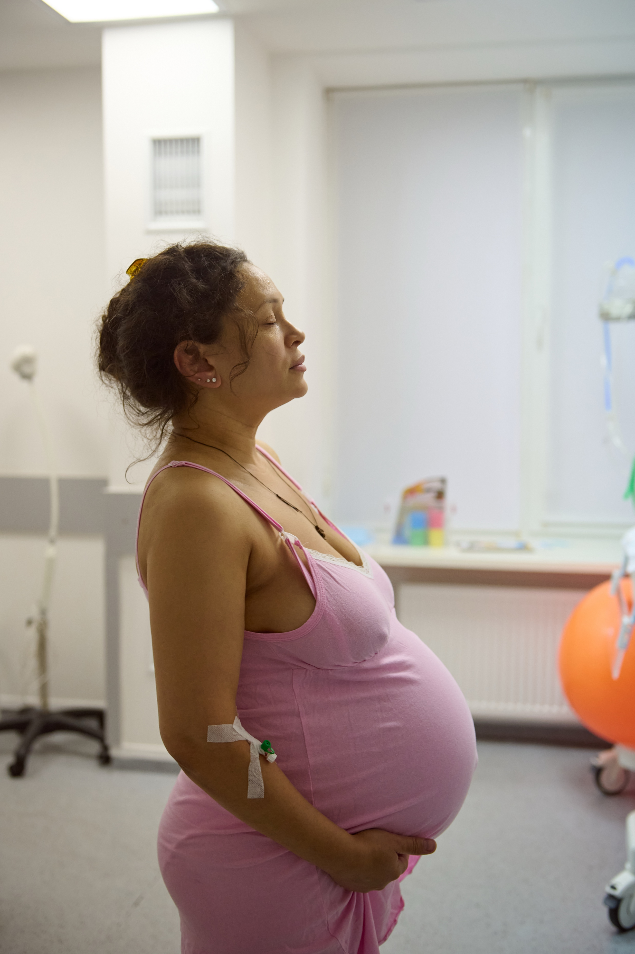
The Learning Initiative
Curriculum education and training
Monthly coaching providing education and capacity building
  QI Fundamentals
  Implementation Science
  Implicit Bias and Principles of Respectful Care
  NTSV-reduction strategies
  Technical assistance in leveraging CMQCC tools
    Maternal Data Center (MDC)
    Hospital Action Guide for Respectful and Equity-Centered Obstetric Care
Asynchronous quarterly webinars on health equity and cesarean rate reduction tools
Notes:
Try to stay up with the program as we move through it and not jump ahead, or it will be difficult to identify what changes have been the most impactful for your unit

Slide 9
Introduction to the Learning Initiative
Today’s Presenters
Eisenhower Medical Center
EL Camino Health
Rancho Mirage
Presenter:
Lourdes M. Jamison, PhD, MSN-Ed, RNC-OB
Mountain View
Los Gatos
Presenter:
Anjali Sardeshmukh, LM/ IBCLC

Slide 10
Eisenhower Medical Center

Slide 11




“Battle of the (NTSV) Births”: A Labor & Delivery Unit Game Aimed to Reduce NTSV Cesarean Section Rates
Lourdes M. Jamison, PhD, MSN-Ed, RNC-OB
Nursing Professional Development Practitioner
Eisenhower Family Birth Center

Slide 12

Eisenhower Medical Center – Family Birth Center
Opened 2021
100 – 120 Deliveries/Month
14 LDRP, 7 PP, 4 OB ED Rooms & 2 OR Suites
Staff Nurses vs Traveler RNs
Leadership Team
Provider Team
Unit Changes From 25 - 26
Notes:
Increased census since opening: Approx. 1000 deliveries annually in 2022 and 2023. 1252 deliveries in 2025. On pace for approx. 1400 deliveries in 2026.

Slide 13

Background
Eisenhower 2025 annual NTSV C/S rate was 22.4% but varied from month to month
Gamification in Nursing Education
Engaging Nursing in Quality Improvement
Mother – Son Discussions
Who Remembers MTV’s Battle of the Bands?

Slide 14
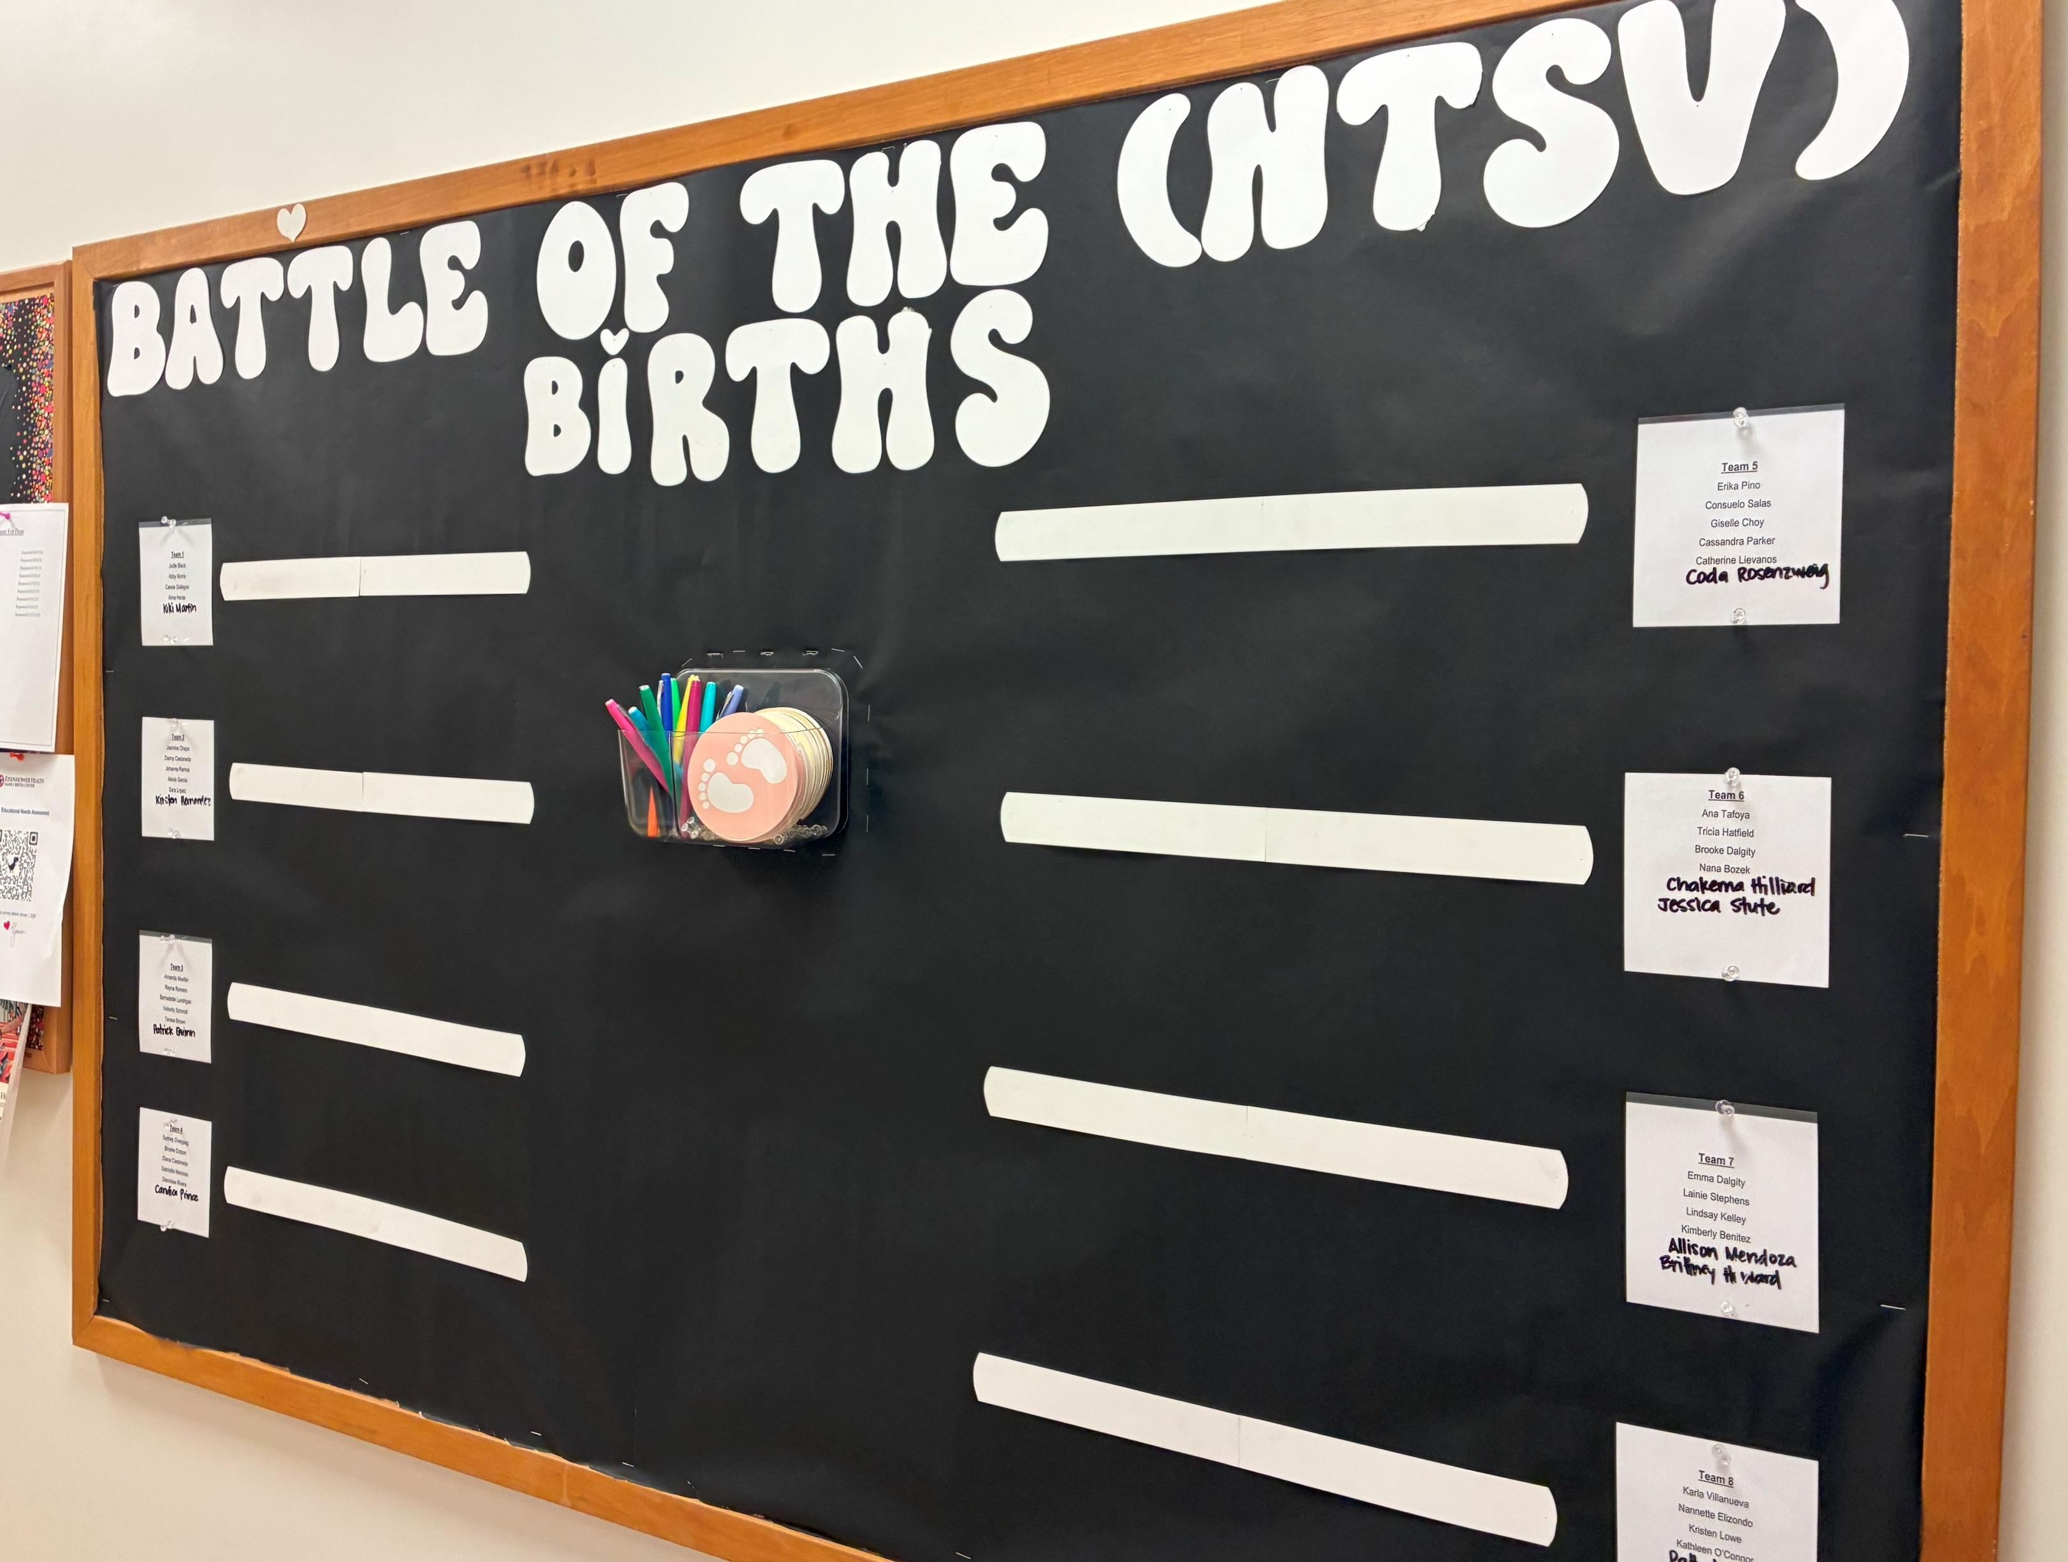

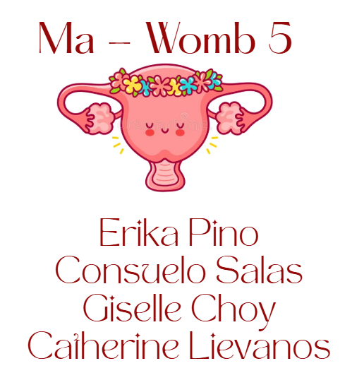
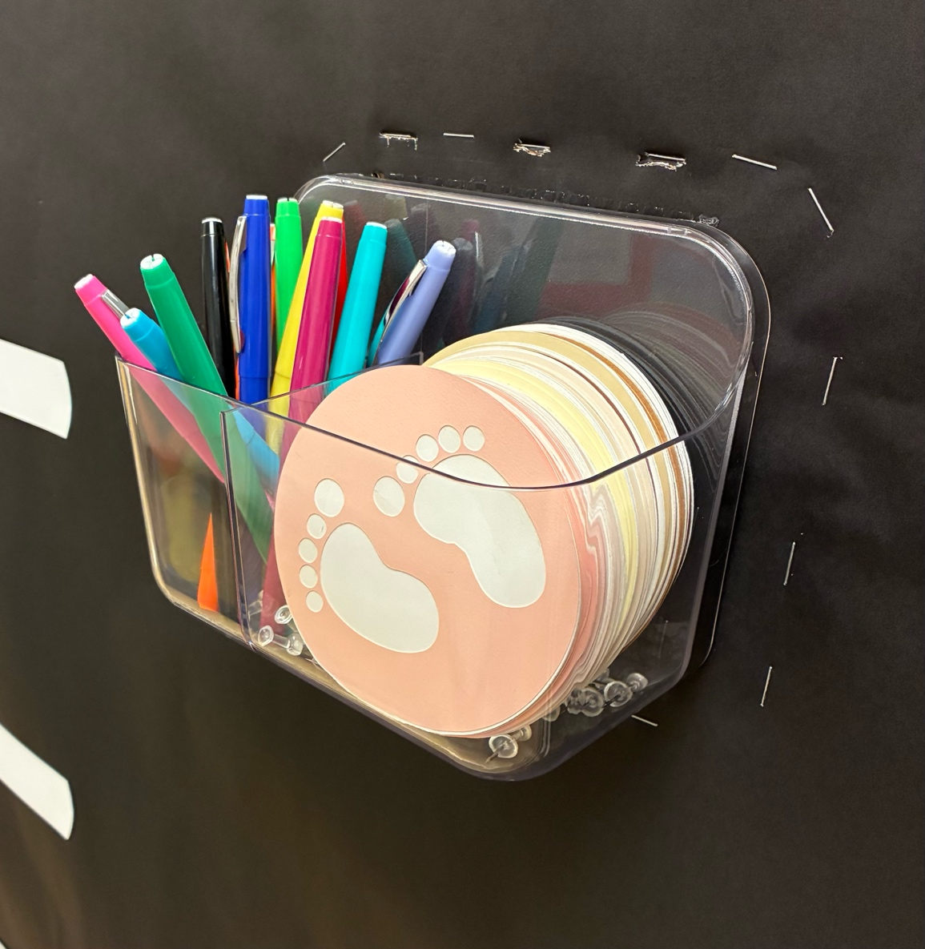

Methods
Collaborative, Friendly Competition
Team Composition
Monthly, Quarterly, & Annual Winners & Prizes.
Notes:
A unit based game was created to create a collaborative and friendly competitive atmosphere for nursing staff to work towards achieving vaginal deliveries in the NTSV patient in labor.
Teams are encouraged to advance their “baby feet” along their team’s “race lane” throughout the month.

Slide 15
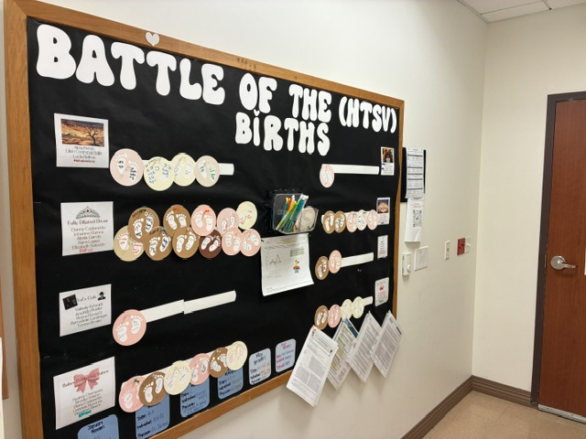
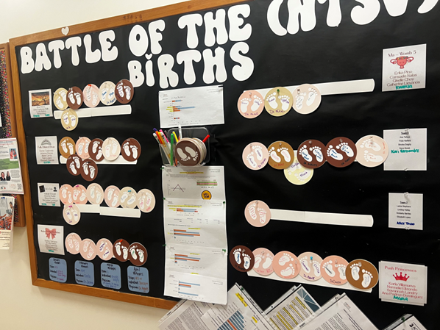
Outcomes
Primary C/S Rates
Staff Engagement
Increased Collaboration, Teamwork, Camaraderie
Inclusion of Travelers into Unit Culture

Slide 16
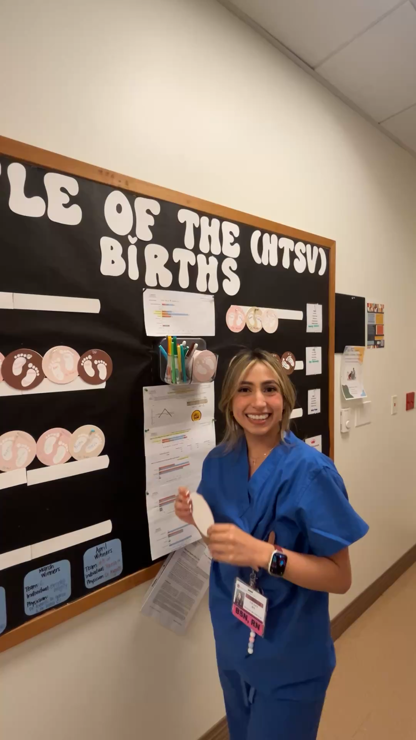
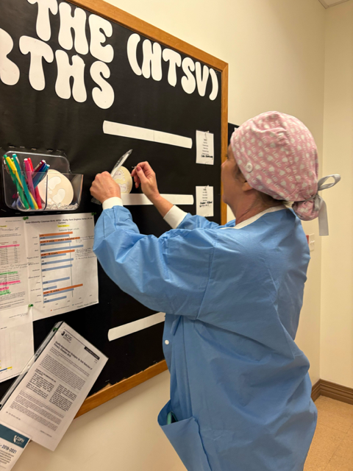
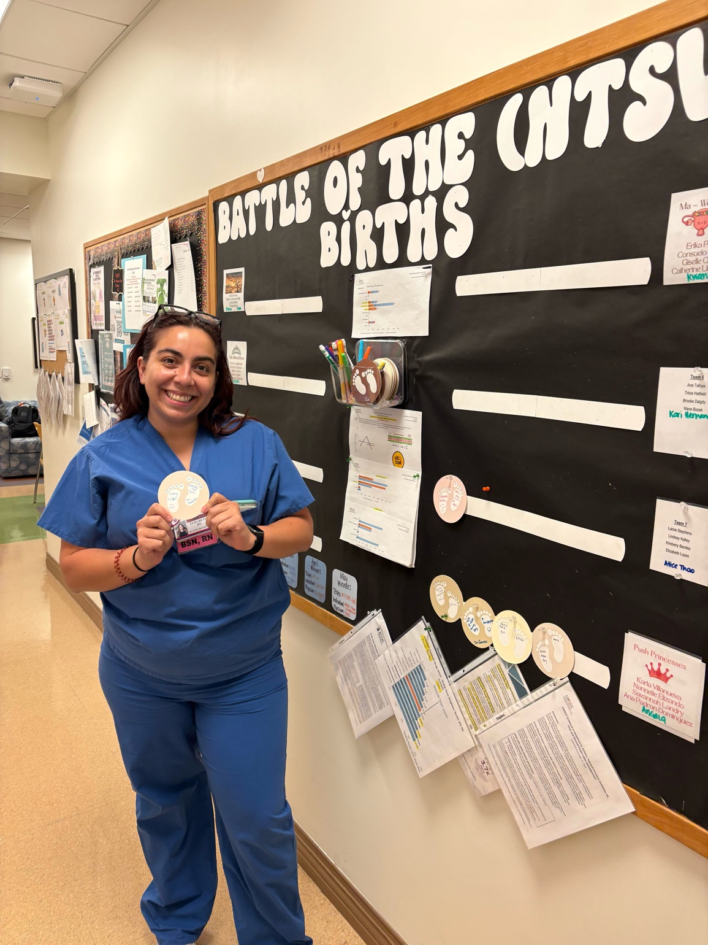
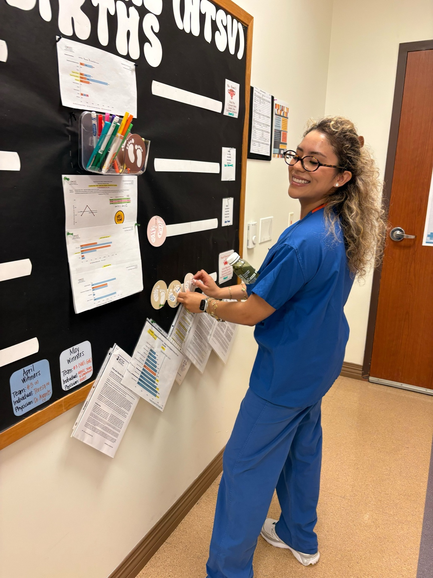
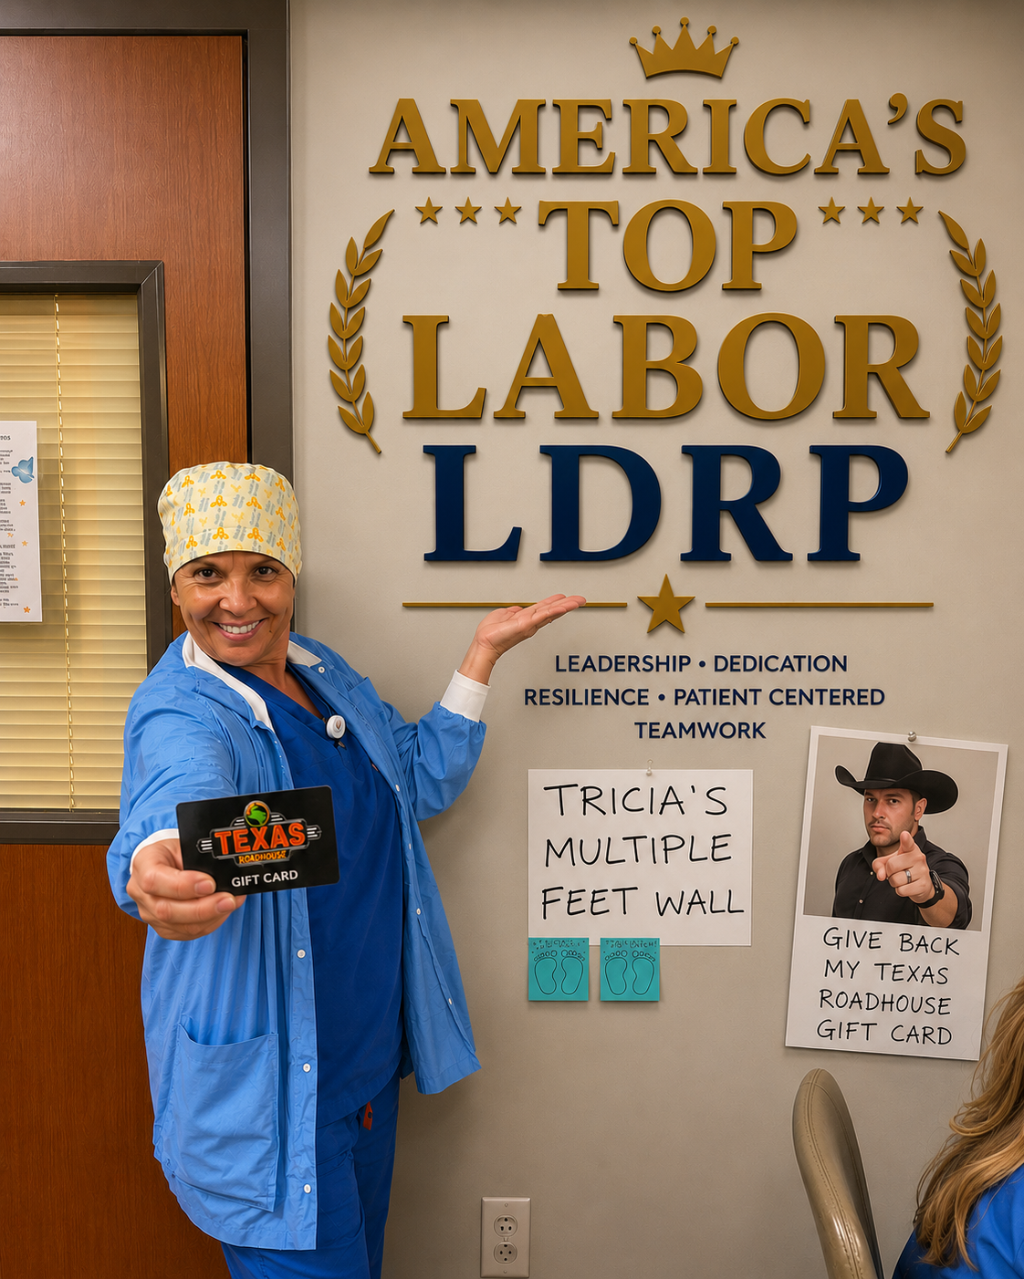
Facilitators & Barriers
Administrative Support
Staff Engagement
Financial
Physician Turnover

Slide 17

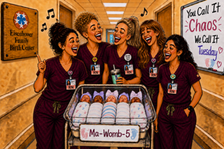
Project Pearls
Focus on the Positive
Focus on the Nursing Role in Preventing NTSV
Include Providers in Positive Reinforcement
Using AI
Notes:
Nursing Role: Using CMQCC resources, ACOG recommendations/changes

Slide 18
References
American College of Obstetricians & Gynecologists (2025). Quality Improvement Strategies for Safe Reduction of Primary Cesarean Birth: Committee Statement. Obstetrics & Gynecology, 145(5). 542 – 552.
Demiray, A., & Acil, A. (2024). Using a board game to learn a physical assessment course in nursing education: A randomized controlled study. The Journal of Nursology, 27(3), 259 – 267. https://doi.org/10.17049/jnursology.1428436
Price, C., Lachica, C., Ferguson, S., Russer, E., Markus-Rodden, M., & Easter, K. (2024). Game on: How a friendly competition grew into a falls safety initiative. Nursing Management, 55(12), 28 – 33. https://doi.org/10.1097/nmg.0000000000000192
Smith, H., Peterson, N., Lagrew, D., & Main, E. (2022). Toolkit to Support Vaginal Birth and Reduce Primary Cesareans: A Quality Improvement Toolkit. Stanford, CA: California Maternal Quality Care Collaborative
Tavares, N. (2022). The use and impact of game – based learning on the learning experience and knowledge retention of nursing undergraduate students: A systematic literature review. Nurse Education Today, 117, 1 – 6. https://doi.org/10.1016/j.nedt.2022.105484
van Dijk, M. D., Mulder, S. A., Erasmus, V., van Beeck, A. H. E., Vermeeren, J. M. J. J., Lui, X., van Beeck, E. F., & Vos, M. C. (2019). A multimodal regional intervention strategy framed as a friendly competition to improve hand hygiene compliance. Infection Control & Hospital Epidemiology, 40(2), 187 – 193. https://doi.org/10.1017.ice.2018.261

Slide 19
El Camino Health

Slide 20
Healthy Pregnancy for South Asians:
An Offering from El Camino Health Maternal Child Health
Anjali Sardeshmukh, LM, IBCLC, Childbirth Education
CMQCC Learning Initiative: Culturally Humble Childbirth Education
Thursday, August 31, 2026

Slide 21
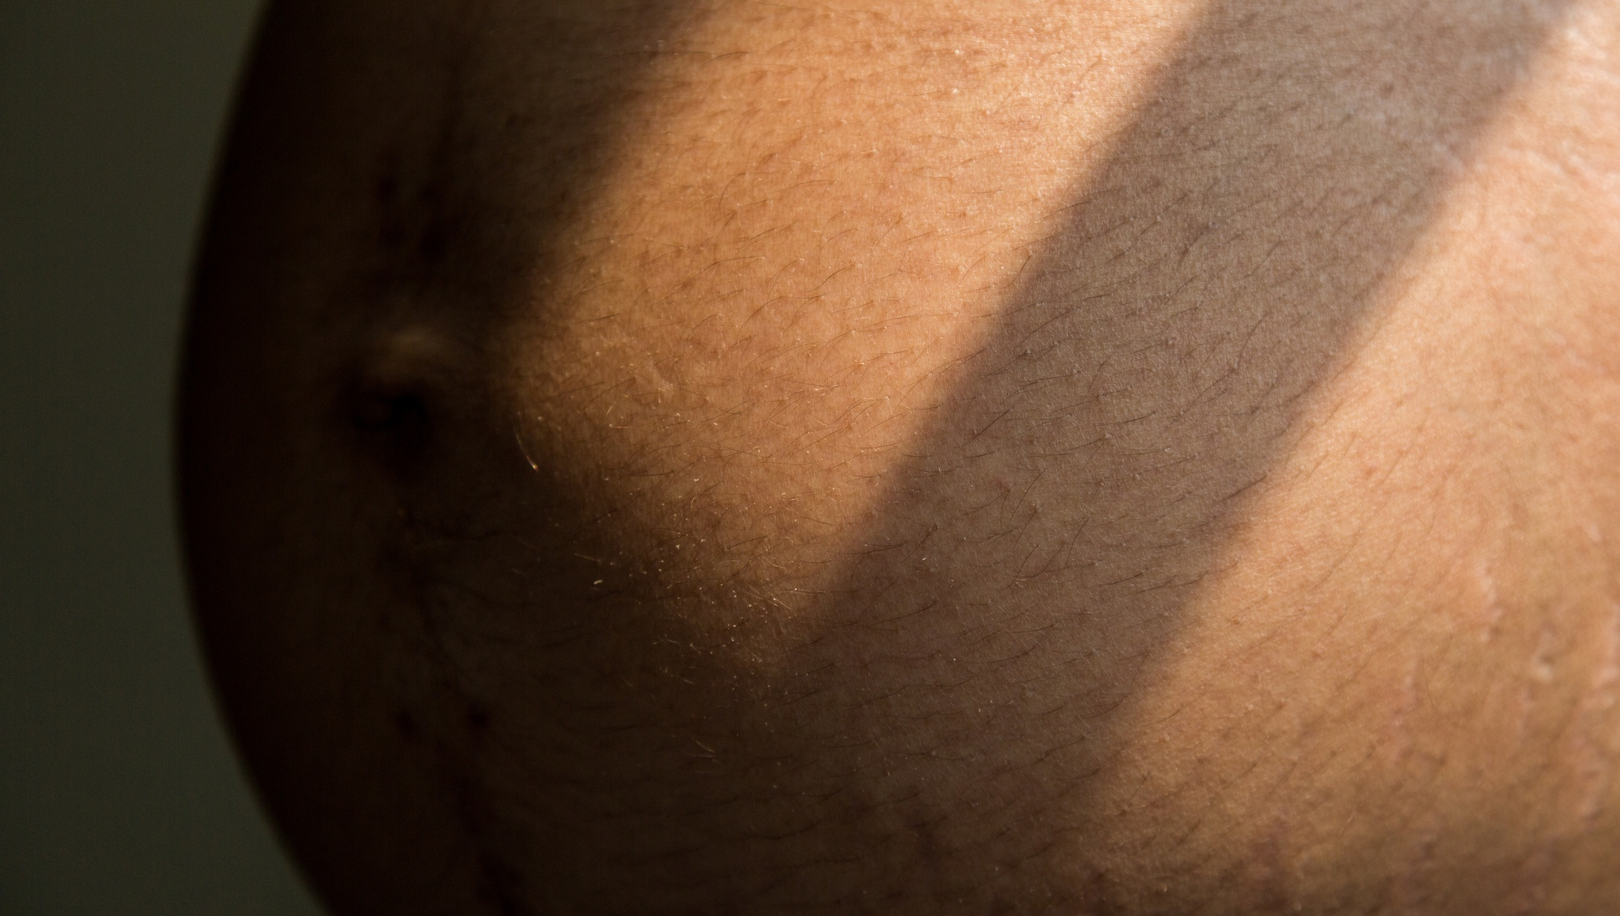
Why did we start this class?

Slide 22
Because of a disparity

Slide 23
About El Camino, Context for Maternity Services
El Camino Health – established 1961
Has two campuses – Mountain View and Los Gatos
Mountain View: Level III NICU , Los Gatos: Level II NICU
Mountain View has a larger volume
Los Gatos has a midwifery service
El Camino team has been participating in the 2nd round of Learning Initiative to Support Vaginal Birth through an Equity Lens

Slide 24
Who is giving birth at El Camino?
% of total births, by Race/ Ethnicity (LG/MV) 2025

Slide 25
What is the NTSV (nulliparous, term, singleton, vertex) C-section rate ?
 | ECH Mountain View | ECH Los Gatos | El Camino Health | CA Average
2021 | 26.6% (452/1697) | 19.4% (74/381) | 25.3% (526/2078) | 24.0%
2022 | 27.1% (492/1817) | 18.9% (70/370) | 25.7% (562/2187) | 24.6%
2023 | 26.9% (508/1890) | 18.3% (51/278) | 25.8% (559/2168) | 24.9%
2024 | 26.0% (478/1835) | 21.8% (69/316) | 25.4% (547/2151) | 24.9%
2025 | 28.0% (533/1904) | 20.5% (63/308) | 26.9% (596/2212) | 24.0%

Slide 26
What is the NTSV (nulliparous, term, singleton, vertex) C-section rate by race/ethnicity at El Camino
 | Overall | White | Black | Hispanic | Asian
2021 | 25.31% (526/2078) | 23.75% (109/459) | 36.67% (11/30) | 25.46% (55/216) | 25.64% (322/1256)
2022 | 25.70% (562/2187) | 23.67% (111/469) | 35.00% (7/20) | 26.25% (63/240) | 26.47% (351/1326)
2023 | 25.78% (559/2168) | 23.91% (110/460) | 26.92% (7/26) | 23.58% (50/212) | 26.00% (337/1296)
2024 | 25.43% (547/2151) | 28.48% (127/446) | 46.15% (6/13) | 25.34% (56/221) | 24.17% (319/1320)
2025 | 26.94% (596/2212) | 23.85% (104/436) | 40.00% (8/20) | 26.27% (57/217) | 27.97% (398/1423)

Slide 27
Taking a Pause: Frameworks for Exploring Data
Using public health terms for categorization
Data based on CMQCC fields/ Birth Certificate Data
Small Group Phenomenon
Lessons from Birth Justice Movement:
Listening to Black birthing women’s experiences and making a change

Slide 28

What happens when we apply an equity lens with this data?
Let’s disaggregate
the “Asian Category”

Slide 29
Asian Population NTSV Rate
 | ECH - Mountain View | ECH - Los Gatos | El Camino Health | CA Average
2021 | 26.7% (303/1136) | 15.8% (19/120) | 25.6% (322/1256) | 24.0%
2022 | 27.0% (319/1181) | 22.1% (32/145) | 26.5% (351/1326) | 25.1%
2023 | 26.8% (319/1191) | 17.1% (18/105) | 26.0% (337/1296) | 26.0%
2024 | 24.8% (288/1163) | 19.7% (31/157) | 24.2% (319/1320) | 25.9%
2025 | 29.1% (374/1286) | 17.5% (24/137) | 28.0% (398/1423) | 25.6%

Slide 30
South Asian Population: NTSV Rate
 | ECH - Mountain View | ECH - Los Gatos | El Camino Health
2021 | 32.5% (177/544) | 13.0% (6/46) | 31.0% (183/590)
2022 | 33.7% (166/492) | 30.0% (18/60) | 33.3% (184/552)
2023 | 35.4% (175/494) | 26.3% (10/38) | 34.8% (185/532)
2024 | 31.1% (168/541) | 36.2% (17/47) | 31.5% (185/588)
2025 | 33.9% (208/613) | 25.5% (12/47) | 33.3% (220/660)

Slide 31
South Asian NTSV rate vs Asian (total) rate
 | ECH Overall | ECH Other Asian | ECH South Asian
2021 | 25.3% (526/2078) | 20.9% (139/666) | 31.0% (183/590)
2022 | 25.7% (562/2187) | 21.6% (167/774) | 33.3% (184/552)
2023 | 25.8% (559/2168) | 19.9% (152/764) | 34.8% (185/532)
2024 | 25.4% (547/2151) | 18.3% (134/731) | 31.4% (185/589)
2025 | 26.9% (596/2212) | 23.3% (178/763) | 33.3% (220/660)

Slide 32
Why we created the class
What providers and clinicians observed and felt in the birth room –
From WHO was birthing to what they were asking
How to share information, reduce fear, and boost confidence in a safe environment
Add an offering for patients to learn and ask questions about the birth process

Slide 33
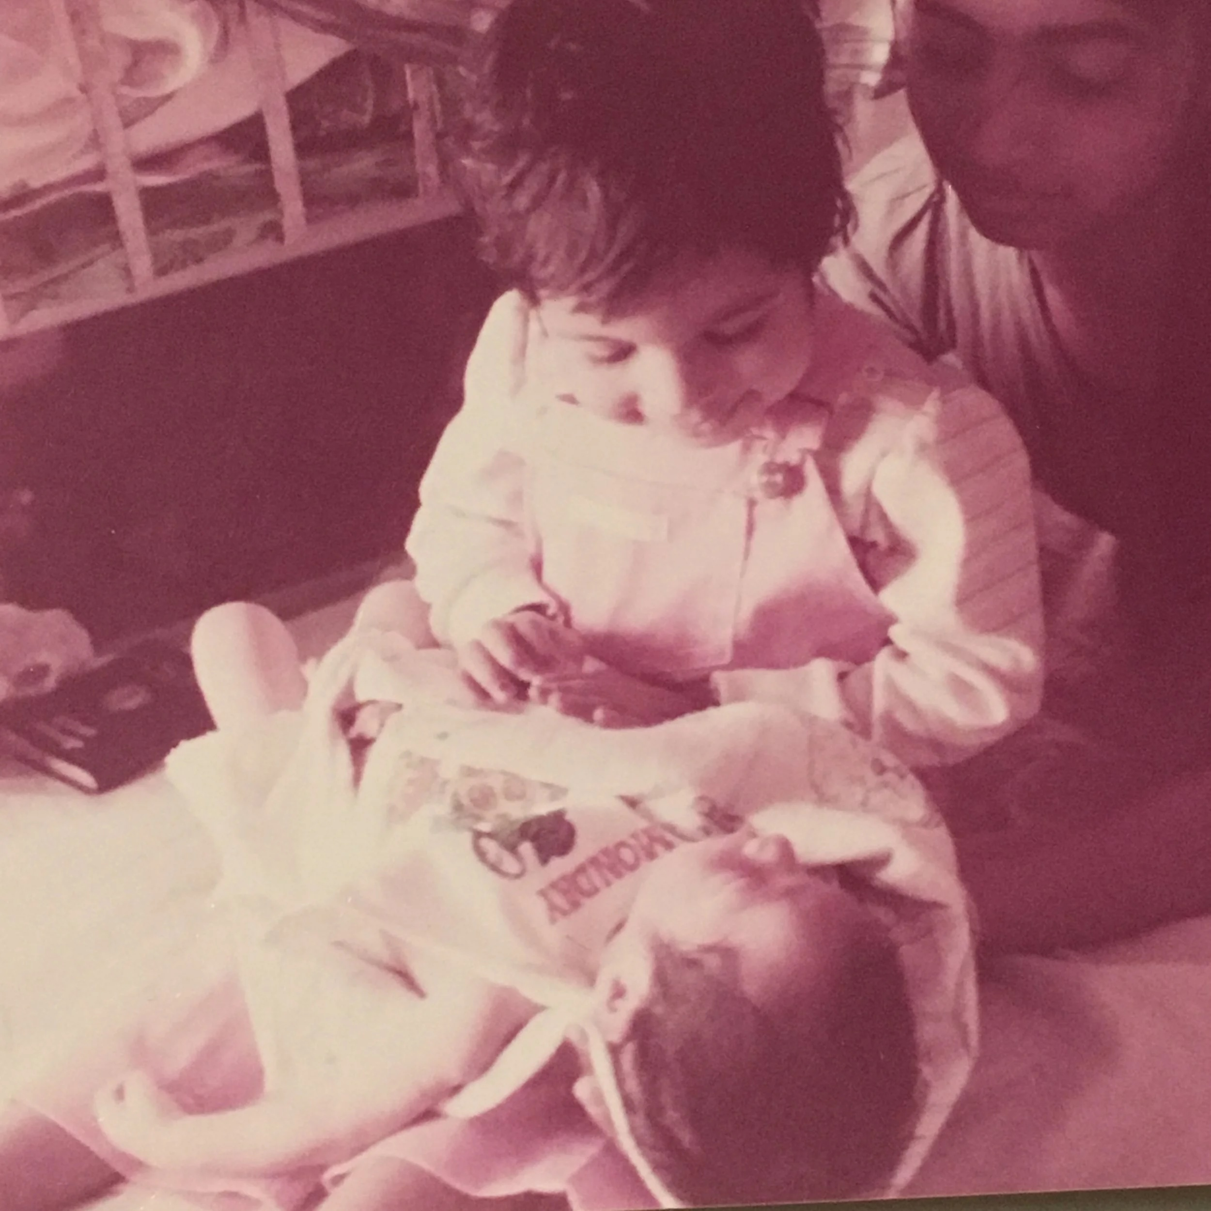
How did I get involved?

Slide 34

Created by an interdisciplinary team

Slide 35
Including:
OB/GYN
Midwives
Nurses (including L&D)
IBCLC
Nutritionist (South Asian Heart Center)
Lifestyle Medicine Coach (South Asian Heart Center)
Childbirth educator

Slide 36
The Context
Understanding our community

Slide 37
South Asian Community: We are not a monolith
Countries of Origin:
India, Pakistan, Bangladesh, Sri Lanka, Maldives, Nepal, Bhutan, and Afghanistan
Religious Diversity:
Hindu, Muslim, Christian, Sikh, Buddhist, Jain, and more
Caste:
System of social stratification, with reports of caste discrimination within community in Bay Area
Multilingual:
Example- India has over 22 official language, the South Asian region hundreds of distinct languages, and thousands of dialects
Immigration:
India is the place that the second largest group of people are originally from, and rapidly growing.
* 1st gen, 1.5 gen, 2nd gen
Model Minority Myth
Rooted in anti-Blackness
Disparities within group
Flattens the story of what is happening in our community

Slide 38
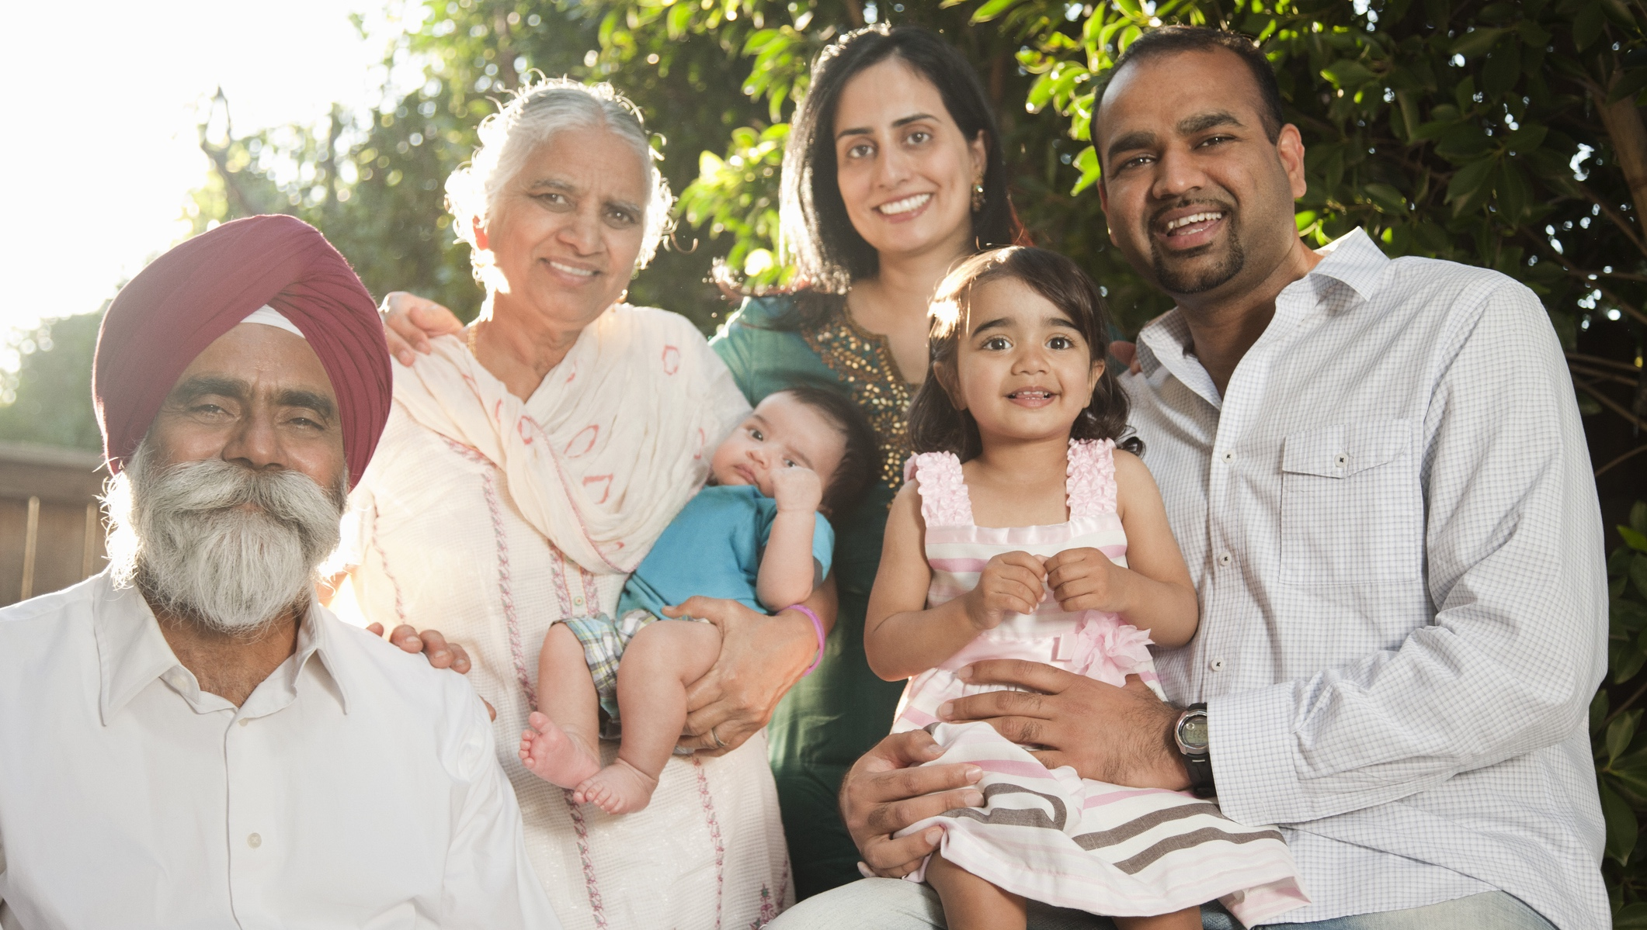

Slide 39
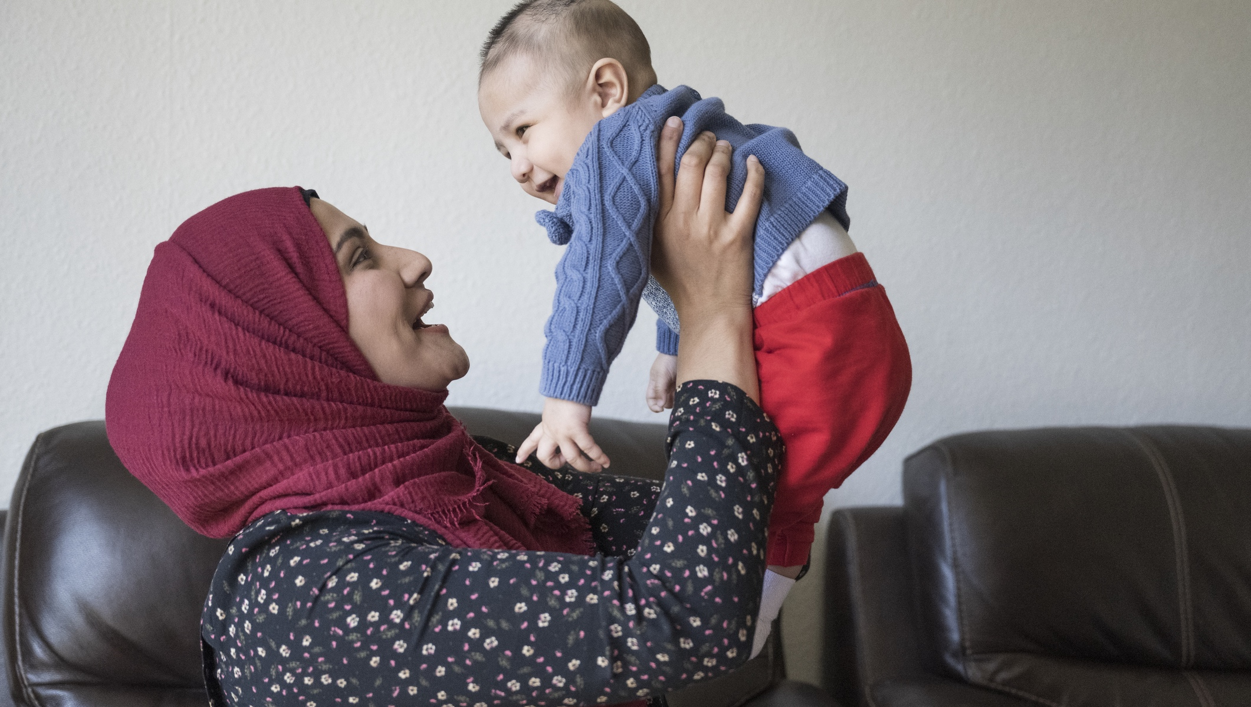

Slide 40


Slide 41
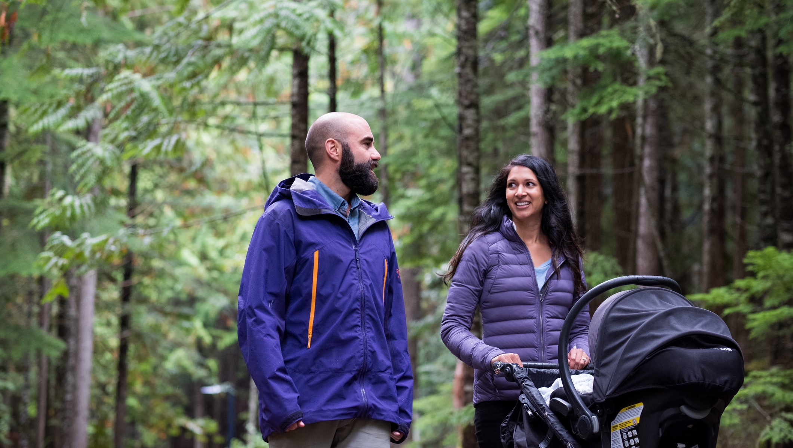

Slide 42
Stereotypes & Bias: A racist healthcare system harms everyone
National context - as community visible, online reporting increase of hate against South Asian and Islamophobia
(Particularly Sikh and Muslim communities)
Stereotypes and Bias:
i.e., Providers wondering about cultural and hygiene practices, Mistreatment- Giving Voice to Mothers Study
Providers still learning best practices to support patients of South Asian origin (and yes, this may also include South Asian providers )

Slide 43


Slide 44
Practicing Cultural Humility
Medical Authority Highly Valued
Different Health Care System
Power Dynamics- Difficult to speak up
Collectivist Approach to decision making (families) & some people may be alone and unsupported
Attitudes & Perceptions of Birth
Let's remain humble and listen.

Slide 45
What we co-created
Our class

Slide 46
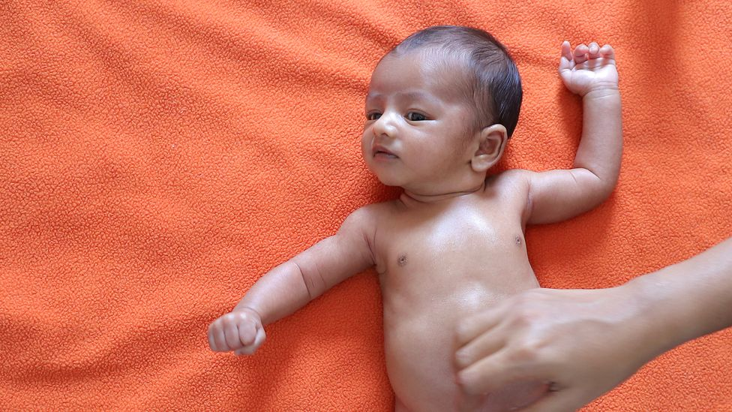
A 5 part class series to nurture confidence for South Asian expectant & birthing families.
Based on due dates-
for folks expecting in 3rd trimester

Slide 47
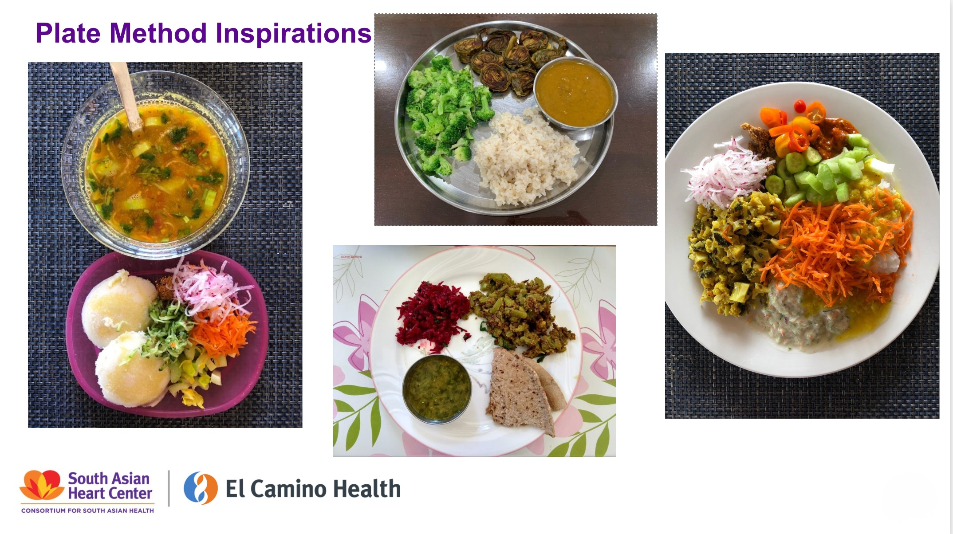
Class 1: Diet and Nutrition with Dr Prajakta Waingankar :South Asian Heart Center

Slide 48

Class 2: Exercise in Pregnancy & Birth
With Radhika Neelakantan, L&D Nurse

Slide 49
Class 3: Physiology of Labor & Birth

Slide 50

Try this-
take a cube of ice and hold it in your hands for a minute.
Notice what helps you get through the minute.
What doesn’t?

Slide 51
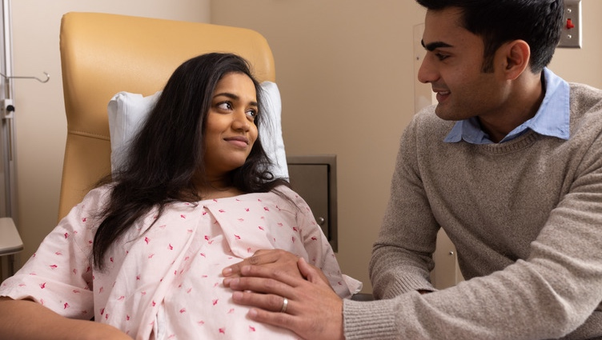
BRAIN
Benefits/ Risks/ Alternatives/ Intuition/Nothing
Asking questions to help you pivot- what is the next best thing?

Slide 52

Class 4: Birth and Preparing for Postpartum (including mental health)

Slide 53
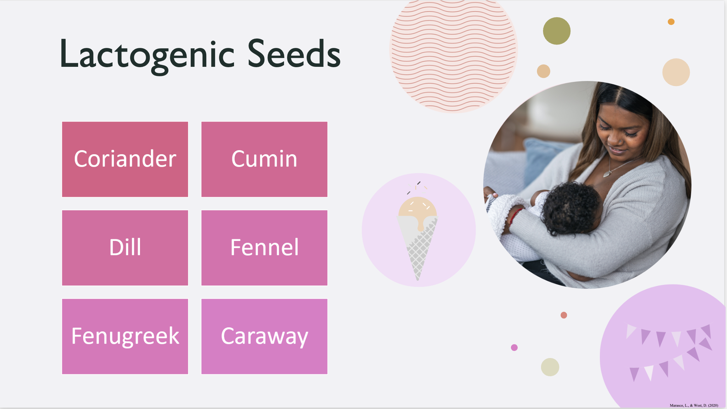
Class 5
Postpartum & Breastfeeding with Harpreet Bolla, RN/ IBCLC
& other members from lactation team

Slide 54
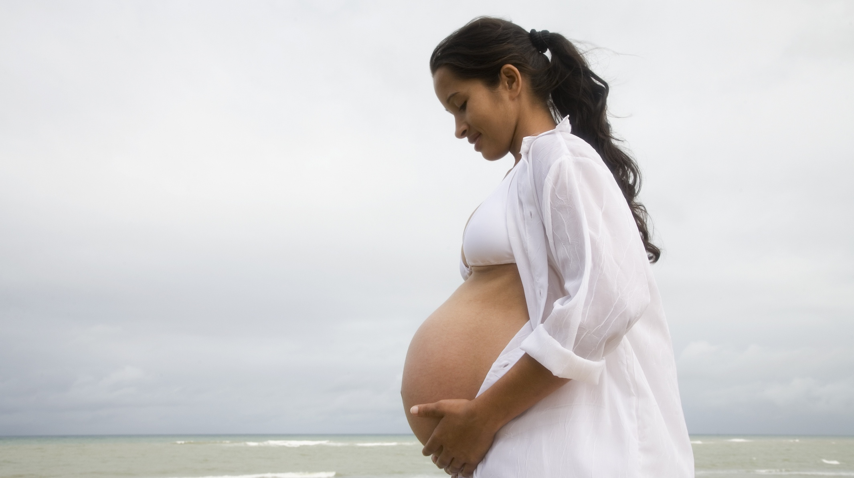
Feedback from Participants
“Nutrition tips were spot on. “
“All the birthing classes were very useful in preparing us for the big day. Made us very aware and informed about the birthing process, duration and pain management techniques”.
“The resource lists (found my doula through your provided list!) and the ability to ask and answer questions live”
“The information and a sense of community with other parents going through the same as we are”.
The instructors and all of the knowledge/resources they provided.
I learned so much from this class from 0 to 90% about
pregnancy journey.

Slide 55
Limitations & Challenges
English Language class
Limitations of patient education
Virtual Setting
Systemic – Institutional limitations
Systemic – Clinical Practices
We are still learning!

Slide 56
Gifts & Opportunities
Dedicated interdisciplinary team with constant reflection
Group desires to connect
(example, what's app group and connections)
Healthcare provider team that is committed to improve NTSV rate
Starting work with pelvic floor PT
More visibility of disparities has shifted questions in class
Inclusive & Solidarity
Just so much more to learn!
We must remain humble and curious.

Slide 57
Why do we do this class ?

Slide 58

Confidence &
Connection

Slide 59

Joy & Wellness

Slide 60

For our babies!

Slide 61
Resources
Maternal Health Equity
  "Race isn't the risk factor, Racism is" - Dr Joia Crear-Perry, MD, OB-GYN https://rewirenewsgroup.com/2018/04/11/maternal-health-replace-race-with-racism/
  www.birthequity.org
  Giving Voice to Mothers Study: https://www.birthplacelab.org/giving-voice-to-mothers/ (About mistreatment in OB health care for BIPOC patients)
South Asian Public Health Association (www.sapha.org)
Equality labs (www.equalitylabs.org)- Caste Equity
Mental Health, Immigration- South Asian : https://preetisimransethi.com/about/
South Asian Hate in US: https://stopaapihate.org/2025/11/04/keeping-count-anti-south-asian-hate-its-gotten-worse/
Islamophobia on the Rise: https://www.aljazeera.com/news/2026/3/10/us-civil-rights-group-documents-broad-attack-on-muslim-life-in-2025

Slide 62
Gratitude- Thank you!
Nancy Held, RN/ Manger of Lactation & Prenatal Ed Services
Anna Anderson, OB-GYN
Kavita Noble, CNM
Prajakta Waingankar, PhD, DipIBLM
Radhika Neelakantan, RN (L&D)
Harpreet Bolla, RN, IBCLC
Ashish Mathur, ED of SAHC
Erika Deshmukh, MS, RDN
Ginny Hibbs, RN
Estephani Torres, RN- IBCLC
Becca Scheiblauer, RN-IBCLC
Christopher Nguyen, MCH Data analyst
Christine Morton, PhD CMQCC
All the families joining us for the class!
My family

Slide 63
Questions/ Connect
Anjali_Sardeshmukh@elcaminohealth.org
Thank you!!!

Slide 64
Q & A
Please submit questions in the chat!

Slide 65
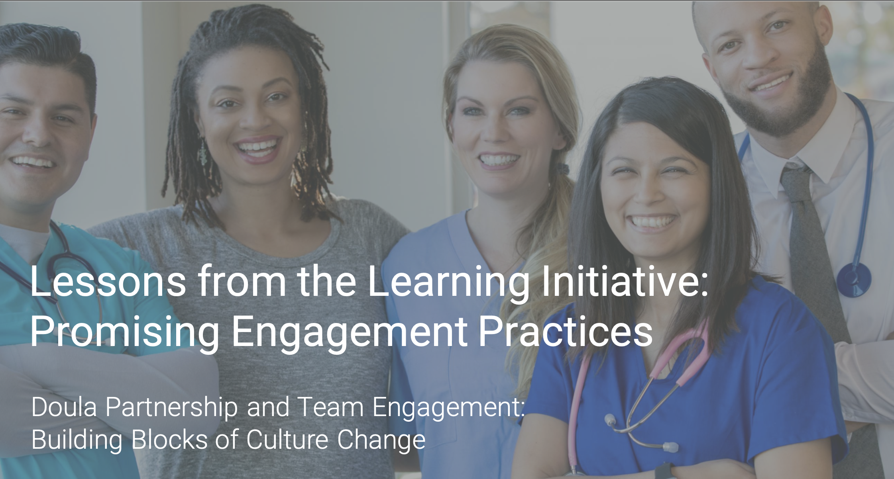
Lessons from the Learning Initiative Webinar Sprint
Round 1 and 2 highlights
Doula Partnership and Team Engagement: Building Blocks of Culture Change
Doula Engagement and Patient Advocacy
Staff and Leadership Engagement
Community Engagement and Birth Support

Slide 66
Thank you for joining us!
Stay involved with CMQCC
TOOLKITS
IMPLEMENTATION
MATERNAL DATA CENTER
ENGAGEMENT
Evidence-based toolkits on leading causes of preventable maternal morbidity and mortality.
Coaching on how to implement best practices and sharing among member hospitals.
Near real-time benchmarking data to support hospitals’ quality improvement.
Engaging partners around aligned goals and promoting patient awareness.

Slide 67
ChristaWalczak
@Stanford.edu
Tdeeds@
Stanford.edu

