Slide 1
Obstetric Sepsis Implementation Sprint
Session 1: Screening and Diagnosis
January 20, 2026
Notes:
1

Slide 2
Welcome and FAQs
Will this webinar be recorded? Will the slides be available?
YES. Both the recording and slides from each session will be available within 1 week on the CMQCC Sepsis webpage: https://www.cmqcc.org/toolkits-quality-improvement/sepsis
Do I need to attend all four sessions?
We encourage you to attend all four webinars in this series because each covers different topics, key to implementation.
How do I ask questions?
During this webinar, you may drop your questions into the Q&A box at any time. Presenters will write out answers to your questions during the webinar and we will have time at the end to address questions live.
If you have remaining questions after the webinar, please email rnath@stanford.edu and the team would be happy to follow-up with an answer.
What type of implementation support will your team be providing after the webinar?
The team is unable to provide direct support for individual hospital implementation challenges. However, we are happy to answer any general sepsis implementation questions.
There will be a two question poll during the Q&A to evaluate this session! We want your feedback!

Slide 3
Objectives and Disclosures for the Sepsis Sprint
Prepare staff and facilities to implement improvements in screening, diagnosis, and treatment of obstetric sepsis
Prepare staff and facilities to implement improvements in listening and supporting patients and families
Conflicts/Disclosures: None
Supported by: NICHD UG3-HD108053: Large-scale Implementation of Community Co-led Maternal Sepsis Care Practices to Reduce Morbidity and Mortality from Maternal Infection

Slide 4

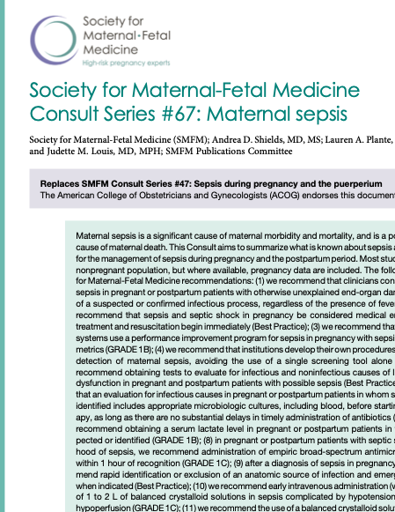
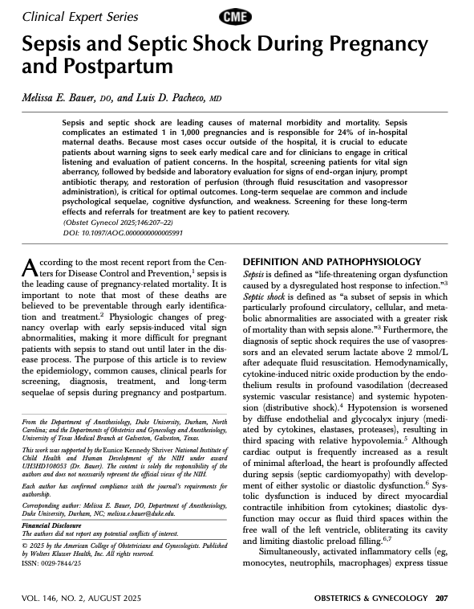
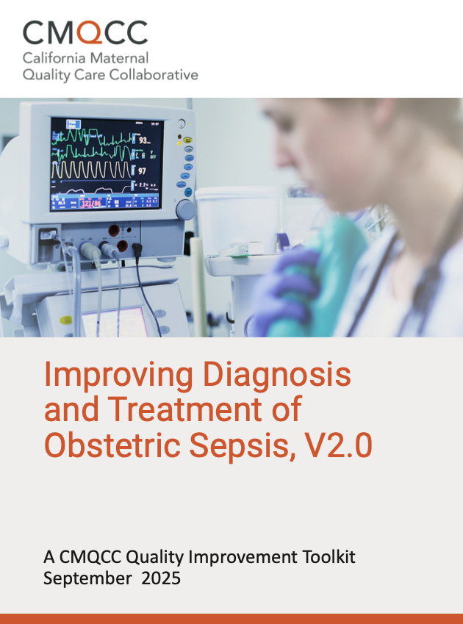


Key Obstetric Sepsis Resources
February 2023
September 2023
August 2025
September 2025
Sepsis in Obstetric Care
AIM Bundle: https://saferbirth.org/psbs/sepsis-in-obstetric-care/
Endorsed by ACOG:
Am J Obstet Gynecol 2023 229(3):B2-B19.l
Clinical Expert Series:
Obstet Gynecol. 2025 146(2):207-222
CMQCC QI Toolkit: cmqcc.org/toolkits-quality-improvement/sepsis
Notes:
SMFM has also come out with new treatment guidance

Slide 5
Why Do We Need to Address Obstetric Sepsis?
Sepsis is one of the top 3 causes of Maternal Mortality and Severe Maternal Morbidity
Deaths from Sepsis are Preventable—We need to do better!
3 Deadly D’s:
Denial
Delay
Dismissal
Notes:
3 hooks

Slide 6
Why are we doing poorly with Maternal Sepsis? after all, we know how to treat sepsis…
How Clinicians Answer:
Sepsis is relatively rare (but deadly when it happens)
Definition of Maternal Sepsis is not standardized
Diagnostic approach is not established
Treatment often delayed and piecemeal
Special Challenge of Chorioamnionitis
How Patients Answer:
Patients and family members do not know the signs and symptoms of sepsis
Patients do not know how to best advocate for themselves
Sepsis not on patient’s or doctor’s mind: symptoms are dismissed
Half of sepsis cases present antepartum or postpartum with delayed diagnosis

Slide 7

April’s Story
Notes:
3 hooks

Slide 8
Today’s Session: Outline and Faculty
Definition and Screening Tools for Obstetric Sepsis
Elliott K. Main, MD MFM, Stanford University
Lori Olvera, DNP RNC, Sutter Medical Center Sacramento
Bedside Evaluation and Documentation
Christa Walczak MSN, Clinical Lead CMQCC
Jenna Ogborn, BSN RNC-OB, Miller Children’s and Women’s
EHR Screening/ Nurse Driven Pathways
Courtney Martin, DO, OB QI Lead, Hoag Health
Daisy Ramos, MSN, RNC-OB, PHN, Loma Linda University

Slide 9
Diagnostic Criteria for Sepsis: United States
Sepsis-2 (1992): Infection + 2 or more SIRS criteria
Sepsis-3 (2016): life-threatening organ dysfunction caused by a dysregulated host response to infection
Sepsis-3 adopted by WHO, CDC, ACOG
CMS still defines sepsis as Infection + SIRS and Severe Sepsis as Sepsis with Organ Injury (SEP-1 metric) note this is the definition used in Sepsis-3
Notes:
It is unclear whether coding favors CMS definition or the current accepted definition of sepsis

Slide 10
Obstetric Infection Terminology
Concern: SEP-3 definition of sepsis that requires End-Organ Injury does not promote early intensive treatment of severe infections in time for prevention.
Infection
Need to identify infections most likely to advance to End Organ Injury for earlier and more intensive treatment.
The term “Serious Infection” is taken from new CDC terminology.
Serious Infection
Sepsis
End Organ Injury related to dysregulated host response to infection

Slide 11
A Two-Step Approach to Identify Obstetric Sepsis
Vital Sign Screens (MEWS, MERT, CMQCC) are commonly used but their role as Only the First Step needs to be emphasized
The key element is the Second Step, the Bedside Evaluation.
Remember that we do Two-Step evaluations for many diagnoses in OB/GYN—think Syphilis, Cervical Cancer

Slide 12
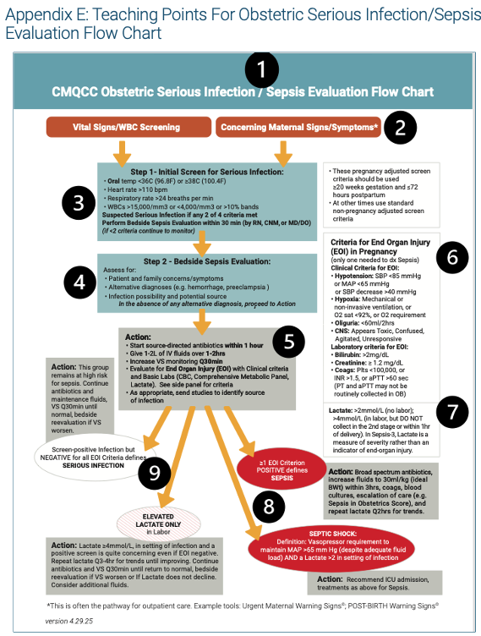
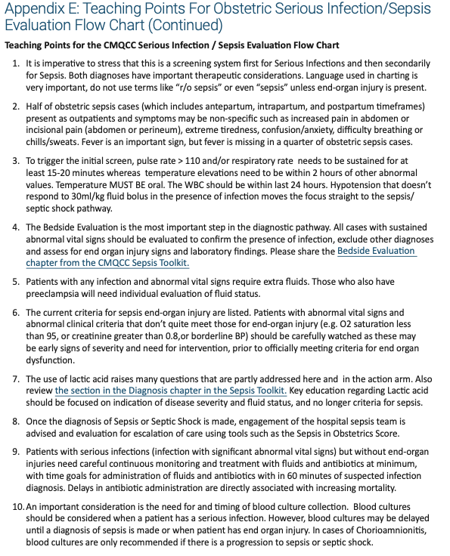

Slide 13

Screening Tools for Obstetric Sepsis
Notes:
3 hooks

Slide 14
Bedside Evaluation
Christa Walczak, MSN, RN, C-ONQS, C-EFM, CLE
Clinical Lead - CMQCC christawalczak@stanford.edu

Slide 15
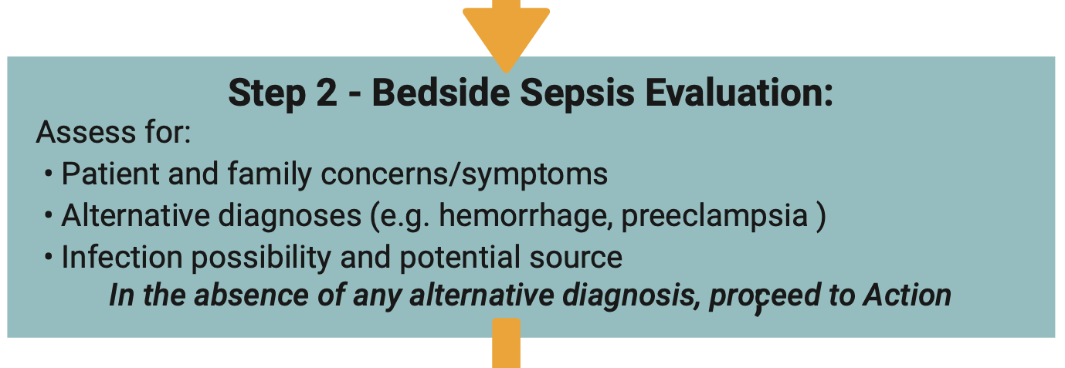
“Eyes-on” history and physical assessment
Default in absence of clear alternative diagnosis is action – treat infection and obtain more information
Closer observation
Simple labs
Full case discussion
Notes:
This flips the tendency to write off signs and symptoms “it’s just because she is pregnant” or “she doesn't look that ill” – wellness bias – stop and think instead of explain away. Lose more patients to sepsis than PRE – yest PRE screening is routine expectation. Improved sensitivity (correctly identify those with disease) demonstrated when utilized in pediatric sepsis screening.
Also an important step for patients with severe HTN, hemorrhage, and others

Slide 16

Components of Bedside Evaluation
Evaluation be done by RN, CNM or Physician
If you’ve not already done so, review available labs
Does patient/family report symptoms or observations?
Perform a physical assessment:
Upon general observation of the patient, are abnormalities noted?
Shivering
Confusion
Clammy skin
Difficulty breathing
Grimacing/Guarding (Signs of pain)
Skin color associated with poor perfusion

Slide 17
Components of Bedside Evaluation
Evaluate possible sources of infection
Incision/laceration
Breasts
Pain with urination, CVA tenderness, other signs of urinary/kidney infection
Cough, abnormal lung sounds
Are there signs associated with alternate diagnosis?
Heavy bleeding or other signs of hemorrhage
HTN, edema, severe headache or other signs of preeclampsia
*If assessment performed by nursing, communication with the provider for orders should occur prior to moving to action steps if a nurse driven pathway is not the standard of care in the facility
Notes:
Most patients have NO risk factors
Universal evaluation must be performed
Nurse-driven pathway will be presented by Dr. Martin

Slide 18
Communication and Documentation
CUS (Concerned, Uncomfortable, Safety issue) words if there is resistance to sepsis screening
Examples:
“I am uncomfortable waiting to initiate sepsis screening. I would like to activate the order set so that we can promote early recognition and treatment if indicated.”
“Although vital signs are elevated in pregnancy, current vital signs meet sepsis screening criteria. This is now a safety issue we must address.”
Document screening results, bedside evaluation, and communication in the EHR.
AHRQ TEAMSTEPPS - https://www.ahrq.gov/teamstepps-program/index.html

Slide 19
Implementing Sepsis Toolkit at MCWH
CMQCC 2025 Update
Jenna Ogborn, BSN RNC-OB

Slide 20
Sepsis Toolkit Update Rollout Plan
Education created with RN and MD taskforce
Clinical RN Superusers identified
Detailed web-based training assigned to all RN staff via Youlearn
In-Person training for RN Superusers
Superusers leading unit huddles with bedside RNs
RN Bedside Companion Decision Making and Audit tools distributed
Lunch & Learns with MD groups
Go-Live Spring 2025

Slide 21
Web-based training for RN staff
Detailed WBT Training Module created and assigned to RN staff.
Key Objectives:
Identify why screening for obstetrical sepsis is critical
Evaluate the current infection identification process
Introduce the CMQCC Sepsis Toolkit update (Sept 2025)
Analyze Epic system limitations
Apply the updated algorithm step-by-step
Implement the bedside assessment tool

Slide 22
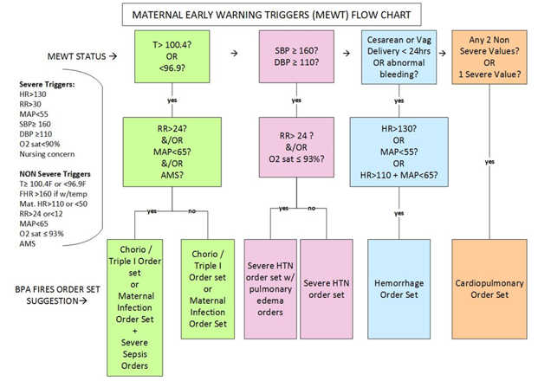
Limitations on MCWH Current Process
MEWT algorithm only triggered if temperature is abnormal.
New studies: Normal temps present in 25% of proven OB sepsis cases!!
MEWT algorithm does not use bedside assessment to consider alternate diagnosis & consider patient/family concerns.
Order sets do not specify to increase VS frequency and clinical monitoring for progression (to sepsis).
We are NOT performing standardized assessment for end organ injury (to diagnose or exclude sepsis) in all patients who trigger for infection with MEWT

Slide 23
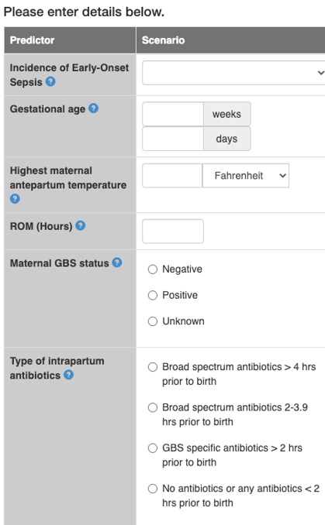


Recognizing Standardized Processes
Evaluating for Maternal Sepsis should be a standardized process like evaluating for Neonatal GBS EOS:
GBS EOS: 1.0/1000 births
Two step screen:
Objective data
GA, maternal antibiotics, ROM hrs, etc.
How does the baby look?
Standardized bedside evaluation
Next steps:
Labs
Enhanced observation
Maternal Sepsis: 1.1/1000 births
Two step screen:
Objective data
Temperature, pulse, RR, WBC, bands
How does the patient look?
Standardized bedside evaluation
Alternate diagnosis instead of infection?
Next steps:
Labs
Enhanced observation
1-hour bundle

Slide 24
MCWH Epic Limitations on Updated Algorithm
Our patients can’t wait to implement the new algorithm
It will take time to update EPIC:
Revise MEWT trigger criteria
Add flowsheet rows for bedside assessment by RN
Default EOI labs in MEWT infection order sets
In the meantime:
Utilize the companion bedside tool to ensure you follow all steps.
It remains critical to validate vital signs q30 min, document all MD notifications, bedside assessment results, and escalation.

Slide 25
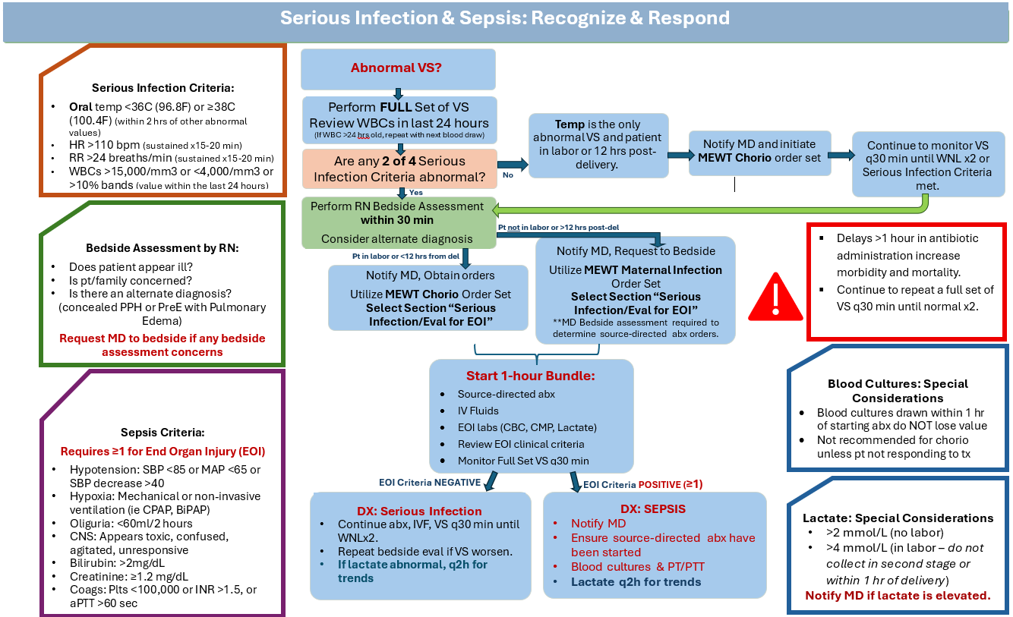
Decision Making Support: Companion Bedside Tool for RNs
RNs will utilize this bedside tool until all Epic updates are completed to recognize New VS & EOI criteria.

Slide 26
MCWH Epic Documentation: Smart Phrase Note
OB Serious Infection Smart Phrase Note to be used by RNs to document clinical findings and decision points:
“MD notified of abnormal values {multi-select: Temp, HR, RR, WBCs} with RN bedside assessment performed and noted {multi-select: Pt appeared ill, Pt concerned, Family concerned, Alternative diagnosis ***}. MD notified and orders obtained for {MEWT Chorio, MEWT Maternal Infection}. 1-hour bundle initiated: Antibiotics {multi-select: Ampicillin, Gentamicin, Ancef, Clindamycin, Vancomycin, Other ***} started at (time)***, IV fluids, EOI labs ordered, and VS monitored every 30 minutes.”

Slide 27
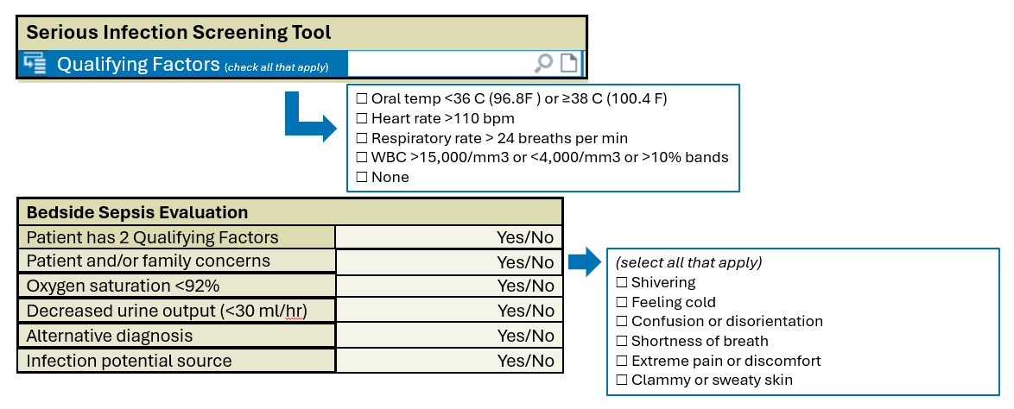
Future State Epic Documentation Flowsheet Rows
While Epic has MEWT tools to alert bedside staff of qualifying factors, this alert may be missed if data was not validated timely.
This allows bedside
RNs to become familiar with serious infection qualifying factors and the bedside assessment red flags.

Slide 28
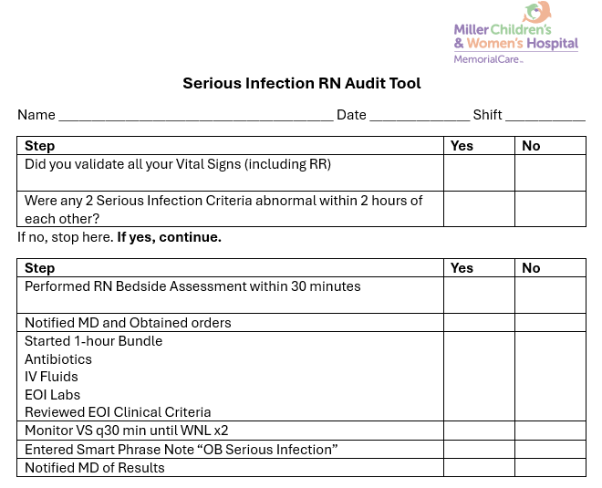
RN audit tool
RNs to utilize audit tool each shift for each patient to ensure all steps are being met until all Epic builds are complete.

Slide 29


Thank you!
2025

Slide 30
EHR Sepsis Screening Tools and RN Driven Pathway
Courtney Martin, DO, OB QI Lead, Hoag Health
Daisy Ramos, MSN, C-EFM, RNC-OB, PHN, Loma Linda University

Slide 31
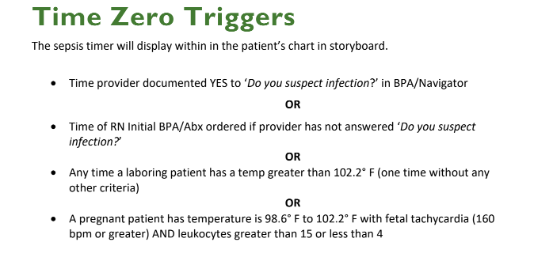
EHR Screening Tools
Triggers based on specific maternal parameters with a series of pop-ups to guide providers and nurses
Orderset for Maternal sepsis
Establishing a “time zero”

Slide 32
Screening and identification
EHR continually monitors patient data to identify maternal sepsis criteria and nursing validation
Structured approach that empowers nurses to act quickly while maintaining physician oversight.
Objective identification with the help of the HER
Objective criteria (e.g heart rate, respiratory rate, temperature, ect.)
Labor specific triggers (e.g laboring patient with temperature over 102.2 F)
RN empowerment preventing delays in recognition

Slide 33
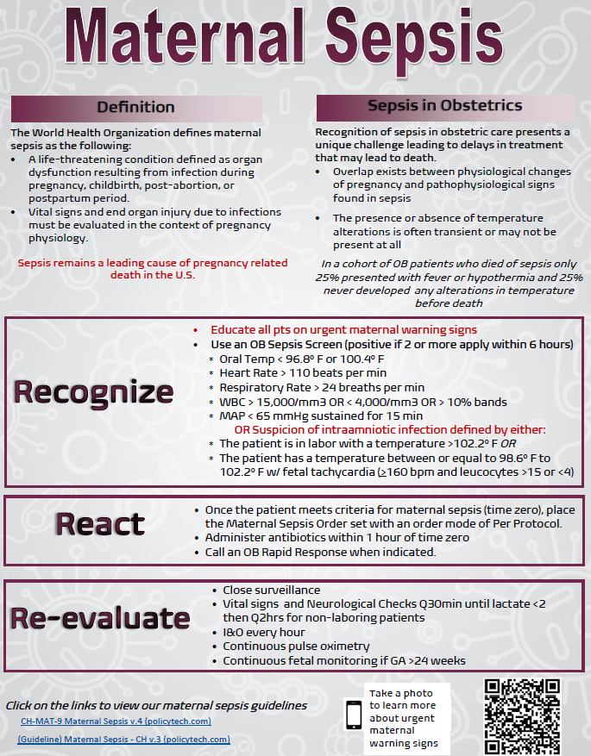

Slide 34
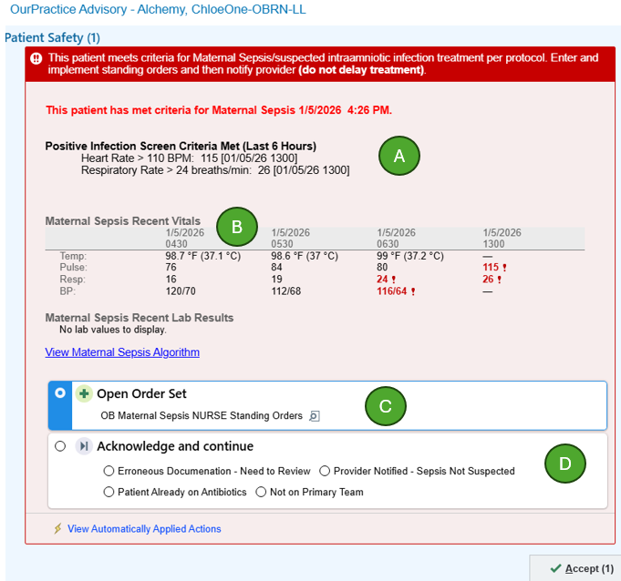
Initial Maternal OurPractice Advisory (OPA) to Alert the Team
The OPA will trigger immediately after saving qualifying values into the flowsheet activity or upon opening a pregnant or postpartum patient’s chat that contains the qualifying documentation.
A. The top indicates the patient meet criteria for Maternal Sepsis, instructs the nurse to enter the OB Maternal Sepsis Standing Orders, and instructs the nurse to notify the provider of the patient’s condition right away.
B. The recent values saved to the chart that triggered the Maternal Sepsis OPA will display.
C. Will Open the OB Maternal Sepsis Standing orders by default. The ability to review and sign the orders will display after clicking Accept.
D. Acknowledgement Reasons:
Not on primary team – will silence the BPA for the current user for 12 hours

Slide 35
RN Driven Initiation
RN driven standing orders allows us to initiate the care “Per Protocol” and developing standing orders to ensure nursing stays within scope of practice.
RN can initiate interventions before a provider is physically at the bedside
To ensure the pathway remains within nursing scope there is built-in escalation points and hard stops
Notification requirements
Documentation requirements
Escalation of care directing the nurse when and who to call with OPA triggers

Slide 36
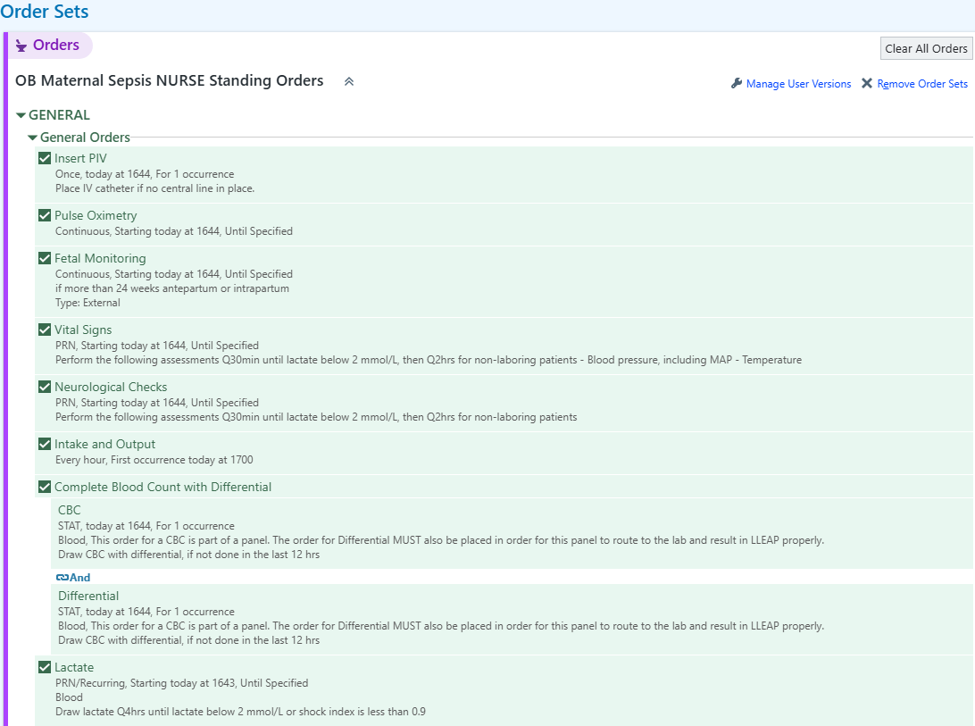
Once the patient meets criteria for maternal sepsis, place the Maternal Sepsis Order set with an order mode of Per Protocol.

Slide 37
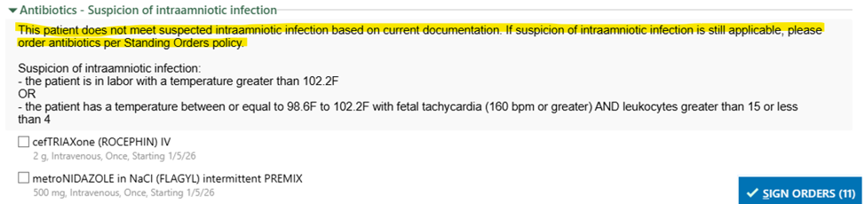
In the event an intraamniotic infection is suspected, the order set contains hard stops to further address orders for antibiotics.

Slide 38
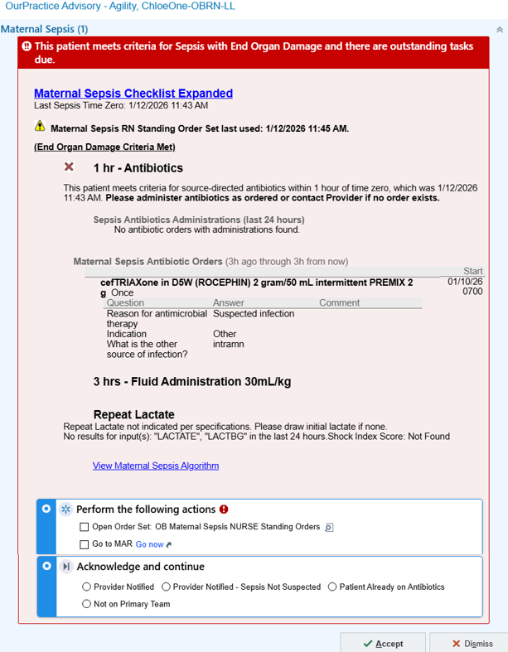
Close the Loop
A second BPA will display for the nurse if the patient does not have antibiotic administration documentation within 30 minutes of time zero.
The BPA will display the (A) date and time that time zero was filled in the system, (B) a visual indicator that the required 1-hour antibiotics has NOT been documented as administered, and (C) any active antibiotic administration orders in the patient’s chart.
(D) Clicking dismiss to close the BPA will quiet the BPA for different timing depending on what is selected

Slide 39
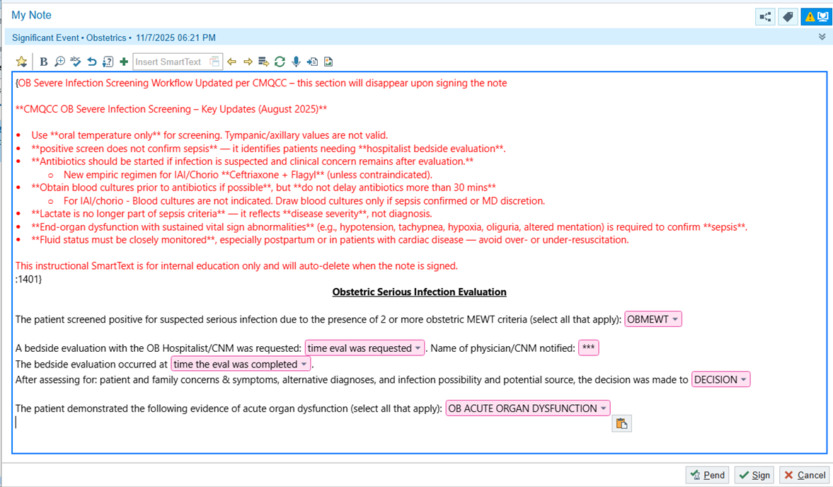
Documentation Tips
Standard Provider templates to document
Disappearing text to remind staff of what to do.

Slide 40
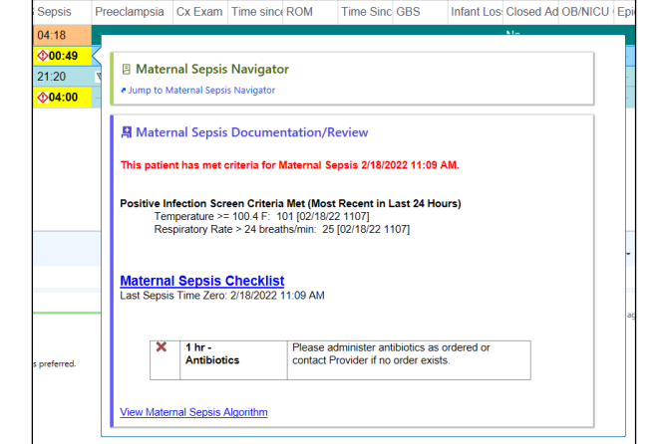
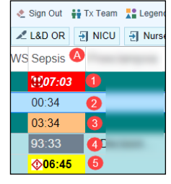
Tips for Use
Use a Clock that counts the time since Time Zero to remind people to meet the goals
Have a navigator created with all things Sepsis in one spot

Slide 41
Implementation and Maintenance
Initial education
Maintenance
Maternal Sepsis campaign
Staff meeting introduction and Q&A
LMS module with quiz
Simulation and champion training
On the floor support and help line phone access 24/7
Don’t be afraid to GO LIVE- Paint the plane as you fly!
Taskforce committee and dashboard creations
Ensure every new hire receives education (LMS, class time discussion, simulation)
Educational refresh schedule
Simulations, modules, etc.
Partnering with hospital sepsis team
Consider a "Green Sheet"

Slide 42
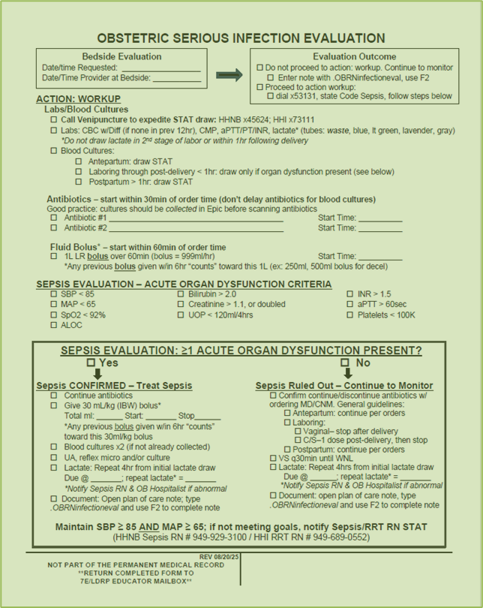
Serious Infection Evaluation "Green Sheet"
Does your patient have an increased MEWT score?
Based on vital signs is it possible infection is suspected?
Are you calling for a bedside evaluation?
If yes, grab a green sheet! (Use even if infection workup is deferred)

Slide 43
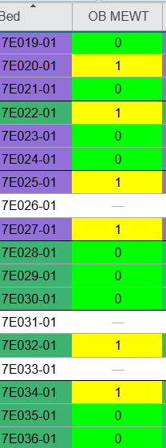
MEWT DOESN’T MISS
In our experience MEWT score elevations are incredibly important and improve recognition when patients are evaluated with positive scores.
This is true for sepsis and other SMM
Consider catchy phrases and showing internal data to maintain and continue progress.
Consider MEWT scores on the grease board with color codes to show if abnormal, i.e.. 2 or higher is RED.

Slide 44
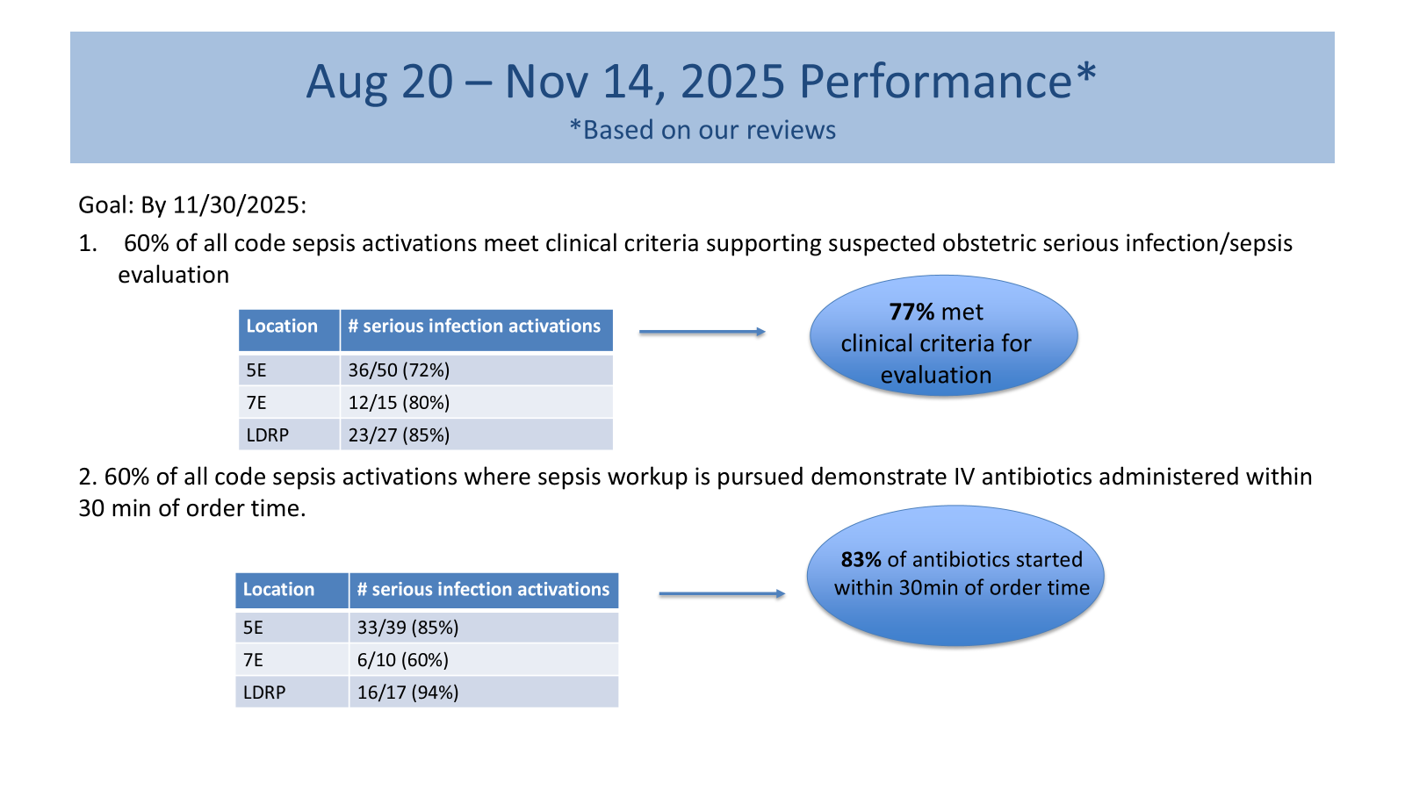
Nurse Driven Care, Nurse Driven QI
Example of our internal monitoring of Severe Infection activations, which is lead by RN clinical ladder teams, and partnered with our Adult Sepsis Program
Always should have a physician champion if possible on these clinical ladder teams and or meetings to prevent lack of adoption, engagement, and prevent frustration on all sides.

Slide 45
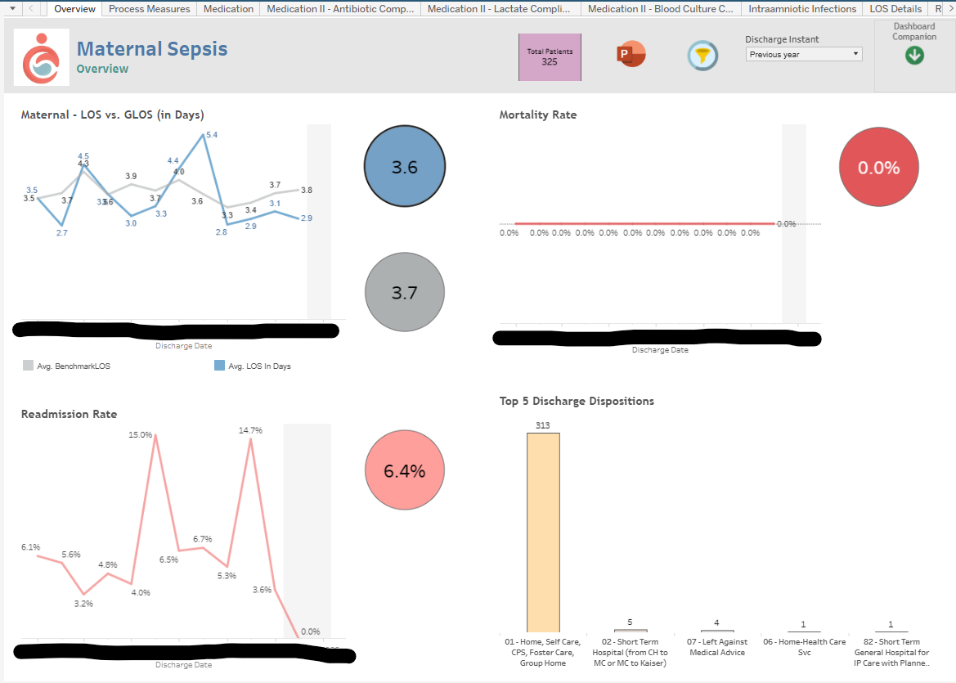
QI Dashboard

Slide 46
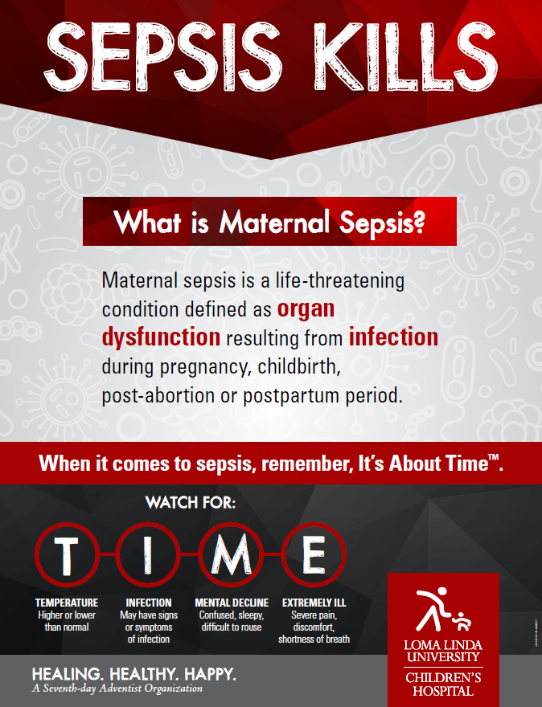
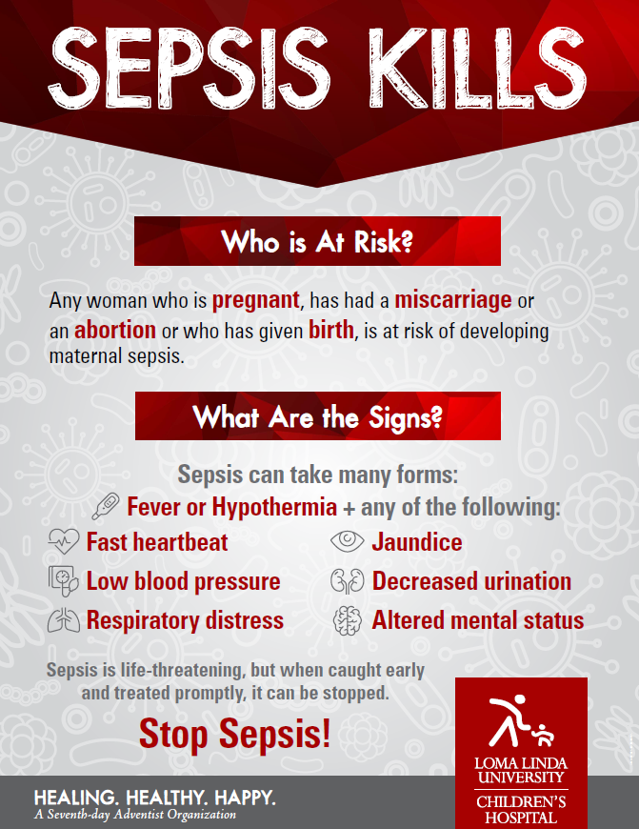

Slide 47
Key Points: Sepsis is Infection with EOI!
Review the Screening Flowchart Teaching Points with all staff and providers.
Bedside Evaluation is the most important step of the screening pathway and documented in the EHR.
Don’t wait for EHR fixes to be done! OK to begin with paper reminder sheets and order sets.
Nurse Driven Pathways save precious time and streamline care for standard diagnoses.
3 Deadly D’s: Denial, Delay and Dismissal!

Slide 48
Action Steps
If your team has not yet begun this bundle, we suggest the completion of the Readiness Assessment.
Assess your current vital sign screening tool for obstetric sepsis
Is it standardly applied?
Does it address the value changes of pregnancy?
Assess bedside evaluation practices
Have you created standard documentation for bedside evaluation?​
Do you have a protocol for next steps after a positive screen?​
Have you reviewed and updated (antibiotics, fluids, labs) sepsis order sets in your EHR?​
Have you considered nurse driven pathways as appropriate in your facility?

Slide 49
Next Session: Treatment Considerations
February 17, noon PST
Topics
Choosing Antibiotics
Chorioamnionitis
Treatment of Sepsis
Please submit your questions regarding antibiotic usage before January 26 via email to Ruhi at rnath@stanford.edu. We will try to field as many as possible during our panel discussion.

