Slide 1
Obstetric Sepsis Implementation Sprint
Session 2: Treatment of Sepsis-Antibiotics, Medical and Surgical Care, Chorioamnionitis
February 17, 2026
Notes:
1

Slide 2
Welcome and FAQs
Will this webinar be recorded? Will the slides be available?
YES. Both the recording and slides from each session will be available within 1 week on the CMQCC Sepsis webpage: https://www.cmqcc.org/toolkits-quality-improvement/sepsis
Do I need to attend all four sessions?
We encourage you to attend all four webinars in this series because each covers different topics, key to implementation.
How do I ask questions?
During this webinar, you may drop your questions into the Q&A box at any time. Presenters will write out answers to your questions during the webinar and we will have time at the end to address questions live.
If you have remaining questions after the webinar, please email rnath@stanford.edu and the team would be happy to follow-up with an answer.
What type of implementation support will your team be providing after the webinar?
The team is unable to provide direct support for individual hospital implementation challenges. However, we are happy to answer any general sepsis implementation questions.
There will be a two question poll during the Q&A to evaluate this session! We want your feedback!

Slide 3
Objectives and Disclosures for the Sepsis Sprint
Prepare staff and facilities to implement improvements in screening, diagnosis, and treatment of obstetric sepsis
Prepare staff and facilities to implement improvements in listening and supporting patients and families
Conflicts/Disclosures: None
Supported by: NICHD UG3-HD108053: Large-scale Implementation of Community Co-led Maternal Sepsis Care Practices to Reduce Morbidity and Mortality from Maternal Infection

Slide 4




Obstetric Sepsis Implementation Sprint Team
Elliott K. Main, MD
Clinical Professor, MFM Department of OBGYN
Stanford University
Melissa E. Bauer, DO
Associate Professor of Anesthesiology
Duke University
Ruhi Nath, MPH
Program Manager Department of OBGYN
Stanford University
Christa Walczak, MSN RN
Clinical Lead
California Maternal Quality Care Collaborative
Stanford University

Slide 5
Session 2 Agenda: Treatment
Antibiotic Stewardship, Antibiograms, Drug Resistance
Critical Role of Order Sets
Strategies for Rapid Access to Antibiotics on Labor and Delivery
Strategies for Prophylactic Antibiotics on Labor and Delivery
Antibiotic Allergies and De-labelling
Addressing Key IAI / Chorioamnionitis Management Questions
Sepsis: Treatment, Escalation of Care, Source Control
There are references throughout this slide set to the CMQCC OB Sepsis Toolkit: CMQCC Improving Diagnosis and Treatment of Obstetric Sepsis, V2.0 (2025) and links to specific Appendix Resources.

Slide 6


Antibiotic Stewardship, Antibiograms, Drug Resistance
Katie Andonian, PharmD Antibiotic Stewardship
Clinical Pharmacist
Sharp Mary Birch Hospital for Women & Newborns, San Diego
Lauren Puckett, PharmD, BCIDP
Antimicrobial Stewardship Pharmacist Clinical Pharmacy Specialist
Stanford Medicine Children’s Health

Slide 7
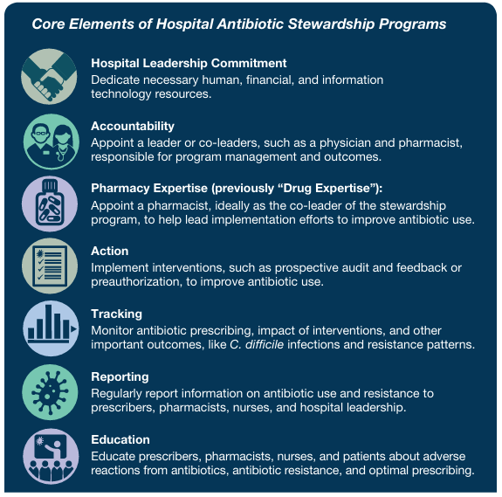
Antibiotic Stewardship
Antibiotic Stewardship is a coordinated, multidisciplinary team with a plan that aims to:
Optimize the use of antimicrobials,
Improve patient clinical outcomes,
Enhance antimicrobial related patient safety, and
Slows the rise of bacterial resistance
Every OB Dept should have MD/RN “Infection and Antibiotic Stewards” (aka “Champions”)
CDC hospital-core-elements-508.pdf

Slide 8
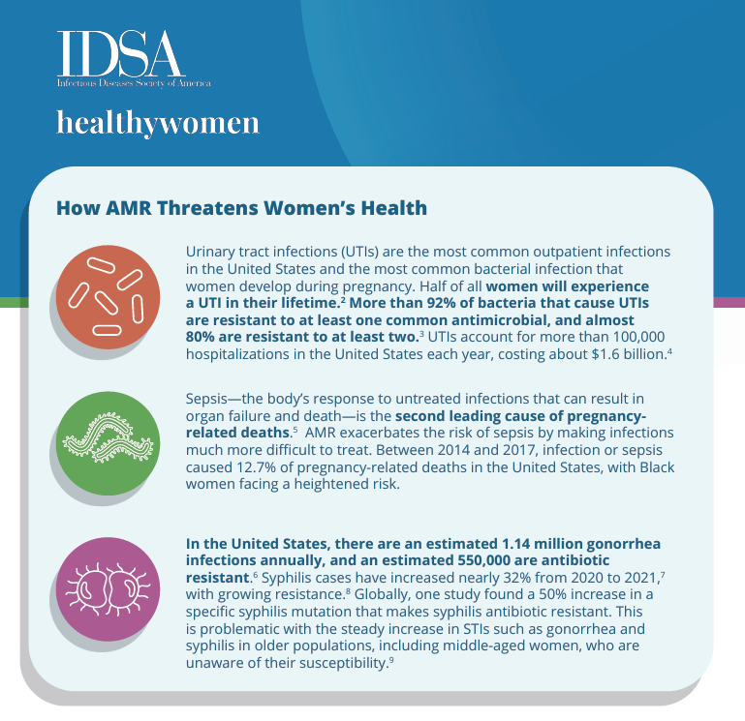
Antibiotic Stewardship: Urgent Need in Obstetrics
Antibiotic exposure during pregnancy and in the peripartum period is becoming increasingly common
Antimicrobial Resistance (AMR) is now a recognized concern in Women’s Health worldwide
Women hold 76 % of U.S. healthcare jobs placing women at higher risks of exposure to resistant organisms
Stewardship efforts are needed to combat reduce inappropriate antibiotic use and slow the rise of AMR in WH
idsa-health-women-one-pager.pdf
Nakitanda, et al. AJOB MFM. 2023
U.S. STI Epidemic Showed No Signs of Slowing in 2021 – Cases Continued to Escalate | CDC Online Newsroom | CDC
Antibiotic resistance disproportionately impacts women’s health — Keep Antibiotics Working
Kakolwa, et al. Overuse of antibiotics in maternity and neonatal wards, Antimicrobial Resistance. 2021
Schilling, et al. Antibiotic Use During Pregnancy and Childbirth, Thieme. 2022
Notes:
Antibiotic exposure during pregnancy and in the peripartum period is becoming increasingly common
Antibiotics are among the most frequently prescribed medications in pregnancy
20-40 % of pregnant women are prescribed antibiotics and this estimation is increasing
Investigation of long-term consequences of antibiotic exposure to birth parent and offspring
Antimicrobial Resistance (AMR) is now a recognized concern in Women’s Health worldwide
Women hold 76 % of U.S. healthcare jobs placing women at higher risks of exposure to resistant organisms
Stewardship efforts are needed to combat reduce inappropriate antibiotic use and slow the rise of AMR in WH:
Urinary Tract Infections, Maternal & Neonatal Sepsis, Sexually Transmitted Infections

Slide 9
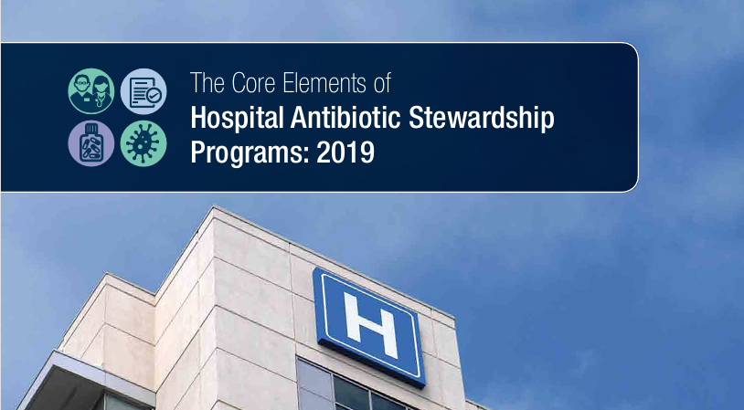
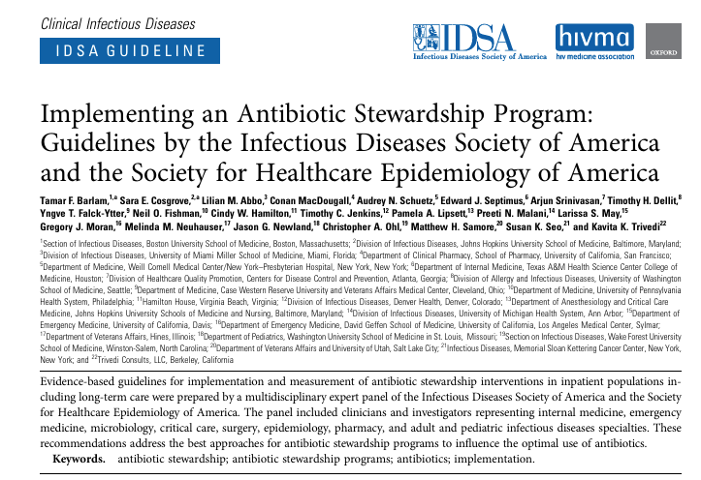
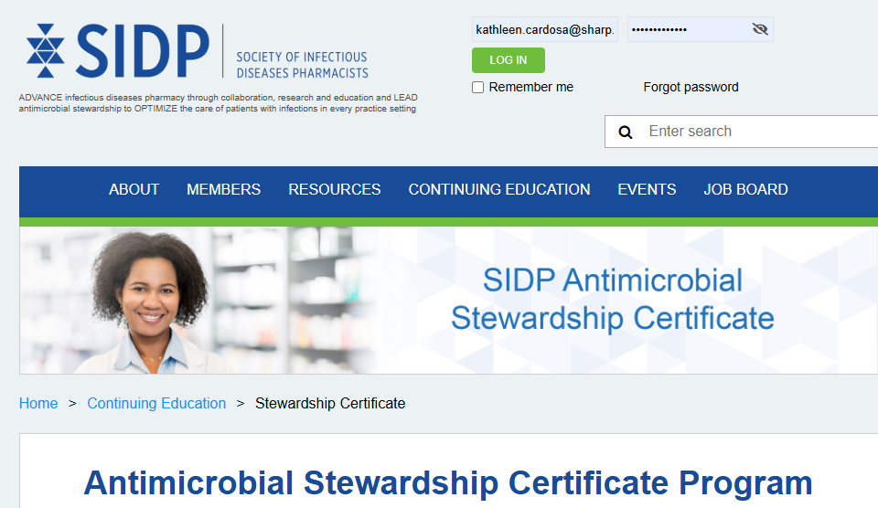
Antibiotic Stewardship Program (ASP) : Getting Started
Getting Started:
Implementation of new programs v. hospitals with established ASPs
Identify Champions & Stakeholders:
OB, Perinatology, Neonatology, ID, Infection Prevention, Pharmacists, Nurse & Hospital Leaders
Understand Resources:
Time & technology
Set Achievable & Measurable Goals:
Order sets
Antibiograms & resistance trends
Performance Improvement: Maternal Sepsis
Seek or Offer Collaboration & Help:
Mentorship or collaboration with other hospitals with WH & Neonatal Services
Stewardship training and certificates
CDC hospital-core-elements-508.pdf
SHEA/IDSA Clinical Practice Guidelines for Implementing an Antibiotic Stewardship Program
SIDP - Stewardship Certificate

Slide 10
Antibiograms
Antibiograms are cornerstone for Antibiotic Stewardship Programs
Essential, local and cumulative bacteria susceptibility data
Partnership between Antibiotic Stewards and Microbiology
Create evidence-based empiric antibiotic therapy treatment guidelines for specific diseases Obstetrics and Newborns
Reduce empiric use with overly broad-spectrum antibiotics
Can be used to facilitate the optimization of antibiotic related outcomes, track and reduce resistance, aid in EHR bug and source-specific susceptibility cascading rules, and reduce antimicrobial related healthcare costs

Slide 11
Antibiograms: Specialty Populations
Identify OB Pathogens
Drug: Bug Pairs
Multi-Year &/or Multi-facility
Compare to General Acute Care
Report to Leadership
Trend over Time
Drive Empiric Antibiotic Choices
Antibiograms in Obstetrics:
Focus on most common bacteria unique to infections in OB and Newbons
Specialized Drug:Bug susceptibility reporting based on antibiotics commonly used, with known safety/ or risk vs benefit in pregnancy and lactation
Often require rolling, multi-year data updated annually
Even if isolate count is < 30
How to enhance your data:
Leverage technology support
Hospital, Healthcare System, and Regional Approach
Develop & Optimize an OB Specialized Antibiogram

Slide 12
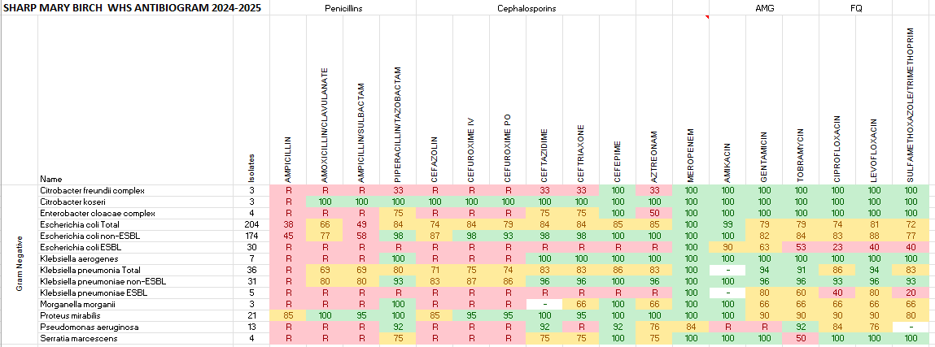
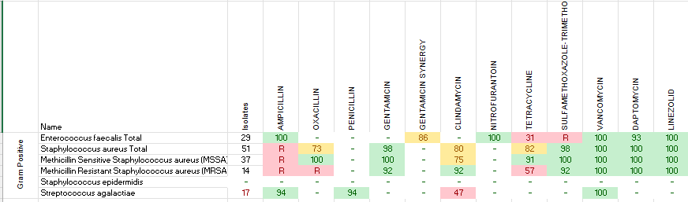
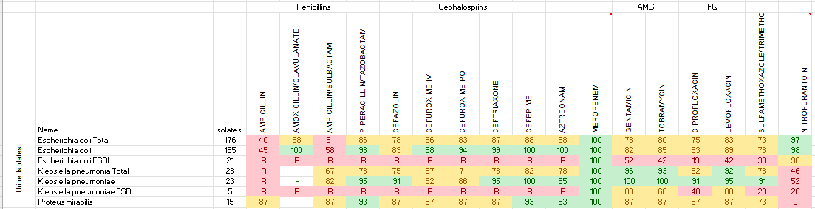

Antibiograms
SHARP Mary Birch Hospital for Women’s & Newborns

Slide 13
Why Resistance Trends Matter (and why OB needs local data)
Resistance is changing fast, especially Multidrug-resistant organisms (MDRO) – empiric choices can’t rely on national averages
Susceptibility patterns vary by region, hospital, and unit
OB/L&D populations may have different exposure risks (healthcare contact, prior antibiotics, device/procedures)
Goal: effective empiric therapy with a streamlined L&D formulary
Newer agents exist → balancing of stewardship & operational simplicity
Practical advantages to limited stock → improved administration and cleaner pathways
Your Sepsis Bundle empiric regimens should match your local risks

Slide 14
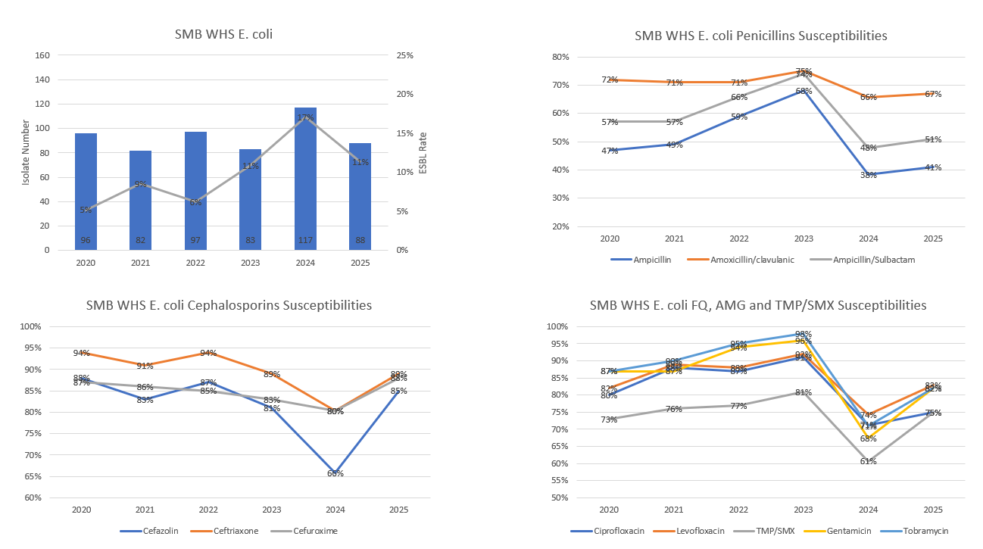
Resistance Tracking and Reporting
Incidence & Resistance Trending:
Identify select pathogens in OB and Neonatal Units with susceptibility or pathogenicity concerns
E.coli
Klebsiella pneumoniae
Group B Streptococci
Enterococcus faecalis

Slide 15
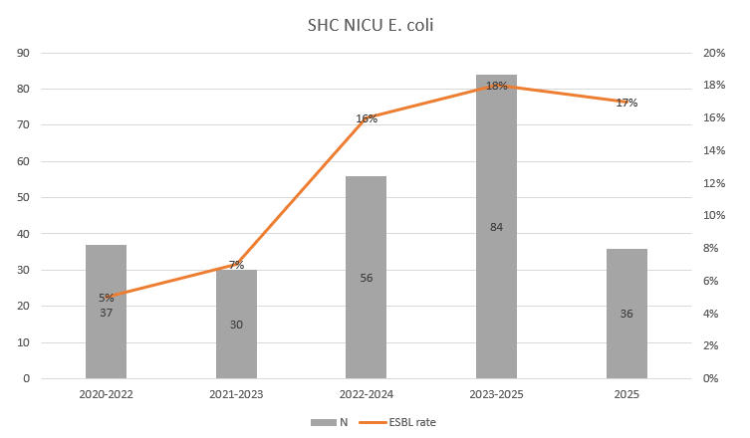
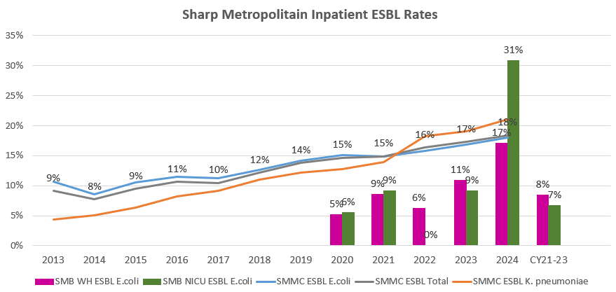
Resistance Tracking and Reporting
Identify:
High-risk infectious disease:
Bacteremia, PPROM, EONS
Compare:
Couple OB with Neonatal Data
Compare OB to general acute care data
Track & report year over year
Percentage, trends, numbers over time
Low isolate number: multi-year, multi-hospital/regional, report % and raw numbers
Impact:
Identify opportunities to slow resistance & improve empiric antibiotic choices

Slide 16

Newer Antibiotic Choices
Casey Smiley, MD
Internal Medicine Infectious Disease
Vanderbilt University Nashville, TN

Slide 17
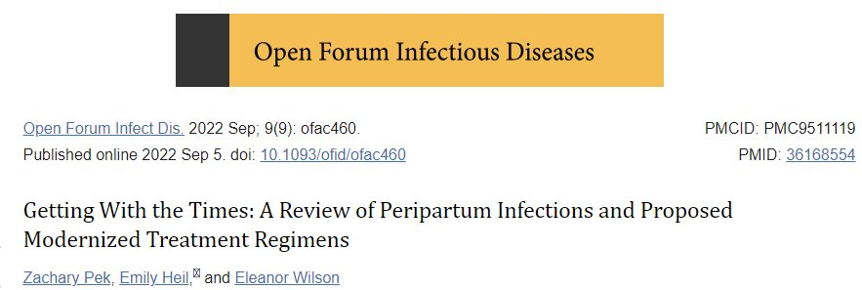
Ampicillin, gentamicin, and clindamycin based on in vitro culture and susceptibility data from the 1980s​
Re-evaluation is needed given rising resistance rates to early generation beta lactams with Entertobacterales, and to clindamycin amongst anaerobic pathogens (specifically Bacteroides spp.)​

Slide 18
Beta-lactams have reliable activity against Streptococci, but coverage of other organisms can be challenging:
Enterobacterales
(E. coli, Klebsiella, etc.)
Anaerobes
(e.g. Bacteroides)
+/-
Enterococcus
Cefepime
Ceftriaxone
Gentamicin*
Metronidazole
Clindamycin*
Ampicillin
Piperacillin-Tazobactam
Ampicillin-Sulbactam*
*These drugs have rising resistance rates--Check Local Antibiogram

Slide 19
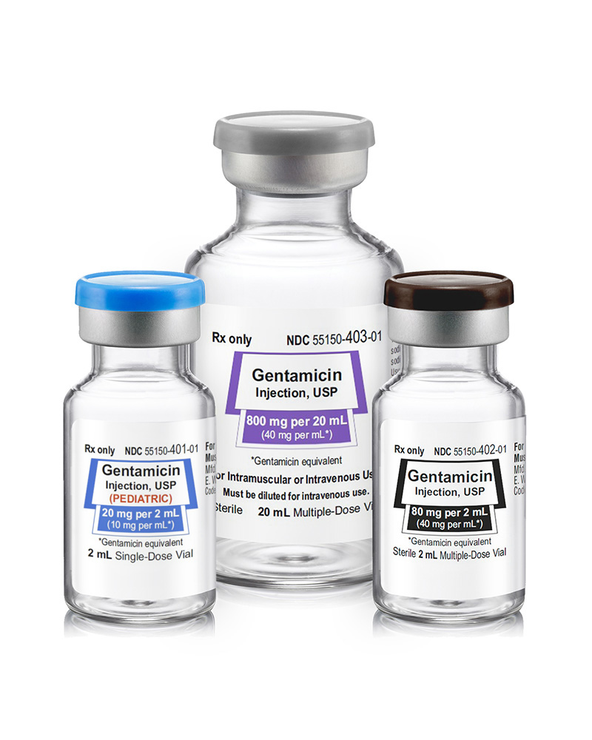
Gentamicin Issues
ACOG guidelines of 5mg/kg q24 hours
New CLSI guidelines (2023) for Enterobacterales lowered Susceptible/Resistant breakpoints
At many facilities, breakpoints are based on dosage of 7mg/kg q24h
Nephrotoxic, Ototoxic
Rising resistance of gram-negative organisms to aminoglycosides
Time to receiving antibiotics (needs to be dosed by weight by pharmacy)
No standardized nomogram for dosing in pregnancy, No recommendations to check levels​​
Increased renal clearance 50% or more during pregnancy
https://eugiaus.com/products/gentamicin-injection-usp/
Sader, H. Open Forum Infect Dis. 2023;10.

Slide 20
Benefits of Newer Antibiotics: Piperacillin-tazobactam and Ceftriaxone
Readily available in non-weight-based dosing = Faster time to antibiotic
More reliable coverage of genitourinary flora
Less nephrotoxicity
Less ototoxicity (including for the fetus)
Years of safety data
No monitoring levels needed
Less overall antibiotic exposure

Slide 21

Critical Role of Order Sets
Lauren Puckett, PharmD, BCIDP
Antimicrobial Stewardship Pharmacist Clinical Pharmacy Specialist
Stanford Medicine Children’s Health
Natali Aziz, MD, MS
Clinical Professor, MFM Department of OBGYN
Stanford University

Slide 22
The Critical Need for Order Sets
Order sets standardize care across providers, shifts, and locations
Improve patient safety → embedded guardrails reduce selection and dosing errors
Speeds up time-to-antibiotics
Tailored for your hospital
Match your formulary and local pathways
Built for L&D realities (availability, workflow, turnaround time)
“Decision support” at the point of ordering
Clear defaults and quick options for common scenarios
Include allergy alternatives without forcing manual workarounds
Accommodate higher-risk scenarios without chaos
Consider adding options for known MRSA risk or ESBL/MDRO history

Slide 23
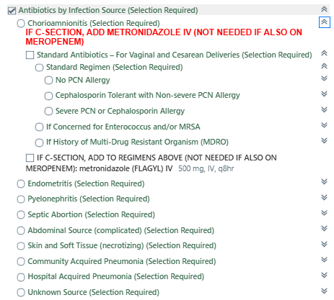
Order Set Examples
Areas of consideration
Clear order set/pathway entry criteria
Link to institution pathway
Nursing interventions
Labs
Antibiotics
Example
For another example of an OB Infection Order Set, see CMQCC Sepsis Toolkit v2: Appendix P: Sample: Miller Sepsis/Chorio Order Sets

Slide 24
Practical Lessons: Make the “Right Choice” The Easy Choice
Plan the medication logistics with Pharmacy
ADC vs. Inpatient pharmacy
After-hours access and backup workflow
Operationalize how antibiotics will run
Options for standard vs. prolonged infusions of beta-lactams
Need for clear nursing instructions and default administration details
Align allergy alternatives with hospital policy
Decision support matters
A simple list of antibiotics is easy – but guided selection pays dividends
Don’t forget the “bundle-adjacent” orders

Slide 25
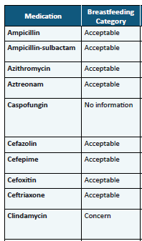
Breastfeeding Safety: Reduce Confusion and Delays
If it’s in the OB sepsis orderset, it should be breastfeeding-safe by design
Sets a clear expectation for providers and staff
Reduces delays caused by last-minute questions
Builds confidence for clinicians in high-stress moment
Avoids inconsistent counseling and mixed messaging across team
Links to reference support at the moment it’s needed
Excerpt from Appendix N: Lactation Safety of Antimicrobials Used for Treatment of Sepsis
See CMQCC Sepsis Toolkit v2: Appendix N: Lactation Safety of Antimicrobials Used for Treatment of Sepsis

Slide 26
Strategies for Rapid Access to Antibiotics on Labor and Delivery
Katie Andonian, PharmD Antibiotic Stewardship
Clinical Pharmacist
Sharp Mary Birch Hospital for Women & Newborns, San Diego
Natali Aziz, MD, MS
Clinical Professor, MFM Department of OBGYN
Stanford University

Slide 27


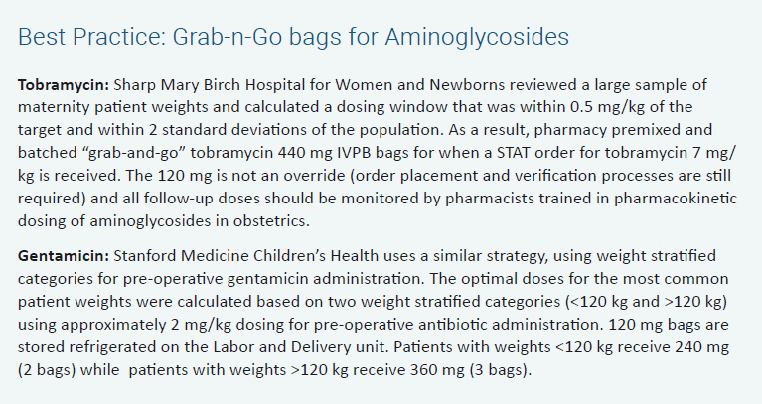
Strategies for Rapid Antibiotic Administration
Medication Dispensing Machines
Urgent, empiric antibiotic doses
Labor and Delivery, OR, and Postpartum Units
Override medication list in collaboration with nursing, medication safety, hospital leadership, regulatory
Weight-banding doses
Grab-n-Go Aminoglycosides
Notes:
NA Slide to present
At Stanford…
in Omnicell where RN may override:
--Ampicillin
--Cefazolin
--Cefoxitin
--Clindamycin
--Gentamicin
--Zosyn
In Omnicell for sepsis antibiotics:
--Meropenem
--Azithromycin
--Ceftriaxone
--Metronidazole

Slide 28
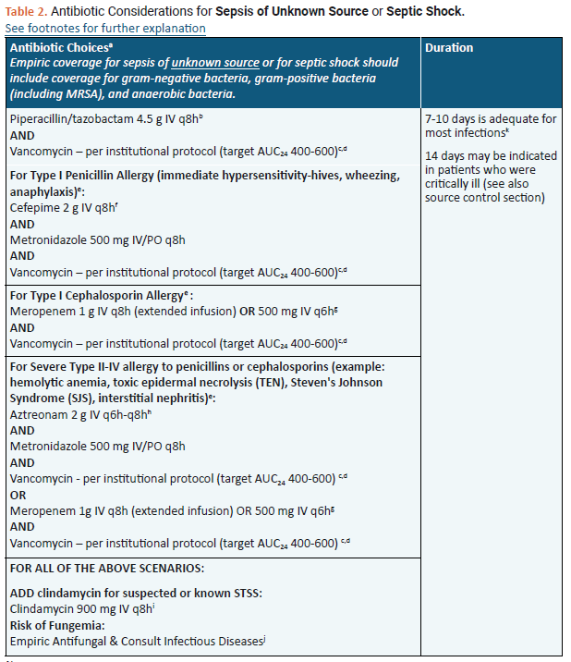
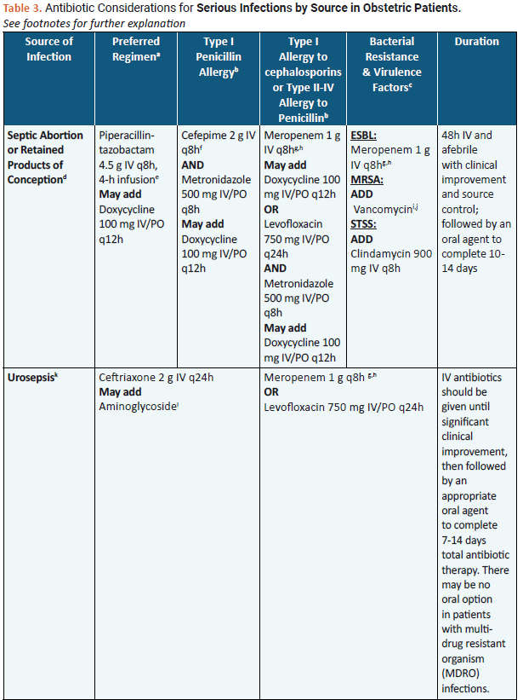
Strategies for Rapid Antibiotic Administration
Empiric Antibiotic Treatment Guidelines for OB Infections
Sepsis
By Suspected Source
See CMQCC Sepsis Toolkit v2, pp 66-74: Antibiotic Considerations for Sepsis and severe Infections, and: Appendix L: Sample: Antibiotic Considerations for Sepsis of Unknown Source or Septic Shock and Appendix M: Antibiotic Considerations for Serious Infections by Source in Obstetric Patients

Slide 29
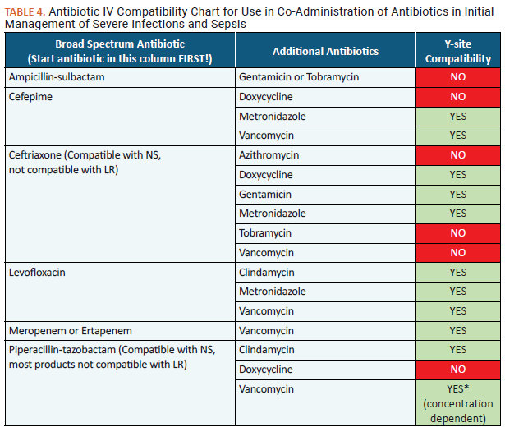
Strategies for Rapid Antibiotic Administration
Antibiotic IV Compatibility for Co-Administration
Order sets, as previously discussed
See CMQCC Sepsis Toolkit v2: Appendix O: Antibiotic IV Compatibility Chart

Slide 30

Strategies for Prophylactic Antibiotics on Labor and Delivery
Deirdre J. Lyell, MD
Dunlevie Professor of MFM
Co-Chair and Co-Principal Investigator, California Maternal and Perinatal Quality Care Collaboratives (CMQCC/CPQCC)
Associate Director, Division of MFM and Obstetrics
Director, Program in Placental Disorders
Department of Obstetrics and Gynecology, Stanford University

Slide 31
Protocol Creation and Implementation
One individual can start a lot!
A team can think it through, identify practicality, implement, make it stick:
Anesthesia, Pharmacy, MFM/obstetrics, Infectious Disease, RN, MD, plus
Practical considerations for ease and to reduce delays:
Weight-based banding (gentamicin, cefazolin, vancomycin) when possible
Stocked anesthesia cart:
Gentamicin in bags so pharmacy does not have to mix
Cefazolin, 2 grams and 3 grams
Metronidazole
Challenges:
Allergy plan, keeping up with antibiogram (e.g. clindamycin sensitivity is declining)

Slide 32
Pre-incision Antibiotics for Cesarean Delivery Algorithm
MRSA colonized: add vancomycin

Slide 33
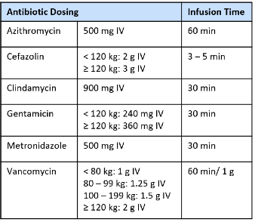
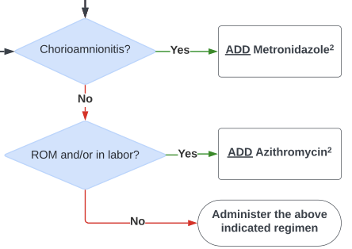
Pre-incision antibiotics for patients treated for….. Chorioamnionitis or ROM
Regardless of penicillin or cephalosporin allergy

Slide 35
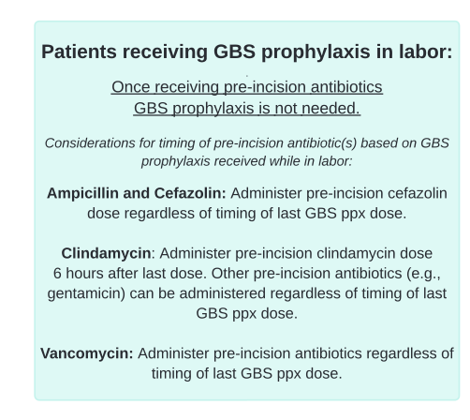
Pre-incision antibiotics for patients treated for….. GBS prophylaxis
Timing:
Give the following pre-incision antibiotics immediately, regardless of timing of GBS prophylaxis dose: cefazolin, gentamicin, vancomycin
Give clindamycin 6 hours after last dose

Slide 37
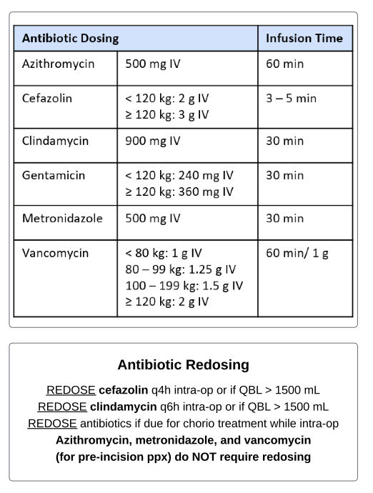
Key Points for Practicality
Banding by maternal weight
Redosing q4-6 hours, >1500 mL
Chorio treatment
Do not need to redose azithromycin, metronidazole and vancomycin

Slide 38
Antibiotic Allergies and De-labelling
Natali Aziz, MD, MS
Clinical Professor, MFM Department of OBGYN
Stanford University
Lauren Puckett, PharmD, BCIDP
Antimicrobial Stewardship Pharmacist Clinical Pharmacy Specialist
Stanford Medicine Children’s Health

Slide 39
Addressing Patients with Penicillin Allergies: The “Must-Knows” for Implementation
Penicillin allergy labels are common – and usually wrong
>90% of reported PCN allergies are not true allergies → major opportunity to improve care through de-labeling
A penicillin allergy label ≠ “no beta-lactams”
A reaction to one beta-lactam may not automatically preclude use of other classes
Build allergy alternatives into pathways and ordersets
Work to define standardized plans for common OB scenarios
Partner with Allergy/Immunology and Pharmacy
Use structured assessment tools – not guesswork: CMQCC Sepsis Toolkit Resources
CMQCC Sepsis Toolkit v2, pp 91-96: Management of Allergies to Penicillin and Beta-Lactam Antibiotics
Appendix R: Medications for Management of Allergy-related Reactions
Appendix S: Beta-lactam Allergy Pathway
The highest-yield intervention is de-labeling penicillin allergies when appropriate.

Slide 40
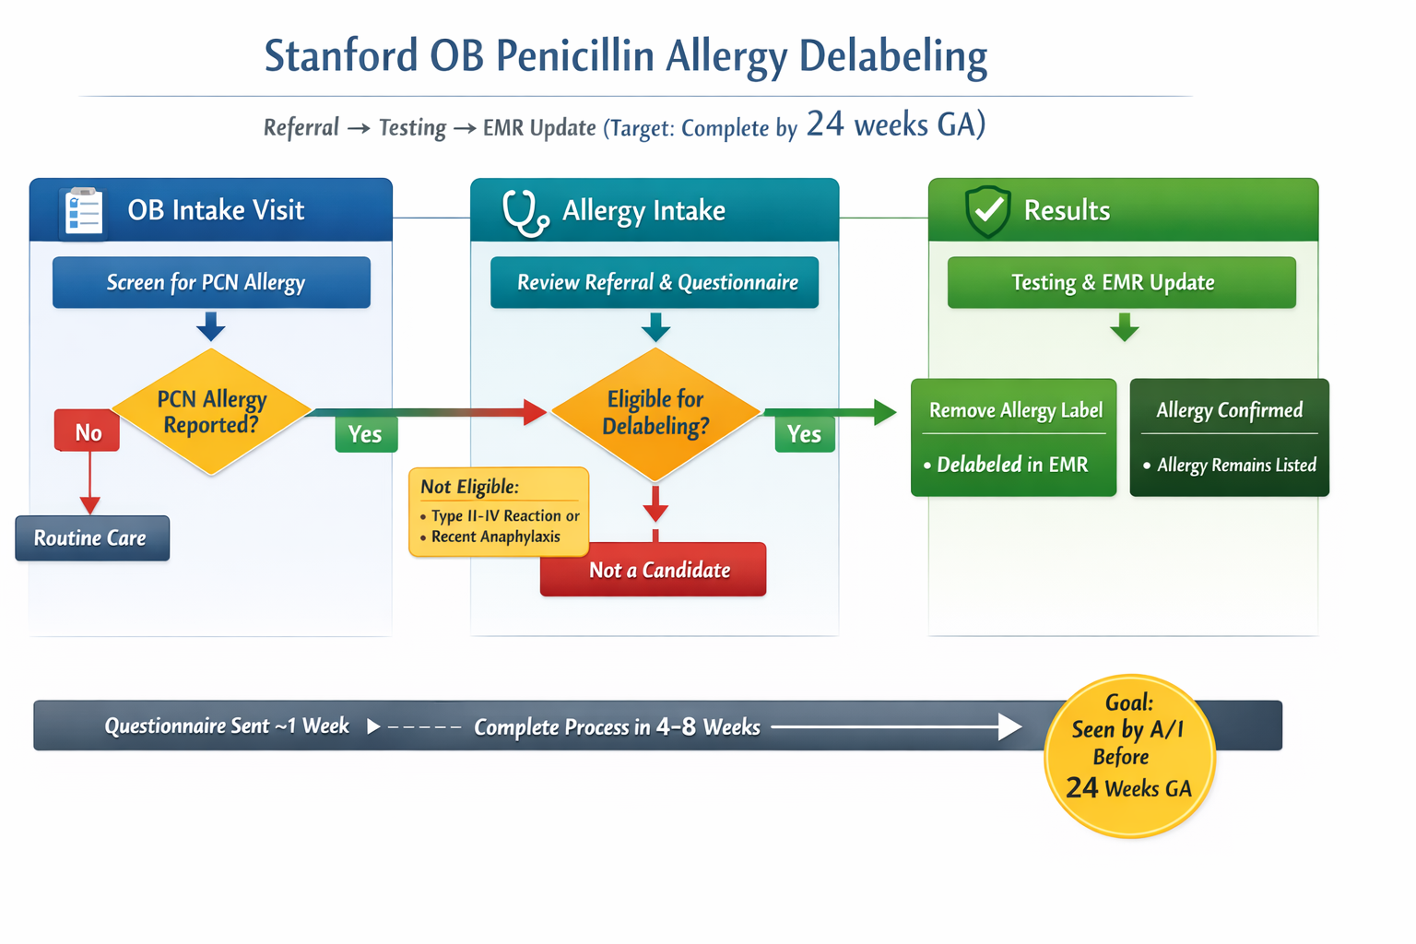
PCN Allergy Delabeling: Stanford QI Initiative
Referral → Testing → EMR Updates

Slide 41
Addressing Key IAI / Chorioamnionitis Management Questions
Elliott K. Main, MD
Clinical Professor, MFM Department of OBGYN
Stanford University
Casey Smiley, MD
Internal Medicine Infectious Disease
Vanderbilt University Nashville, TN

Slide 42
FAQ 1: What is the Definition of IAI / Chorioamnionitis?
Terms used by ACOG (2017)
“Intraamniotic Infection”- an infection with resultant inflammation of any combination of the amniotic fluid, placenta, fetus, fetal membranes, or decidua.
“Chorioamnionitis” – Intraamniotic infection is “also known as chorioamnionitis”
“Suspected intraamniotic infection” – “Temperature > 39C or 38.0-38.9C and one additional clinical risk factor is present.”
“Isolated maternal fever” - “Any maternal temperature between 38.0 and 38.9C with no additional risk factor present, and with or without persistent temperature elevation.
ACOG CO #712, August 2017

Slide 43
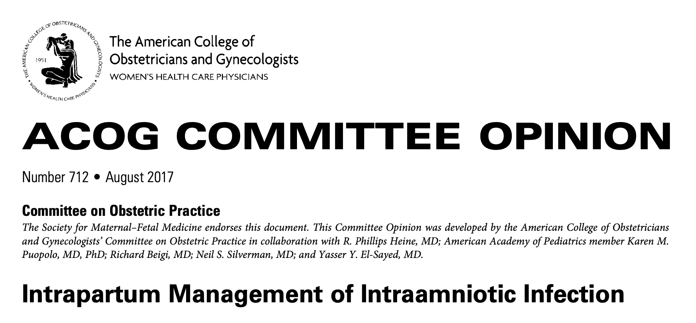
FAQ 2: What are the best antibiotics for IAI / Chorioamnionitis?
Administration of intrapartum antibiotics is recommended whenever an intraamniotic infection is suspected or confirmed.
Antibiotics should be considered in the setting of isolated maternal fever.
Intraamniotic infection alone is rarely, if ever, an indication for cesarean delivery.

Slide 44
ACOG Antibiotic Recommendations (2017)
Primary regimen: Ampicillin plus Gentamicin
Mild penicillin allergy: Cefazolin plus Gentamicin
Severe penicillin allergy: Clindamycin or Vancomycin plus Gentamicin
(add Clindamycin to above regimens at cesarean delivery)
Alternative regimens: Ampicillin-sulbactam Piperacillin-tazobactam Cefotetan Cefoxitin Ertapenem
(No need to add Clindamycin to above regimens at cesarean delivery)
Source Control (especially vaginal delivery) is an effective part of treatment
ACOG CO #712, 2017

Slide 45
Most Common Pathogens in IAI / Chorioamnionitis
Primarily Enterobacter spp, such as Escherichia coli, Klebsiella spp.
Enterococcus more rarely cause of acute illness, though coverage should be considered, especially if not improving on initial regimen
Anaerobic coverage is important (esp Bacteroides)--particularly for Cesarean delivery!
As discussed earlier, emerging resistance with ampicillin, gentamicin, and clindamycin is a problem

Slide 46
Most Attractive Alternatives in Wide Use (2026)
Piperacillin-tazobactam 4.5g IV q8h, 4-h infusion (Zosyn ®)
Ceftriaxone 2g IV q24h AND Metronidazole 500mg PO/IV q8h (Rocephin ®, Flagyl ®)
Ampicillin-Sulbactam 3g IV q6h (Unasyn ®)
Consult your local Antibiogram!
See CMQCC Sepsis Toolkit v2, pp 75-85: Chorioamnionitis and Intraamniotic Infection, and: Appendix Q: Empiric Management of Chorioamnionitis/Endomyometritis
Notes:
The 3 most attractive alternatives that are widespread use are shown here. Thes address most of the concerns about immediate availability and ease of administration

Slide 47
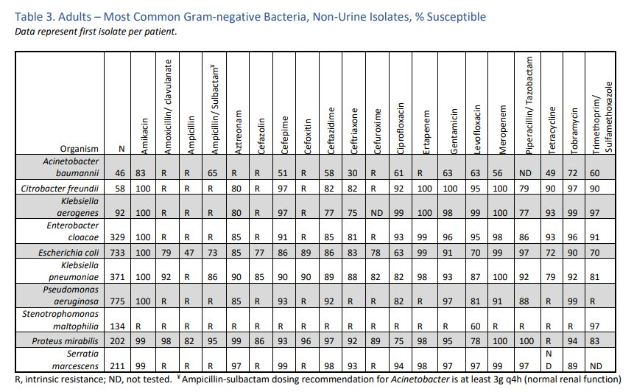
What it Takes to Change Antibiotic Regimens: Our Experience at Vanderbilt University Medical Center
Meetings with multiple groups of stakeholders
Ampicillin
Gentamicin
Clindamycin
Piperacillin-tazobactam
Education
Resistance, unfamiliarity with Pip-tazo
Implementation of updated electronic clinical decision support tool

Slide 48
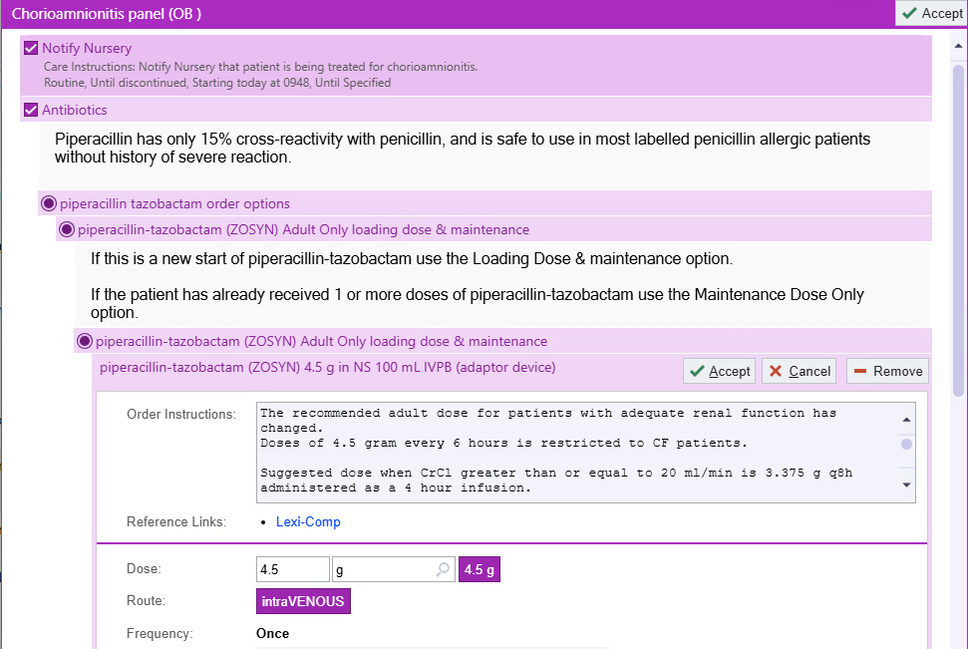

Slide 49
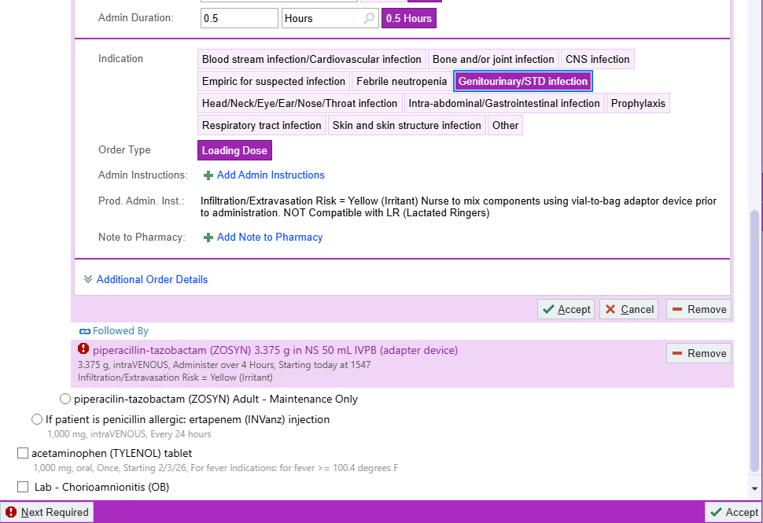

Slide 50
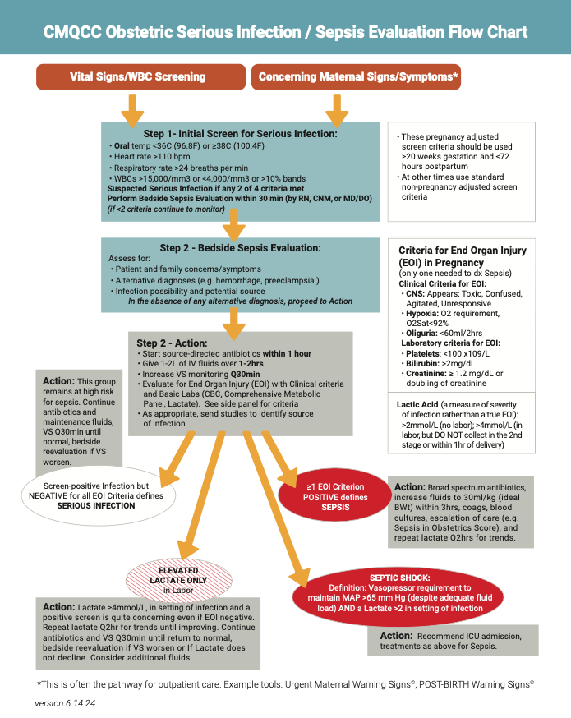
FAQ 3: How does IAI / Chorioamnionitis fit into the CMQCC Two-Step Approach for evaluation serious infections?
Like most infections, IAI is a spectrum of severity: from 38°C with few symptoms to full Sepsis
Many patients with IAI will have triggers: Temp ≥38°C, pulse >110, WBC >15k
It should be noted that we do draw a full set of labs with every patient with hypertension and the rates of death and ICU admission are higher for OB sepsis…
How can we take a balanced approach to evaluation of these patients?

Slide 51
Recommendations for which IAI Patients Need Evaluation with CBC & Chem Panel
Key step is to “Lay Eyes” on the Patient (Bedside Evaluation)
Dilemma: We know that most patients with IA/Chorioamnionitis will not develop sepsis, BUT there are some who get very sick--
When would you do something?
Pulse >120 (sustained for 20 min)
Respiratory Rate >24
Temp ≥39C
Mental Status changes: confused, agitated
Clinical judgement for “appears sick/toxic”

Slide 52
FAQ 4: Role of Lactate Tests in IAI/Chorioamnionitis?
Lactate is an assessment of Anaerobic metabolism but also elevated in the setting of extended exercise including Labor and should return to normal range within an hour after delivery.
In SEP-3 Consensus Guidance: Lactate is no longer considered a marker of End Organ Injury but an indicator of illness severity and poor tissue perfusion.
CMS SEP-1 measure calls for Lactate measurement in Severe Sepsis evaluation BUT specifically indicates that you should NOT measure it during Labor.
Recent analysis of 1,049 IAI cases with ICD codes for with Sepsis found that a Lactate 2-4 mmol/L was the ONLY indicator of sepsis in 40.5% of cases
If a patient has evidence of End Organ Injury (Sepsis), ALL guidelines recommend a baseline lactate, debate as to whether to wait until delivery

Slide 53
Sepsis: Treatment, Escalation of Care
Melissa E. Bauer, DO
Associate Professor of Anesthesiology and
Population Health Sciences
Duke University

Slide 54
Key Sepsis Treatment Recommendations
1) Timely Antibiotics
2) Timely Fluid resuscitation
3) Restoration of perfusion
Evans, L., Rhodes, A., Alhazzani, W. et al. Surviving sepsis campaign: international guidelines for management of sepsis and septic shock 2021. Intensive Care Med 47, 1181–1247 (2021)

Slide 55
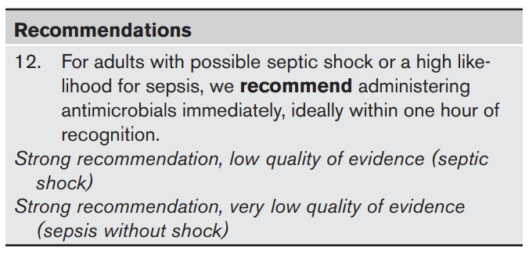
Rapid Antibiotic Administration
Evans et al. Intensive Care Med (2021)

Slide 56
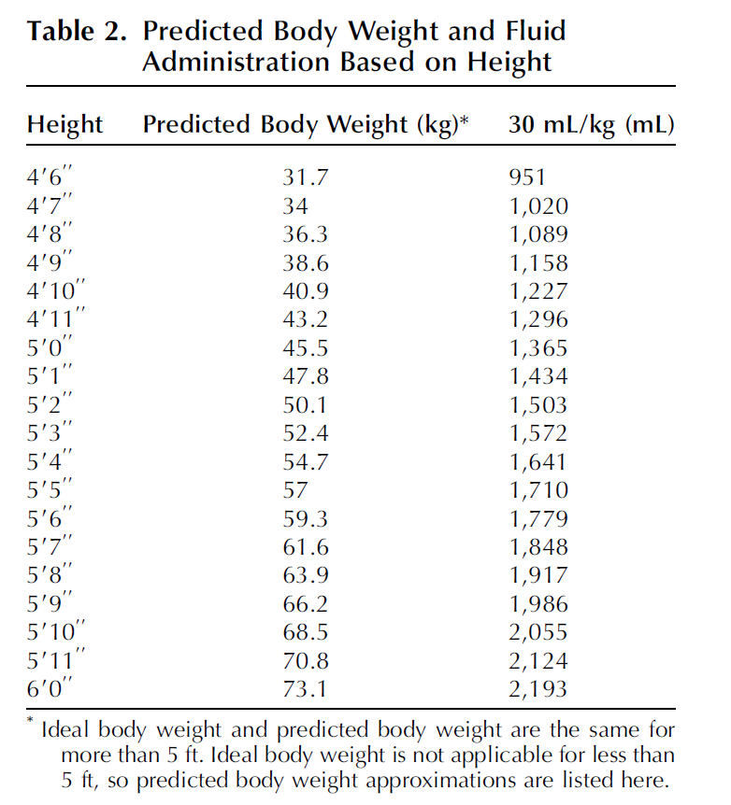
Fluid Resuscitation
Use Predicted Body Weight (based on Height alone)
NOT actual body weight.
Evans et al. Intensive Care Med (2021)
Bauer et al. Obstet Gynecol (2025)

Slide 57
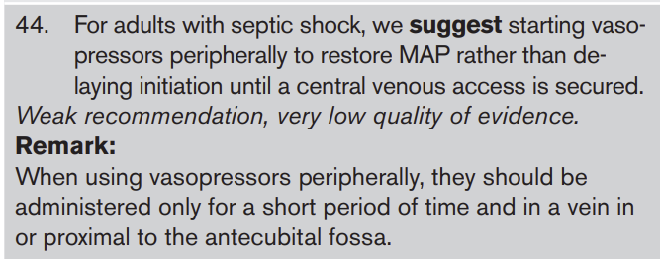
Restoration of Perfusion
Evans et al. Intensive Care Med (2021)

Slide 58
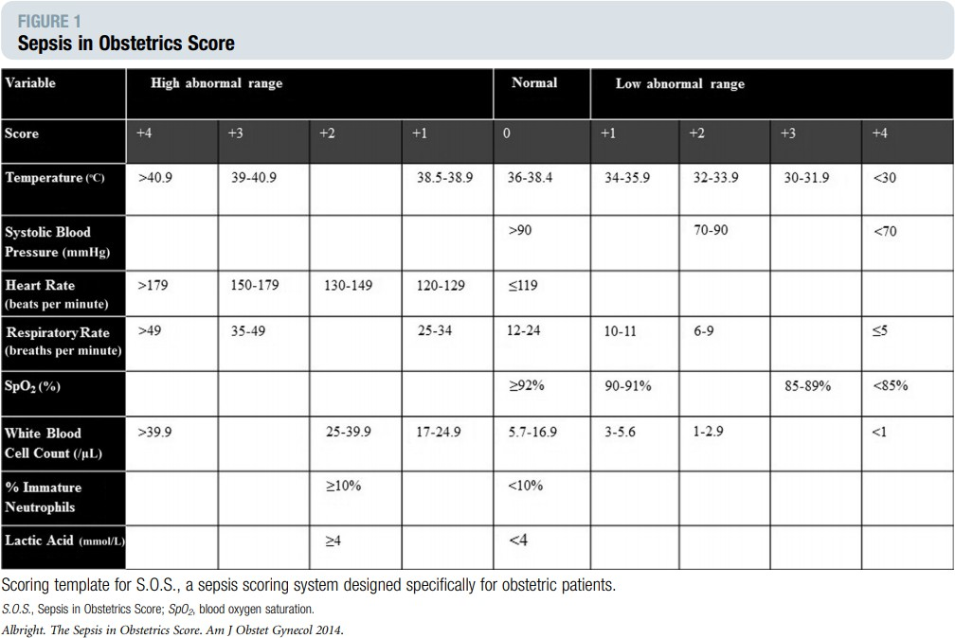
Evaluation for Escalation of Care:
Sepsis in Obstetrics Score

Slide 59
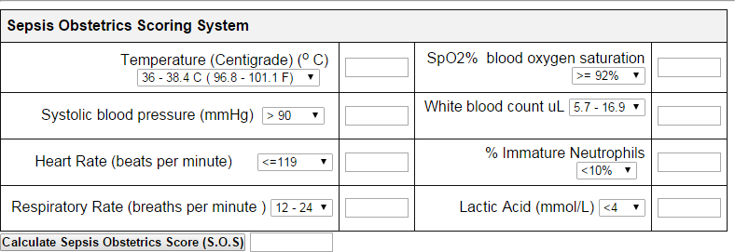
Sepsis in Obstetrics Score
A score of ≥ 6 was associated with ICU admission
http://perinatology.com/calculators/Sepsis%20Calculator.htm

Slide 60
Ensuring That You Have Rapid Access to Help
Rapid response team
Team members vary by institution
Example team: ICU nurse, physician, respiratory therapist, administrator (to find an ICU bed)
Activate to have additional expertise at the bedside to complement obstetric expertise
Stress the need for collaborative care with OB/ICU/Anesthesia

Slide 61
RRT Consultation
Rapid Response Team consultation (how to set up)
One representative from the RRT team to come to the bedside to assess and provide recommendations
RRT team already aware of the patient in case condition worsens
If not the right time to move the patient (such as during active labor), the ICU nurse may stay at bedside to help with ICU care (arterial line management, pressor titration, etc.)

Slide 62
Sepsis: Source Control
Natali Aziz, MD, MS
Clinical Professor, MFM Department of OBGYN
Stanford University
Elliott K. Main, MD
Clinical Professor, MFM Department of OBGYN
Stanford University

Slide 63
Source Control
Preparedness!
Rapid facilitation of imaging
US, MRI, CT
OR access in L&D – rapid completion for Septic Ab
Rapid access to antimicrobials on L&D
Mobilization of subspecialty services
Gynecology, Interventional Radiology, General Surgery
Know who to call!

Slide 64
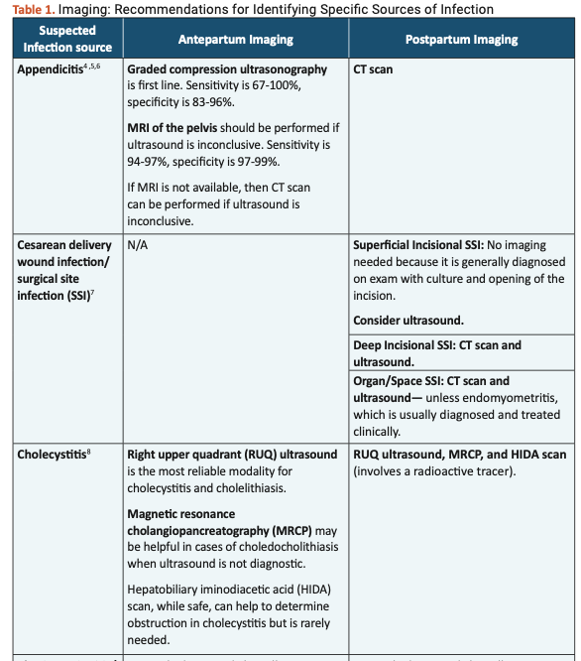
Source Control
Imaging Recommendations for Identifying Specific Sources of Infection during Pregnancy and Postpartum
See CMQCC Sepsis Toolkit v2, pp 57-62: Source Control for Serious Infections during Pregnancy and Postpartum
3 pages!

Slide 65
Specific Guidance for Septic Abortions
With changes in reproductive laws, this is an increasing issue. Key steps:
Early recognition is critical: patient education, close surveillance—EMPTY THE UTERUS
Broad spectrum ABX (within an hour!)
IV fluids
Tests for end organ injury, monitoring Lactate, and continual assessment for escalation of care
Notes:
Note recent maternal deaths in Georgia…

Slide 66
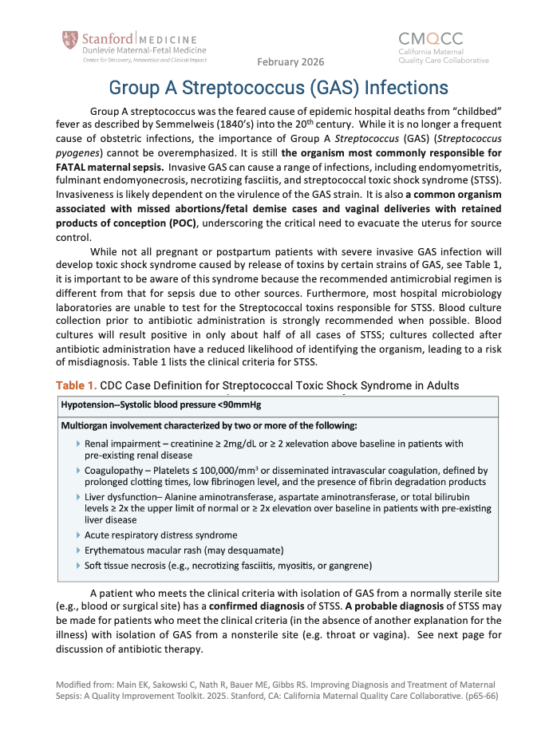
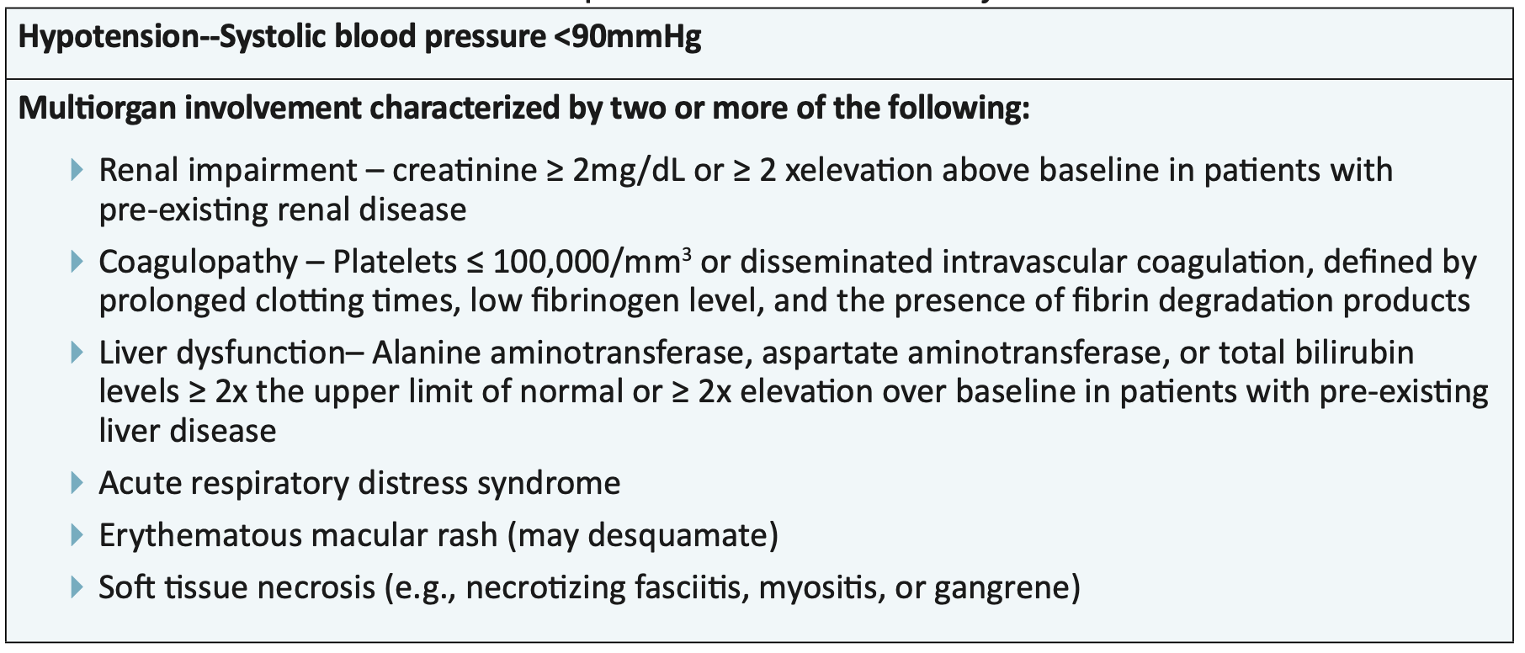
Group A Streptococcus (GAS) Infections
Table 1: CDC Case Definition for Streptococcal Toxic Shock Syndrome in Adults

Slide 67
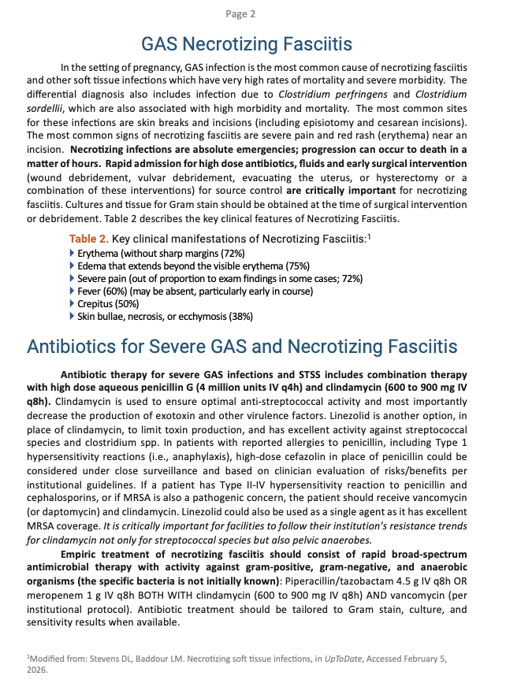
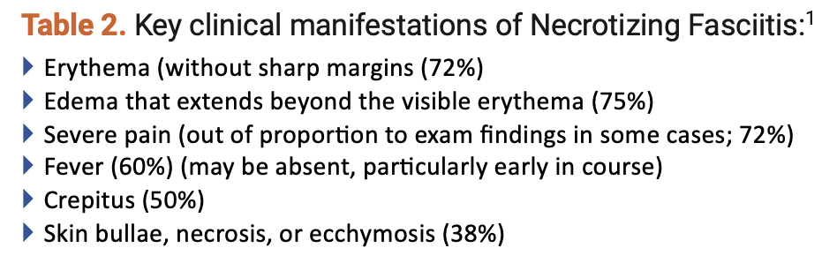
Necrotizing Fasciitis
Early recognition is crucial…
Notes:
Watch The PITT Season 2 Episode 5 and you have these signs of Nec Fasciitis seared into your memory

Slide 68
Source Control: Necrotizing Fasciitis
Education on diagnosis and treatment
Rapid blood cultures
Rapid initiation of antimicrobials
Rapid facilitation of CT imaging as needed
Should not delay surgical intervention when crepitus or rapid progression of clinical manifestations
Rapid surgical consultation
Evaluate fascia; obtain tissue for culture, Gram stain, path
Debridement

Slide 69
Key Points
Every OB Dept should have MD/RN Infection-Antibiotic “Stewards” (aka “Champions”).
Hospital (or regional) Antibiogram should be reviewed and antibiotic regimens reevaluated annually.
Order Sets, Order Sets, Order Sets! “Make the right choice the easy choice.” Standardized approaches to infection save lives.
Establish an approach to appropriately triage IAI/Chorio cases.
Preparedness is key for responding to serious infections and sepsis! Create partnerships with other clinical departments ahead.

Slide 70
Action Steps
Meet with your hospital Antibiotic stewardship team and review the current local antibiogram. Express your desire to partner to meet the special needs of obstetrics.
Review your current serious infection/sepsis protocol and order sets
Do you have standard antibiotic regimens and updated them?
Have barriers to rapid administration of antibiotics been assessed and addressed?
Is escalation of care organized? Meet with your RRT team to review obstetric cases and discuss protocols
Notes:
In our session last month, we focused on recognition, this session is all about treatment

Slide 71
Next Session
March 17
12 – 1:30pm Pacific Time
Focus: Patient Education/Support After an Adverse Event Materials
If you would like to add any additional colleagues, please reach out to Ruhi directly rnath@stanford.edu.

Slide 72
