Slide 1

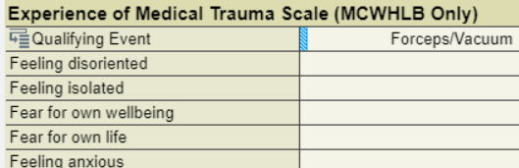
Serious Infection Screening Tool
Qualifying Factors (check all that apply)
☐ Oral temp <36 C (96.8F ) or ≥38 C (100.4 F)
☐ Heart rate >110 bpm
☐ Respiratory rate > 24 breaths per min
☐ WBC >15,000/mm3 or <4,000/mm3 or >10% bands
☐ None
Bedside Sepsis Evaluation
Patient has 2 Qualifying Factors
Yes/No
Patient and/or family concerns
☐ Shivering
☐ Feeling cold
☐ Confusion or disorientation
☐ Shortness of breath
☐ Extreme pain or discomfort
☐ Clammy or sweaty skin
Oxygen saturation <92%
Yes/No
Appears toxic or ill
Yes/No
Decreased urine output (<30 ml/hr)
Alternative diagnosis
Yes/No
Infection potential source
Yes/No

